Slide 1
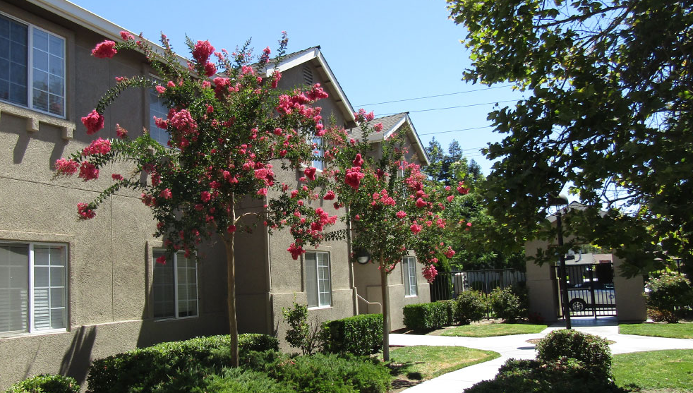

Stanislaus County
6th Cycle Housing Element Update
Draft Housing Element Overview
September 2023 – Virtual
Source: Stanislaus County Affordable Housing Corporation
Notes:
Welcome to the Stanislaus County, 6th cycle Housing Element, Virtual Overview of the Public Review Draft Housing Element.
The Draft Housing Element is available for review and public comment through September 30, 2023. The draft is accessible on the Planning department webpage at [website address]

Slide 2
Presentation Outline
Housing Element Overview
Regional Housing Needs Allocation (RHNA)
Sites Inventory Overview
Housing Plan
Project Schedule and Community Engagement
Notes:
In this video we will provide a summary of Housing Element basics, followed by:
A discussion of the county’s housing goal, which is called the Regional Housing Needs Allocation (or RHNA)
An overview of residential sites with capacity to provide housing; and
A summary of the key elements of the County’s housing plan
This session will conclude with a discussion of the Project schedule and community engagement process.

Slide 3
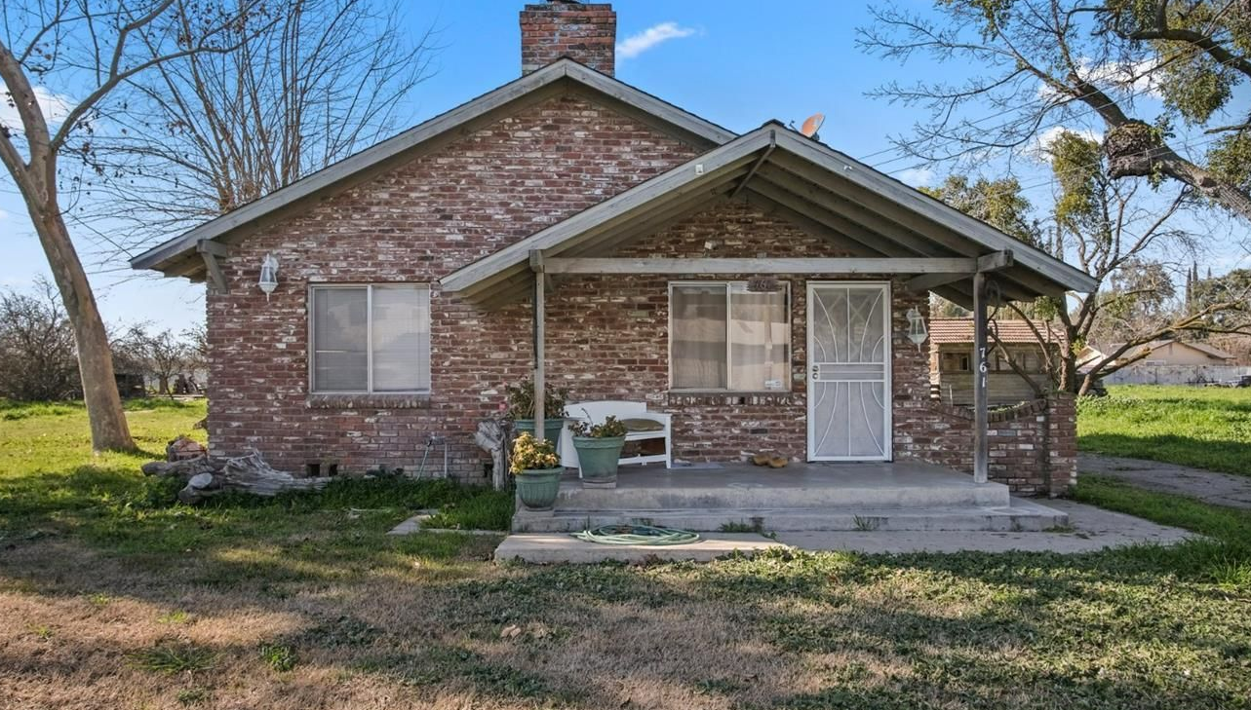
Housing Element Overview
Source: Stanislaus County Affordable Housing Corporation
Notes:
Let’s jump in. First, we will start with some Housing Element basics.

Slide 4
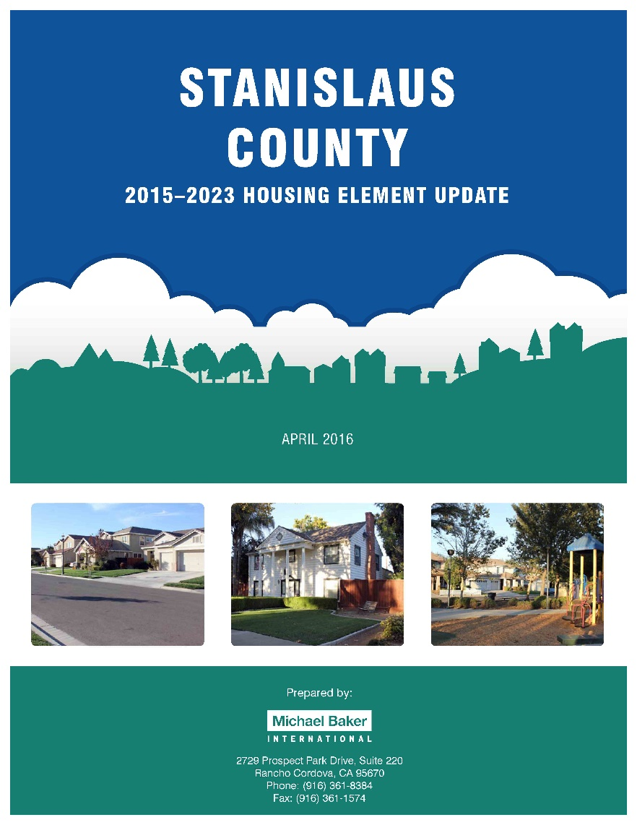
What is a Housing Element?
One of eight elements in the County General Plan
Housing Element updates required by State law in eight year “cycles.”
Currently preparing the 6th cycle Housing Element update
Updates done on a schedule prescribed by the State (adoption deadline December 31, 2023)
Notes:
The Housing Element is the County’s plan to meet the housing needs of the community.
It is one of the Elements (or chapters) of the County General Plan, but it is the only Element that needs to be reviewed and certified by the State of California.
Additionally, unlike other chapters of the General Plan, which typically plan for the next 20 to 25 years, the Housing Element plans for housing needs in 8-year cycles and must be adopted on a schedule prescribed by the State.

Slide 5
What does a Housing Element do?
Provides an assessment of both current and future housing needs
Identifies opportunities and constraints on housing production
Establishes goals, policies, and programs to meet housing needs
Updates County practices and regulations to reflect new State laws
Notes:
The Housing Element serves many purposes.
It identifies existing housing needs, as well as housing needs for the next eight years.
It analyzes opportunities and barriers (also called constraints) to housing development
It creates an action plan to address housing needs in the community and to respond to new opportunities and barriers; and
Finally, it ensures that County policies comply with State law.
Since the last Housing Element Update, which was adopted in 2016, the State legislature has passed a number of new laws related to housing. The Housing Element must analyze county regulations to identify compliance issues and set a plan to update policies to bring them into compliance.

Slide 6
Housing Element Basics
Community Profile
Demographics
Housing stock characteristics
Housing Constraints
Governmental constraints
Housing Resources
Non-governmental constraints
Housing Plan
Goals, policies, and implementation programs to address housing needs, constraints, and AFFH.
Projected housing needs and RHNA requirements
Housing preservation
Housing sites inventory
Affirmatively Furthering Fair Housing Analysis
Zoning for a variety of housing types
Opportunities for energy conservation
Notes:
There are several sections of the Housing Element, including:
The Community Profile, which identifies existing conditions in the County. This section analyses population characteristics, as well as the state of the current housing stock. Finally this section analyzes fair housing issues in the community.
The Housing Constraints section identifies barriers to housing development imposed by both governmental policy and the housing market.
The Housing Resources section identifies the County’s housing needs through 2031 and provides an inventory of residential parcels appropriate for housing development. The section also identifies energy conservation measures, programs, and opportunities.
Lastly, the Housing Plan provides goals, policies, and implementation programs that serve as the County’s housing action plan through 2031.

Slide 7
Housing Element Basics
Housing Element identifies strategies and programs that focus on:
Conserving and improving existing affordable housing
Assisting in the provision of affordable housing
Maximizing housing opportunities throughout the community
Provide housing choices that serve the needs of special needs populations
Removing governmental and other constraints to housing investment
Ensure fair and equal housing opportunities
Notes:
Generally, housing elements work to:
Retain existing housing, and particularly affordable housing in the community
Encourage and support the development of new affordable housing
Create a diversity of housing opportunities throughout a community – including for those with special housing needs, such as seniors, residents with a disability, and farmworkers
Remove barriers (or constraints) to housing development
And ensure that all members of the community have fair and equal access to housing.

Slide 8
What happens if the County doesn’t update the Housing Element?
Out of compliance with State Law
The General Plan could be deemed inadequate and therefore invalid
A noncompliant or invalid General Plan creates the potential for the County to be sued when making land use decisions
The County would be ineligible for several Federal and State housing, community development and infrastructure funding and grant programs
Notes:
The State of California requires every jurisdiction in the state to adopt a housing element. The Element must be certified by the State as compliant with State law.
Without a certified housing element, a city or county is at risk of being sued, either by the State or by a developer, if housing decisions conflict with State law.
Additionally, many State grants related to housing or infrastructure require a certified housing element as a condition of eligibility. Without a certified housing element, the County would not be able to pursue these critical funding opportunities.

Slide 9
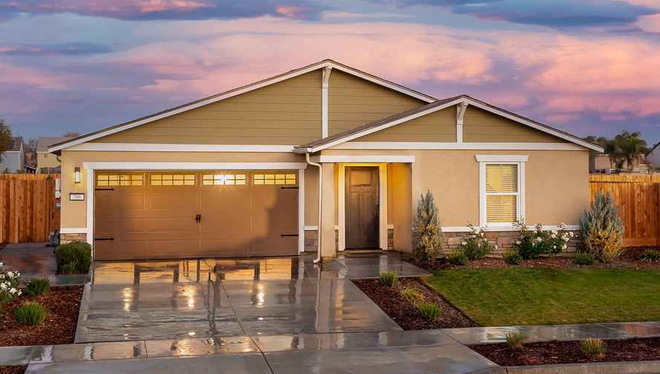
Regional Housing Needs Allocation (RHNA)
Source: Stanislaus County Affordable Housing Corporation
Notes:
Next we will discuss the Regional Housing Needs Allocation, otherwise known as the RHNA.
The RHNA is a quantified housing goal assigned to each city and county in the State.
The Housing Element must establish a plan to meet this goal, by providing enough land to ensure sufficient capacity for new development as well as programs to support development on residential sites.

Slide 10
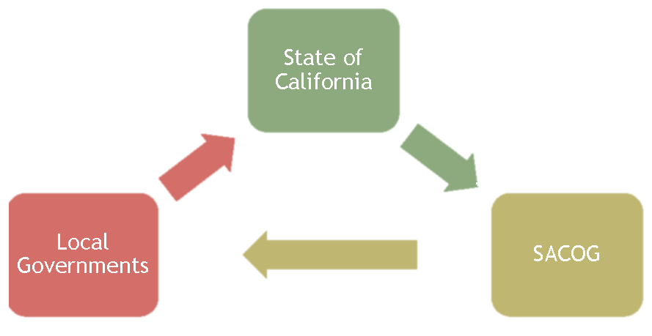
What is RHNA?
The representation of the future housing needs for all income levels in the County for the next eight years
Prepared by Stanislaus Council of Governments (StanCOG)
6th cycle: December 15, 2023 – December 15, 2031
Housing
Element
Updates
RHNA
Determination
StanCOG
RHNA Methodology
Notes:
The RHNA represents housing goals for residents of all income levels, including very low-income, low-income, moderate-income, and above moderate-income residents. We will discuss these categories further in a minute.
The RHNA begins as a regional determination developed by the State of California – a number of housing units needed in the county to provide for the expected increase in population over the next eight years.
Regional governments, in this case the Stanislaus Council of Governments (or StanCOG), then creates a methodology to split these units up among all each of the jurisdictions in the region.
Local jurisdictions update their Housing Element to plan to meet this housing need and the report, to the State, the number of housing units developed each year during the 8-year planning period.
At the end of the planning period, the State then analyzes this data as well as updated population projections and assigns a new RHNA determination for the next eight-year housing element cycle.
We are currently in the 6th cycle of housing element updates, and are planning for housing needs in the county through 2031.

Slide 11
StanCOG RHNA Distribution
StanCOG
Stanislaus Council of Governments
2023-2031 RHNA = 34,344 housing units
Waterford
557
Ceres
3,361
Modesto
11,248
Unincorporated County
2,475
Turlock
5,802
Oakdale
1,665
Newman
1,048
Patterson
3,716
Riverbank
3,591
Hughson
881
Each jurisdiction must accommodate its “fair share” of the regional housing need.
Notes:
This graphic illustrates how the regional RHNA determination was distributed among jurisdictions in Stanislaus County.
As you can see, the State determined that 34,344 housing units are needed countywide in the next eight years to meet the needs of current and future residents.
These units were distributed among local jurisdictions as shown here. Stanislaus County is responsible for planning for 2,475 new housing units in the unincorporated county.

Slide 12
RHNA Breakdown
Lower |  | Moderate | Above Moderate | Total RHNA
Very Low | Low
574 | 398 | 458 | 1,045 | 2,475
Unincorporated Stanislaus County
39% of the RHNA is for sites that can accommodate
lower-income housing
Notes:
The RHNA for Stanislaus County is further distributed into income categories as shown here, with nearly 40percent falling into the very-low and low-income categories.
To plan for lower income categories, the County must identify residential parcels that can accommodate higher density projects. These parcels must be free of environmental or infrastructure constraints that require expensive mitigation measures.

Slide 13
RHNA Change Since Last Housing Element Update
Cycle | Lower |  | Moderate | Above Moderate | Total RHNA
Cycle | Very Low | Low
5th Cycle | 538 | 345 | 391 | 967 | 2,241
6th Cycle | 574 | 398 | 458 | 1,045 | 2,475
Change | +36 | +53 | +67 | +78 | +234
Cycle | Lower |  | Moderate | Above Moderate
Cycle | Very Low | Low
5th Cycle | 24.0% | 15.4% | 17.4% | 43.2%
6th Cycle | 23.2% | 16.1% | 18.5% | 42.2%
Source: The Board of Supervisors of the County of Stanislaus Board Action Summary, Resolution No. 2020-0169, Board Agenda Item 6.D.1 (April 21, 2020), StanCOG Proposed RHNA Methodology Framework, Option 1B RHNA, Figure 17; 2020 American Community Survey, and Mintier Harnish, 2022.
Notes:
This slide compares the RHNA for the current 6th cycle to the RHNA for the previous cycle. As shown, if in the 5th cycle, the County was assigned a RHNA of 2,241 units. This increased to 2,475 units in the 6th cycle.
While this increase may seem like a lot, between the 5th and 6th cycle, the State increased the RHNA for nearly every city and county in the state. Some communities, such as those in the Bay Area, saw huge increases in their assigned RHNA. The modest increase in the RHNA for Stanislaus County indicates that the State assumes a small increase in population in the county over the next eight years.
As shown in the lower table, despite the increase in total RHNA, the distribution by income category remained largely the same between the 5th and 6th cycles.

Slide 14
Stanislaus County Housing Need Requirement
RHNA for Unincorporated Stanislaus County by Income Category, 2023-2031
and Ability to Pay for Housing Based on HCD Income Limits, Stanislaus County, 2022
Income Category | RHNA (Housing Units) | Estimated Income (Four Person Household) | Maximum Affordable Monthly Rent
Extremely Low Income (<30% of Median Income) | 287 | < $18,850 | $471
Very Low Income (30-50% of Median Income) | 287 | $31,450 | $786
Low Income (50-80% of Median Income) | 398 | $50,300 | $1,258
Moderate Income (80-120% of Median Income) | 458 | $62,850 | $1,571
Above Moderate Income (>120% of Median Income) | 1,045 | > $74,450 | $2,201
TOTAL | 2,475 | -- | --
Source: StanCOG Option 1B RHNA, Figure 17; 2020 American Community Survey, and Mintier Harnish, 2022.
Notes:
The income categories established within the RHNA are determined based on the area median household income.
Households that make less than 30 percent of the area median income are considered extremely low-income.
Those that make 30-50 percent of the median income are considered very low income, and those that make 50 to 80 percent are categorized as low income.
As shown on the table, low income households are those making up to $50,300 annually. This represents many working families in the County.
The table also summarizes what households in each category can pay for rent without paying more than 30 percent of their income on housing costs. Beyond 30 percent, a household is considered to be overpaying for housing, which means they may struggle to pay other bills, purchase necessities, and increase savings. Based on this, a low-income households can pay up to $1,258 per month on rent, without overpaying for housing.
To achieve monthly rental rates that are affordable to lower income households, affordable developments typically require grant funding, tax credits, subsidies, and other funding assistance.

Slide 15
Meeting the RHNA
Sites or credits in the inventory can include:
Housing projects under review or approved through Planning and expected to be built during the planning period
ADU trends
County-owned sites with housing in line with County goals
Residentially zoned vacant sites or non-vacant sites with redevelopment potential
Sites that would be rezoned to permit residential uses or higher density
Notes:
In order to meet the RHNA, the County must provide an inventory of available sites that can accommodate the identified housing need.
This process begins with identifying current projects under development, as well as the number of accessory dwelling units, also known as ADUs, that are expected to be developed in the next 8 years.
Next the county can identify county-owned parcels or residential zoned parcels appropriate for housing development. These parcels may be vacant, or underutilized, meaning they have existing vacant uses or additional space for development, such as an expansive and under-used parking lot.
If current projects, projected ADUs, and residentially zoned parcels do not have the capacity to meet the RHNA, the County can then identify commercial, office, industrial, or agricultural parcels that have potential for housing development if rezoned to allow residential uses.

Slide 16
Housing Credits and ADU Trends
 | Total Units | Lower Income | Moderate Income | Above Moderate
Pending Projects | 253 | 0 | 0 | 253
ADU Trends | 184 | 0 | 0 | 184
ADU trend based on permitted number of ADUs in recent years (approximately 23 per year in recent years)
Notes:
Currently, the County can count 253 units toward the RHNA based on pending and previously approved projects that are under development but have yet to be built.
Additionally, based on development trends in recent years that indicate that about 23 ADUs are developed annually, the County can count 184 units toward the RHNA.

Slide 17
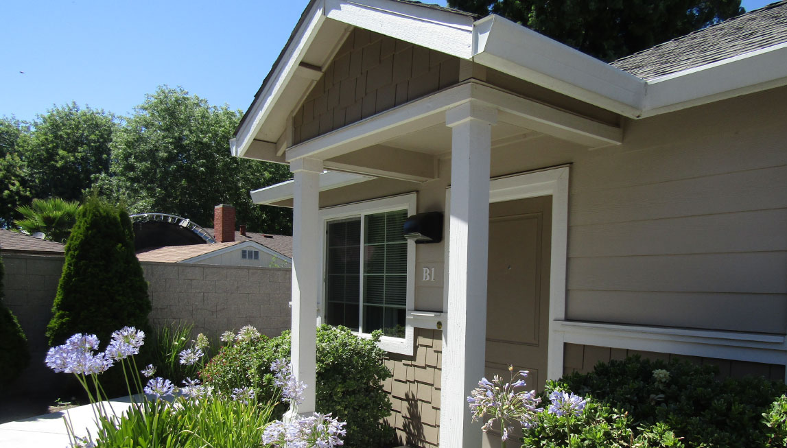
Sites Inventory Overview
Source: Stanislaus County Affordable Housing Corporation
Notes:
After identifying pending projects and ADU projects, the County must provide for the remaining RHNA through the identification of sites with potential for residential development. These sites are compiled into a list known as the “sites inventory”.

Slide 18
How were sites selected?
Lot Size
Preferred sites are 0.5 – 10 acres
Opportunity to merge small lots or divide large lots
Location
Close to transit, schools, healthcare facilities, grocery stores
Infrastructure availability
Public Input
Input from previous workshop
Trends
Vacant or potential for redevelopment
Demonstrated pattern of redevelopment
Credits for pending and approved development and ADUs
Notes:
Sites included in the sites inventory are investigated based on a number of criteria including, site size; proximity to transit, infrastructure, and services; and development patterns in the County.
Specifically, sites identified to provide capacity to meet lower income housing needs must be between 0.5 and 10 acres, and must allow for a density range including 20 dwelling units per acre. These are criteria established by the State based on feedback from affordable housing developers.
Public input plays a critical role in the development of the sites inventory. Throughout the process, public input was used in the identification and analysis of potential sites.

Slide 19
Sites Overview
Reviewed housing opportunity sites throughout unincorporated County that met criteria
Identified 458 total sites
54 rezones to facilitate housing for lower income households
404 vacant or underutilized sites, which would not be rezoned
Notes:
In the development of the Sites Inventory, County staff and the Consultant team analyzed all parcels in the unincorporated county to identify sites with potential for development of residential uses.
458 total sites were identified as appropriate, including 404 sites currently zoned for residential uses and 54 sites appropriate for rezoning to allow residential uses.

Slide 20
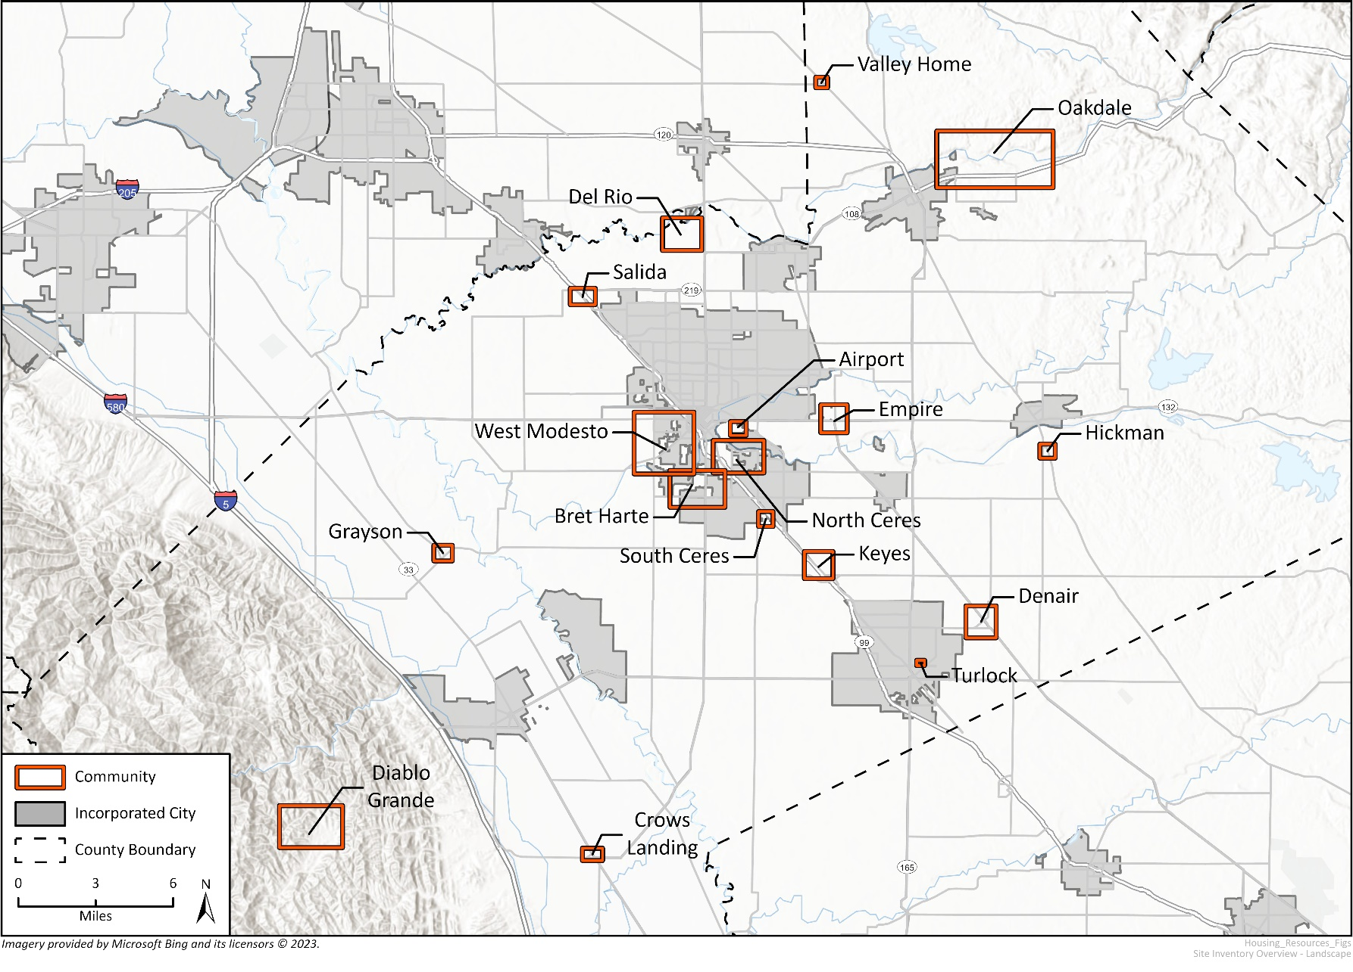
Sites Overview
Communities:
Airport
Bret Harte
Crows Landing
Del Rio
Denair
Diablo Grande
Grayson
Hickman
Keyes
Modesto
North Ceres
Oakdale
Salida
South Ceres
Turlock
Valley Home
West Modesto
Notes:
The sites inventory includes sites throughout the unincorporated county, including in the areas identified on this slide.
Please note: Both the sites inventory and individual area maps are available on the County’s website.
Additionally, the detailed sites inventory analysis in included in the Public Review Draft Housing Element. Please review the Draft and send us your comments!

Slide 21
Summary by Community
Community | Number of Parcels | Number of Units
Airport | 10 | 44
Bret Harte | 28 | 494
Crows Landing | 5 | 5
Del Rio | 57 | 129
Denair | 28 | 353
Diablo Grande | 112 | 112
Empire | 18 | 154
Grayson | 4 | 8
Community | Number of Parcels | Number of Units
Hickman | 4 | 27
Keyes | 20 | 121
North Ceres | 25 | 207
East Oakdale | 51 | 168
Salida | 6 | 51
South Ceres | 5 | 97
Turlock | 3 | 10
Notes:
This slide summarizes the number of parcels and potential unit capacity within each area of the county. Assumptions for each area are based on available parcels and infrastructure connections and capacity.

Slide 22
Site Inventory Summary
 | Lower | Moderate | Above Moderate | Total
RHNA Allocation | 1,167 | 458 | 1,045 | 2,475
Pending Projects | 0 | 0 | 253 | 253
Projected ADUs | 0 | 0 | 184 | 184
Preliminary Units | 1,268 | 581 | 712 | 2,561
Total Units | 1,268 | 581 | 1,149 | 2,998
Unit Surplus | 296 | 123 | 104 | 523
Notes:
The table here compares the RHNA to the capacity identified in the sites inventory.
Based on the combination of pending projects currently under development, the projected number of ADUs, and sites identified in the draft sites inventory, the county has identified sufficient capacity to meet and exceed the RHNA.

Slide 23
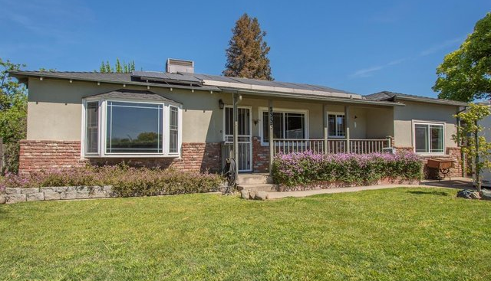
Housing Plan
Source: Stanislaus County Affordable Housing Corporation
Notes:
While the sites inventory identified parcels with the potential for residential development, the Housing Plan identifies efforts the County will undertake to support the development of housing.
The County’s housing plan is an extensive set of goals, policies, and programs that work to incentivize housing development, remove constraints, provide a wider array of housing options, and overcome fair housing issues that lead to inequality in housing access. The following slides summarize some of the key measure included in the housing plan.

Slide 24
Significant Programs and Actions
Program 1-1: Home Rehabilitation
  Provide housing rehabilitation assistance for owner-occupied lower-income households
  Spread awareness of home and accessibility rehabilitation programs
Program 2-1: Affordable Housing Development Assistance
  Identify affordable housing development opportunities and promote housing choices for special needs populations
  Ensure a streamlined process for affordable housing development
Program 3-1: Ensure Adequate Sites to Accommodate Regional Fair Share of Housing Growth
  Actively promote sites available for affordable housing development
  Amend Zoning Ordinance to prohibit development of single-family dwellings in multifamily zones
Notes:
Program 1-1 commits the County to assisting lower income households with rehabilitation projects. Home repairs can be costly and can lead to displacement of current owners. This program provides financial support to current owners challenged by high repair costs.
Program 2-1 is designed to assist in identifying new opportunities for housing development and to incentivize and support the development of housing for special needs households, including seniors, residents with a disability, those experiencing homelessness, and farmworkers.
Program 3-1 involves publicizing the sites inventory and engaging local developers to encourage consideration of these sites for affordable housing development. It also prohibits the development of low density uses in multifamily zones, which limits housing capacity in these areas.

Slide 25
Significant Programs and Actions Continued
Program 4-1: Housing for Special Needs Populations
  Encourage the inclusion of units and services needed to support individuals with special needs
  Encourage the use of Universal Design Principles in new construction and/or rehabilitation of housing
Program 5-1: Affirmatively Furthering Fair Housing & Environmental Justice
  Ensure that local housing programs respond to the needs of a culturally diverse community that includes multi-generational families, a variety of living arrangements, and limited English proficiency households
  Strive to achieve and maintain recognition as a “Prohousing” jurisdiction
  Program 5-2: Fair Housing Services
  Provide fair housing and tenant/landlord services, including housing counseling and education and tenant/landlord counseling and mediation
  Require contracted fair housing provider to conduct random fair housing testing
Notes:
Program 4-1 encourages the development of housing appropriate for households with special needs, particularly for those with a disability or accessibility concern.
Program 5-1 works to ensure that the Housing Plan addresses the needs and concerns of a diversity of community members. It also includes actions meant to establish the county as a “prohousing” jurisdiction, which makes the County eligible for additional grant funding to support the development of housing.
Program 5-2 commits the County to funding a fair housing provider and to work with the service provider to provide with fair housing services, education, and enforcement.
These are just a few of the programs outlined in the Housing Plan. For more information, please review the Draft Housing Element available on the Planning Department webpage.

Slide 26
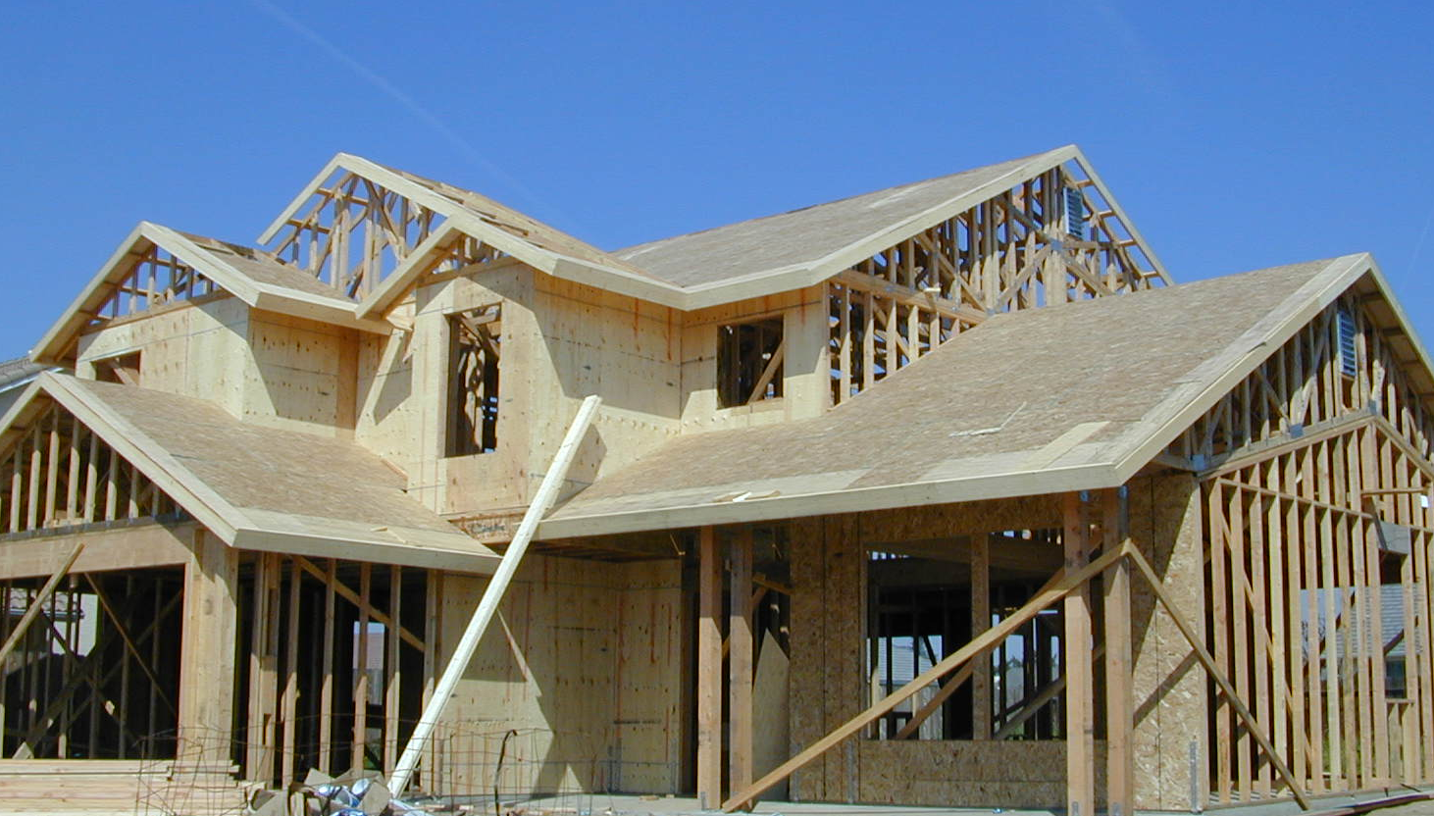
Project Schedule
and Community Engagement
Source: New Home Construction by Great Valley Center (Flickr, CC 2.0)
Notes:
The final section of this presentation will outline the project schedule and community engagement efforts.

Slide 27
Project Schedule
Milestones | Estimated Date
Workshop #1: Housing, Safety, and EJ | June 23, 2022
Workshop #2: Preliminary Site Inventory | October 11, 2022
Planning Commission Study Session | October 2022
Board of Supervisors Study Session | November 2022
Public Review Draft Housing Element | August/September 2023
HCD Review of Draft Housing Element | Fall 2023
Public Hearing Draft Housing Element | Winter 2023
Planning Commission Hearings | Winter 2023
Board of Supervisors Hearings | Winter 2023
Submit to HCD for Certification | January 2024
WE ARE HERE
Notes:
This Housing Element update began in the summer of 2022, with two community workshops, as well as study sessions with the Planning Commission and Board of Supervisors.
County staff and the Consultant Team relied on input received during these events in the development of the Draft Housing Element, which was compiled and released on the Planning Department webpage.
We are currently in the Public Review Draft phase of the project. The Draft is available online and comments will be taken at least through September 30, 2023. Please review the Draft and send us your comments.
Following the public review period, the County will prepare a Draft that incorporates public input. This updated draft will be submitted to the California Department of Housing and Community Development, also known as HCD, for initial 90-day review.
Following the 90-day review period, HCD will issue a comment letter indicating any additional changes that are needed to achieve compliance with State law.
The County will revise the documents accordingly, and will present the Revised Housing Element in public hearings with the Planning Commission (for recommendation) and Board of Supervisors (for consideration of adoption). Public input will be taken during each of these hearings.
Following adoption of the housing element, the County will submit the final housing element to HCD for a follow-up 60-day review and certification.

Slide 28
Community Engagement Events
Two Community Workshops (already occurred)
Two Study Sessions (already occurred)
  Planning Commission (1)
  Board of Supervisors (1)
Public Hearings
  Planning Commission
  Board of Supervisors
Notes:
Engagement events undertaken during the Housing Element update include workshops and study sessions. These events provided the public, planning commission, and Board of Supervisors opportunities to provide input and direction to the Project Team in the development of the Draft Housing Element.
Upcoming public hearings will provide opportunities for residents, stakeholders, and decision-makers to guide the refinement of the Housing Element and preparation of the final Housing Element.
Community input is critical to the development of the Housing Element. In addition to commenting on the Public Review Draft, please plan to attend the Public Hearings currently scheduled for Winter 2023.

Slide 29
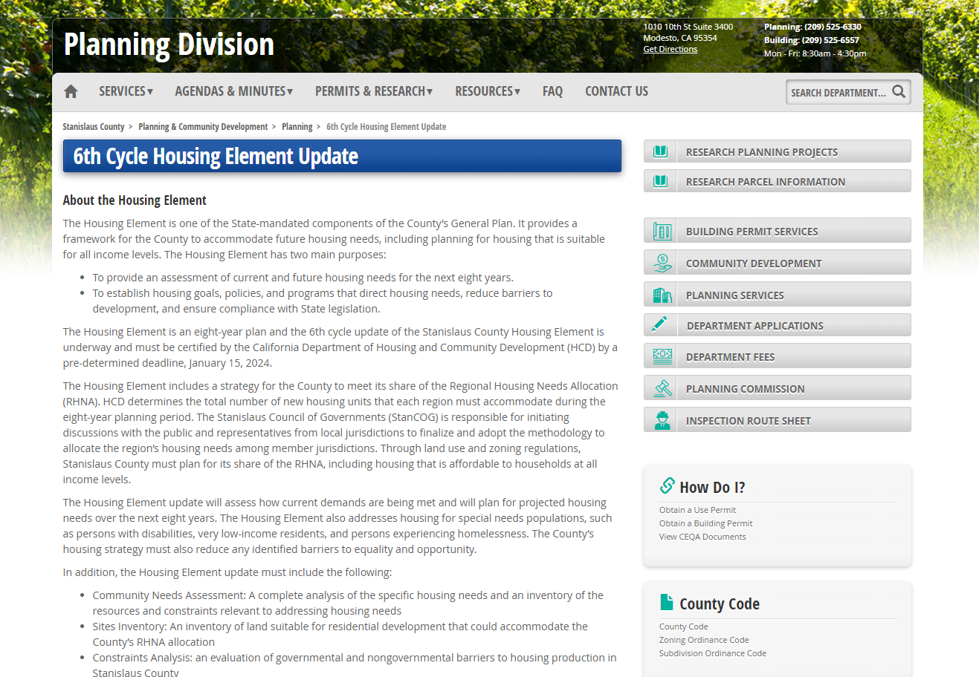
Public Information and Participation
Website:
www.stancounty.com/planning/pl/housing-element.shtm
E-mail Blasts
Social Media Engagement
Stakeholder Interviews
Bilingual Online Survey
Participatory Mapping
Exercise
Notes:
County staff and the Project Team worked diligently to provide information and engagement opportunities to residents throughout the county.
The project website serves as an information hub for the Project. It includes information on the housing element, opportunities to provide input, and draft documents available for comment.
The County used eblasts and social media to promote events and engagement opportunities, and to being attention to the Project.
Additionally, the County completed stakeholder interviews with local developers, non-profit agencies, and services providers to get a better understanding of the housing needs and constraints in the county.
Finally, the County developed online activities, including a bilingual online survey and mapping exercise, to generate additional public input to inform the Housing Element.

Slide 30
Questions?
County Staff
Kristy Doud
Deputy Director of Planning
doudk@stancounty.com
(209) 525-7652
Notes:
This slide includes the contact information for the County’s Housing Element contact person. Please submit your questions to and comments to Kristin Doud, Deputy Director of Planning at doudk@stancounty.com.
As a reminder, please review the Draft Housing Element on the Planning Department website and submit your comments prior to September 30, 2023.
Thank you for joining us today for this overview of the Stanislaus County Public Review Draft 2023-2031 Housing Element Update.

