Slide 1
Stanislaus County Water Advisory Committee
Sustainable Groundwater Management Update
May 31, 2017

Slide 2
Snowpack and Selected Reservoir Storage Conditions

Slide 3
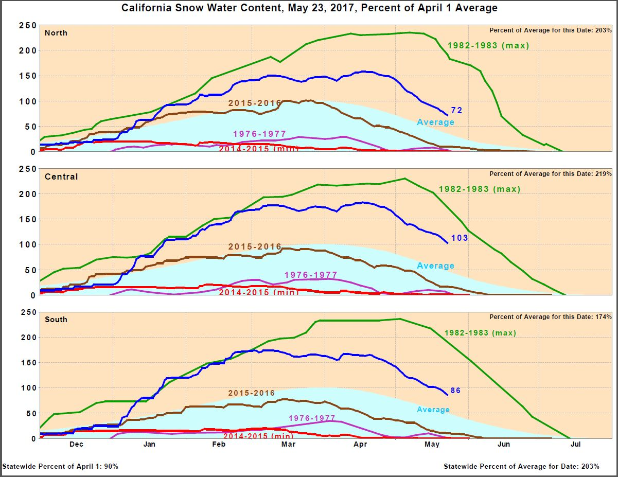

Slide 4
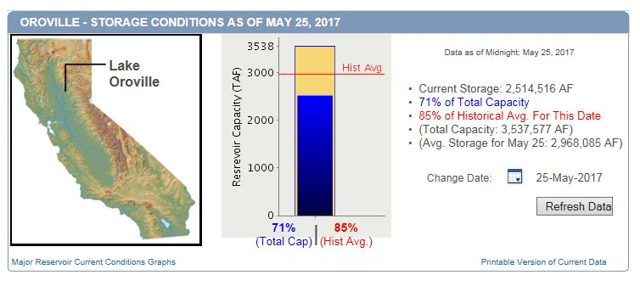

Slide 5
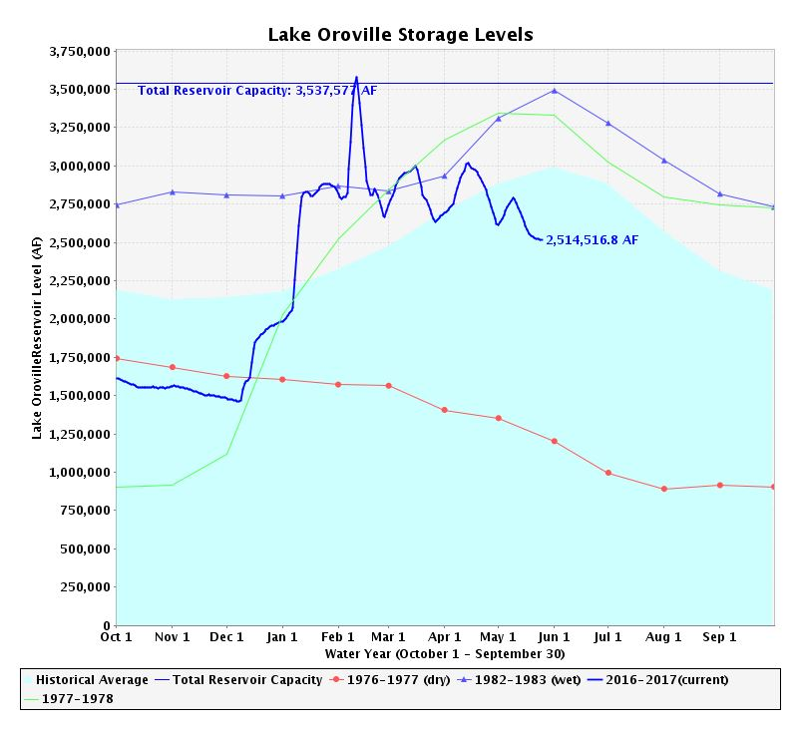

Slide 6
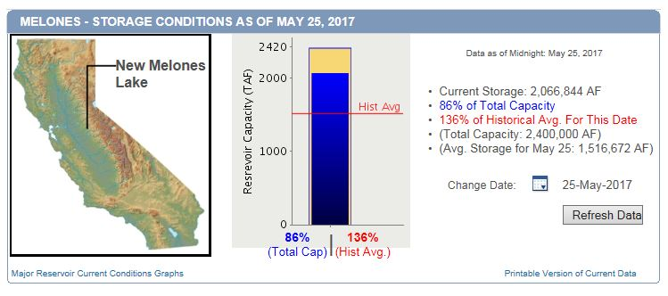

Slide 7
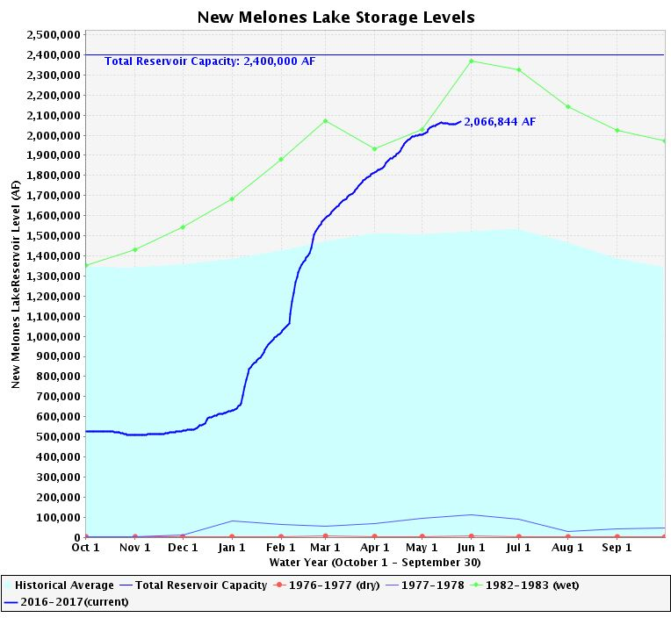

Slide 8
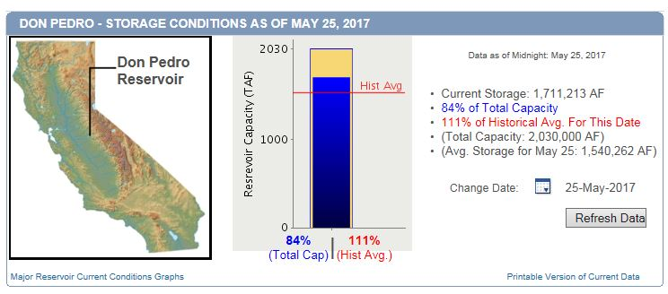

Slide 9
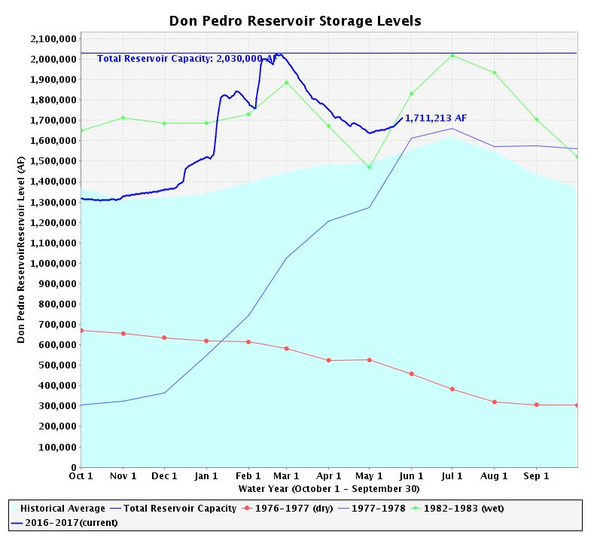

Slide 10
Groundwater Sustainability Agency Formation
June 30, 2017 Deadline

Slide 12
Eastern San Joaquin Groundwater Basin
5

Slide 13
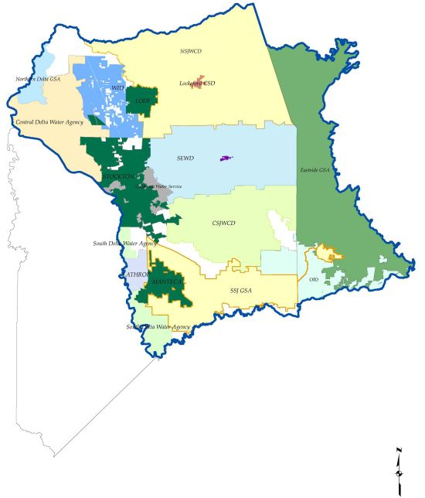

Slide 14
Eastern San Joaquin Subbasin GSAs
City of Lathrop Oakdale ID
City of Lodi South San Joaquin ID
City of Manteca Woodbridge ID
City of Stockton Central Delta WD
Linden CWD Linden CWD
Stockton East WD
Central Delta Water Agency
South Delta Water Agency
Central San Joaquin Water Conservation District
North San Joaquin Water Conservation District
Eastside San Joaquin GSA

Slide 15
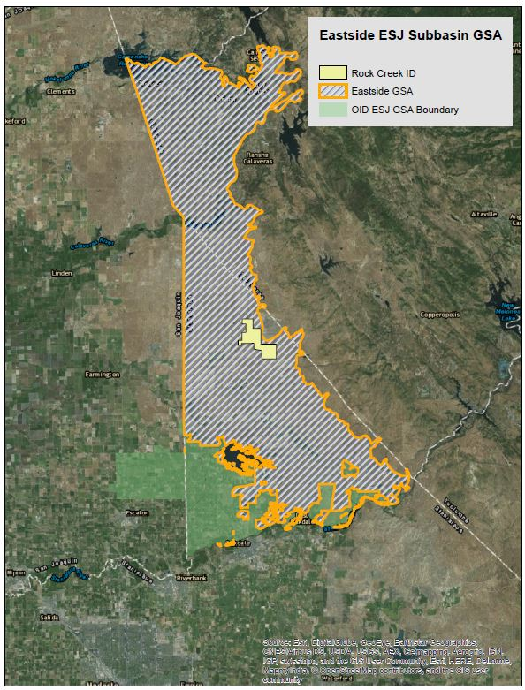

Slide 16
Eastside San Joaquin GSA
Calaveras County WD
Stanislaus County
Rock Creek WD

Slide 17
Modesto Groundwater Basin
5

Slide 18
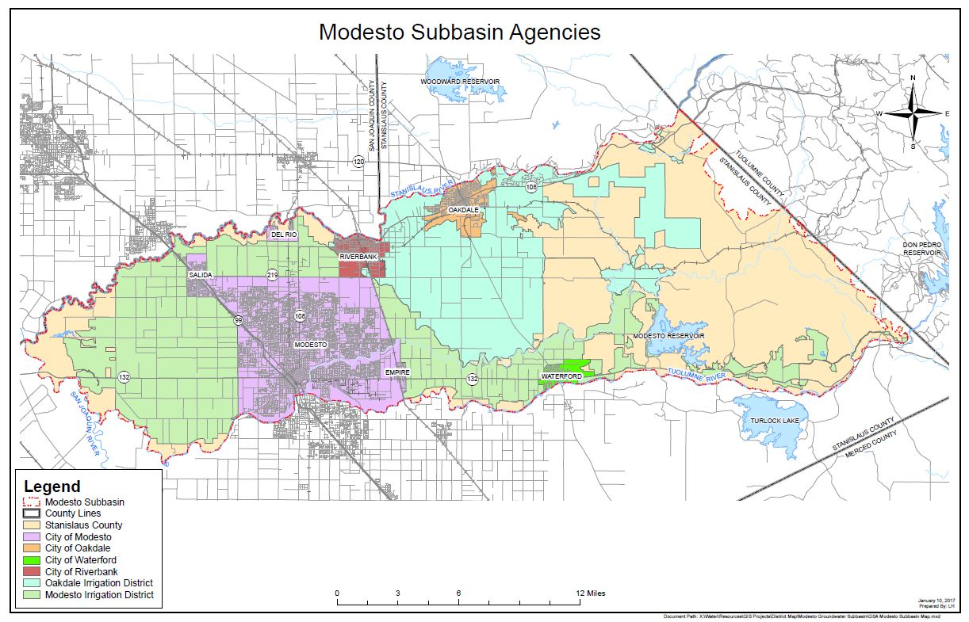

Slide 19
Stanislaus & Tuolumne Rivers Groundwater Basin Association GSA
  City of Modesto
  City of Oakdale
  City of Riverbank
  City of Waterford
  Oakdale ID
  Modesto ID
  Stanislaus County

Slide 20
Turlock Groundwater Basin
5

Slide 21
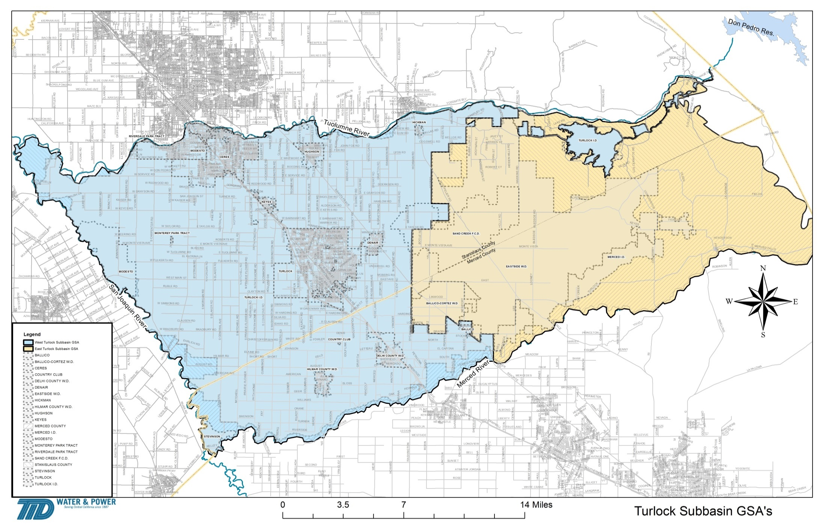

Slide 22
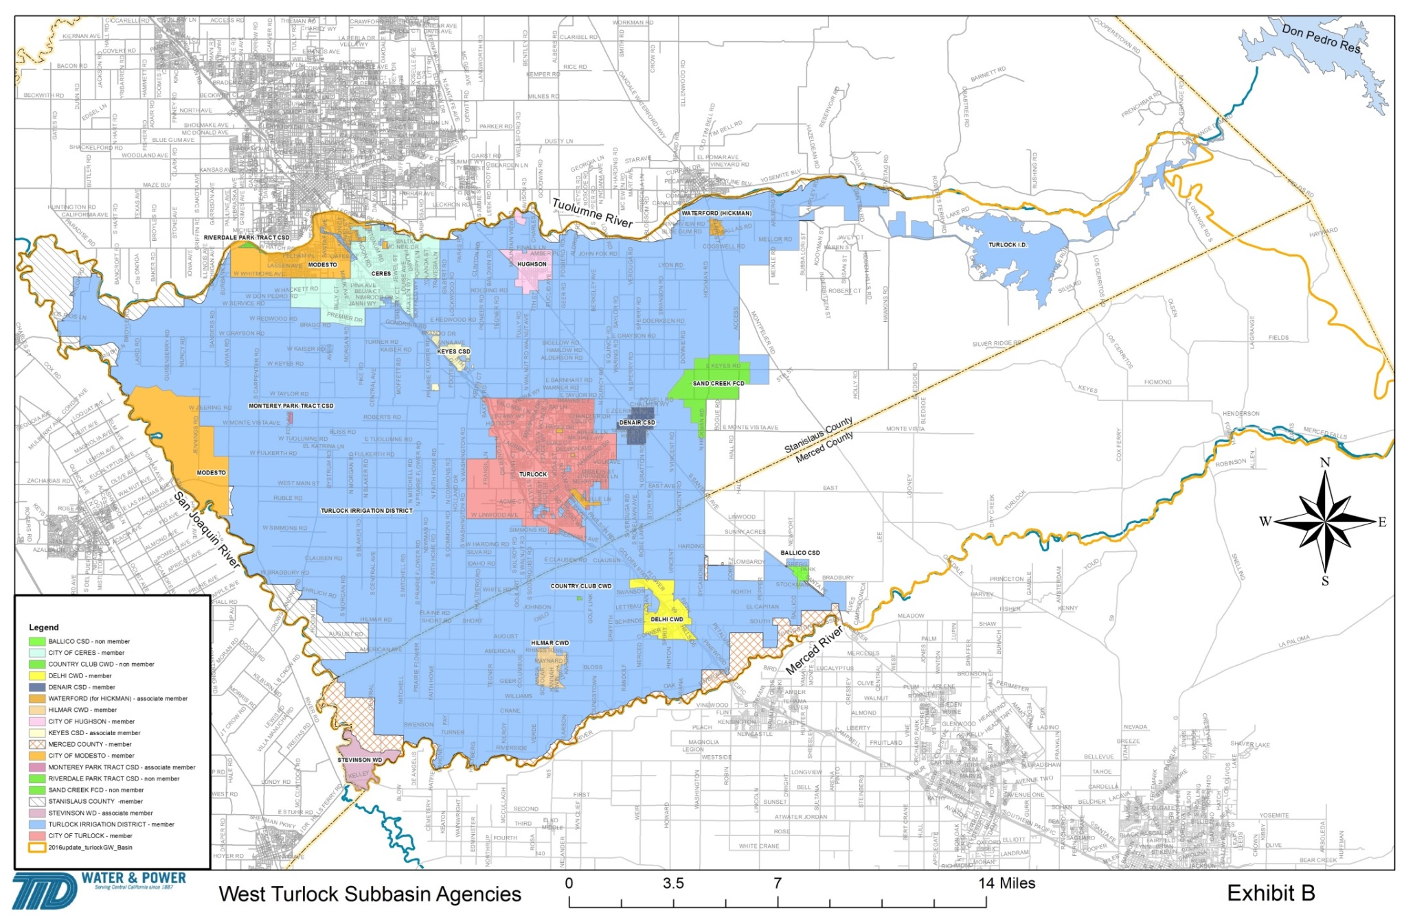
West Turlock Subbasin GSA

Slide 23
West Turlock Subbasin GSA
City of Ceres Turlock Irrigation District
City of Hughson Merced County
City of Modesto Stanislaus County
City of Turlock Delhi County Water District
Denair CSD Hilmar County Water District
Associate Members:
Keyes CSD
Stevinson WD
City of Waterford

Slide 24
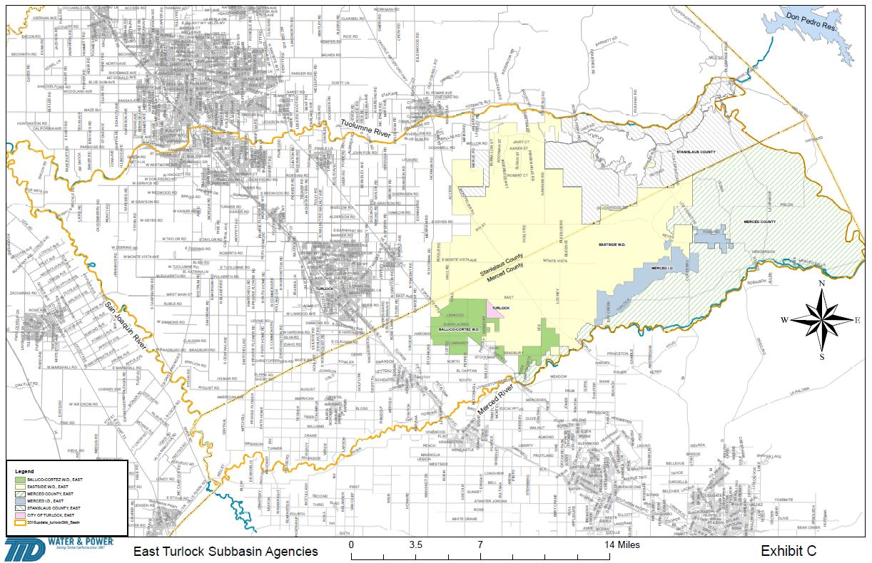
East Turlock Subbasin GSA

Slide 25
East Turlock Subbasin GSA
Eastside WD
Ballico-Cortez WD
Merced Irrigation District
Merced County
Stanislaus County
City of Turlock *
* Associate Member

Slide 26
Delta-Mendota Groundwater Subbasin
5

Slide 27
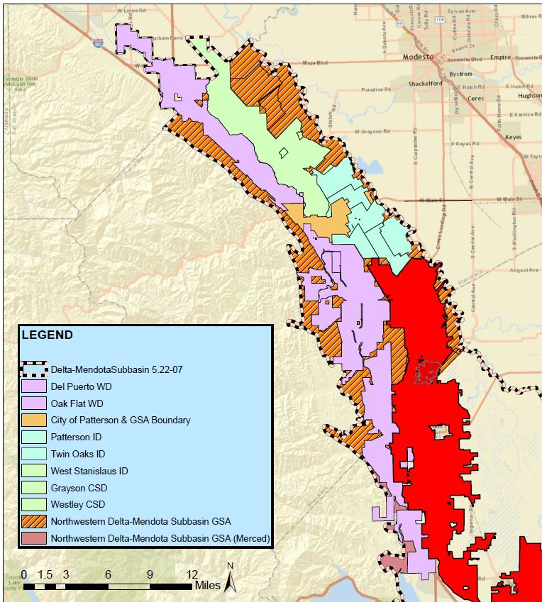

Slide 28
Delta-Mendota Groundwater Basin – Northern Group GSAs
  City of Patterson
  Del Puerto WD
  West Stanislaus ID
  Patterson ID
  Northwestern Delta-Mendota GSA

Slide 29
Northwestern Delta-Mendota Subbasin GSA
Stanislaus County
Merced County

Slide 30
Stanislaus County “Default” Coverage
  “White” areas
  El Soyo WD
  Blewett MWC
  Whitelakes MWC
  Crows Landing CSD
  Eastin WD
  China Island WR
  Stevinson WD

Slide 31
Proposition 1
SGMA Groundwater Sustainability Plans Grant Funding
Program Solicitation Package (PSP)

Slide 32
PSP Highlights
Category 1 – Severely Disadvantage Communities Projects
  Regional Integrated Regional Water Management Groups
Category 2 – Groundwater Sustainability Plans (2 Tiers)
Tier 1 - Critically Overdrafted Basins (Jan. 2020)
Tier 2 - All other High and Medium Priority Basins (Jan. 2022)

Slide 33
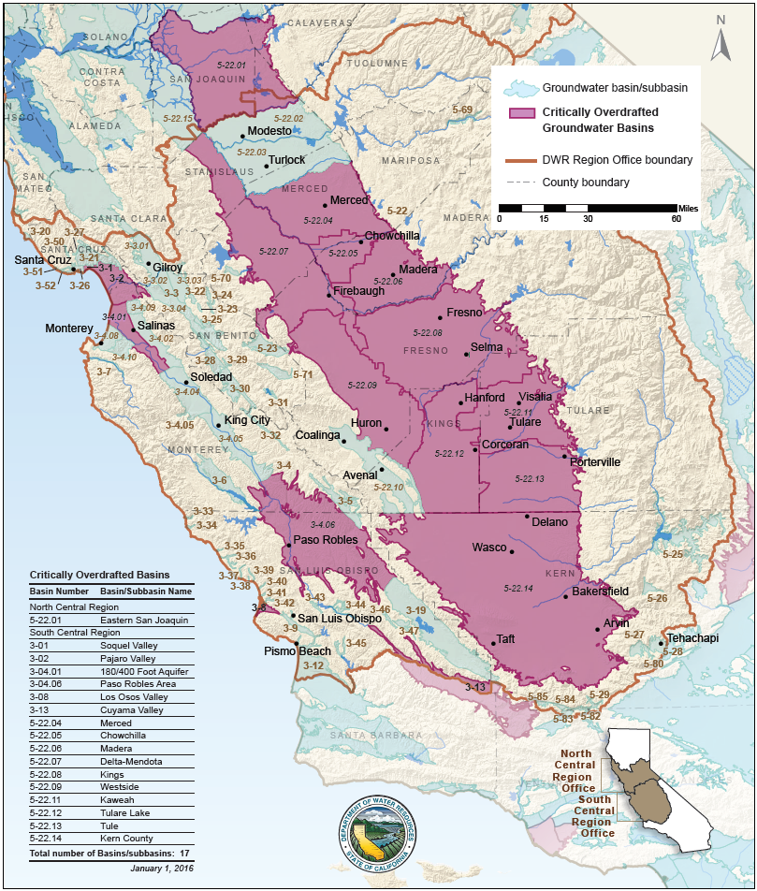

Slide 34
PSP Highlights
For Category 2, only 1 application will be accepted per basin
For Category 2, the applicant must be a GSA
For Category 2, non-applicant GSA’s may be a part of the proposal as a Project Proponent
Requires a 50% local cost share

Slide 35
Potential PSP Issues
Potential Eligibility Issues with Multiple Parties
  If the applicant is an urban water supplier, or urban water suppliers will receive funding from the proposed grant through a JPA…..provide documentation from DWR that verifies that the 2015 UWMP addresses the relevant Water Code Requirements.
  All urban water suppliers must submit documentation that demonstrates they are meeting the 2015 interim Gallons Per Capita Day target.

Slide 36
Potential PSP Issues
Potential Eligibility Issues with Multiple Parties
  If the applicant is an agricultural water supplier, or agricultural water suppliers will receive funding from the proposed grant through a JPA…..include documentation, from DWR, that verifies that the 2015 AWMP addresses the relevant Water Code requirements.
  If the applicant is a surface water diverter, or will receive funding from the proposed grant through a JPA…..state whether they have submitted to the SWRCB surface water diversion reports in compliance with requirements outlined in Part 5.1 of Division 2 of the Water Code. Submit SWRCB verification documentation.
  Must be fully compliant with all aspects concerning the CASGEM Program.

Slide 37
Potential PSP Issues
Potential Issue with multiple basins – “an applicant with jurisdiction over multiple basins must submit one consolidated application and may request up to $500,000 for additional basins, in addition to the maximum grant amount.”
  Does this mean that an entity, such as a county whose footprint overlies multiple separate subbasins, must submit one application for all of the basins?
    What about basins that have multiple counties?
    Why limit the grant amount based on this criteria?

Slide 38
Potential PSP Issues
“Final product for Category 2 Projects shall be complete GSP(s) approved by DWR….”. SGMA Regulations allow DWR 2 years to review the submitted GSP and issue an assessment of the plan. This is too long to keep the grant open and withhold the final payment. Final product should be submittal of the plan to DWR.

Slide 39
PSP Schedule

Slide 40
PSP Public Meetings
June 12, 2017, 10:00 AM
Bonderson Building
901 P Street, Hearing Room
Sacramento, CA 95814
June 13, 2017, 1:00 PM
Fresno Irrigation District
2907 S. Maple Avenue, Boardroom
Fresno, CA 93725
June 14, 2017, 1:00 PM
Irvine Ranch Water District
15600 Sand Canyon Avenue, Sand Canyon Room
Irvine, CA 92618

Slide 41
  REGIONAL COORDINATION IS
  THE KEY TO SUCCESS FOR
  ALL !!

Slide 42
QUESTIONS & DISCUSSION

