Slide 1
Stanislaus County Water Advisory Committee Meeting
January 25, 2017
SGMA Update and GSA Formation Status

Slide 3
Sustainable Groundwater Management Act (SGMA) Implementation
Effective Date: January 2015
Develop long-term Groundwater Sustainability Plans that include programs, projects and practices that avoid undesirable results in six resource areas:
Land Subsidence
Water Quality Degradation
Seawater Intrusion
Streamflow Capture
Drawdown Interference
Aquifer Storage Depletion

Slide 4
Groundwater Sustainability Agency (GSA)
Local Control is a cornerstone of the legislation
Public agencies with water and/or land use authority
Memorandum of Understanding/Agreement
Joint Powers Authority/Agency
Other Legal Contract or Legislation

Slide 5
Groundwater Sustainability Agency (GSA)
June 30, 2017 deadline - otherwise face State Water Board enforcement for non-compliance
Draft enforcement regulations and proposed penalties and fines

Slide 6
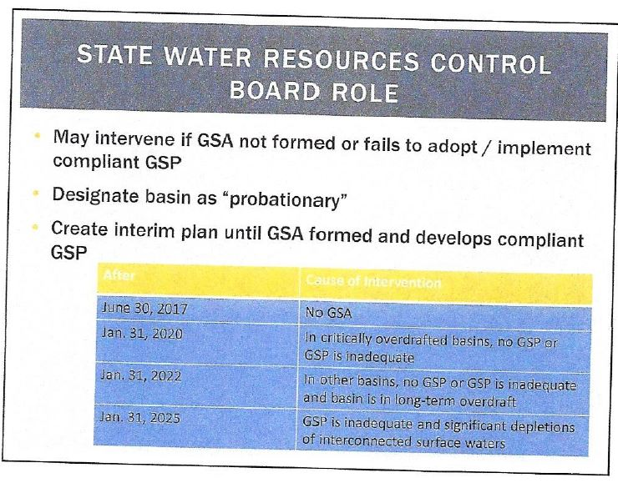

Slide 7
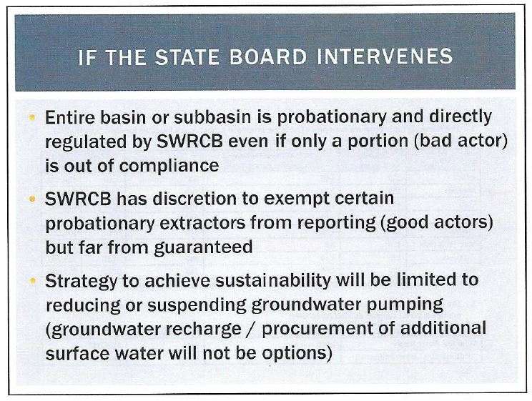

Slide 8
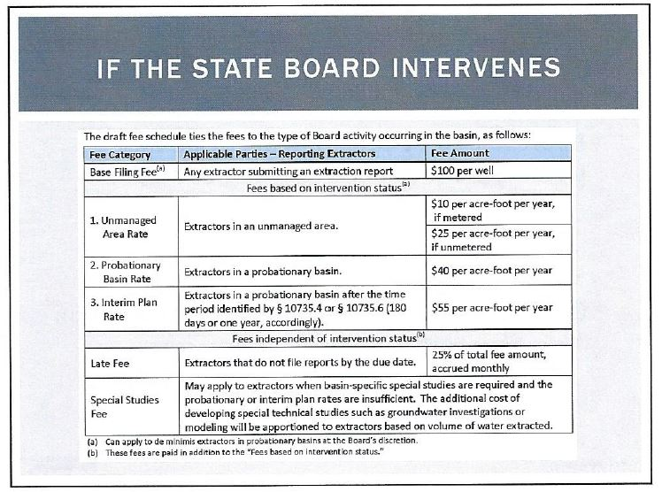

Slide 9
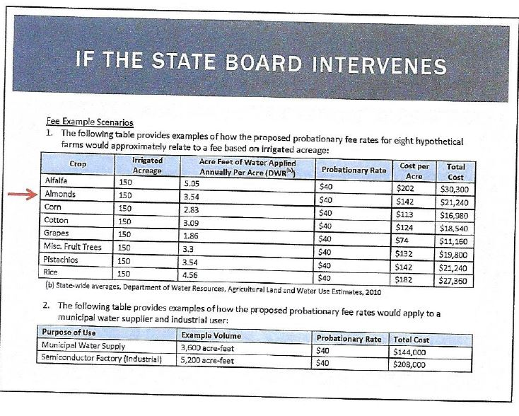

Slide 10
GSA Responsibilities
GSA coverage must be Basin-wide
One or more (coordination)
No Gaps or Overlaps (basin probation status – State Water Board intervention)
GSAs must prepare and implement Groundwater Sustainability Plans (GSPs)
  Sustainable Yield + Measurable Objectives
  50 Year Planning Horizon with 20 Year Implementation Period

Slide 11
Groundwater Sustainability Plan Due Dates
GSP Deadlines – Basin Category
  Critical Condition of Overdraft
January 31, 2020
  High & Medium Priority Basins
January 31, 2022
Annual reporting of conditions
Five Year Updates

Slide 12
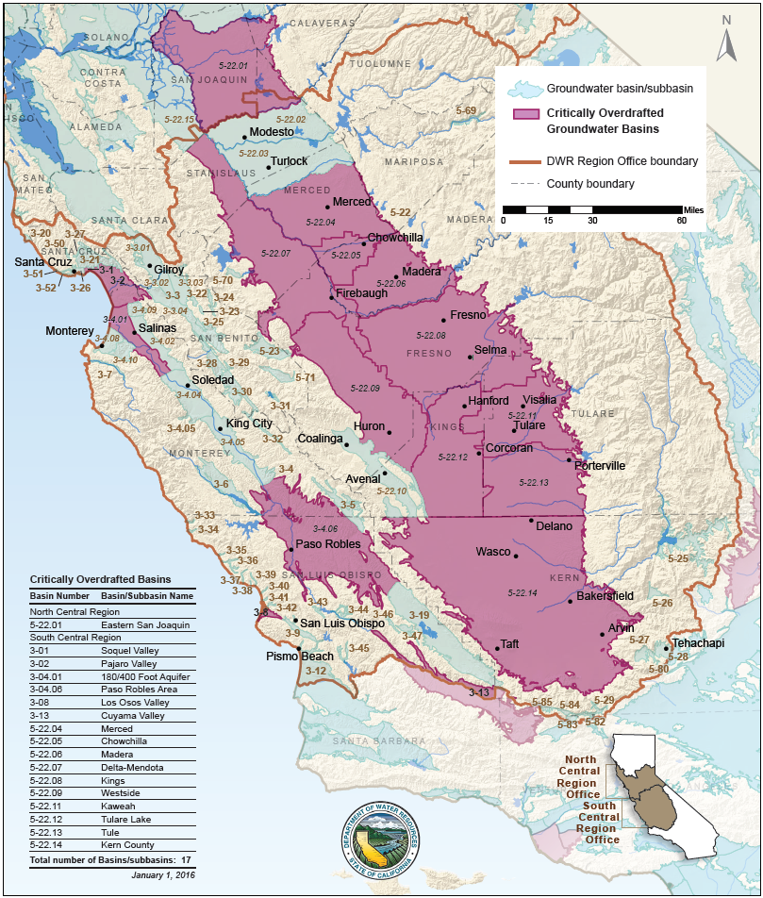

Slide 14
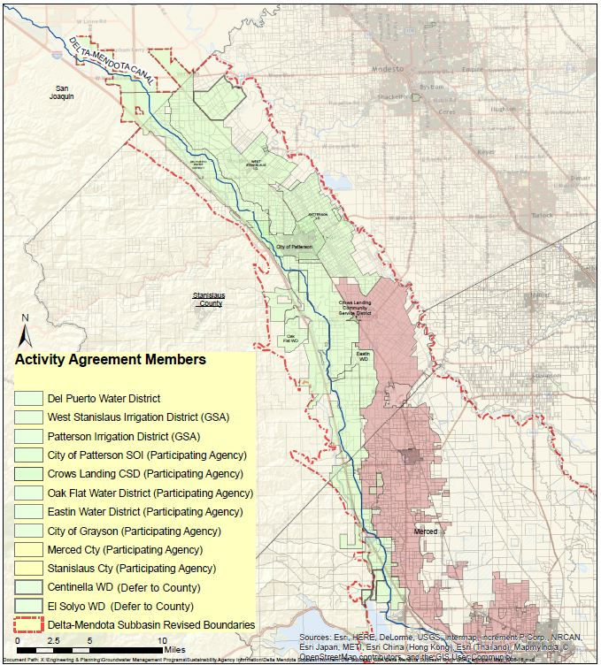

Slide 15
Northwestern Delta-Mendota Subbasin GSA
Entities:
Governance
Stanislaus County
  “White” areas
  El Soyo WD
  Blewett MWC
  Whitelakes MWC
  Crows Landing CSD
  Eastin WD
  Grasslands WR
  Stevinson WD
Merced County
MOA for multi-agency GSA with a target date for adoption by October 2016.
Creation of a umbrella “Activity Agreement” for preparation of a single basin-wide GSP.

Slide 16
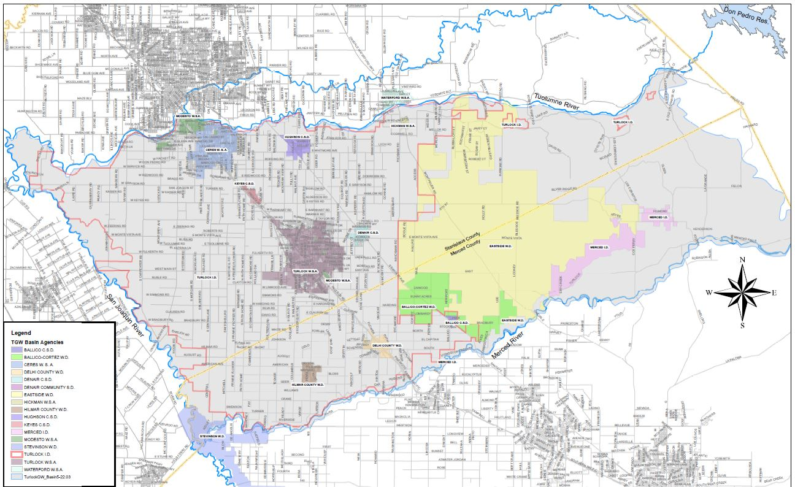

Slide 17
Turlock Groundwater Basin
Member agencies agreed to create two GSAs to provide full basin coverage:
  West Turlock Subbasin GSA
  East Turlock Subbasin GSA
Notes:
The agencies have agreed that while there may be two GSAs within the subbasin, it was was in the best interest of the subbasin to develope a single GSP.
As such, an MOU was signed by the agencies in September of 2015 committing to developing a single GSP.

Slide 18
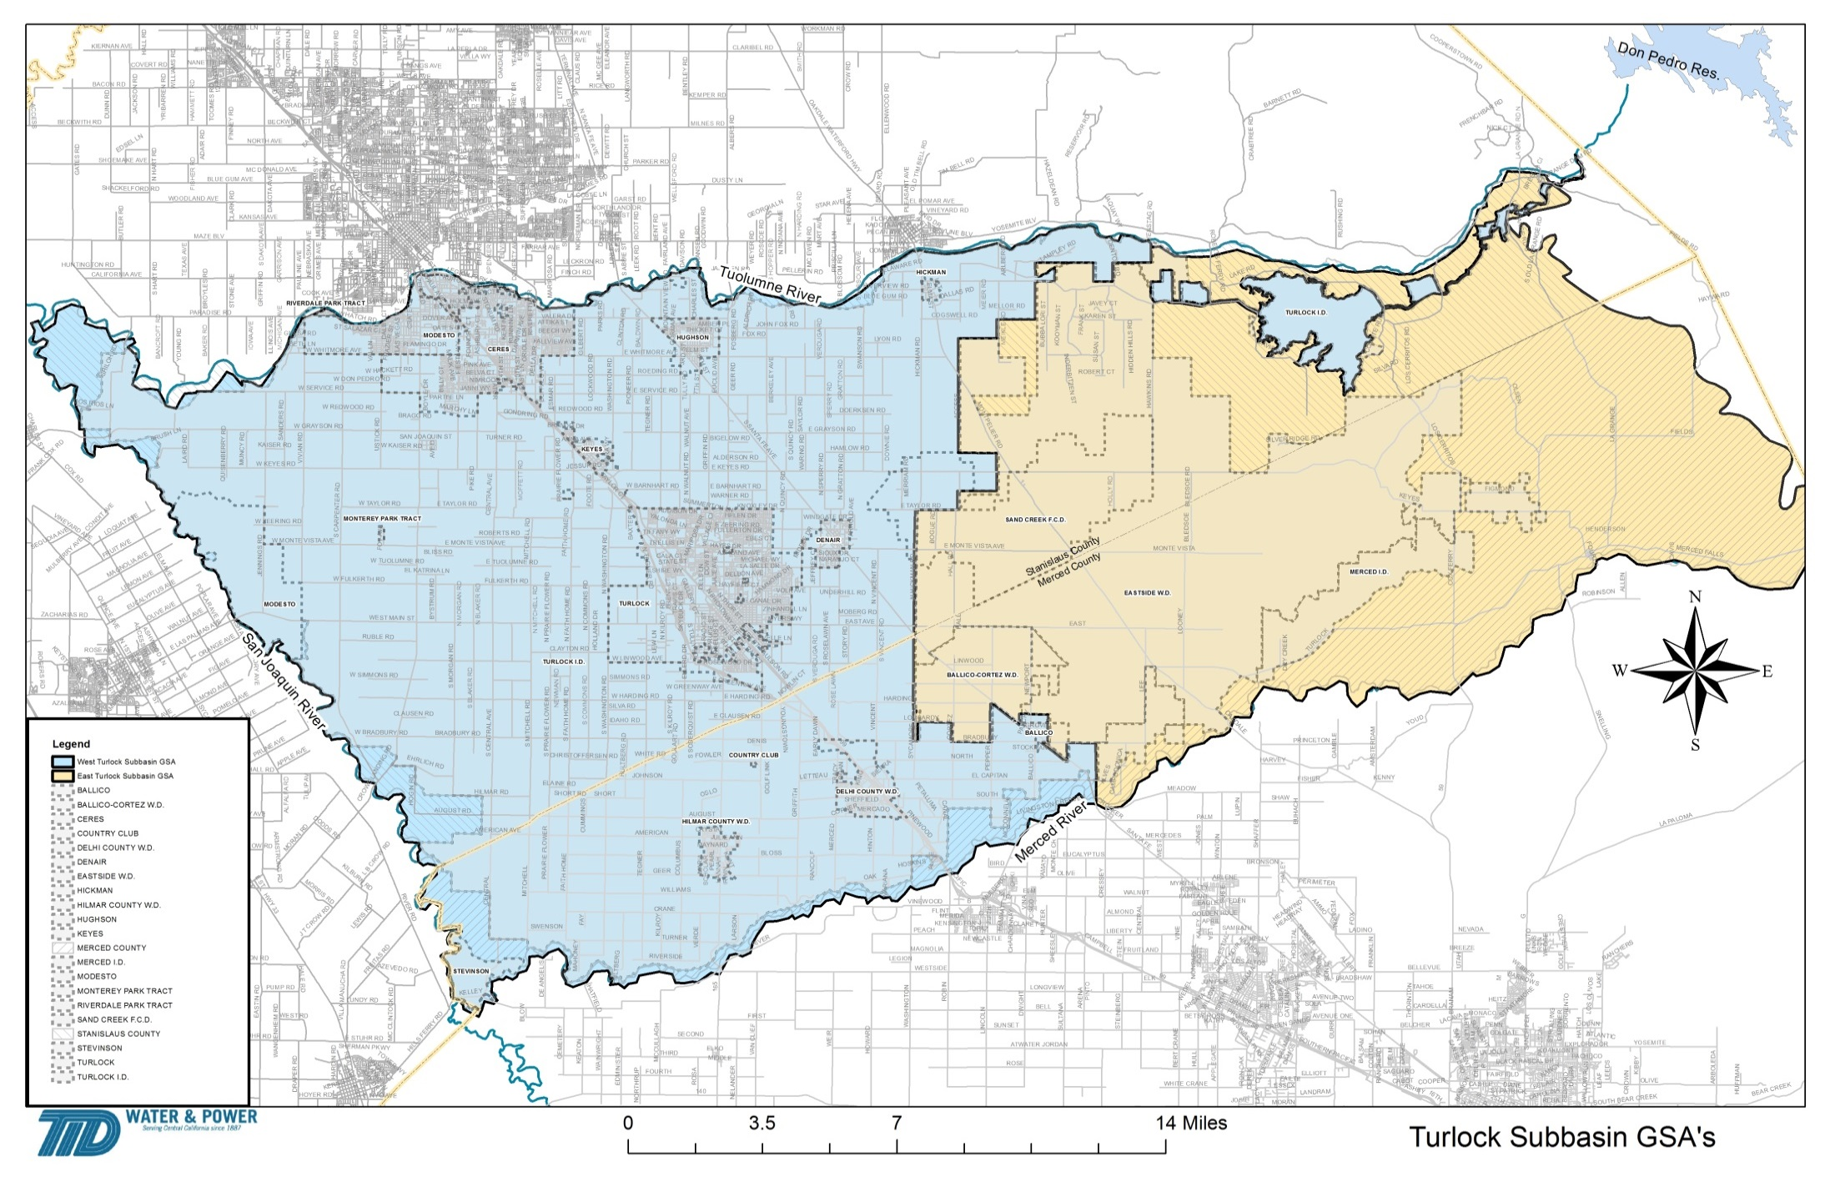

Slide 19
West Turlock Subbasin GSA
City of Ceres City of Turlock
City of Hughson City of Modesto
City of Waterford Denair CSD
Keyes CSD Monterey Park CSD
Delhi CWD Hilmar CWD
Stevinson WD Turlock ID
Stanislaus County Merced County

Slide 20
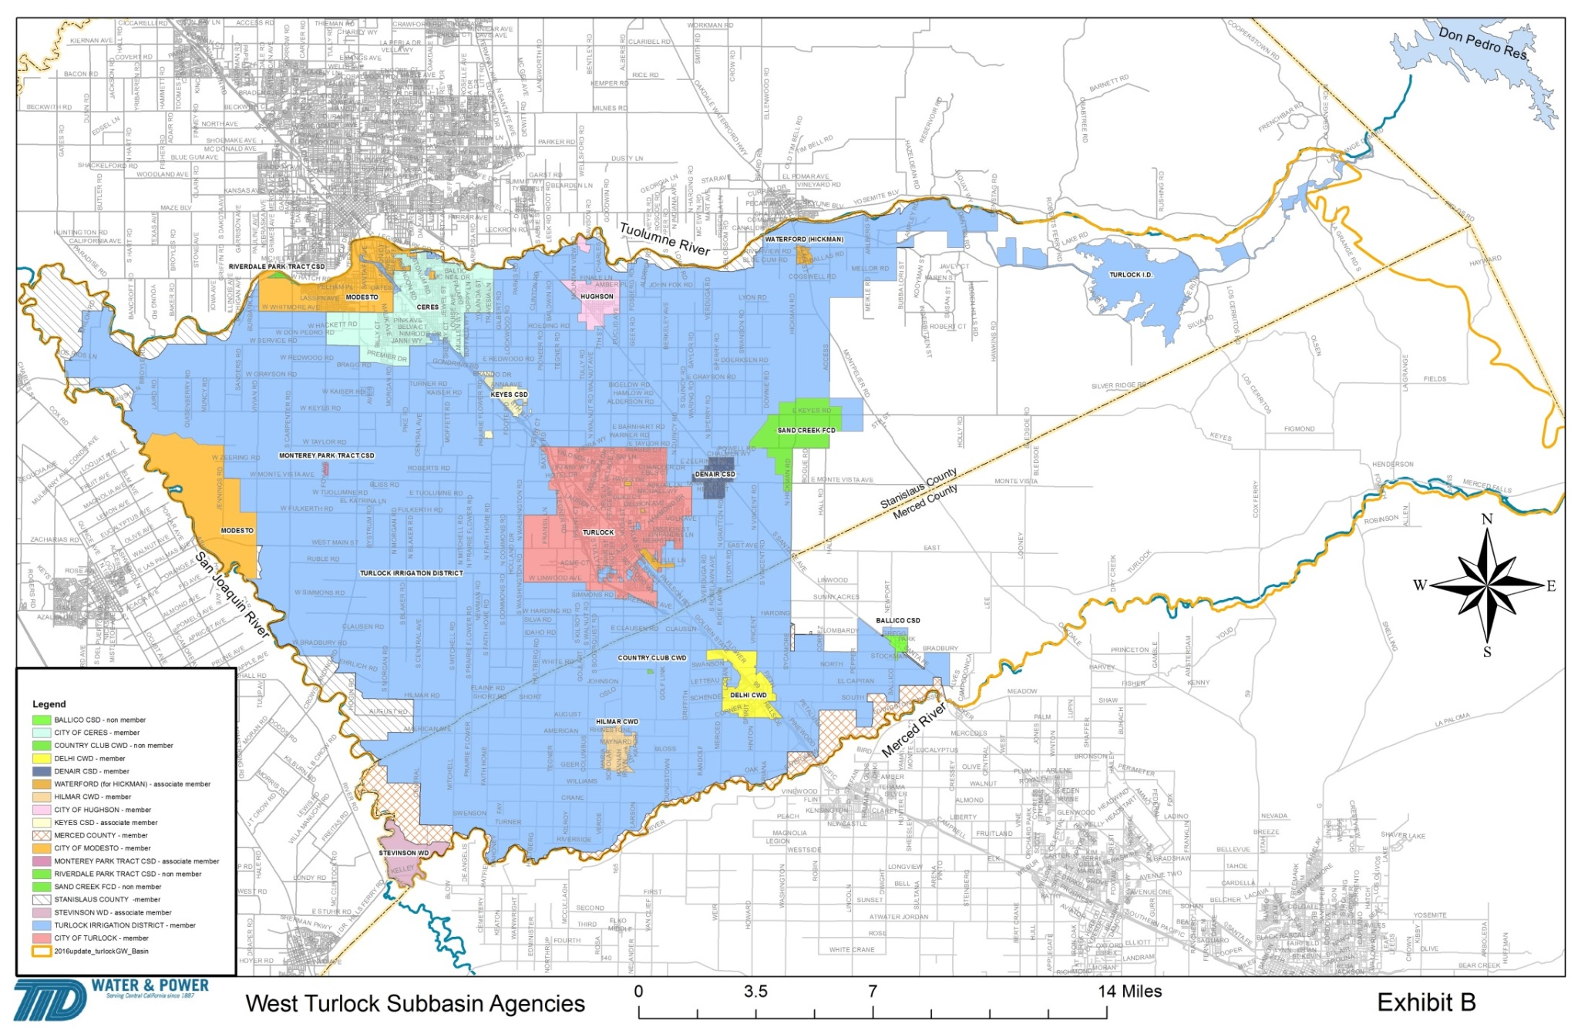
West Turlock Subbasin GSA

Slide 21
East Turlock Subbasin GSA
Eastside WD
Ballico-Cortez WD
Merced Irrigation District
City of Turlock
Merced County
Stanislaus County

Slide 22
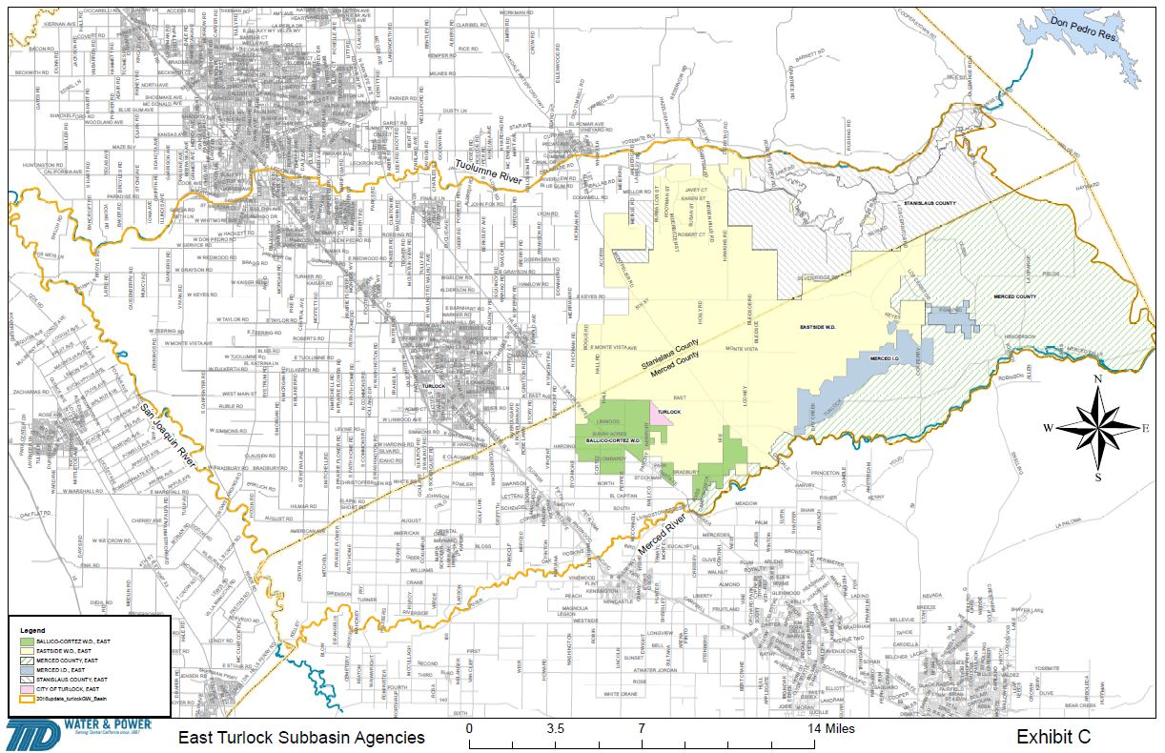
East Turlock Subbasin GSA

Slide 23
Modesto Subbasin GSA
Entities:
Governance
City of Modesto
City of Oakdale
City of Riverbank
City of Waterford
Oakdale ID
Modesto ID
Stanislaus County
MOA for GSP preparation (staff driven)
JPA for GSP implementation and enforcement

Slide 24
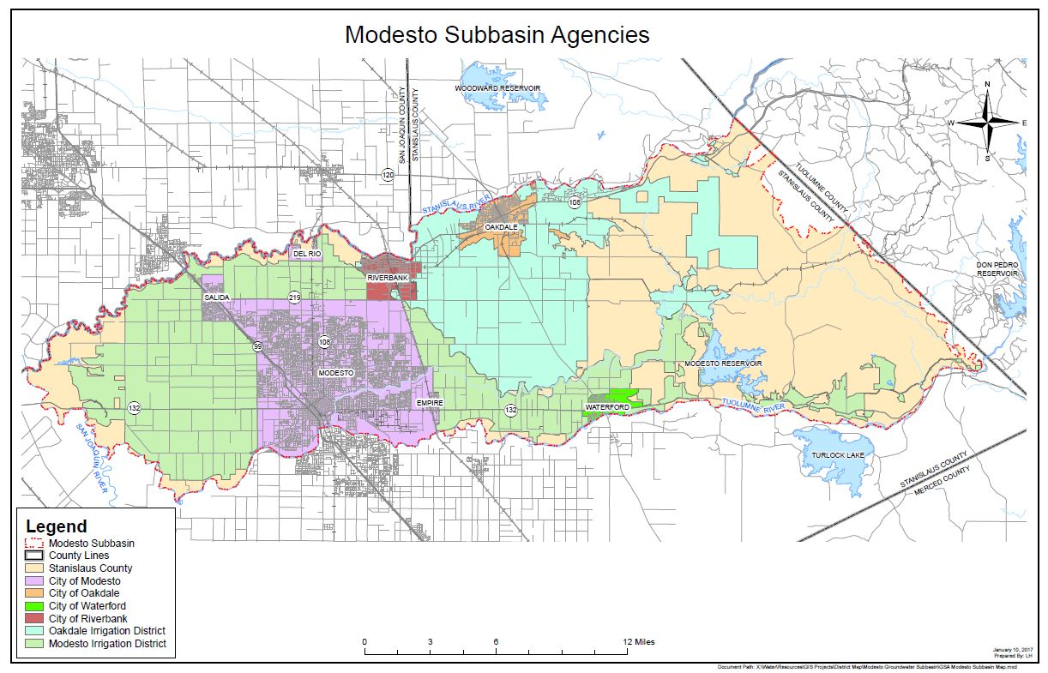

Slide 25
Eastern San Joaquin Subbasin
Entities:
Governance
Calaveras County
Calaveras County WD
Valley Springs PUD
Stanislaus County
Rock Creek WD
Stockton East WD?
Oakdale ID*
South San Joaquin ID*
*Separate GSA
JPA? MOA? Other?

Slide 26
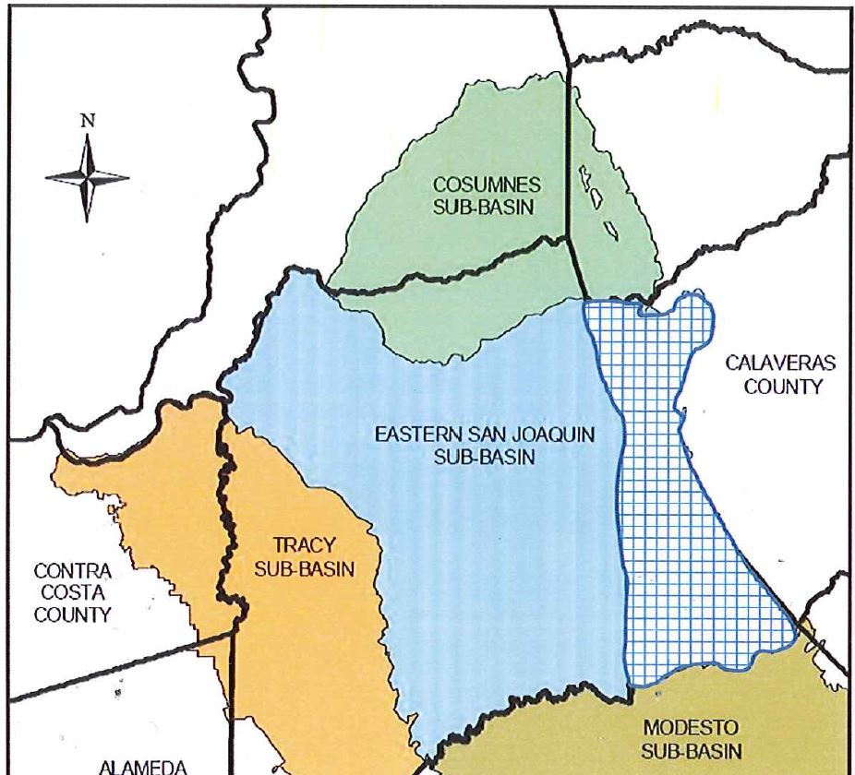

Slide 27
QUESTIONS & DISCUSSION

