Slide 1
Winter/Spring Outlook
Stanislaus County Water Advisory Committee
Scott Rowe | Senior Service Hydrologist
January 16, 2023: Yolo Bypass near I-80 and West Sacramento

Slide 2
2023-2024 ENSO Predictions
According to the Climate Prediction Center:
El Niño Advisory: El Niño conditions are observed today, with characterics reflective of a strong El Niño.
El Niño is anticipated to continue through the Northern Hemisphere winter
73% chance of transitioning out of El Niño (to neutral) in April - June 2024.

Slide 3
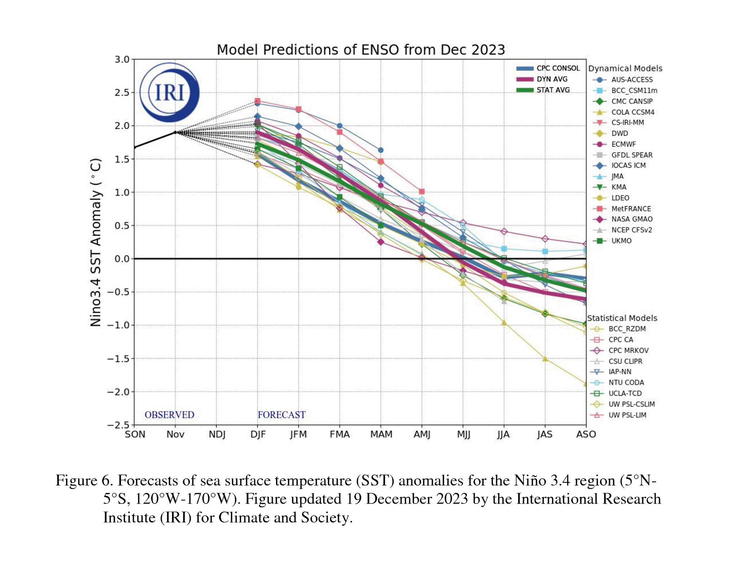
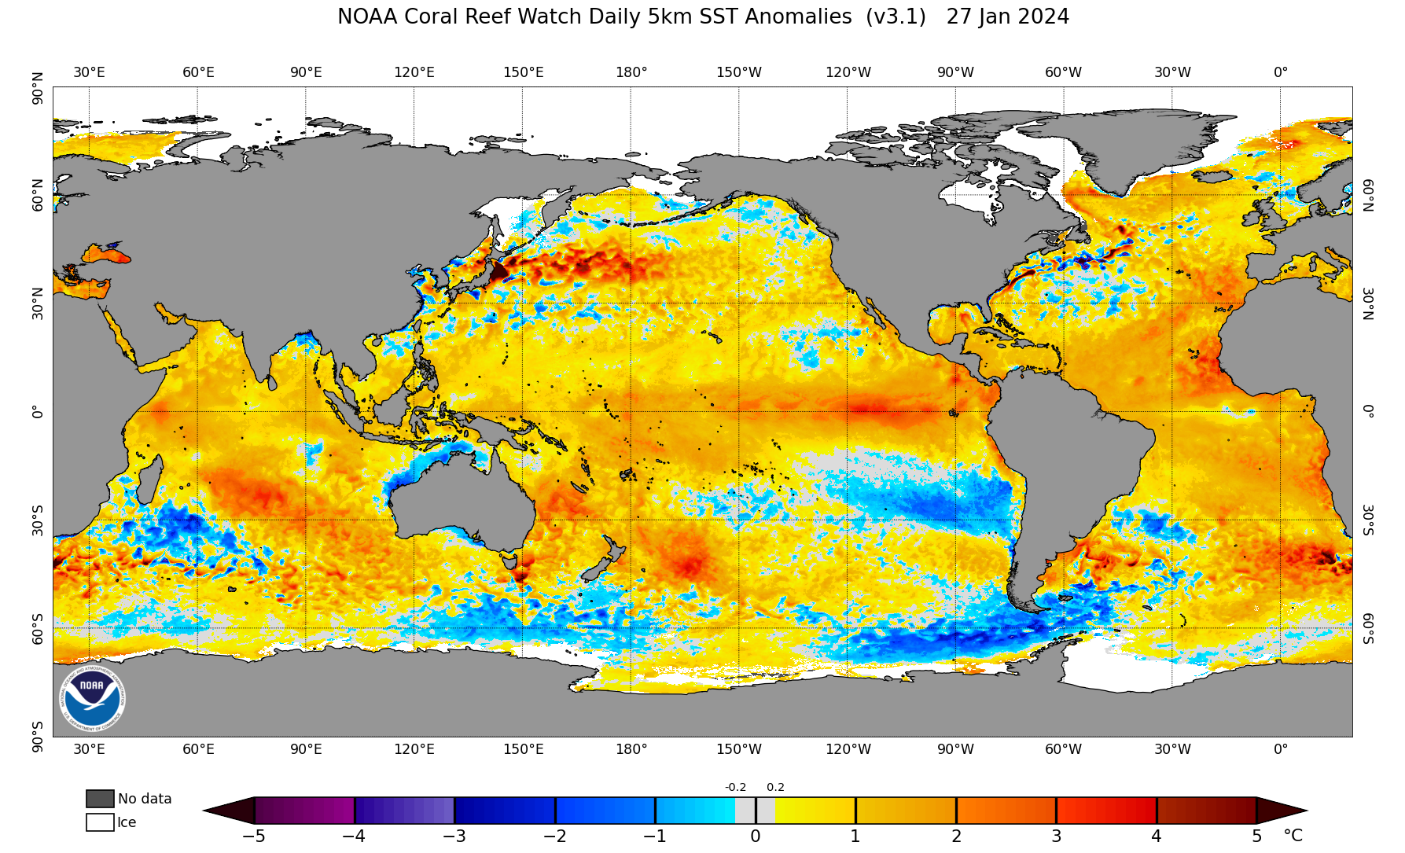
Model Predictions of El Niño Strength
Strong El Niño >= 1.5°C SST Anomaly
El Niño: Warmer than normal sea-surface temperatures in the equatorial eastern Pacific.
La Niña: Cooler than normal sea-surface temperatures in the equatorial eastern Pacific

Slide 4
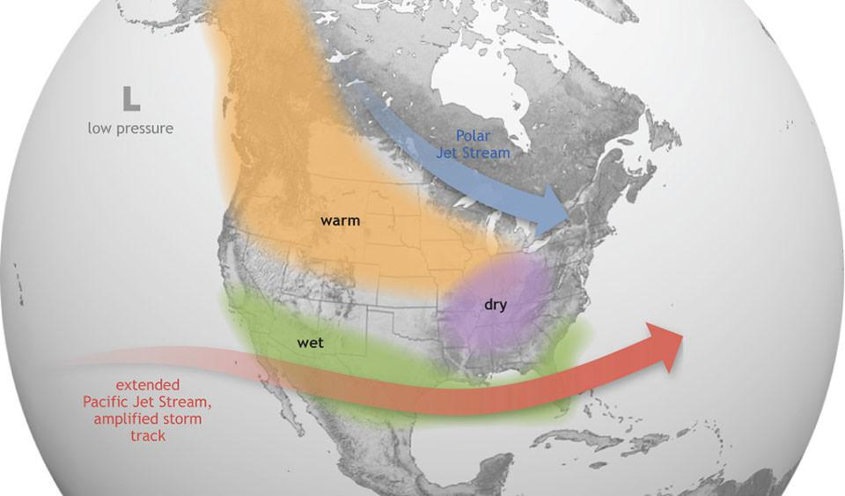
“Typical” El Niño Impacts in the U.S.

Slide 5
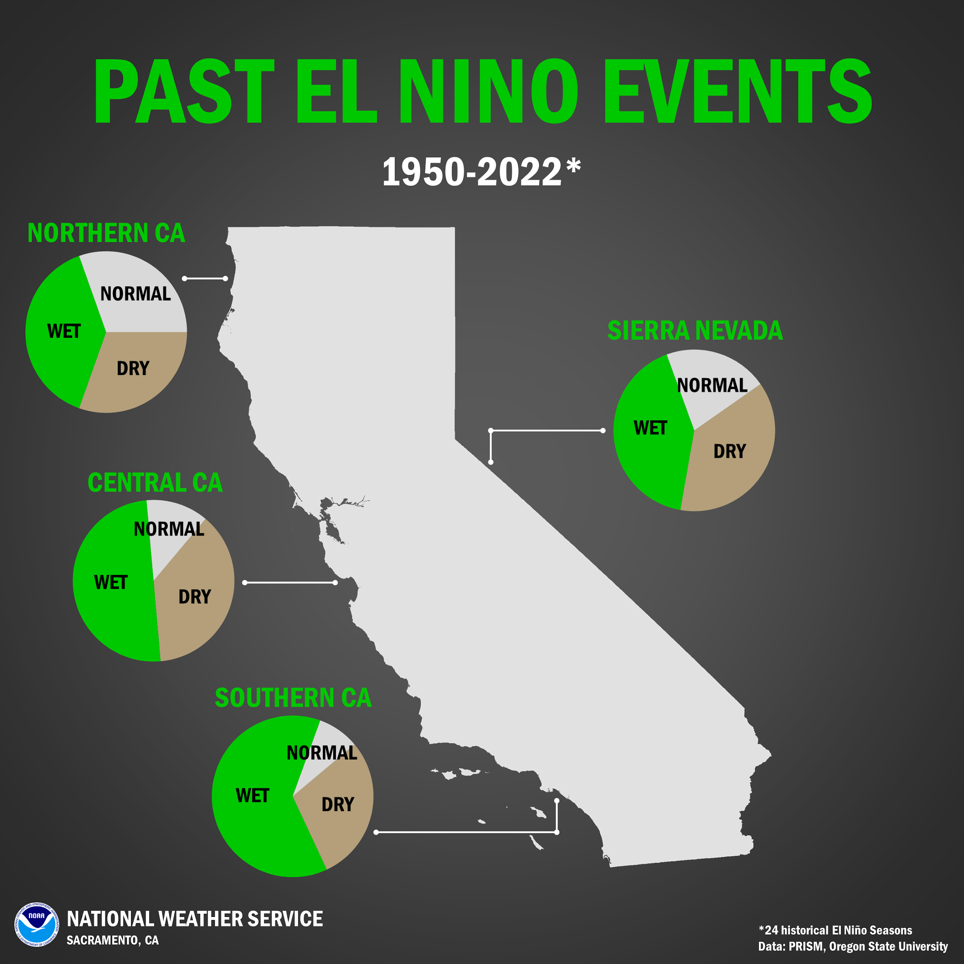
What Has Happened in Past El Niños?
El Niño conditions typically drive the storm track farther south than a average winter
Southern California has better predictability of precipitation than northern California in El Niño winters
El Niños have recorded anywhere from very dry to very wet winters!
Remember, our future water supply will be dependent on individual storms!

Slide 6
Historical El Niño Precip % of Normal

Slide 7
Comparing Past El Niños to Today’s El Niño
No two El Nino events are the same, even strong ones
Think of 1997-1998 (very wet) vs 2015-2016 (below normal to near normal)
Our current El Niño developed earlier in the summer than previous El Niños have
This El Niño is notably warm in eastern Pacific (off the coast of South America), whereas for the last several decades, the warmest region has been in the central Pacific
Overall, the oceans are very warm globally.
How is that going to impact this year’s ‘typical’ El Niño influence on our weather patterns? To be determined.
All of these factors mean we’re going to be less reliant on the past years’ El Niños.

Slide 8
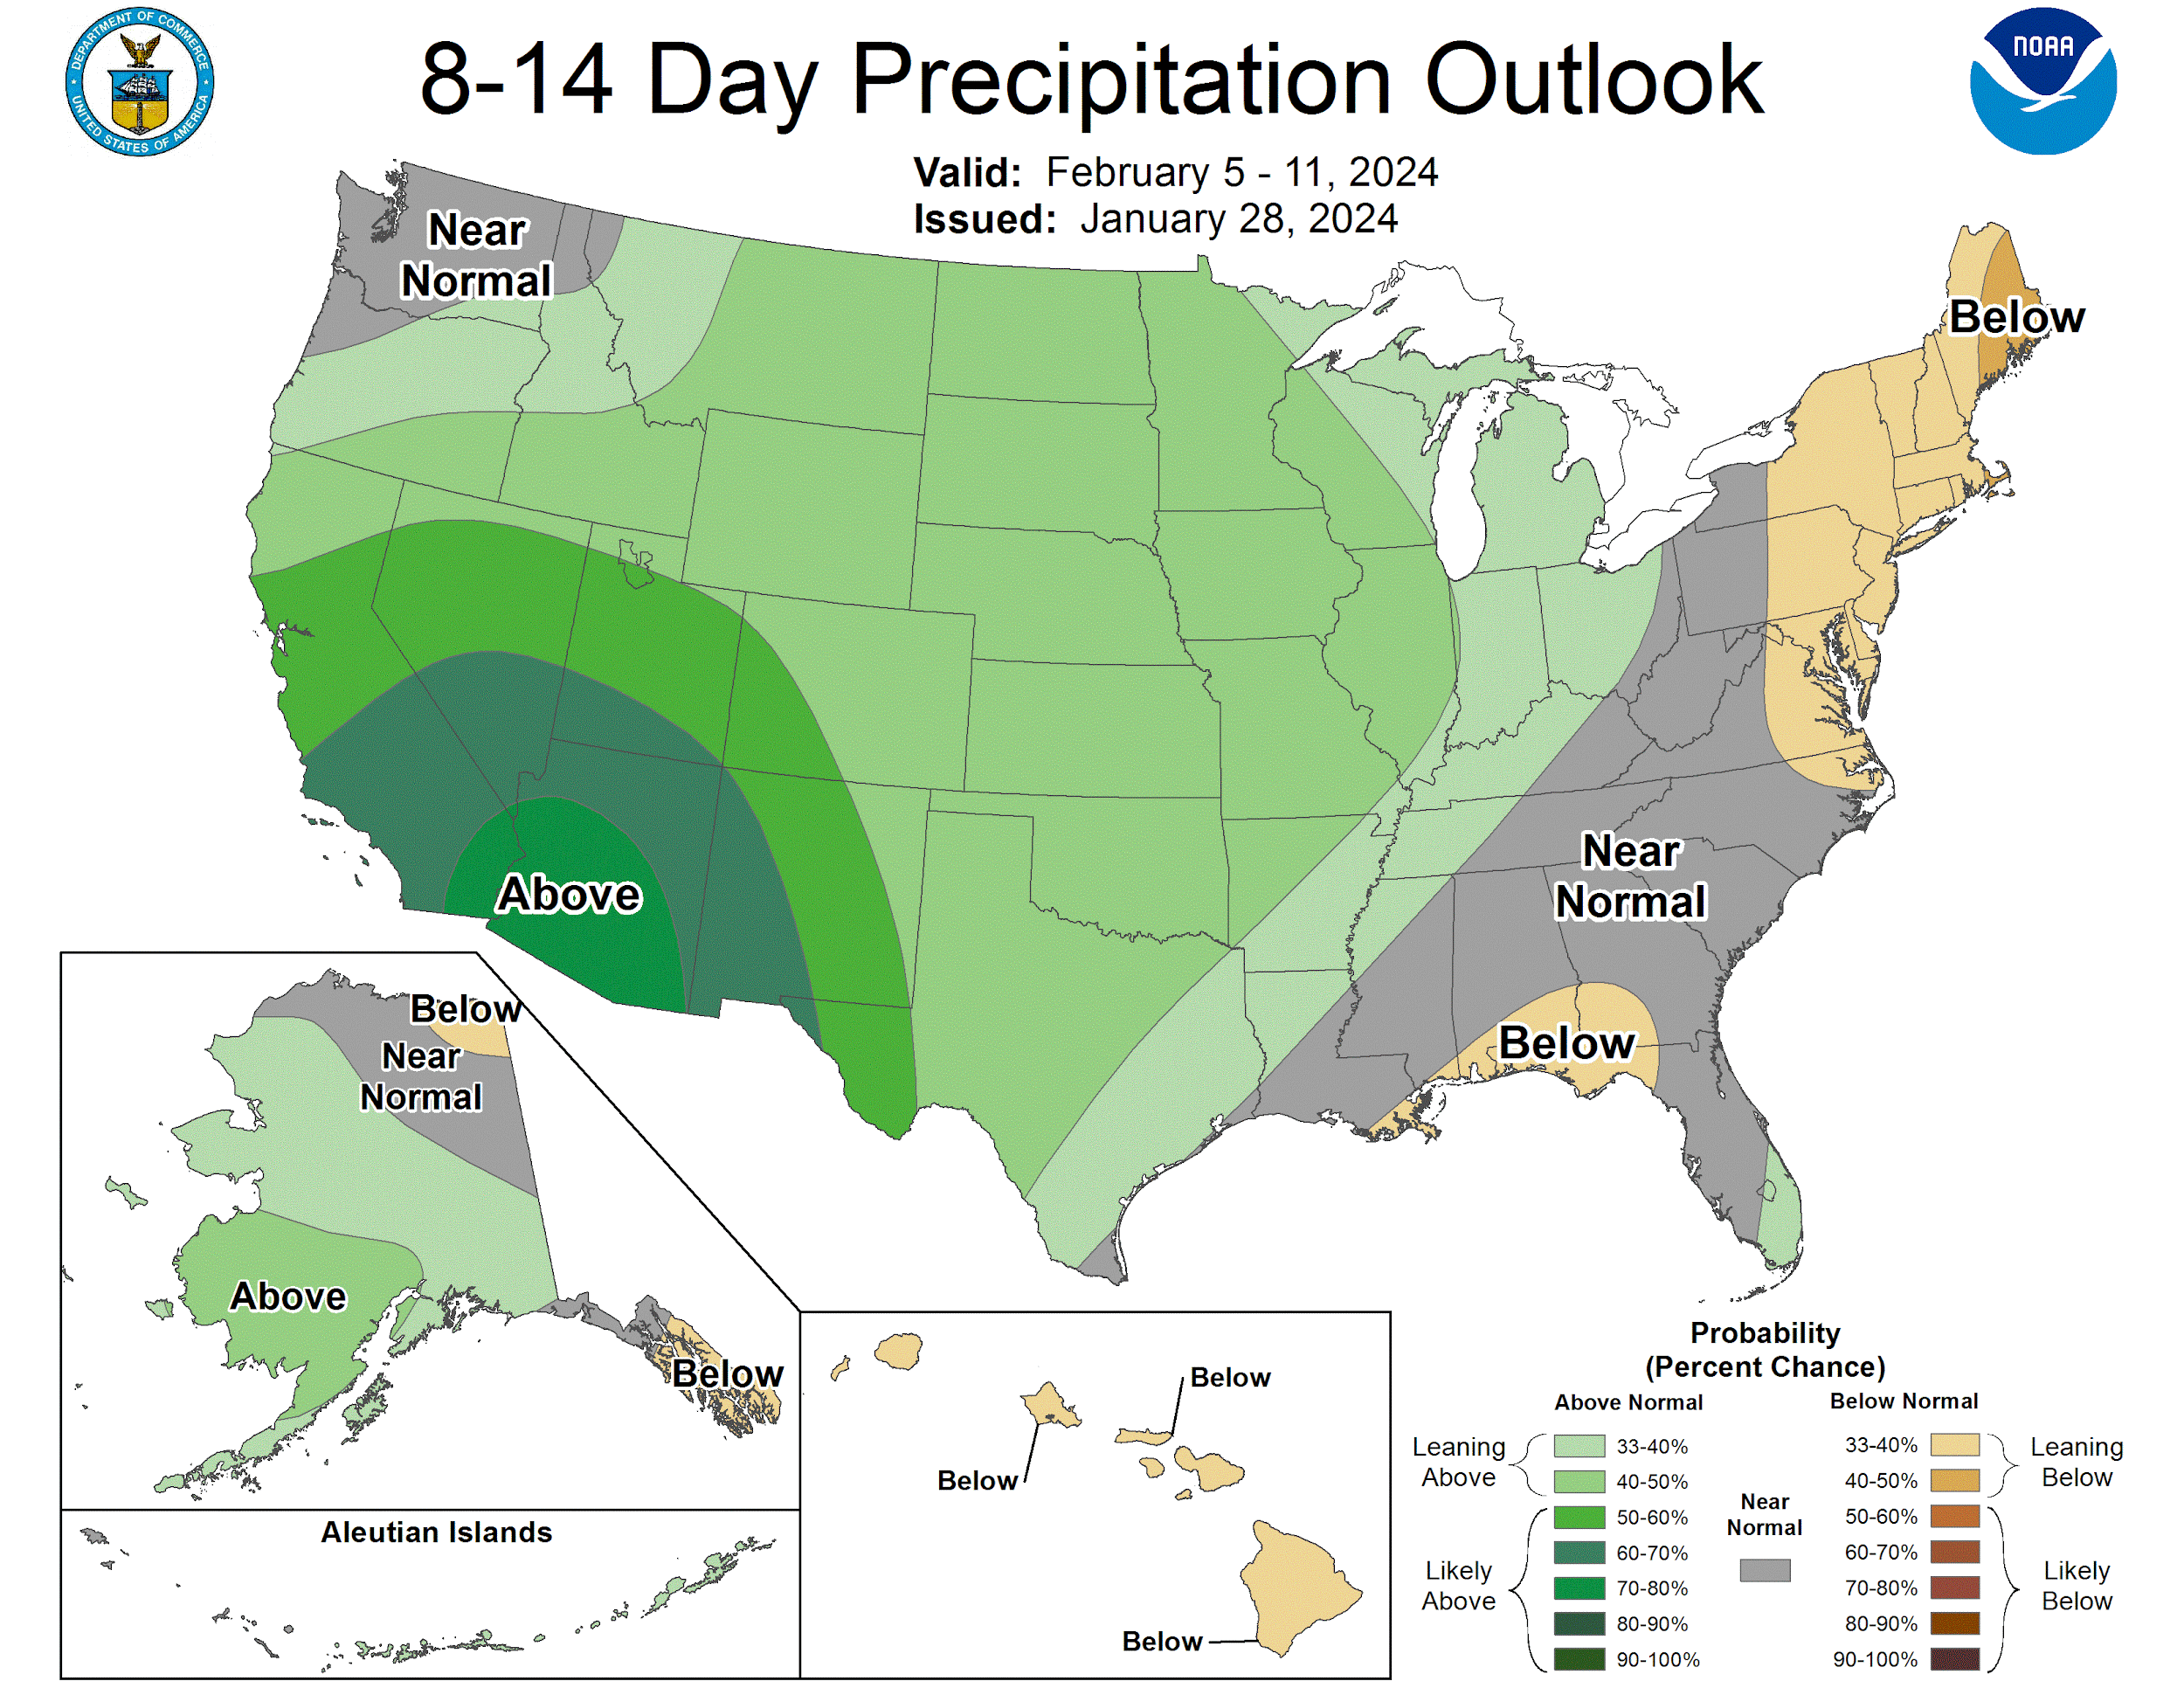
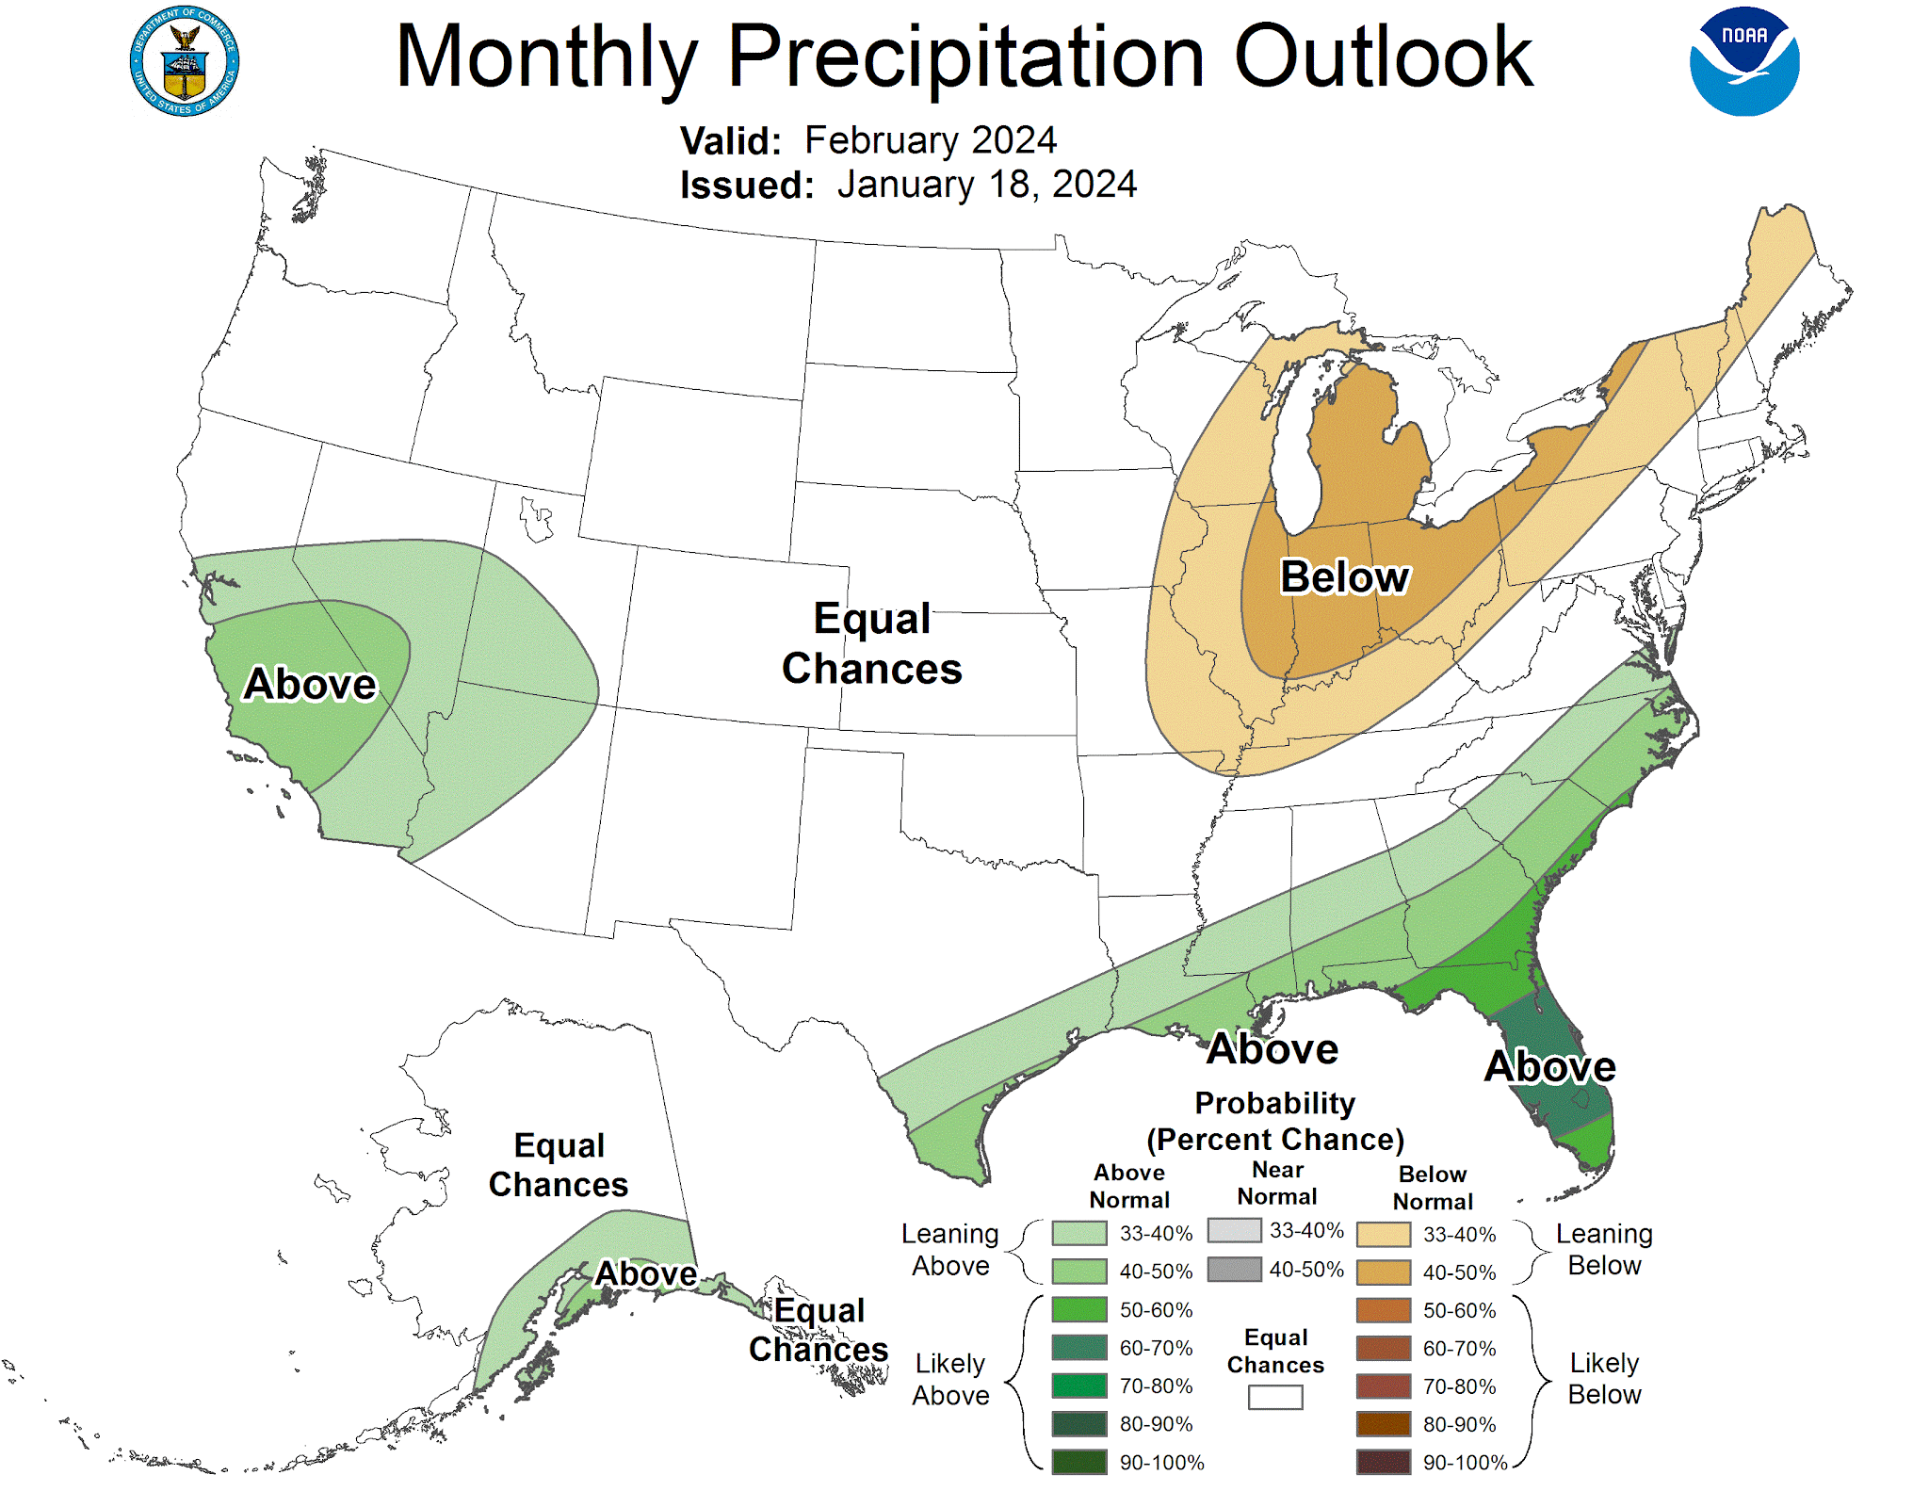
CPC Outlooks
Precipitation:
50-60% probability of ABOVE NORMAL
Precipitation:
33-40% probability of ABOVE NORMAL

Slide 9
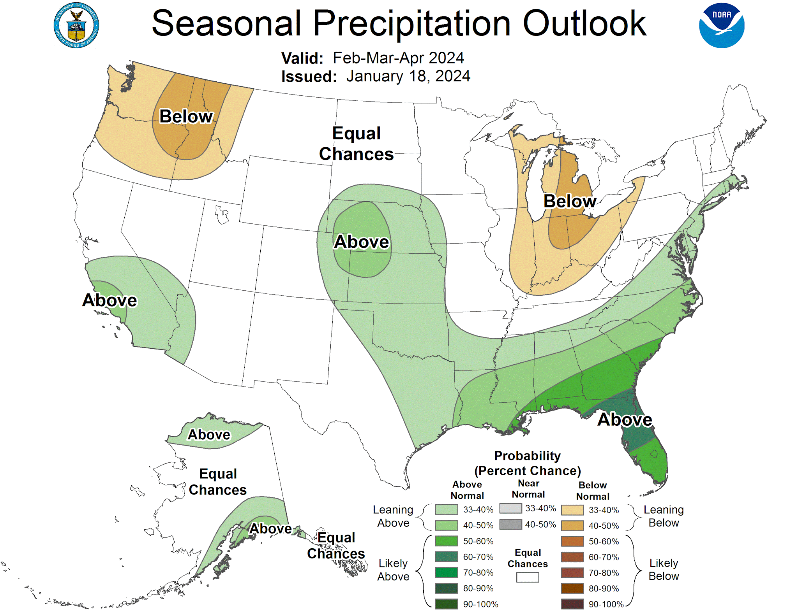
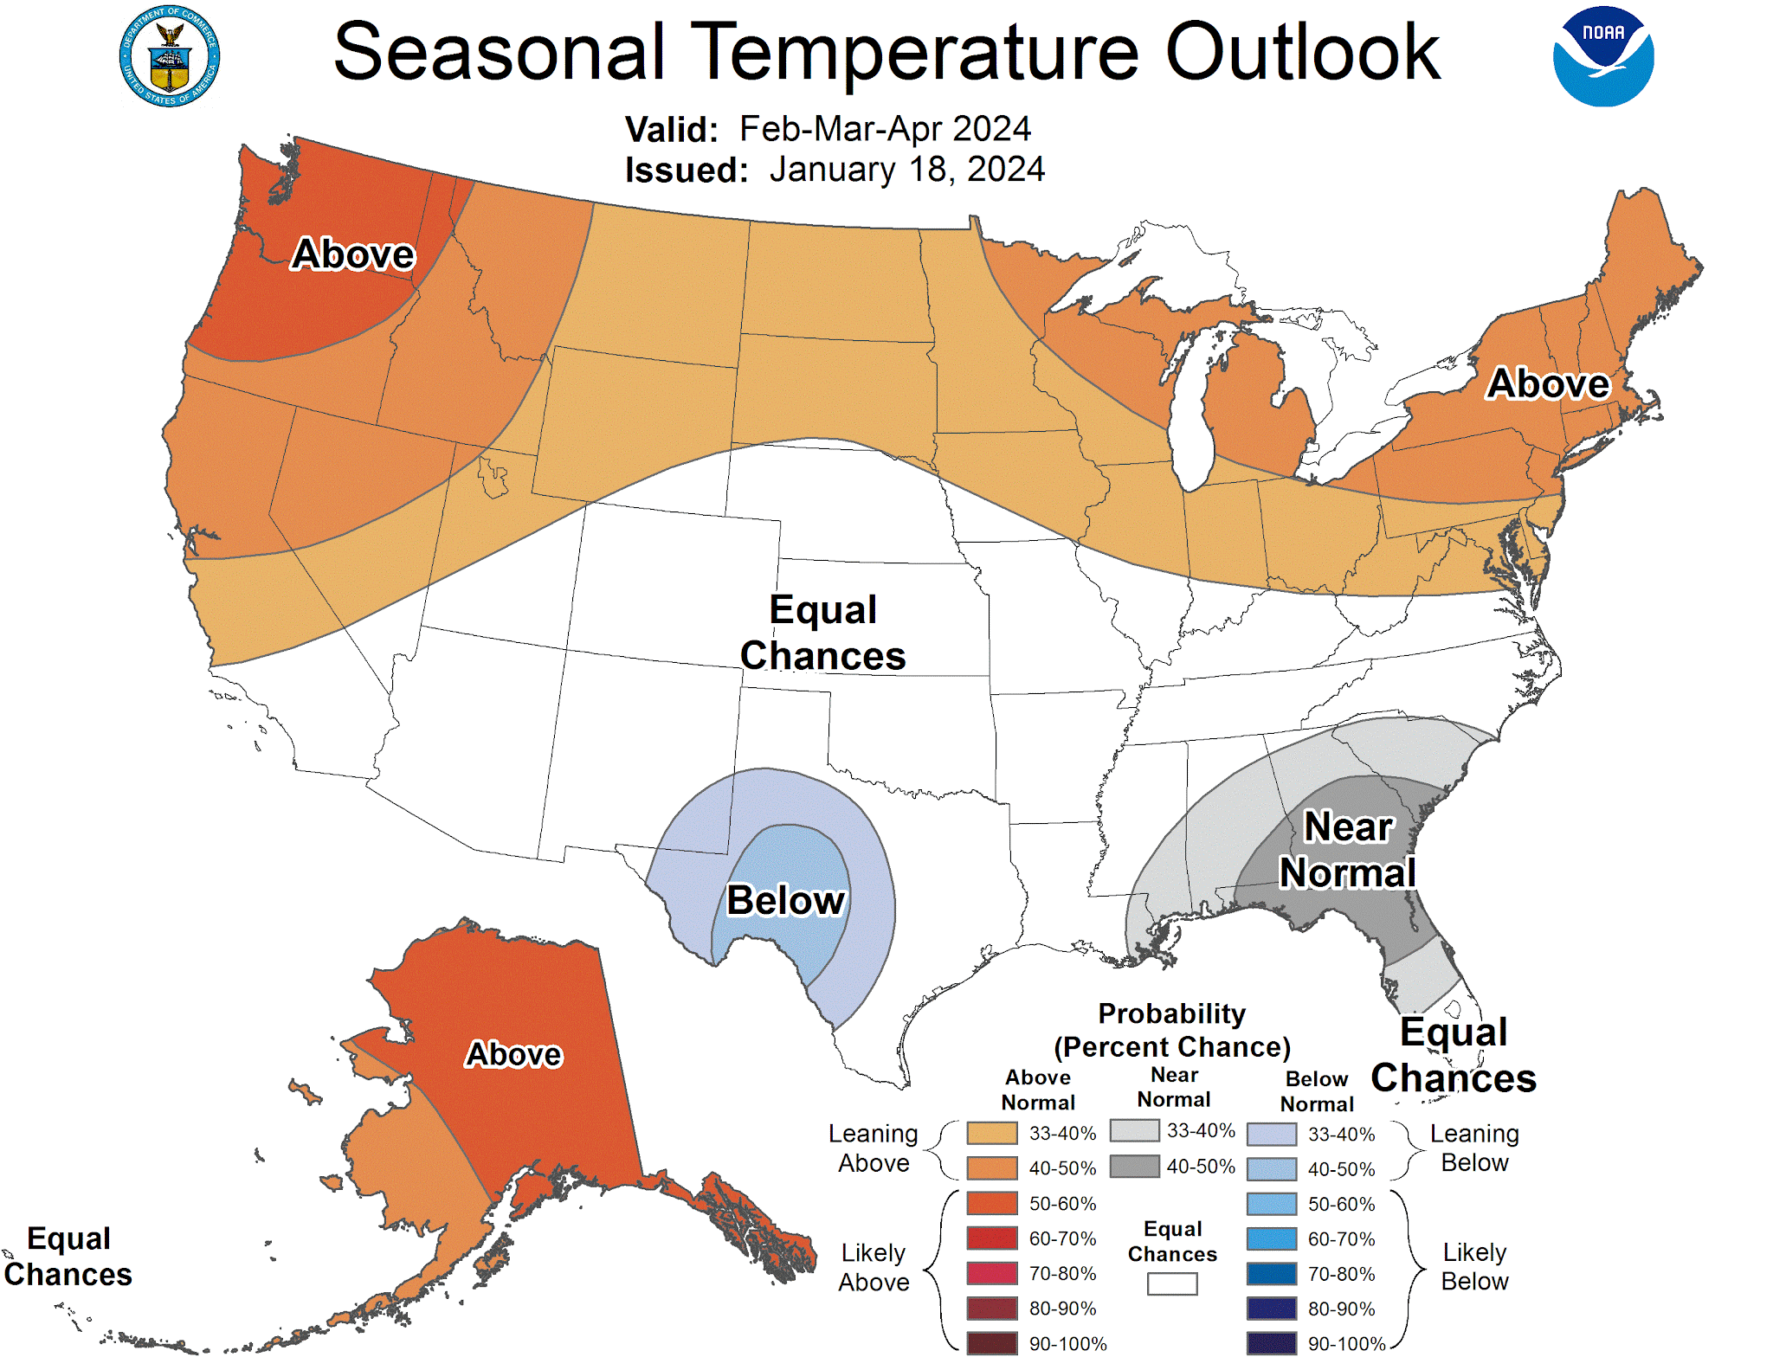
CPC 3 Month Outlooks
January-February-March
Precipitation:
Equal Chances of Above or Below Normal
Temperature:
33-40% probability of ABOVE NORMAL

Slide 10
Words of Caution
California winters typically see 5 Strong (or greater) atmospheric rivers a year
These storms are apparent in the 7-14 day forecast window & will be highlighted by partner emails

Slide 11
Words of Caution
Reservoirs are in a different situation compared to this same time last year though we have had a dry start to the water year especially in terms of snowpack
Any single storm can produce impacts & flooding – localized and/or regional-scale

Slide 12
How is Winter 2023-2024
Going So Far?

Slide 13
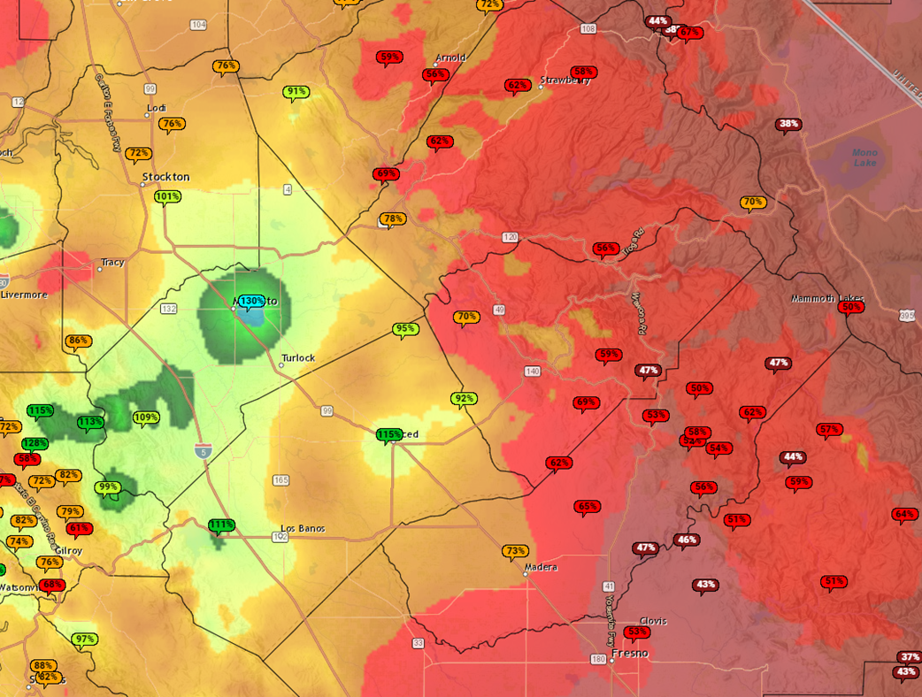
Percent of Normal Precipitation
October 1, 2023 to January 28, 2023:
Northern San Joaquin Valley: 75-125% of normal
Central Sierra: 40-75% of normal

Slide 14
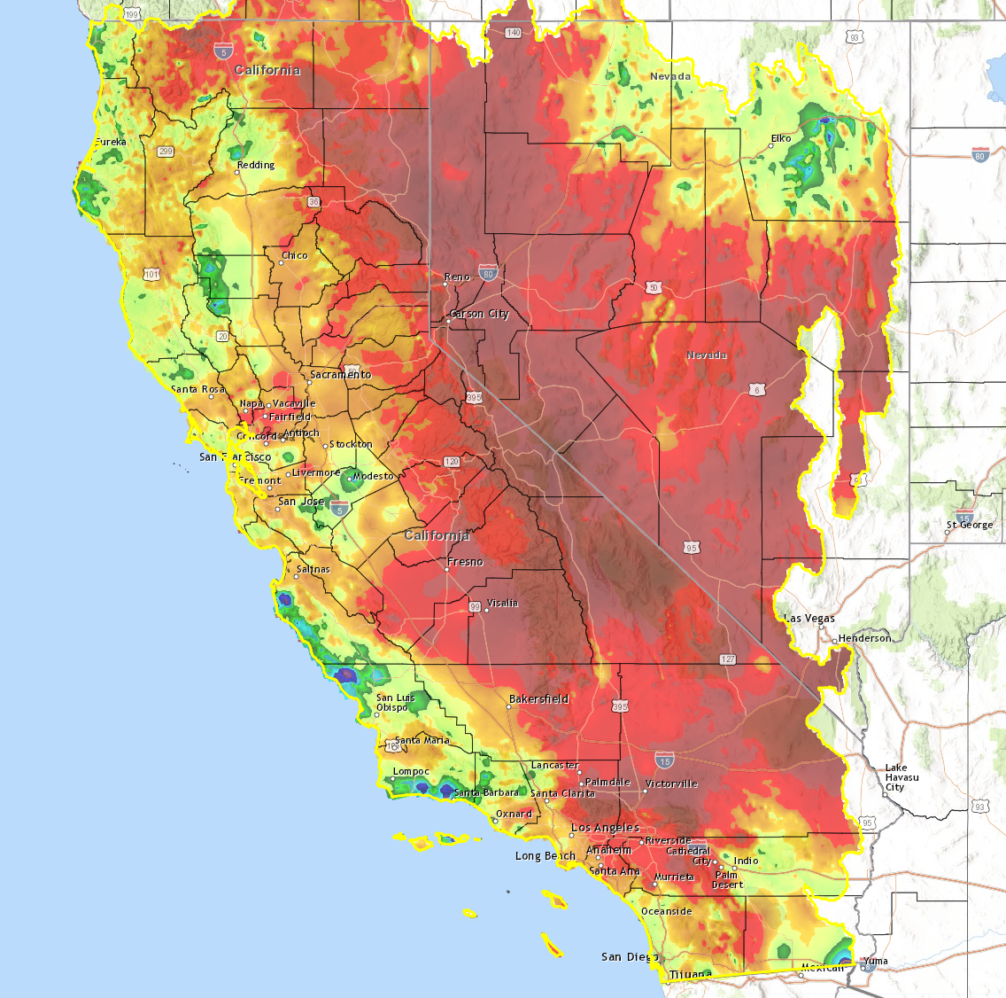
Percent of Normal Precipitation
October 1, 2023 to January 28, 2023:
Statewide:
Majority of locations are running below normal

Slide 15
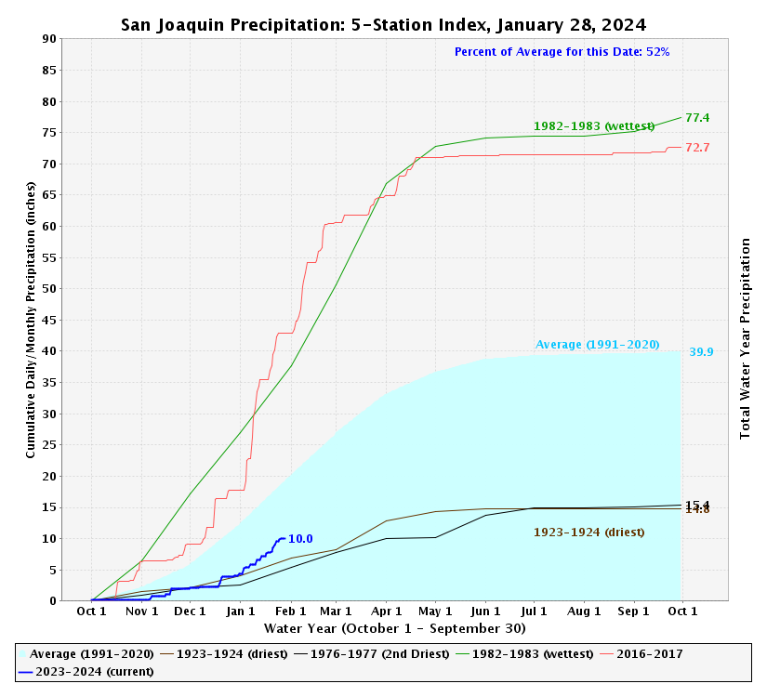
San Joaquin 5-Station Index
10.0” observed, or 52% of average for January 28, 2024
Last year: ~34.0”

Slide 16
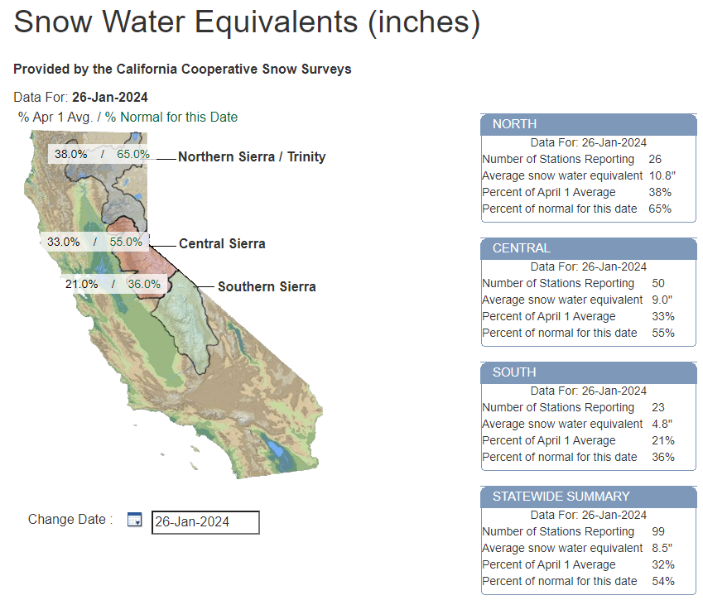
Sierra Snow Pack / Snow-Water Equivalents
North: 65% of normal for Jan 26
179% one year ago
Central: 55% of normal for Jan 26
219% one year ago

Slide 17
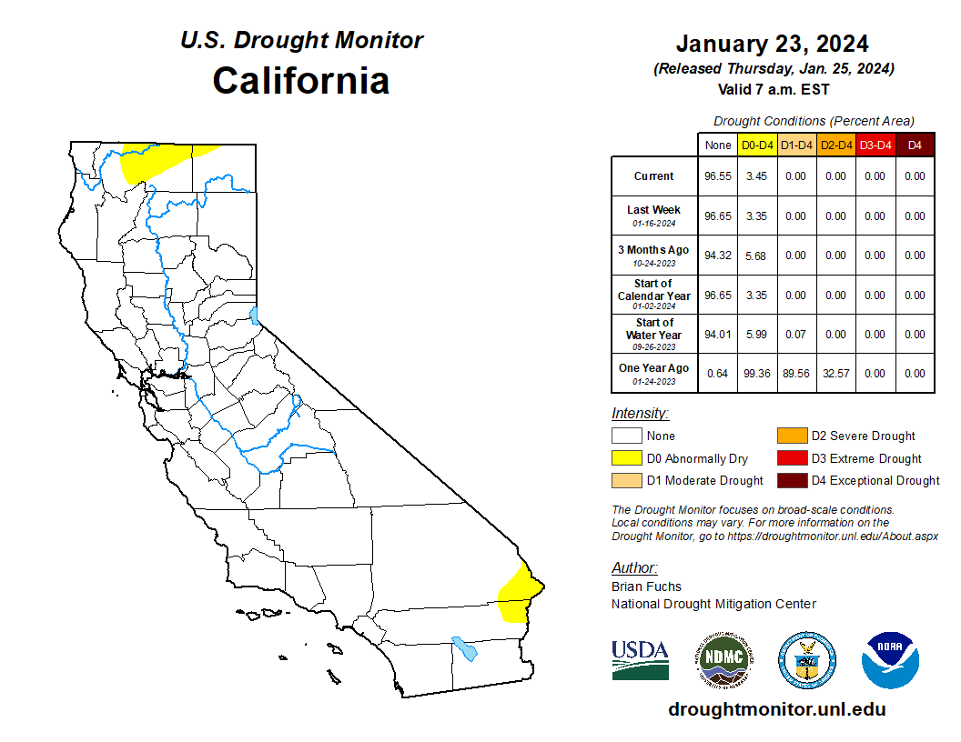
Drought Monitor

Slide 18
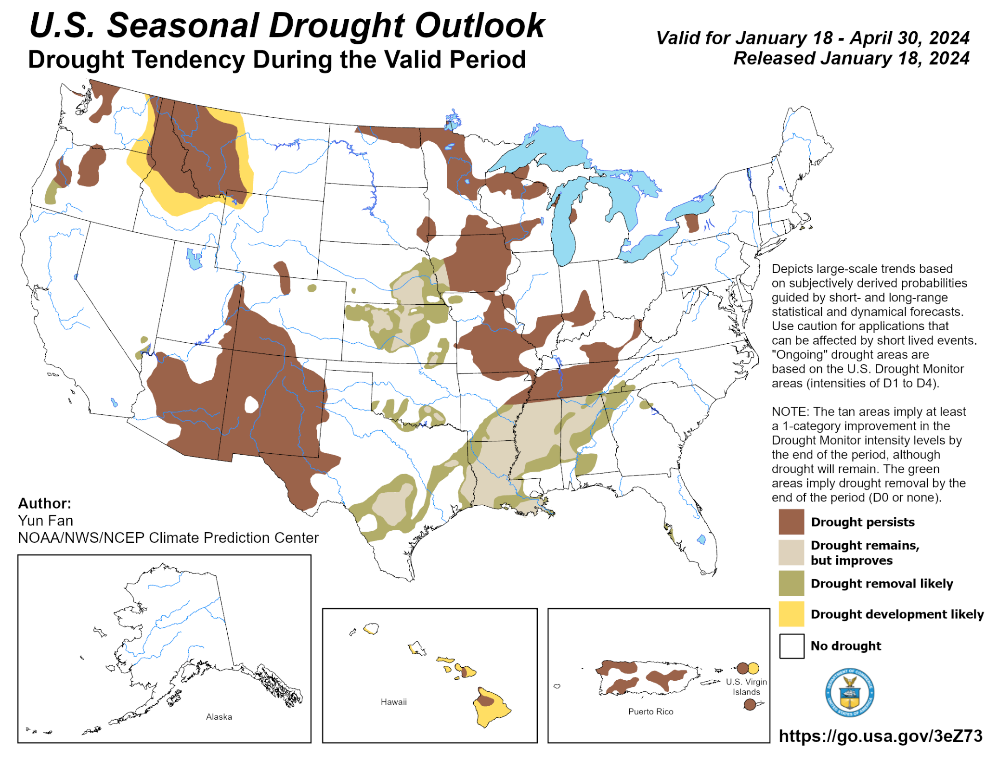
Drought Outlook

Slide 19
Key Messages Winter So Far
Overall: slow start for California
But – there is still time
December-January-February are our wettest months
There is time to “make-up ground”
Exercise caution when comparing to last year’s very anomalous wet season.

Slide 20
NWS Products, Services, Resources

Slide 21
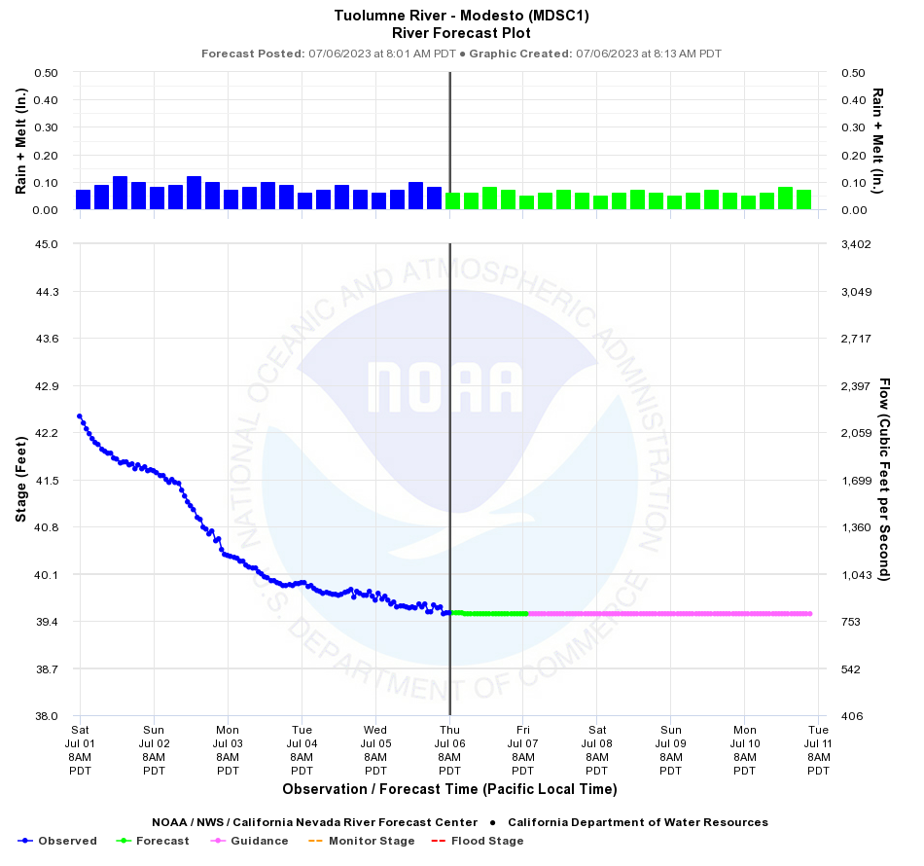
California-Nevada River Forecast Center
California-Nevada River Forecast Center (CNRFC) provides excellent overview for river conditions and forecasts for points throughout the state.
https://www.cnrfc.noaa.gov/

Slide 22
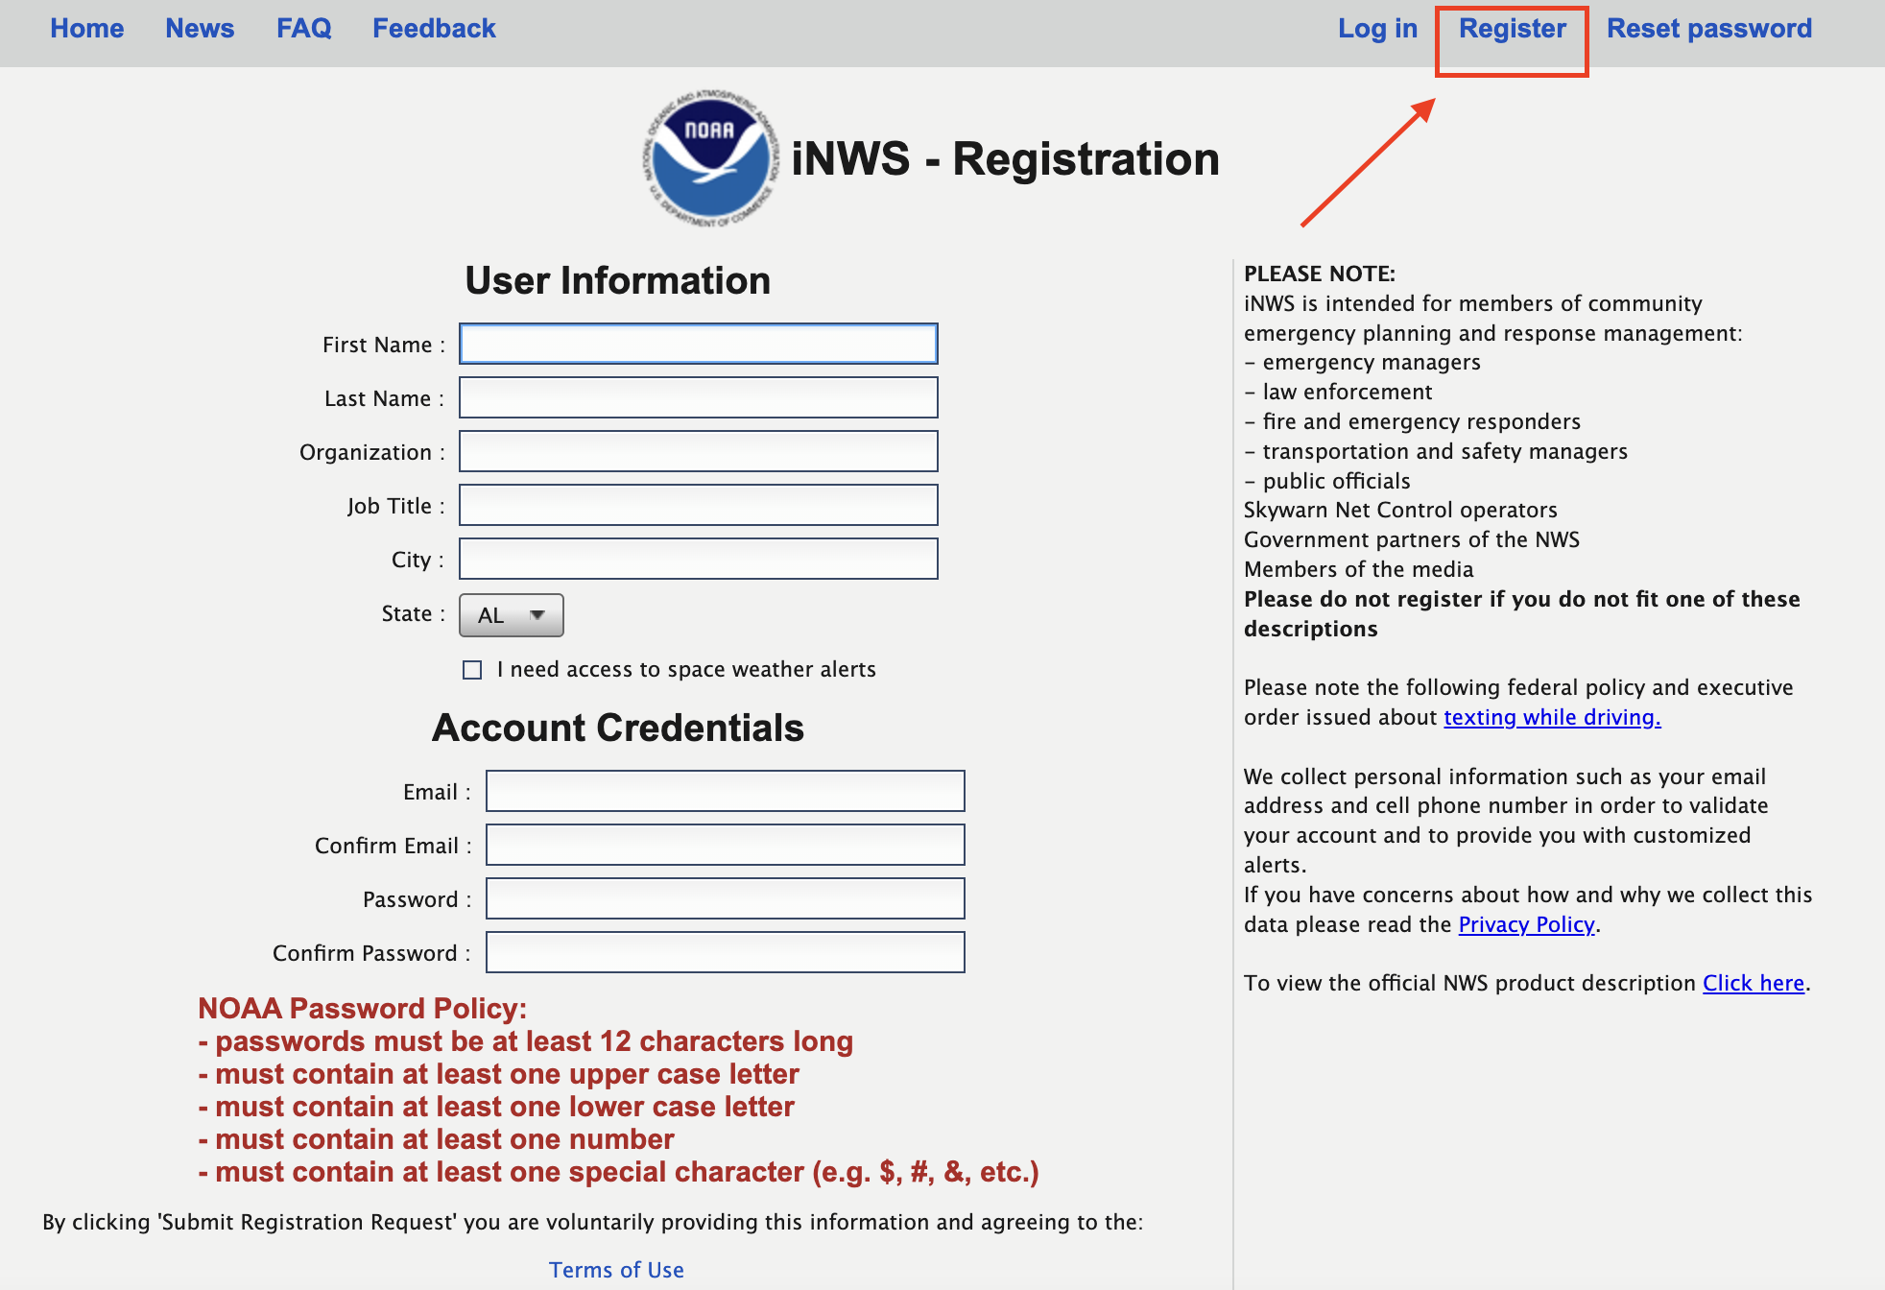
iNWS Alerts
A way to receive mobile text alerts of NWS hazards, including map & hazard text product link
Different from WEA
Experimental texting service intended for core NWS partners
inws.ncep.noaa.gov

Slide 23
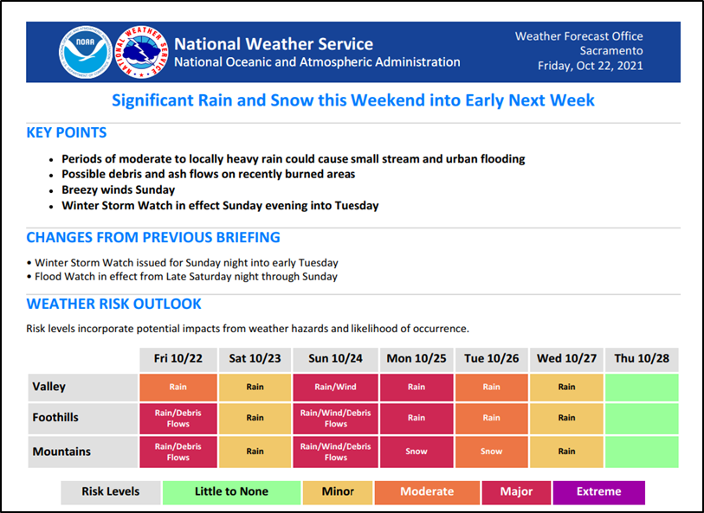
NWS Partner Emails
Early heads up of impending weather
Prior to traditional watches and warning
To be added to partner email list, email:
courtney.carpenter@noaa.gov

Slide 24
Thank You! Any Questions?
If you have any questions or want to be added to our partner email list, please contact:
NWS Sacramento
nws.sacramento@noaa.gov
Warning Coordination Meteorologist
courtney.carpenter@noaa.gov
Senior Service Hydrologist
scott.rowe@noaa.gov
NWS Sacramento forecaster can be reached 24/7/365 at 916-979-3045

