Slide 1
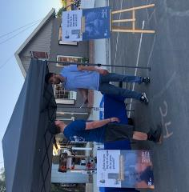

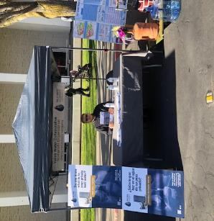
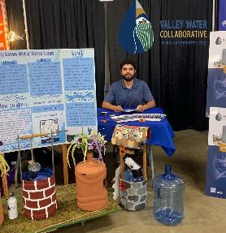

Stanislaus County
Water Advisory Committee
June 1, 2023
Parry Klassen
Executive Director

Slide 2
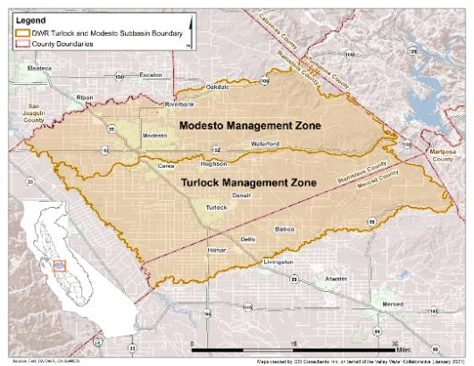
What is the Nitrate Control Program (NCP)?
New Water Board Regulation (adopted 2020) to address nitrate in groundwater
Program has 3 goals:
  Provide safe drinking water when nitrate
  exceeds drinking water standard
  Reduce nitrate impacts to water supplies
  Restore groundwater quality, where
  reasonable, feasible and practicable
Management Zone approach to implement NCP
Early Action Plan submitted March 8, 2021
Rollout May 8, 2021
Management Zone Proposal
  Submitted August 2022

Slide 3
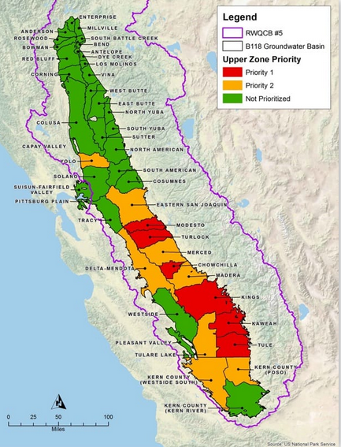
What is the new Nitrate Control Program?
Central Valley sub basins divided into three priority levels:
Priority 1: Notice to comply May 2020
Priority 2: est. Notice to Comply Dec. 2022
Priority 3: no date given for NTC
Valley Water Collaborative was formed to initially encompass Modesto-Turlock Management Zones
https://www.cvsalinity.org/nitrate-control-program.html

Slide 4
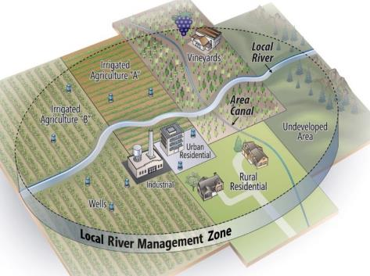
Response to Notice to Comply –
Select Compliance Pathway
Select compliance pathway and prepare required materials for submittal to the Regional Board:
  Path A – Discharger elects to comply with Nitrate Control Program requirements as an individual entity
  Path B – Through establishment of a Management Zone, permitted dischargers opt to work collectively to comply with Nitrate Control Program requirements

Slide 5
Valley Water Collaborative structure
We are a non-profit organization …
  Formed to implement Management Zone approach to address nitrate contamination of groundwater drinking water supplies
  Based in Modesto
Mission
  To maintain and improve the quality of life in the northern San Joaquin Valley by
  implementing programs that provide access to safe drinking water for residents, and by engaging in activities with the goal of
  protecting or enhancing the quality of groundwater used as drinking water
  for residents in the region

Slide 6

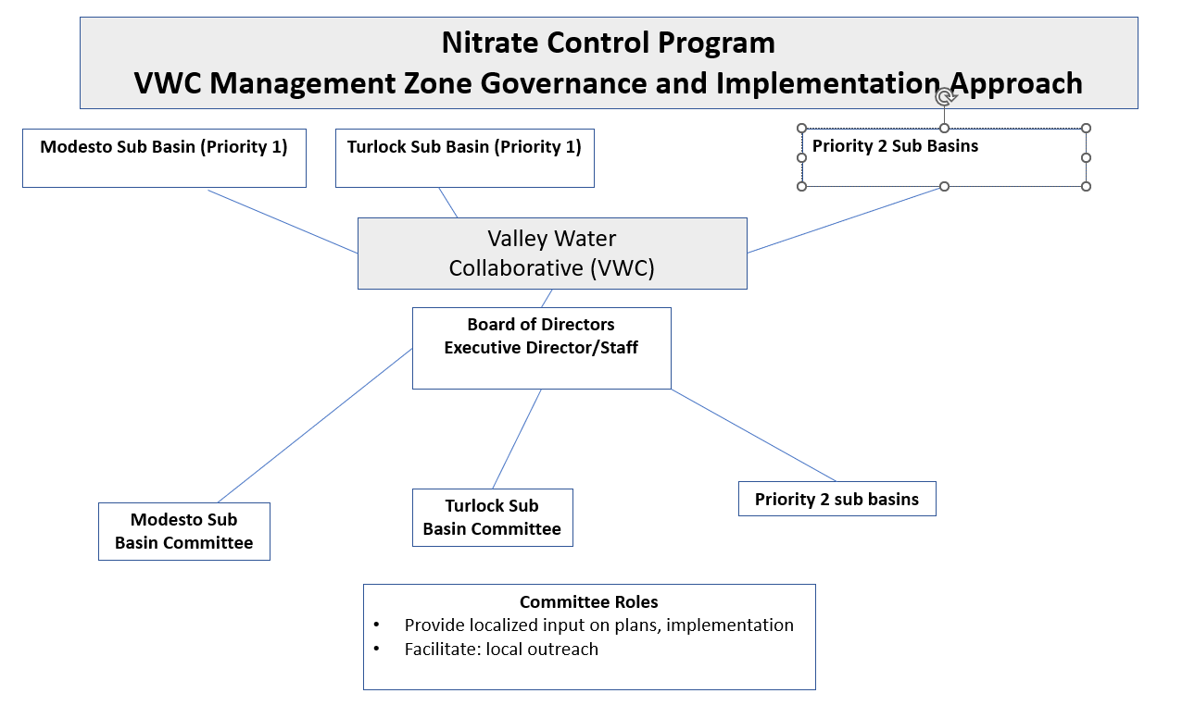
Who is the Valley Water Collaborative?

Slide 7

Valley Water Collaborative
Board of Directors
12 Board Members
3 irrigated agriculture
3 food processor/winery
2 dairy industry
1 poultry
3 Cities
City/Municipal Participants
Ceres
Delhi
Del Rio East
Hilmar
Hughson
Merced County
Modesto
Salida
Stanislaus County
Waterford

Slide 8

VWC Staff
Parry Klassen
Executive Director
Outreach Team
  Maureen Thompson
  Jesus Nunez
  Eva Dwyer
  Ezra Klassen
Consultants/Contractors
GEI Consultants
Luhdorff & Scalmanini
Geoanalytical
Ready ReFresh

Slide 9
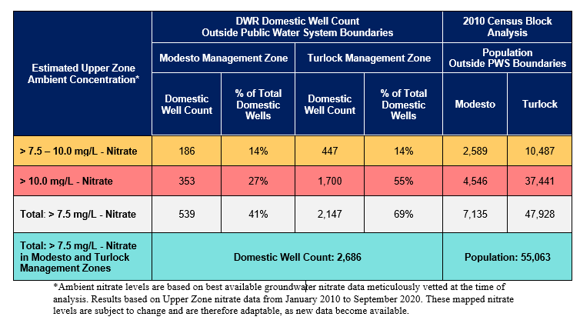
Potentially Impacted Wells and Populations in VWC Region

Slide 10
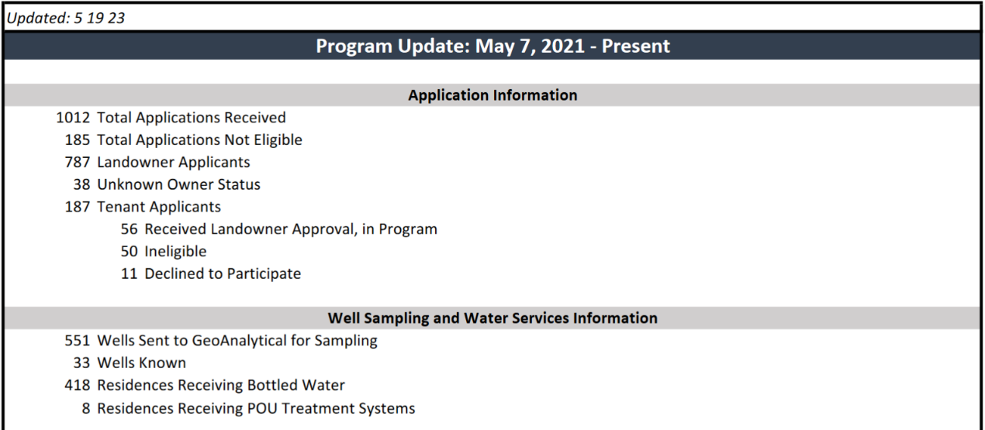
Application Update

Slide 11
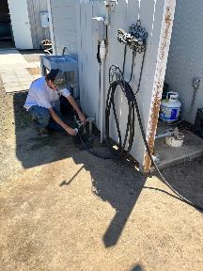
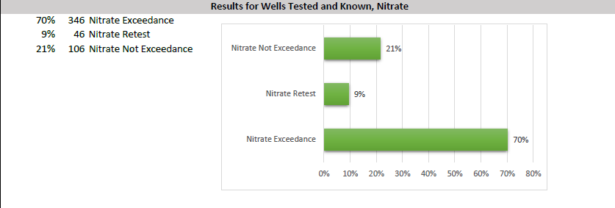
Well Test Results: Nitrate

Slide 12
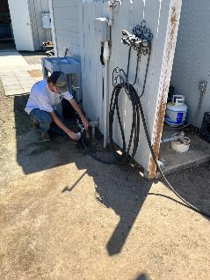
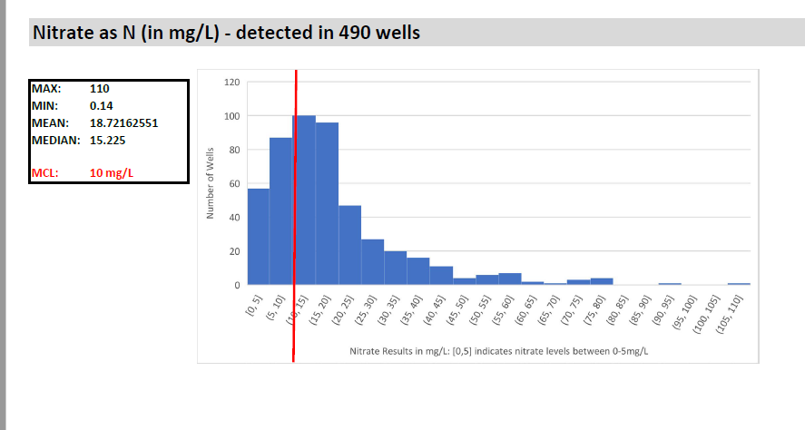
Well Test Results: Nitrate

Slide 13
Expanded Program Update: Safer Grant
SAFER = Safe and Affordable Funding for Equity and Resilience Program
VWC Received SAFER grant to expand program to drinking water co-contaminants
  Arsenic, I,2,3-TCP, Uranium, other locally identified contaminants
Program cost sharing for outreach, administration, replacement water
  SAFER to cover additional cost to analyze for co-contaminants
SAFER program launched January 2022

Slide 14
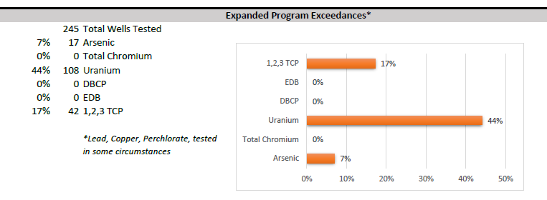
Well Test Results: Other contaminants

Slide 15
How did you hear about us? MARCH 2022 - PRESENT
Neighbor/Friend/Family Member: 31.77%
Postcard: 23.03%
Newspaper: 20.68%

Slide 16
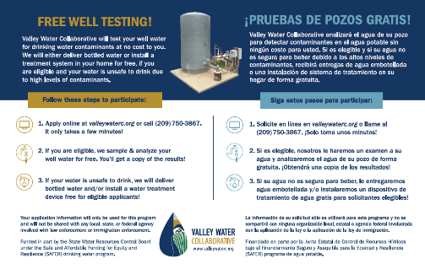
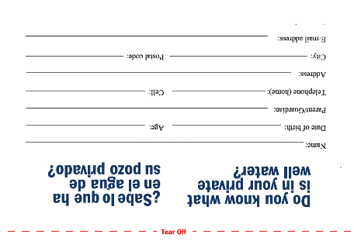
Postcard mailing
Total Postcards Mailed: 6
Total Quantity Mailed: 23,377
NOTES
Final postcard was a return mailer
  5 returns for more information
Final mailing list revised & increased quantity
  From 3,500 to 5,500

Slide 17
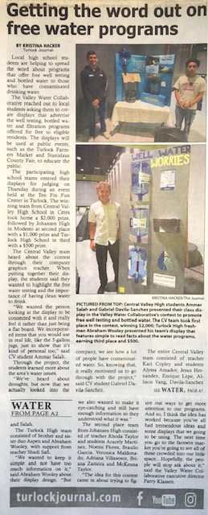
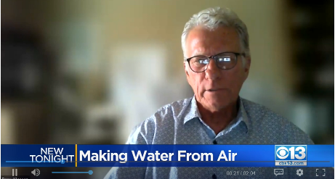
Media
Newspaper: 9 articles; 1,350,584 reach
Spanish Radio: 1 PSA aired 7 times, 1 live event / day = 2 weeks; 69,085 reach
TV: 4 segments; 170,279+ reach
Date | Media Type | Media Outlet | Readership, Viewers, Listeners
4/19/2021 | Newspaper | Modesto Bee | 154,532
6/1/2021 | Newspaper | Modesto Bee | 154,532
3/19/2022 | Newspaper | Modesto Bee | 154,532
3/18/2022 | Newspaper | Turlock Journal | 2,866
3/18/2022 | TV | abc10
4/11/22 - 4/24/22 | Radio | La Favorita Radio Network | 69,085
5/6/2022 | Newspaper | Turlock Journal | 2,866
5/9/2022 | Newspaper | Modesto Bee | 154,532
5/11/2022 | Newspaper | Ceres Courier | 19,000
8/5/2022 | Newspaper | Modesto Bee | 154,532
8/6/2022 | Newspaper | Sacramento Bee | 553,192
8/8/2022 | TV | CBS 13, CW31 GoodDay | 170,271
8/22/2022 | TV | abc10
12/13/2022 | TV | YouTube - "Notes with Knightsby" Channel | 8

Slide 18
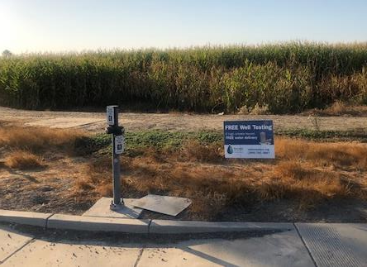
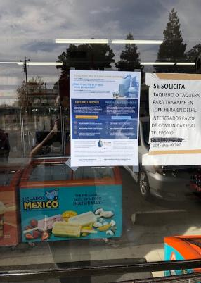
Flyer & Street Sign distribution
Total Flyers Distributed: 1835
Flyer Locations: 71+
Street Sign Distribution: 64
AREAS OF FOCUS
New and Existing Businesses:
  Waterford
  Ballico
  Denair
  Delhi
  Hughson
  Southern Turlock
  All flyers and street signs in English and Spanish

Slide 19
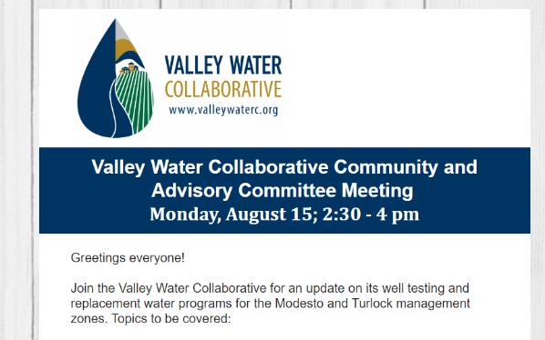
EMAIL BLASTS
Total Individuals Emailed: 38,777
Total Emails: 40
  INCLUDED TOPICS
Email sent to bottled water recipients encouraging them to spread the word, included flyer
High School Display Contest participation
VWC hosted Community Outreach Meetings
Stakeholder Meetings
Plans available for public comment, with links

Slide 20
Presentations & Meetings
Total Presentations: 31
Total in Attendance: 814
City of Hughson City Council Meeting
Stanislaus County Department of Environmental Resources Water Advisory Committee / Drought Stakeholder Meeting
Yokuts/Sierra Club Meeting
Turlock Unified School District Board meeting
Modesto City Schools Board Meeting
Riverbank Unified School District Board Meeting
Modesto Chamber of Commerce Green Team, Waterford Unified School District Board Meeting
Oakdale Joint Unified School District Board meeting
Merced County Board Meeting
Hilmar Unified School District Meeting
Airport Neighborhood Collaborative
Modesto Chamber of Commerce Water Committee
Delhi County Water District
Opportunity Stanislaus
Turlock Chamber of Commerce
Denair Community Services District Board Meeting
West Turlock Leadership Institute
City of Waterford City Council Meeting
Central Valley Immigrant Integration Collaborative
Municipal Advisory Council Meeting in Denair, Wood Colony, Empire, Salida, Hickman, Keyes, Delhi, Hilmar

Slide 21
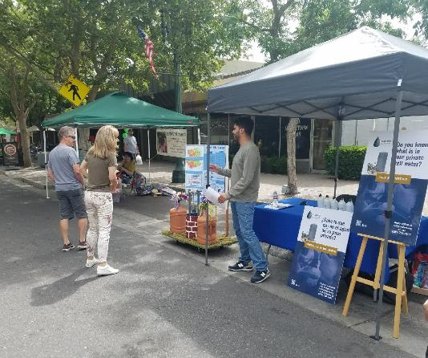
Tabling Events
Total Conversations: 2034
Total Events: 41
United Samaritans Foundation
Turlock Farmers Market
Modesto Farmers Market
4th of July Modesto Celebration & Parade
El Rematito Ceres Swap Meet
Turlock Swap Meet
Oakdale Farmers Market
Stanislaus County Fair
EV Ride & Drive Event (Valley Improvement Project)
West Modesto Community Collaborative

Slide 22
Canvassing: Summary
SUMMARY
AUGUST 2022 - PRESENT
Addresses Canvassed: 1,025
Conversations: 337
Expressed Interest: 212
Expressed No Interest: 119
VWC packets left at homes when there was no answer
AREAS OF FOCUS
Canvassed areas include:
Turlock
Denair
Delhi
Modesto
Ballico
DAC communities are prioritized

Slide 23
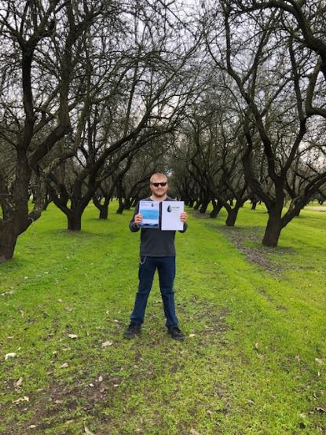
Canvassing: highlights
Respondents are generally very polite regardless of response
People are more receptive when offered info as public awareness
Pets generally are well behaved
Surpassed 1000 canvassed homes!

Slide 24
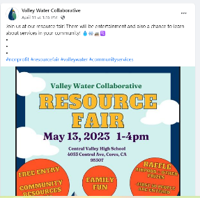
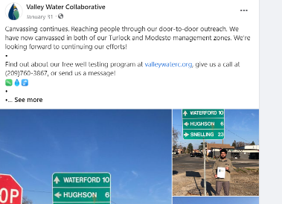
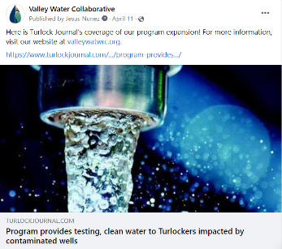
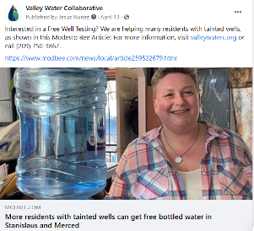
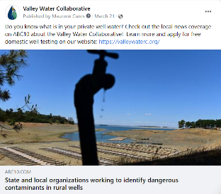
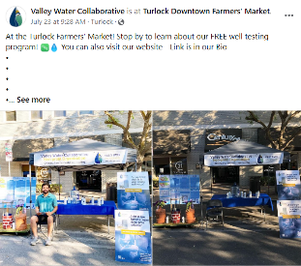
SOCIAL MEDIA
Total Posts: 51
Total Reach: 2419
Total Engagements: 201

Slide 25
UPCOMING outreach activities
  Focus on 400+ water recipients
    -- Email Newsletter
    -- Pilot cash incentives to refer for testing
    -- Continue building relationships
  Increased Social Media
  Spring/Summer Tabling Events

Slide 26

For More information…
Nitrate Control Program
  https://www.cvsalinity.org/nitrate-program/
Valley Water Collaborative
  www.valleywaterc.org
Contact Parry Klassen
  klassenparry@gmail.com
  559-288-8125
Go to website www.valleywaterc.org for:
  Sign-up to receive program updates and notifications
  Past, present and future presentations about the Management Zones

