Slide 1
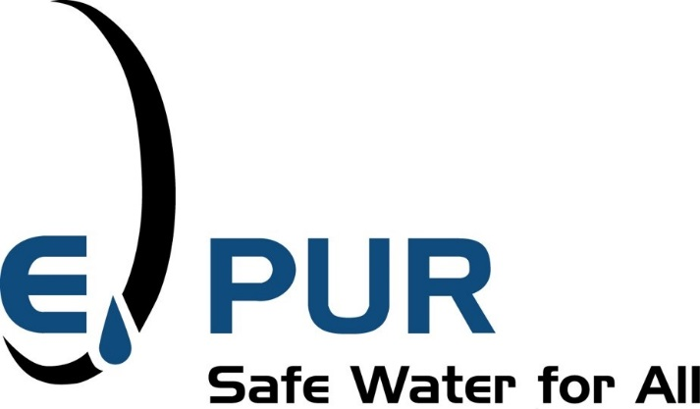
Enhanced Groundwater Recharge Technologies
Presented to Stanislaus County Water Advisory Committee
July 27, 2022
Notes:
We are your projects consultant

Slide 2
Background in Enhanced Groundwater Recharge
E-PUR siting studies for recharge spreading basins, drywells, and aquifer storage and recovery wells
Review of spreading basin performance and O&M
Technology evaluations on a variety of methods
Enhanced recharge modeling
Recharge system design and specifications
Recharge system operation and monitoring

Slide 3
The source of the surface water governs
When is it legally available within a water year?
What’s the rate when you have it?
What’s the volume when you have it?
What’s the timing of development of that source?
capital planning
project development planning

Slide 4
Local Assessments of Groundwater Recharge
Groundwater Recharge in Dry Creek of Modesto for Stanislaus County
Timing and Availability of Water
Potential recharge sites and flood water hold locations
Water availability for water rights in the Dry Creek
Review of recent flood water rights filings on the Tuolumne and Merced Rivers
Eastside Water District
Percolation pond siting for EWD
Pilot study of drywells
Cost analysis of broad scale enhanced groundwater recharge in the region

Slide 5
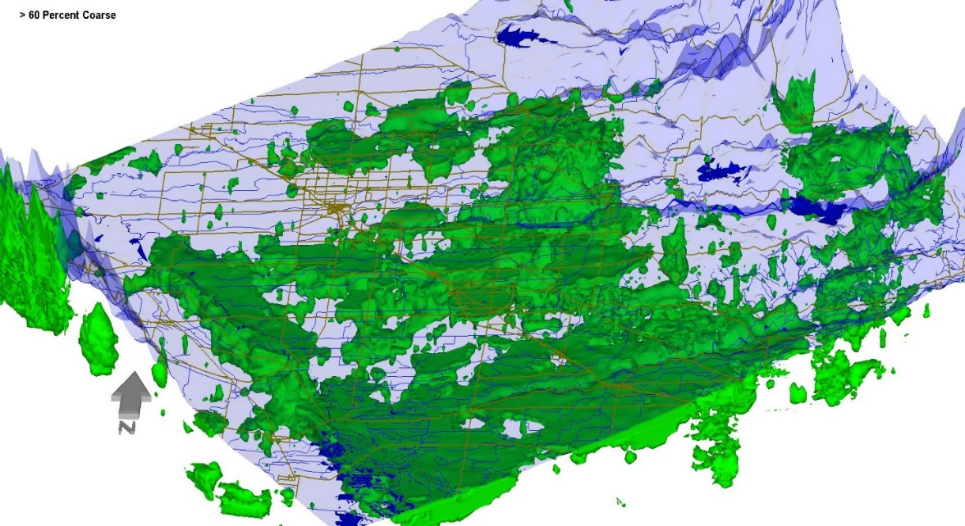
A Local View of Groundwater Recharge Zones
New Melones
Modesto Reservoir
City of Modesto
Turlock Lake

Slide 6
Enhance Groundwater Recharge Nearby
In-lieu recharge using transferred water from Merced ID
Streambed leakage in the Dry Creek of Merced County using Merced ID water
Drywells in Merced Subbasin for Merced River Diverted Water
Drywells in Mustang Creek using floodwaters held
Notes:
Dry Creek evaluation for water available to a water right

Slide 7
Some Stanislaus County Area Opportunities for Enhanced Groundwater Recharge
Drywells for Injection
Streambed Leakage and Canal Leakage
Agricultural Aquifer Storage and Recovery (Ag-ASR)
Percolation Ponds or Spreading Basins
Exfiltration Galleries (a.k.a. reverse tile drains)
Field flooding
Notes:
In-lieu gets talked about as drop for drop of water but in reality it is not, it is however typically the lowest cost and most certain form of groundwater recharge
Lake leakage is a local possibility

Slide 8
Some Broad Challenges for Enhanced Groundwater Recharge
Lack of statewide policy(ies) on injection technologies
Regional agencies have to follow current law – project specific
Drywell standards – Sources and Methods
Aquifer Storage and Recovery – Sources and Methods
Could be aided by General Orders from SWRCB like those for low risk, low volume waters (e.g. hydrant flush water)
In-stream LSA permits from CA Fish and Wildlife structures
Water rights accounting for Climate Change and FIRO
Notes:
Lake leakage is a local possibility

Slide 9
Questions? John Lambie (209) 451-5933 jlambie@e-purwater.com

