Slide 1
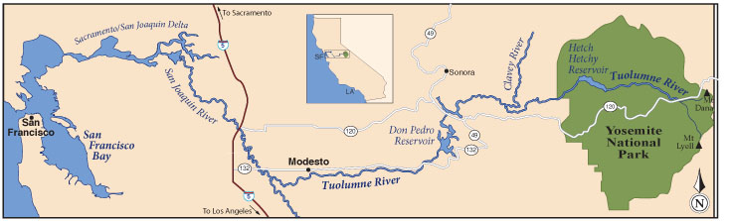
The Tuolumne River
From Yosemite to San Francisco Bay
Notes:
1

Slide 2
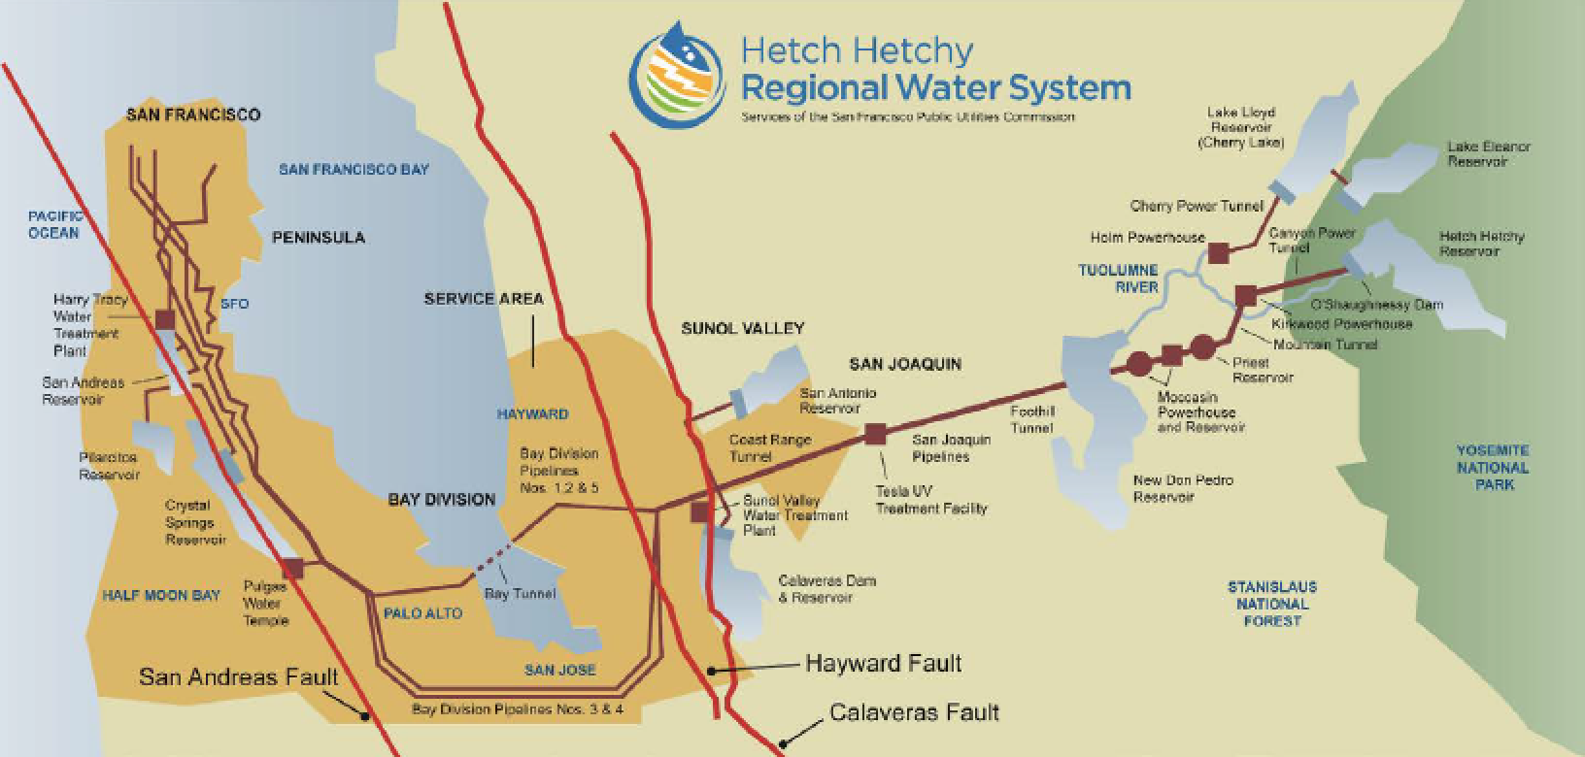
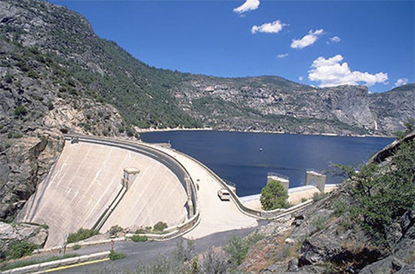
The Tuolumne River
Notes:
2

Slide 3
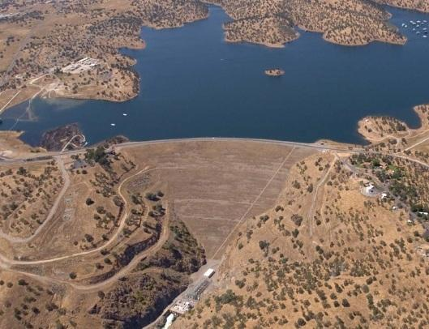
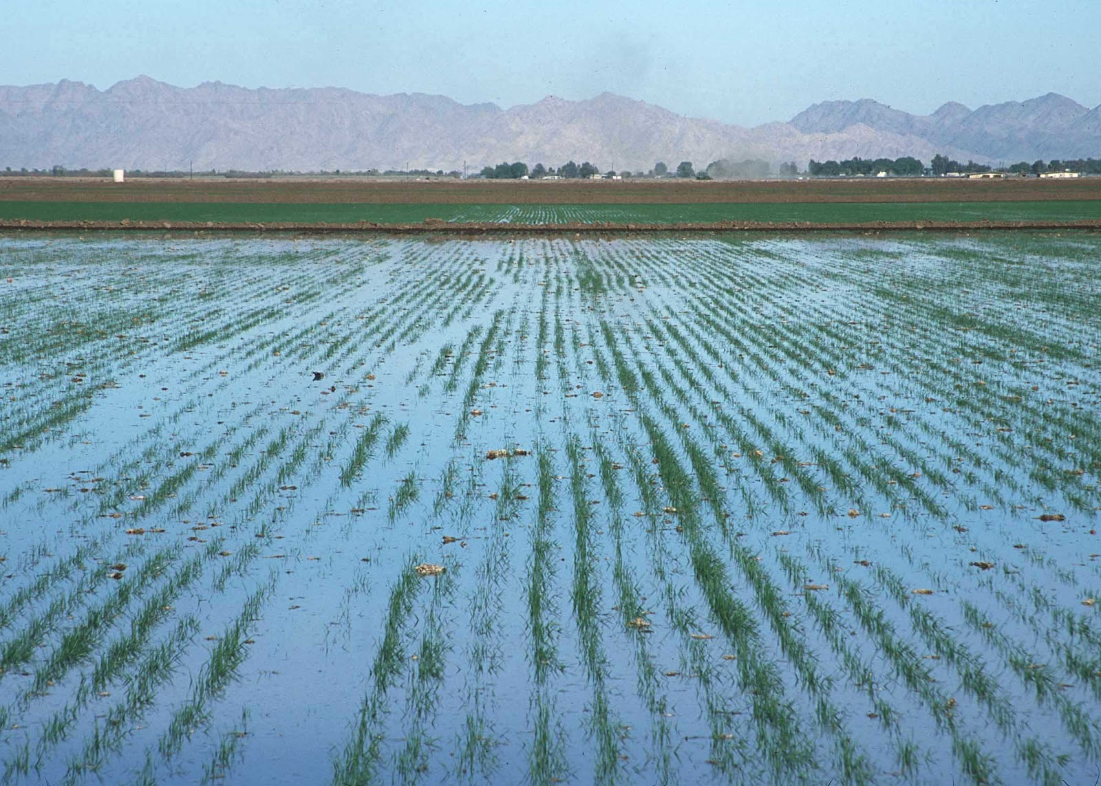
Notes:
3

Slide 4
Notes:
4

Slide 5
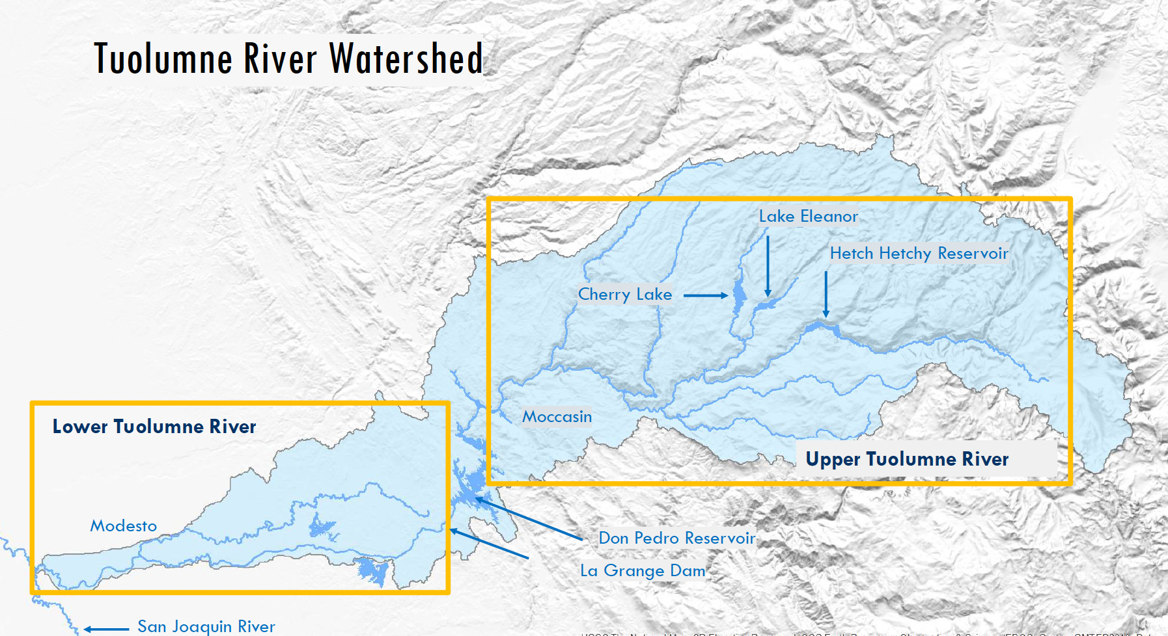

Slide 6
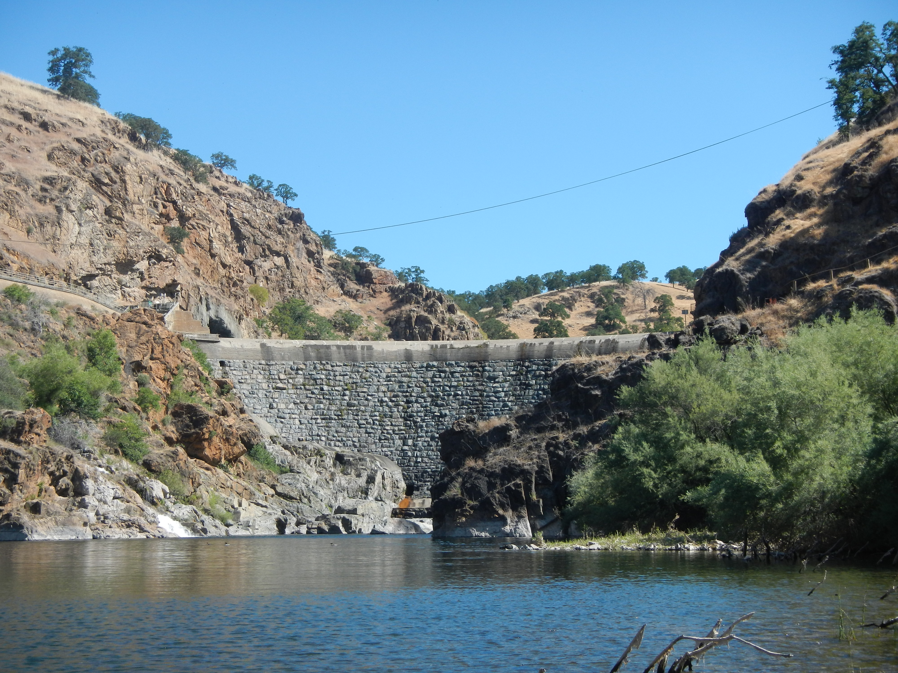
La Grange Dam
Notes:
6
Here’s the Don Pedro Reservoir, which is created by the Don Pedro Dam. It’s 600 feet tall, so it’s impossible for fish to get past it. That’s why the rainbow trout upstream can make it to the ocean to become steelhead.
The first reservoir we talked about was Hetch Hetchy, and that’s where a lot of the Bay Area gets it’s drinking water. Do you remember where the water stored in Don Pedro goes? That’s right, it’s used for farming.
On the downstream side of Don Pedro Dam is where we start to see steelhead trout and salmon.

Slide 7
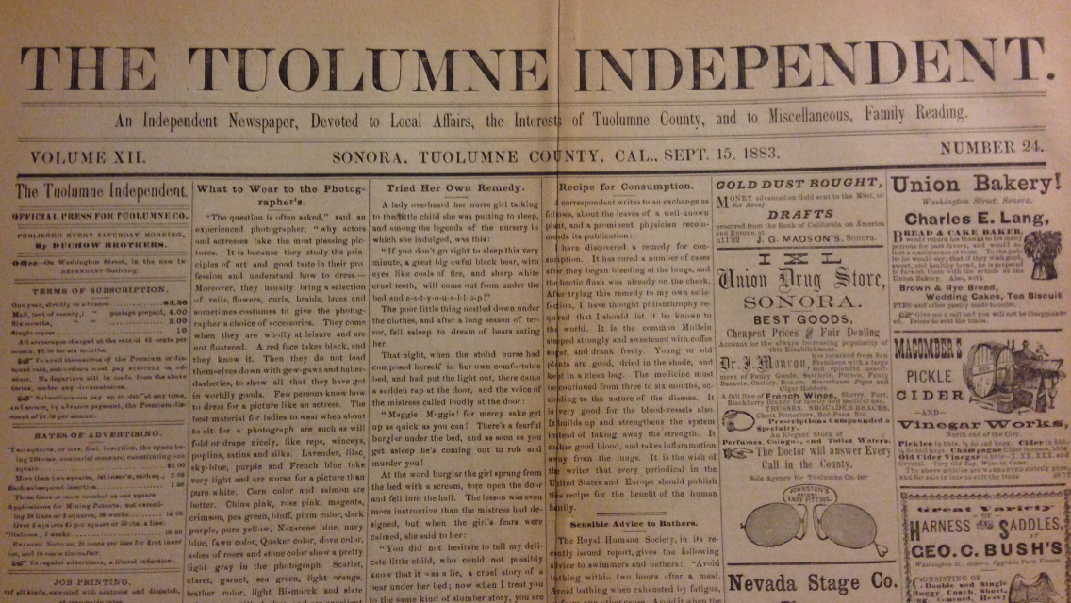
“We Want a Fish Ladder – Considerable complaint is manifested, from time to time, regarding the dam that retards the fish from ascending the Tuolumne at La Grange…The worthless fish-ladder that was put in, some two years ago, washed out…We are informed that the water at the foot of the dam is now literally alive with salmon trying to ascend the river…”

Slide 8
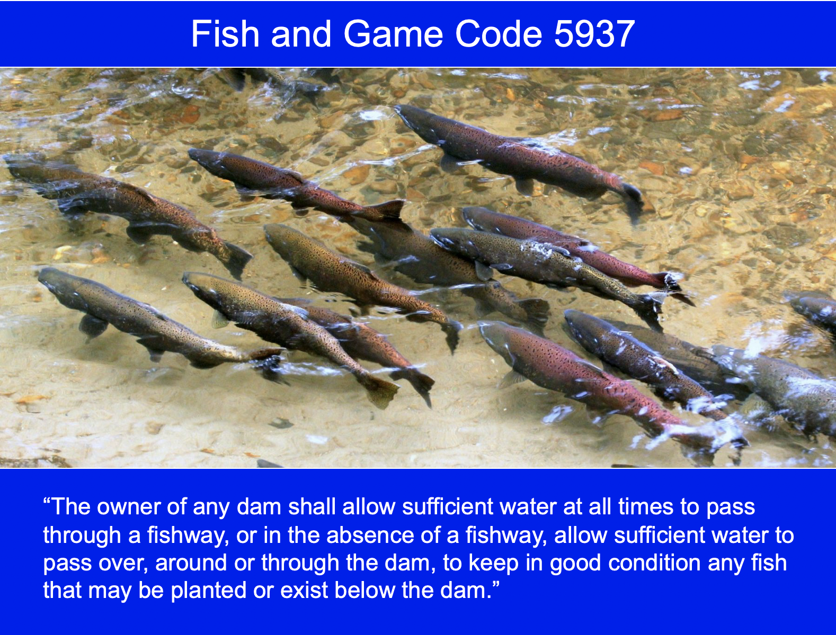

Slide 9
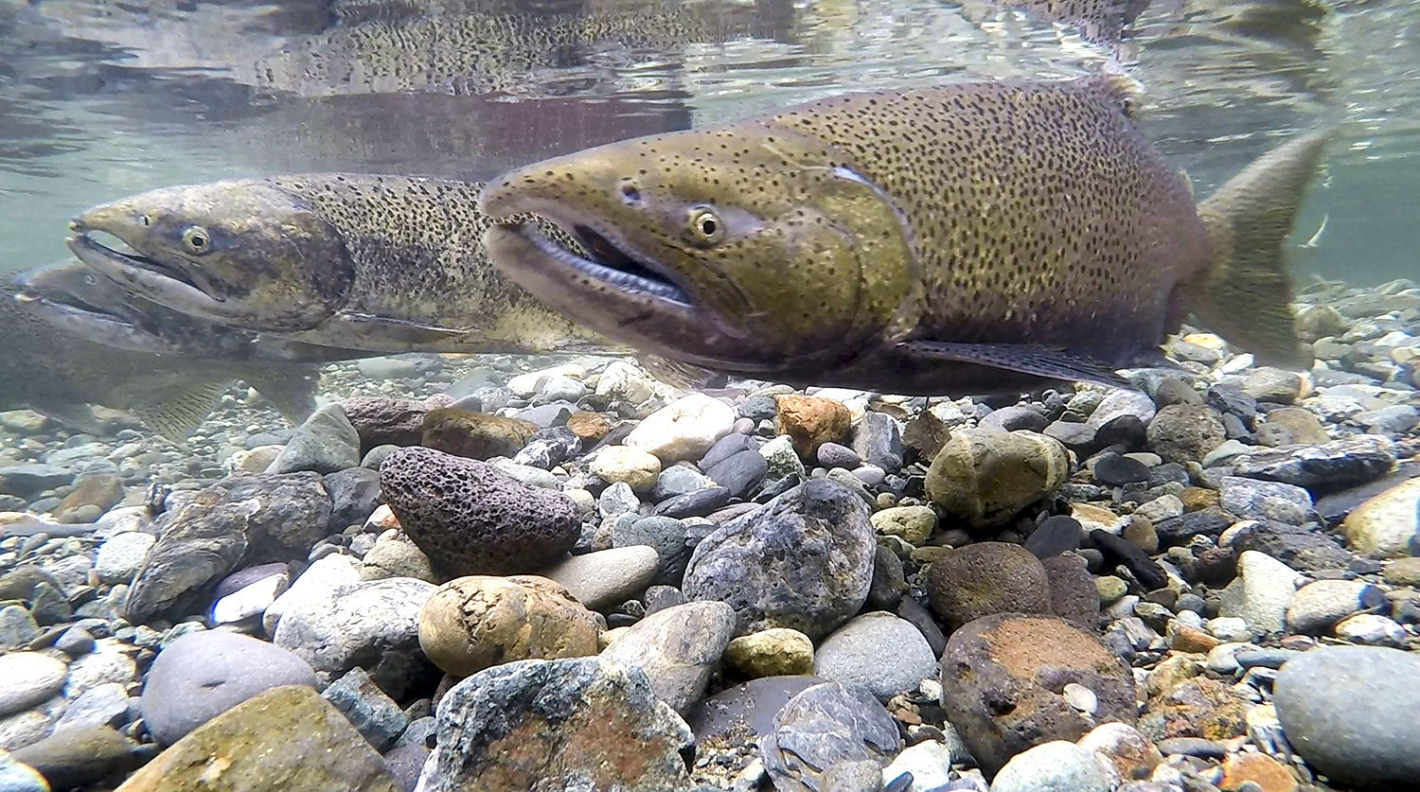
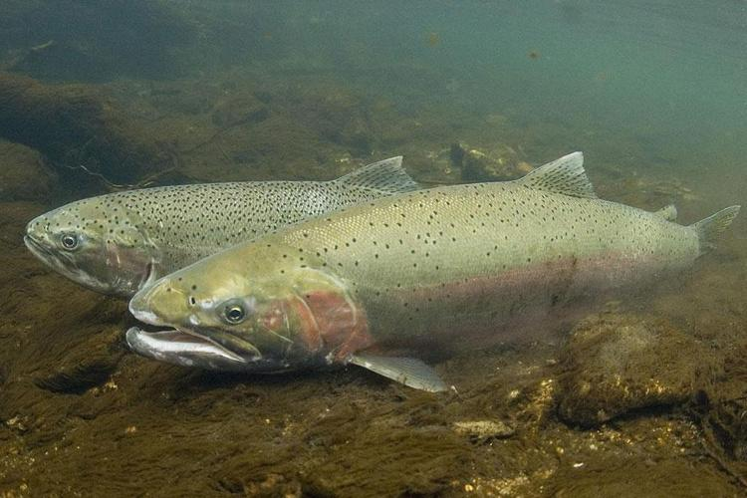
Dams Have Had a Big Impact on Fish
Steelhead Trout
Spring-Run Chinook Salmon

Slide 10
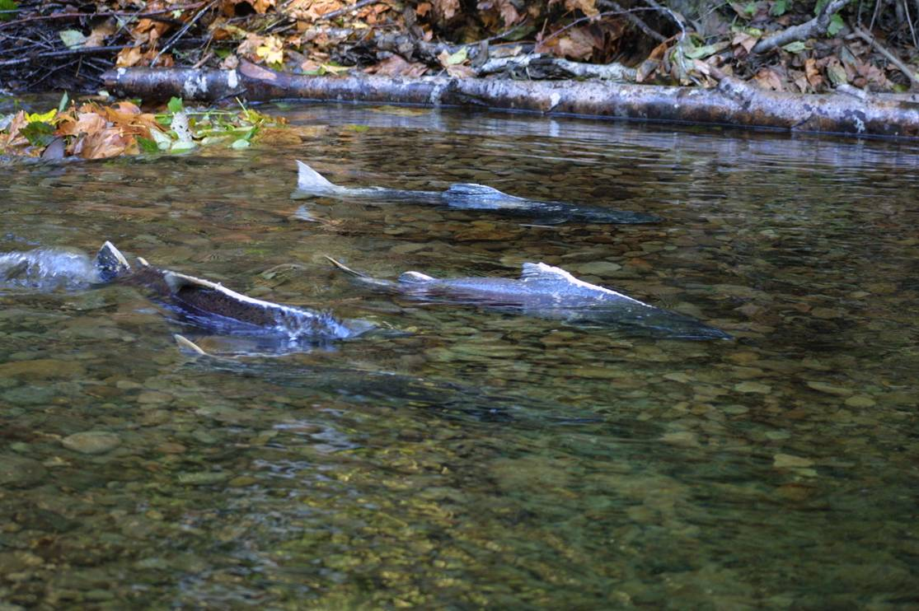
Fall-Run Chinook Salmon
Notes:
10

Slide 11
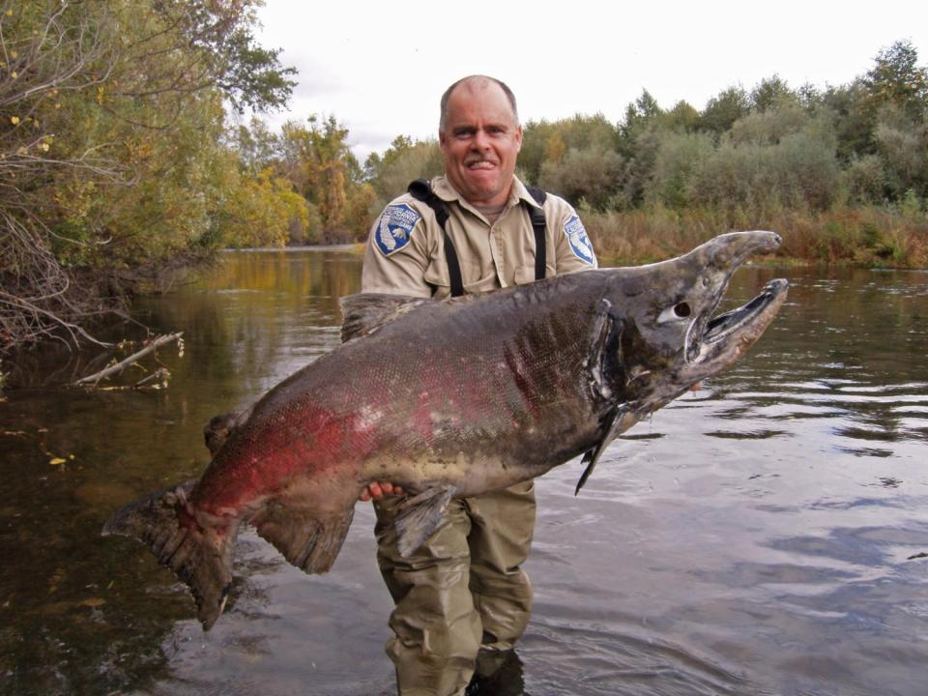
Also Called King Salmon
Notes:
11

Slide 12
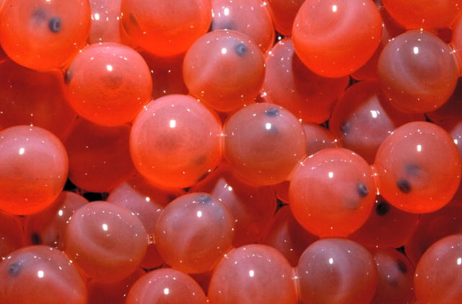
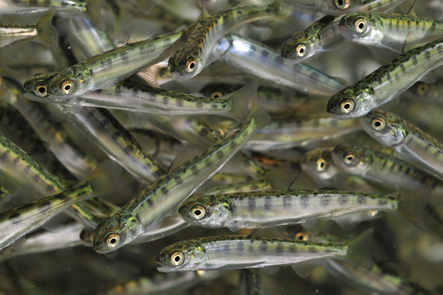
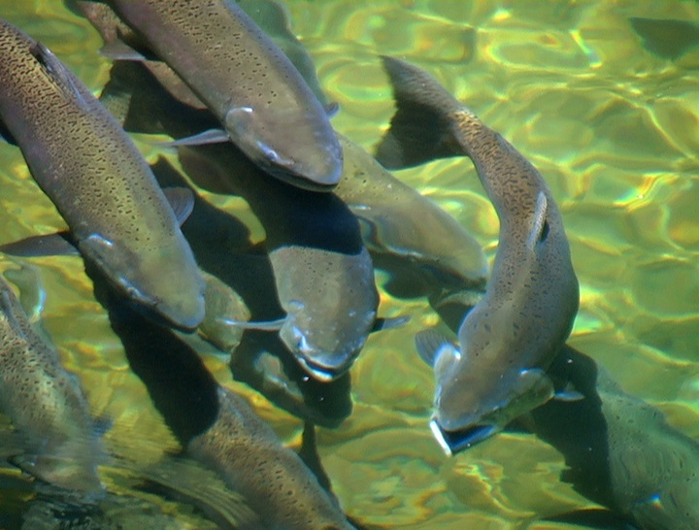
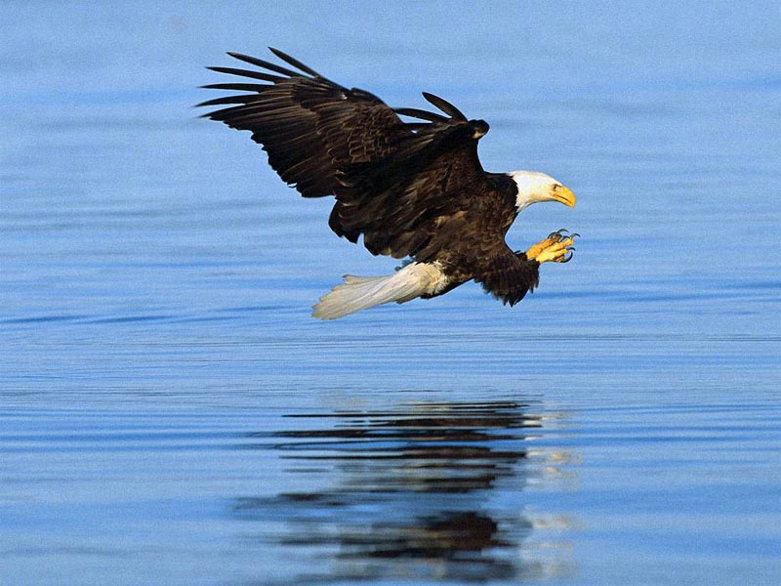
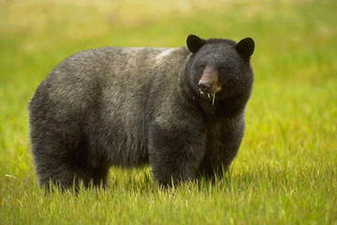
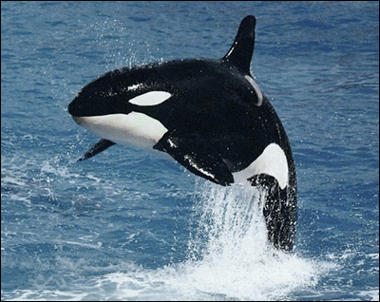
Salmon are a “keystone” species
Supporting other species throughout their life stages
More than 100 species depend on salmon

Slide 13
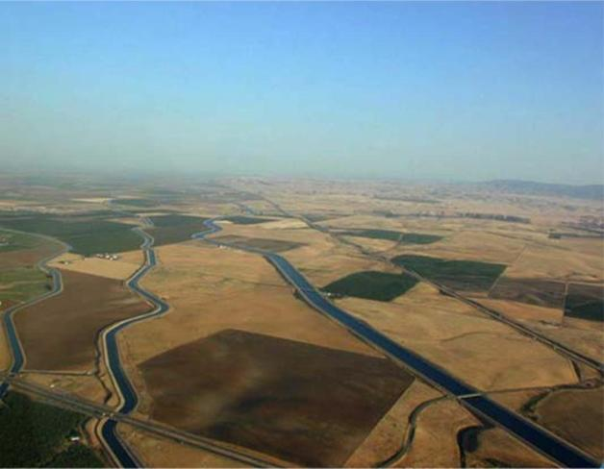
In an average year, only 21% of the Tuolumne reaches the San Joaquin River

Slide 14
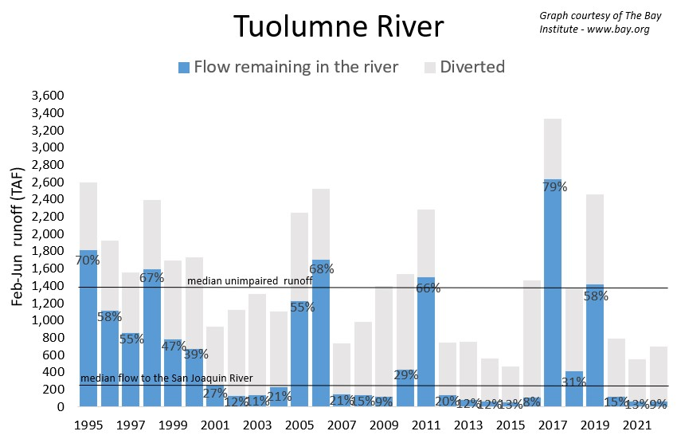
Current Policies Harm the River in Dry Years

Slide 15
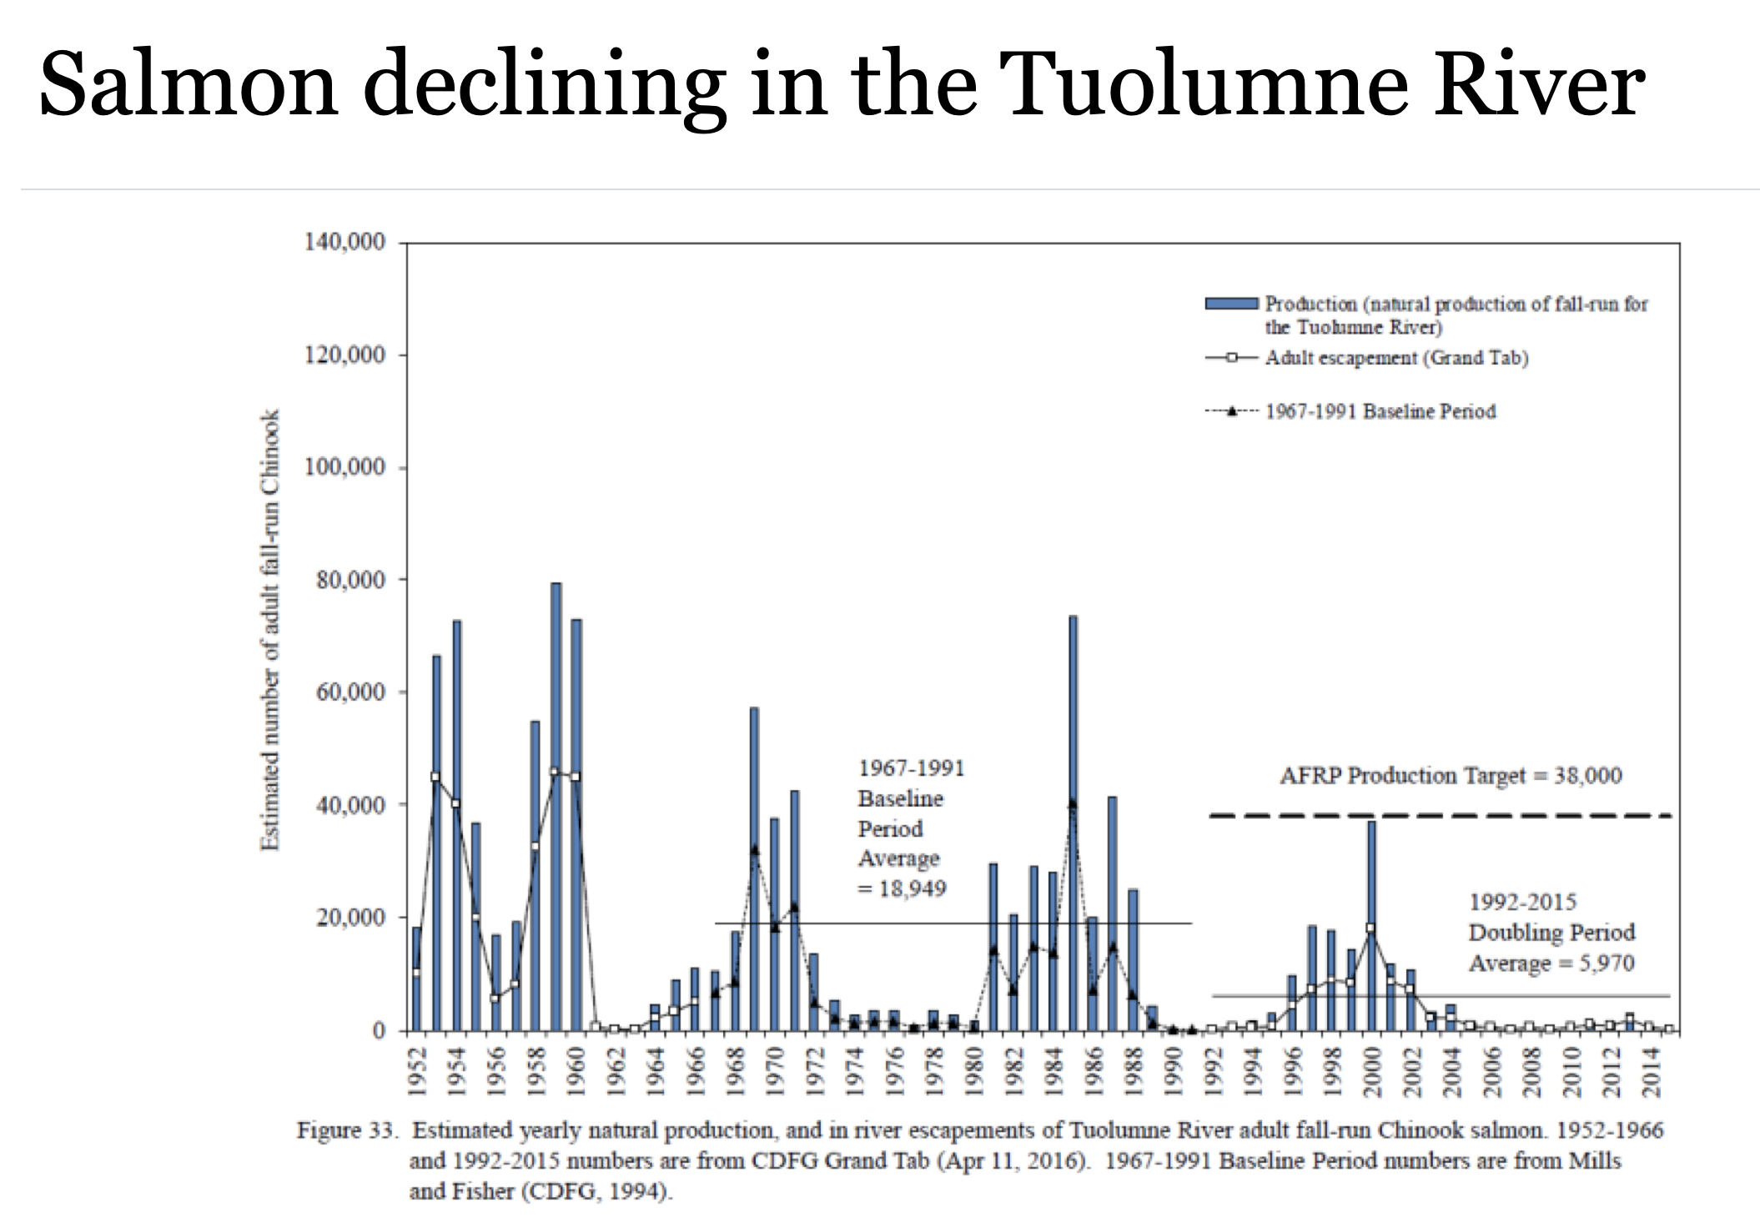
Notes:
15

Slide 16
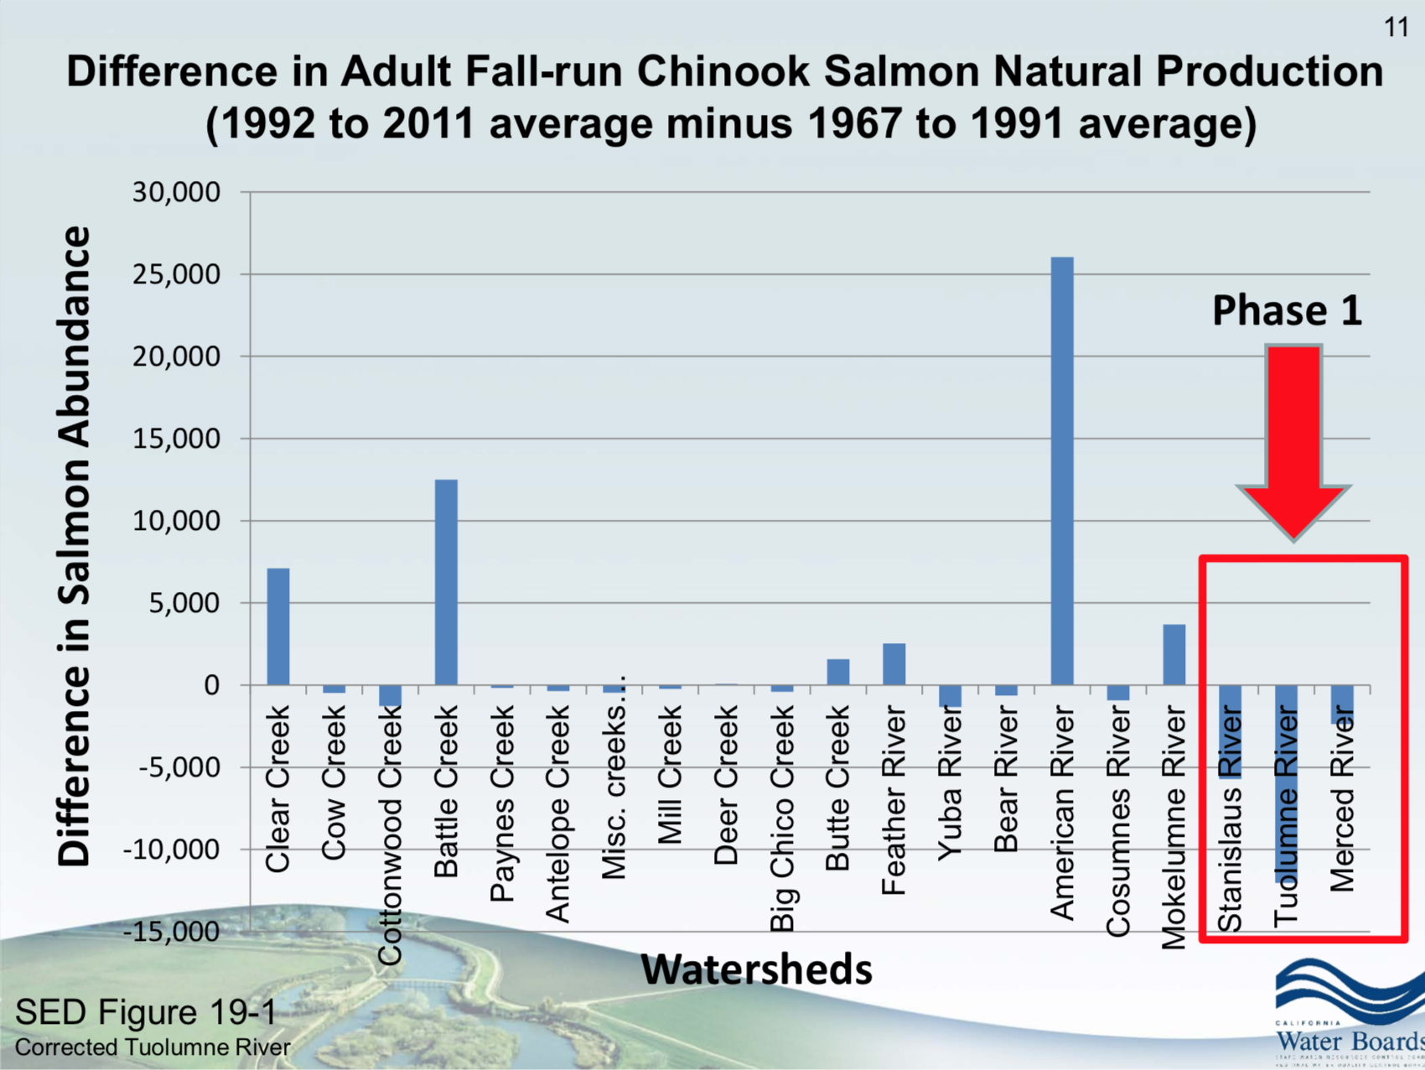

Slide 17
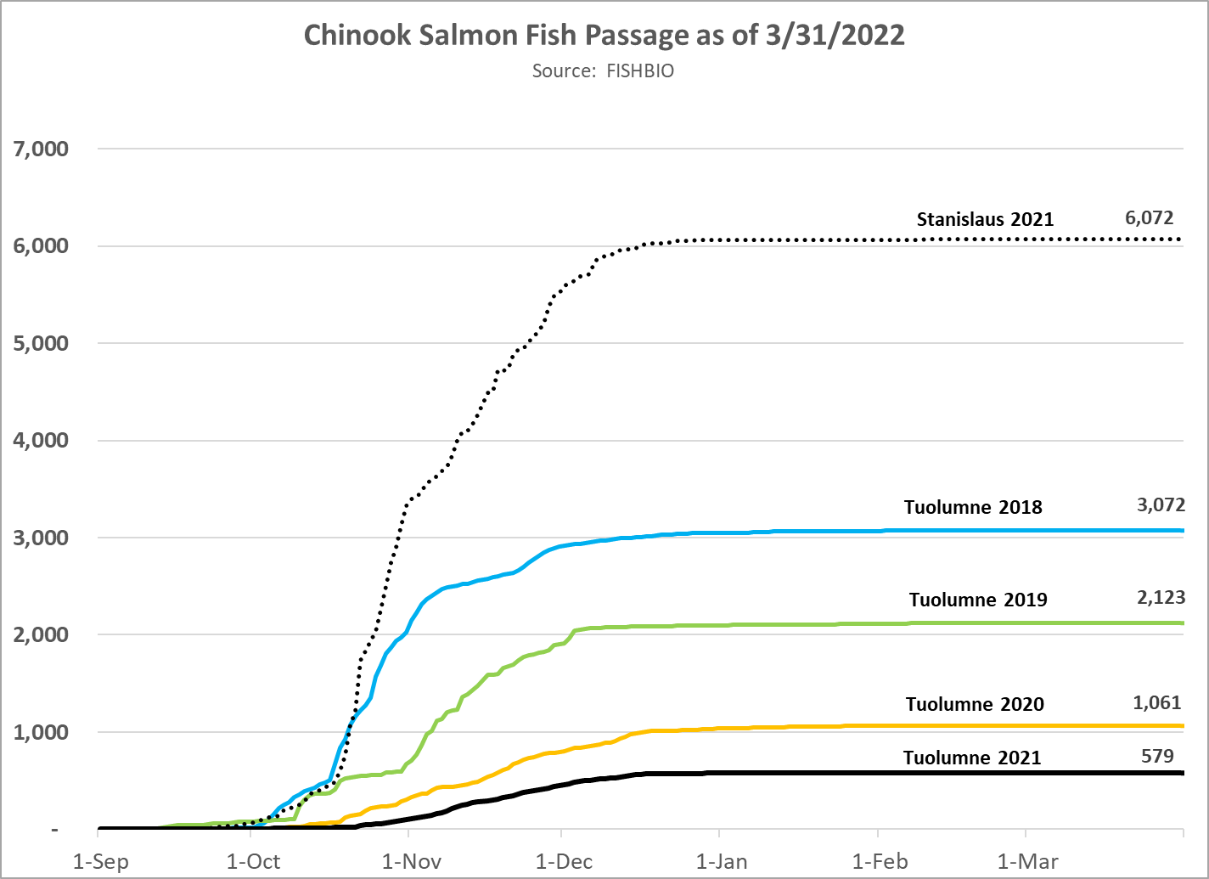
Notes:
17

Slide 18
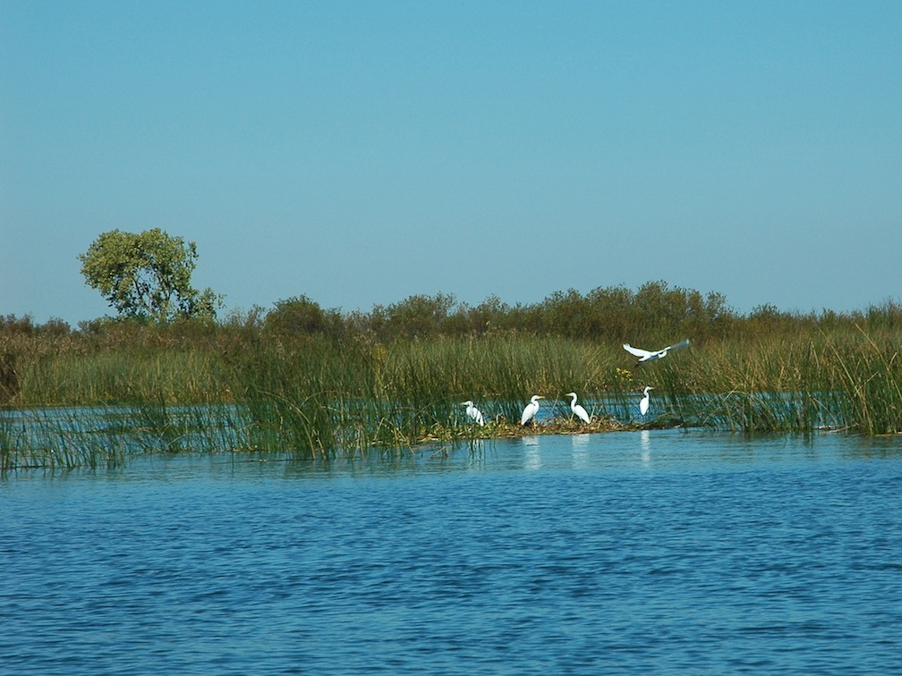
Bay Delta Water Quality
Control Plan
Both habitat restoration and
instream flows are important.

Slide 19
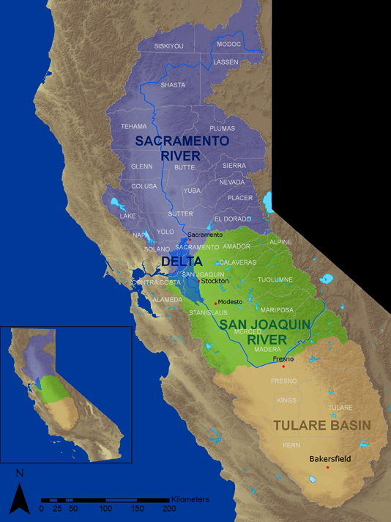
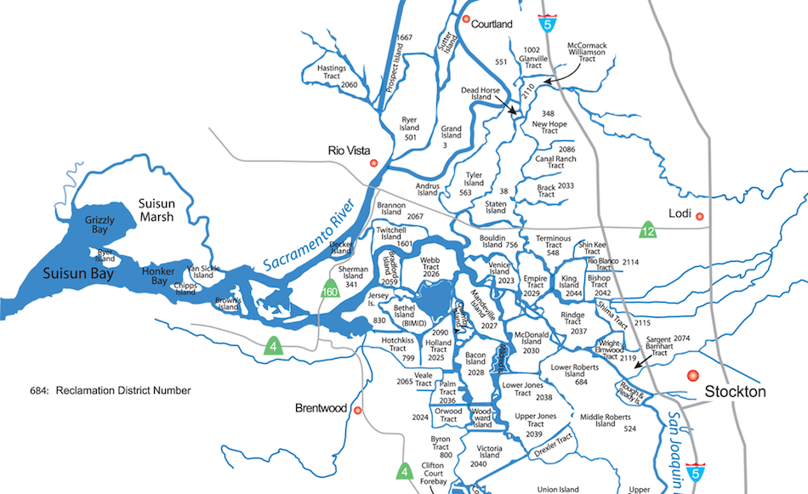
Half of California’s water drains out through the San Joaquin and Sacramento Rivers into the Bay-Delta.
Notes:
Half of the water that falls on California drains out through the Bay-Delta.
The San Francisco Bay-Delta is the largest estuary on the west coast of the Americas.

Slide 20
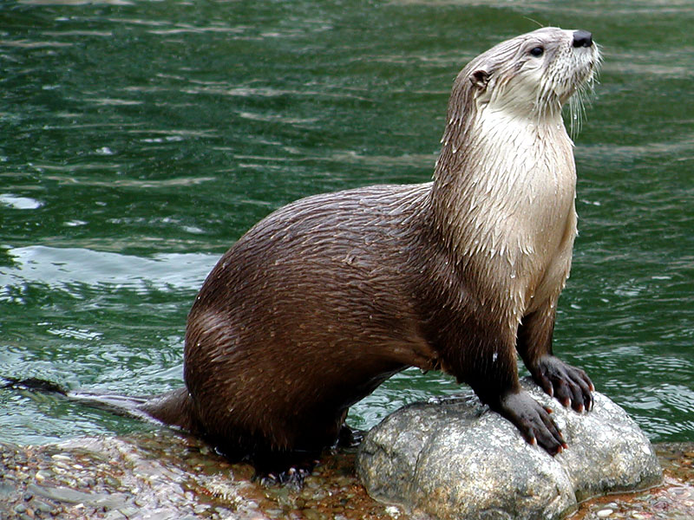
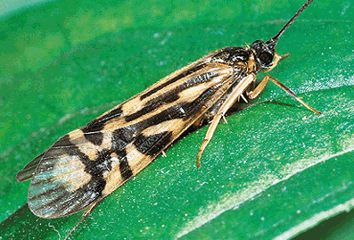
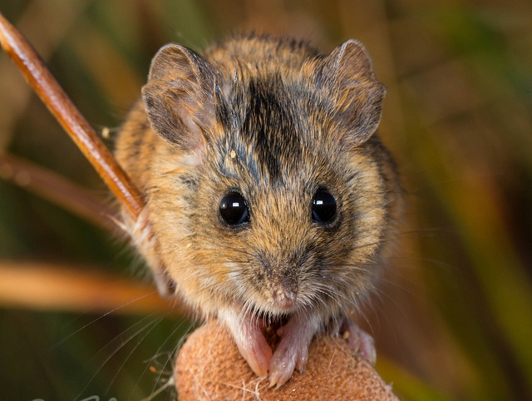
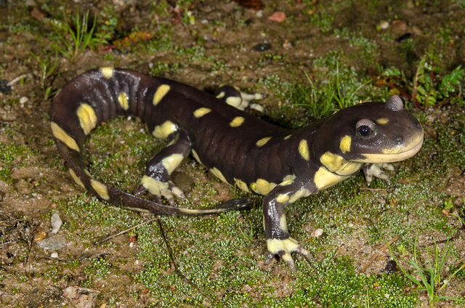
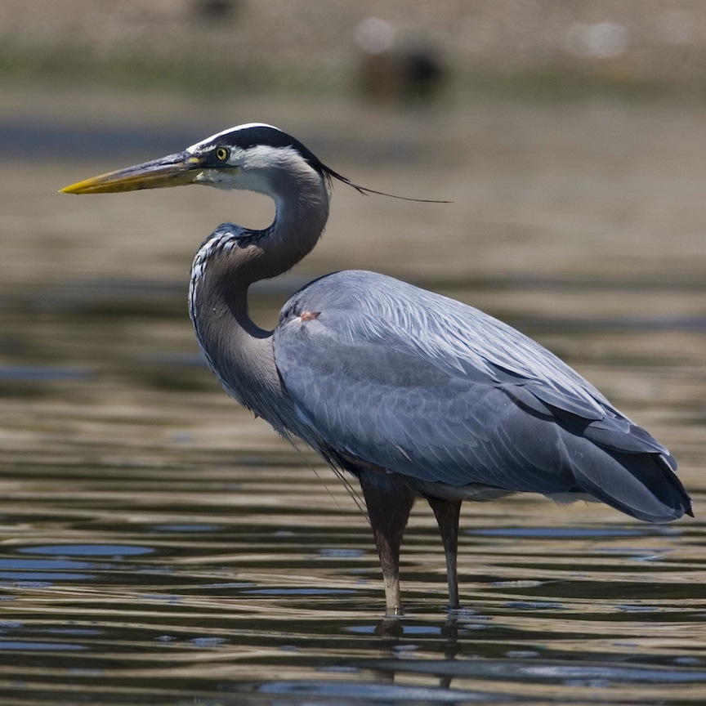
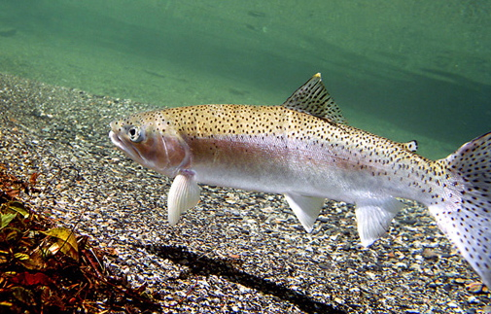
The Delta and its tributaries provide for remarkable biological diversity
Habitat for more than 500 species of fish and wildlife.

Slide 21
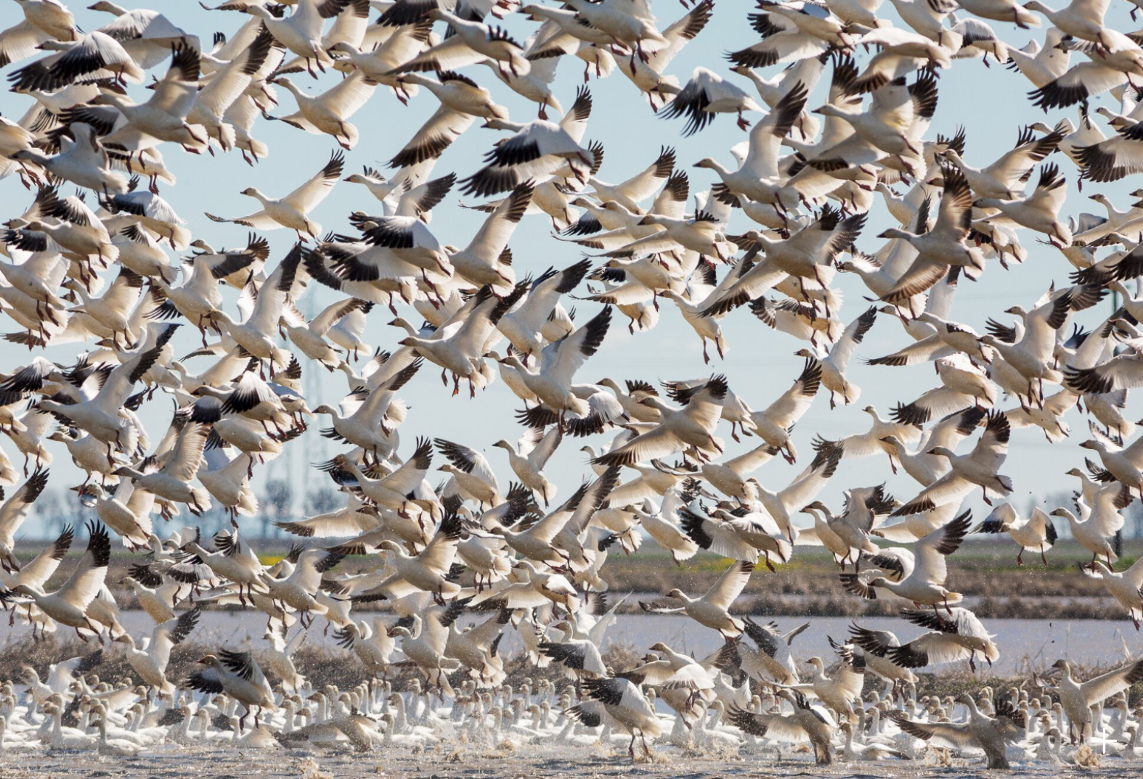
A major stopover for the Pacific Flyway

Slide 22
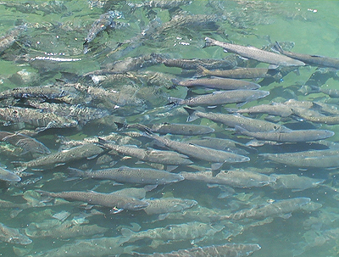
Historically, more than a million salmon spawned in Central Valley rivers each year

Slide 23
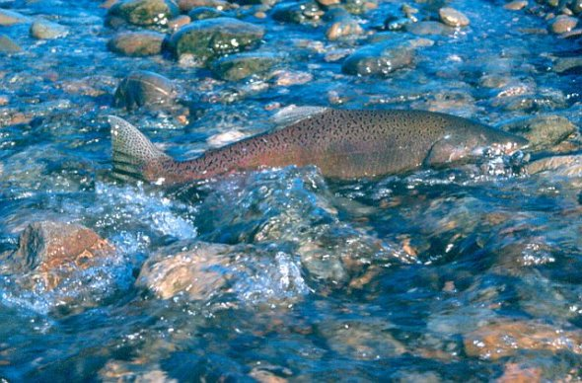
Low flows affect fish migration
Both to and from their natal streams to the ocean.

Slide 24
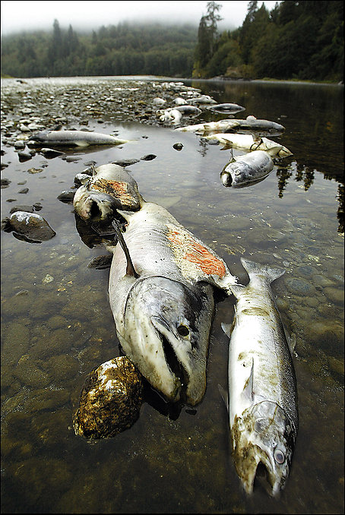
Low flows impact temperature and water quality

Slide 25
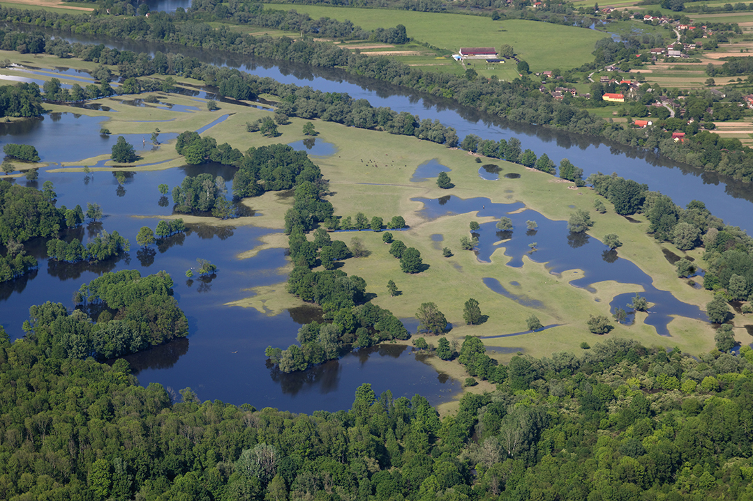
Floodplains are rarely inundated

Slide 26
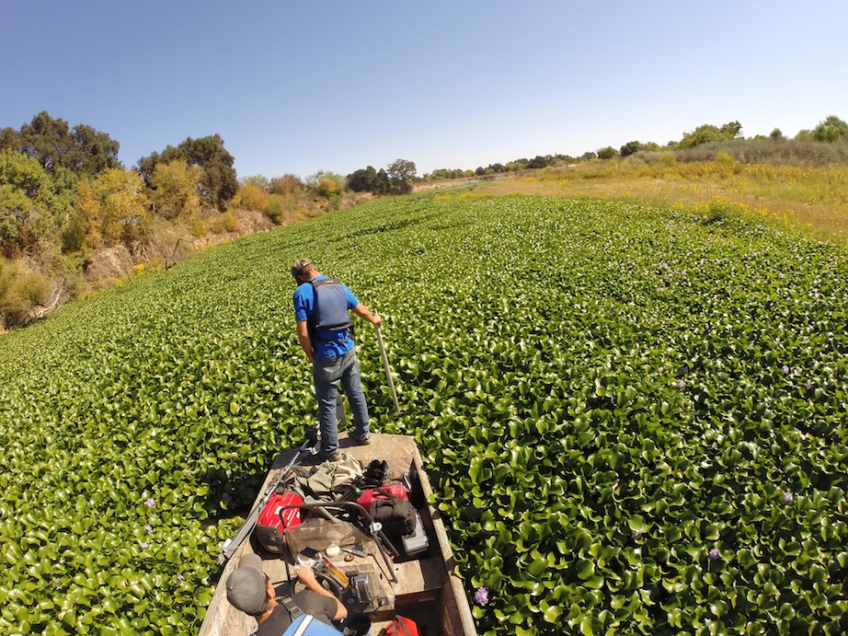
Non-native species thrive under
low flow conditions

Slide 27
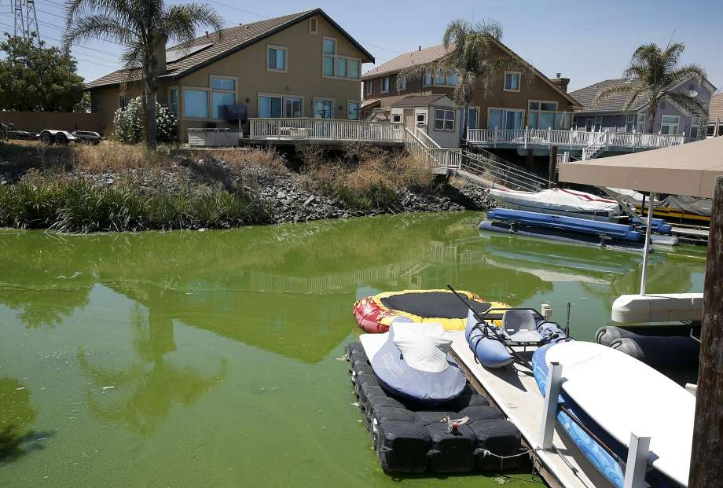
Slow-moving, warm water has led to
toxic algae blooms in the Delta

Slide 28
A Flow Criteria Study Determined
the Need for Higher Unimpaired Flows
“Recent Delta flows are insufficient to support native Delta fishes for today’s habitats. In order to preserve the attributes of a natural variable system to which native fish species are adapted, many of the criteria developed by the State Water Board are crafted as percentages of natural or unimpaired flows. These criteria include:
  75% of unimpaired Delta outflow
  75% of unimpaired Sacramento River inflow
  60% of unimpaired San Joaquin River.”
-State Water Resources Control Board, 2010
Notes:
The State Water Board’s own report, Development of Flow Criteria for the Sacramento-San Joaquin Delta Ecosystem, determined that approximately 60% of unimpaired flow between February and June would be fully protective of fish and wildlife beneficial uses in the three eastside Tributaries and the Lower San Joaquin River when considering flow alone.

Slide 29
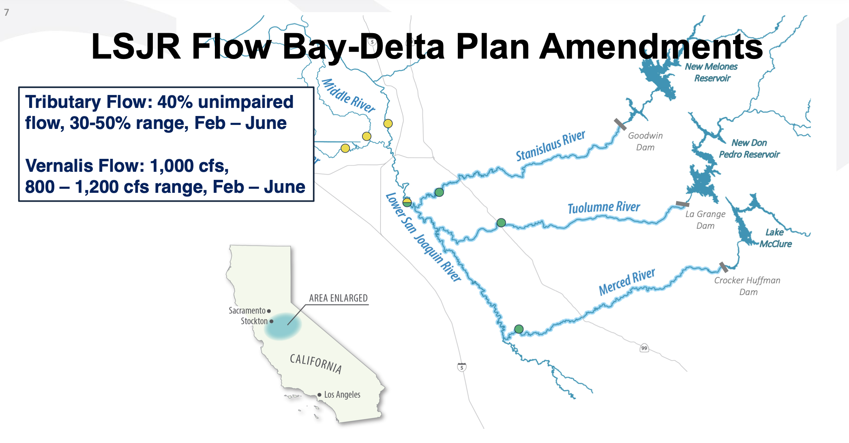
The Bay Delta Plan adopted 40% of
unimpaired flow between February and June
Current Flow Averages
Stanislaus: 40% Tuolumne: 21% Merced: 26%

Slide 30
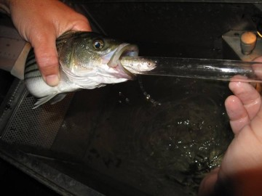
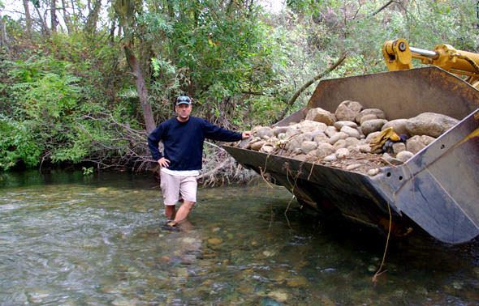
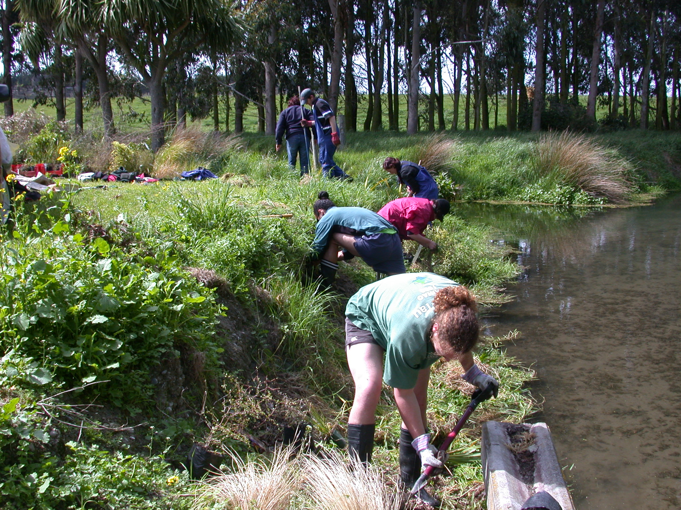
Flows Could Range from 30-50%
of Unimpaired Flow
Depending on whether biological goals are met.

Slide 31
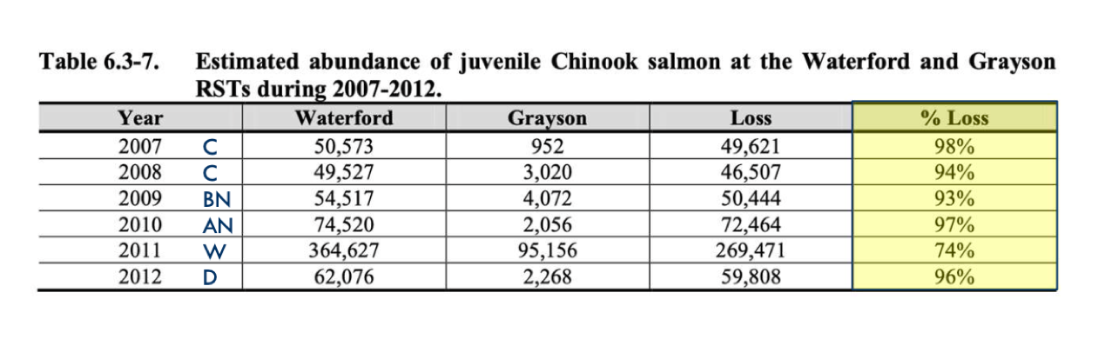
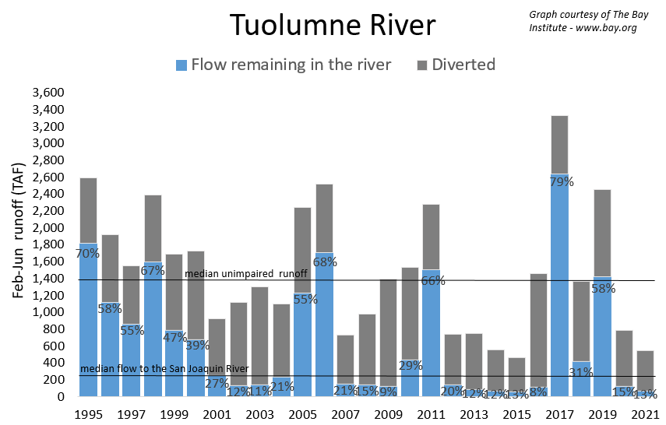
Source: Don Pedro Licensing Predation Study

Slide 32
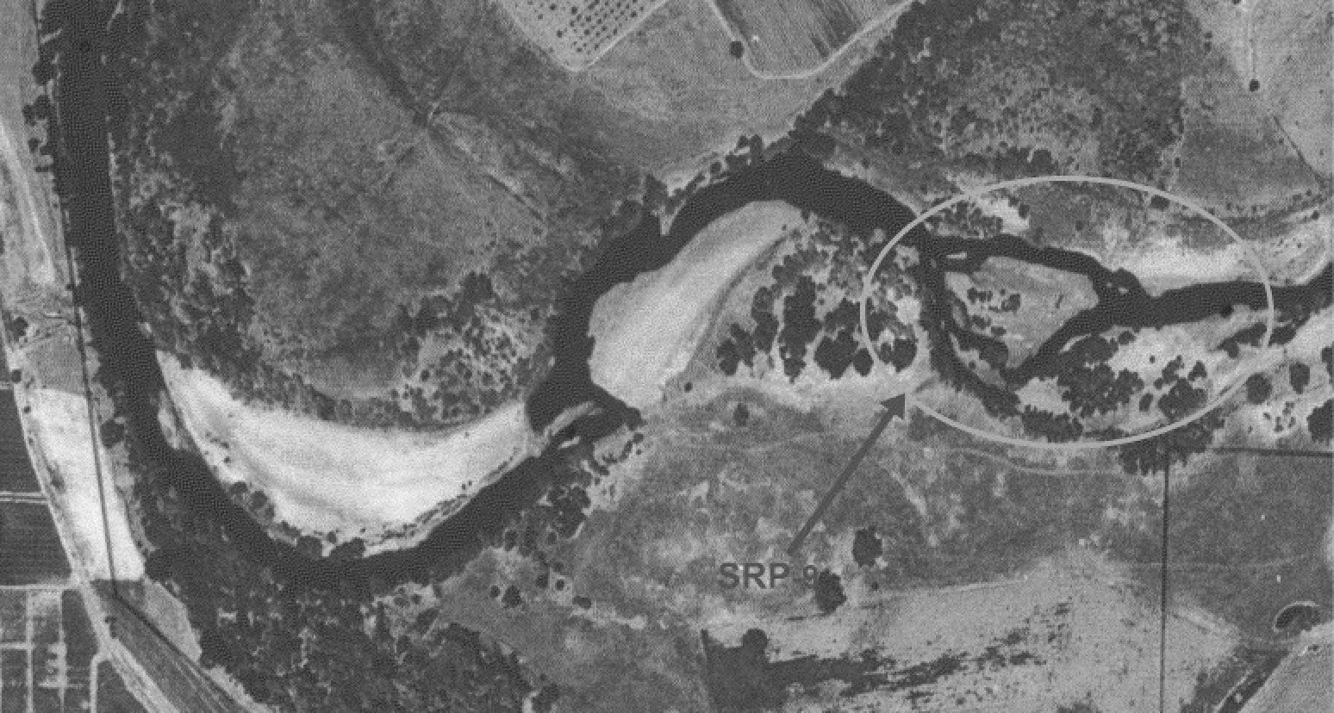
1995 FERC Settlement Agreement
Filling Special Run Pool 9

Slide 33
Irrigation Districts’ Post-Project Monitoring Report
During extremely wet years, high flows can flush largemouth bass out of a stream, but typically a sufficient number of adults can find shelter in flooded areas to repopulate the stream during lower flow conditions. During the years following the flood, largemouth bass abundance was controlled by spring and summer flow conditions that were unfavorable for reproduction. Largemouth bass require low water velocities and warm water temperatures to reproduce.
Notes:
In 2013, San Joaquin Valley irrigation districts bused their supporters to the State Water Board hearing in Sacramento.

Slide 34
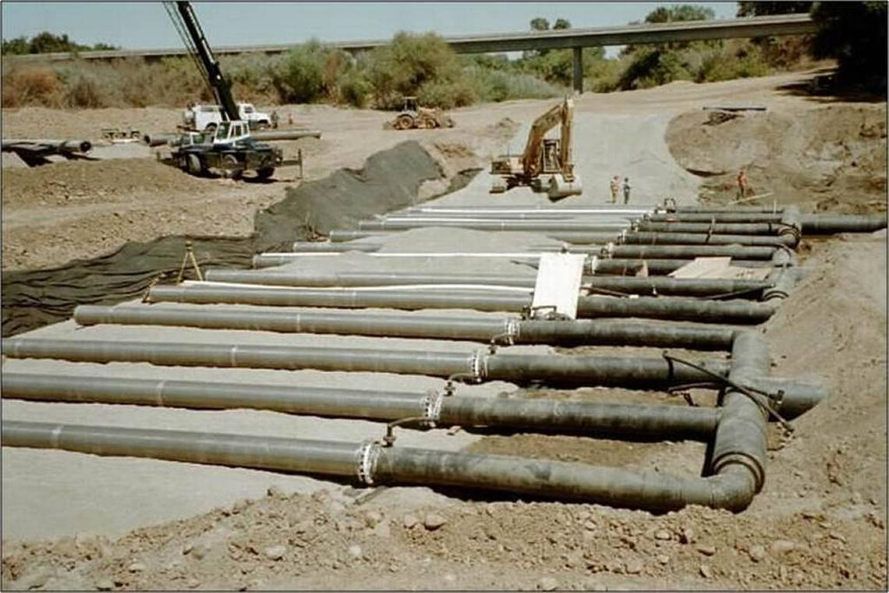
Infiltration Gallery

Slide 35
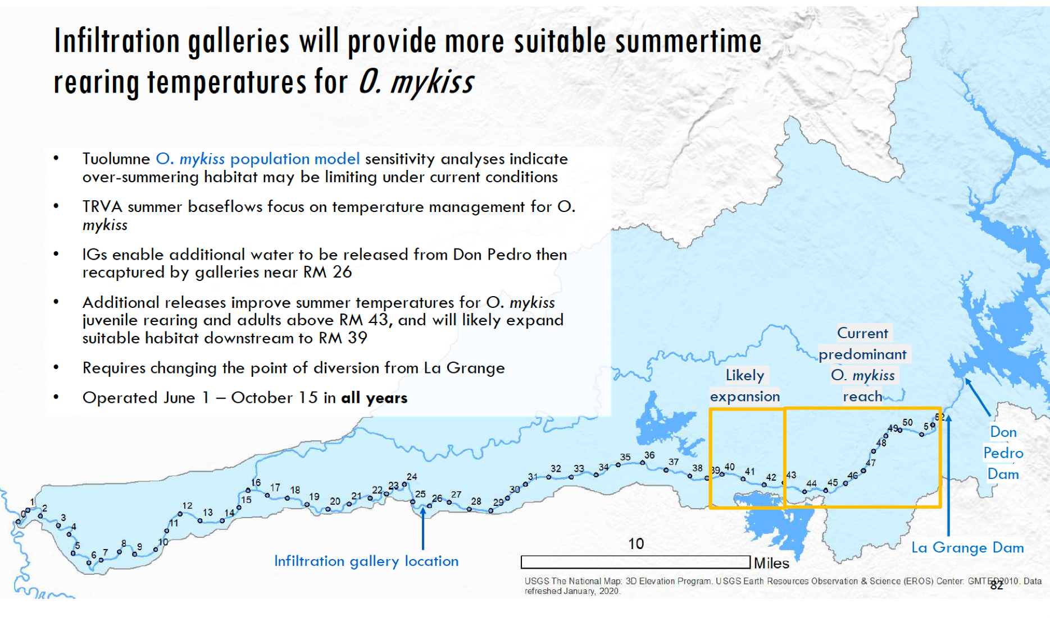

Slide 36
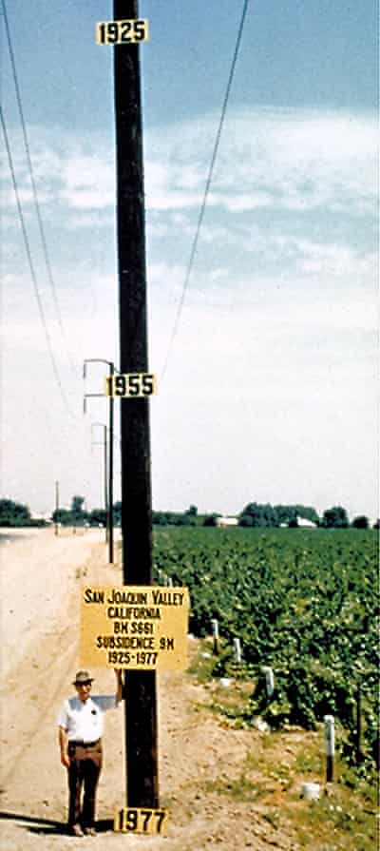

Groundwater Sustainability Plans
Working Together to Manage Groundwater

Slide 37
Current Policies Harm the River in Dry Years

Slide 38


The SFPUC could partner with
the Irrigation Districts to recharge
groundwater in wet years and establish
a water bank similar to Don Pedro

Slide 39



Opportunities for Agricultural Efficiency
A pressurized irrigation enhancement project reduced water
and energy use by 30%, while increasing crop yield by 30%.
Notes:
Through water efficient irrigation practices, and replacing lower-value, water-intensive crops with higher-value, water efficient crops, we could grow more food with less water.
Drip irrigation can double the production per acre of some crops.
Field crops, such as rice and alfalfa, currently account for 56% of irrigated acreage in California. They use 63% of applied water but generate only 17% of California’s crop revenue. Vegetables, on the other hand, account for only 16% of irrigated acreage, and use just 10% of applied water, but generate 39% of California’s crop revenue.
Water efficient irrigation practices and technologies include 1) soil moisture sensors and smart irrigation controllers, 2) real-time weather data, daily evapotranspiration reports and computer models that help farmers irrigate more precisely, and 3) shifting crops from flood irrigation to sprinklers and drip systems.

Slide 40


Slide 41

Amortized over 20 years = $144-$230 per AF
Notes:
The SFPUC could help fund infrastructure improvements in the Central Valley and share in the water savings.

Slide 42

The SFPUC is planning for an extremely unlikely mega-drought
Source: SFPUC
The Design Drought

Slide 43

The SFPUC has the longest drought scenario of California’s major urban water agencis

Slide 44
Drought of Record Repeat
(With Bay Delta Plan flows in place)
Year | Demand (MGD) | Rationing (%) | Storage Reduction (TAF) | Water in Storage (TAF)
=1986 |  |  |  | 1,517
=1987 | 198 | 0 | 450 | 1,067
=1988 | 198 | 0 | 319 | 748
=1989 | 198 | 0 | 42 | 706
=1990 | 198 | 0 | 289 | 417
=1991 | 198 | 0 | 97 | 320
=1992 | 198 | 0 | 242 | 78
If the worst drought on record were to repeat, and the Bay Delta Plan flows were in place, the SFPUC could manage the drought without requiring any rationing or developing any new water supplies.

Slide 45

SFPUC Tuolumne Storage
Source: SFPUC
At the height of the 2012-15 drought, the SFPUC had enough water to last three years. (Bay Area storage not included.)

Slide 46


Slide 47

Much Has Changed Since the
Design Drought Was Conceived
Water demand peaked at 293 mgd in 1987.
It has been under 200 mgd for the past 8 years.
Source: SFPUC

Slide 48
Much Has Changed Since the
Design Drought Was Conceived
Water demand peaked at 293 mgd in 1987.
It has been under 200 mgd for the past 8 years.
In response to the 1987-92 drought, the SFPUC adopted the “Water First” policy, prioritizing water supply over hydropower generation.
The Long-Term Vulnerability Assessment (LTVA) analyzed water supply vulnerability using tree ring data and 25,000 model runs based on simulated historical data.

Slide 49


Slide 50
“According to climate projections and expert elicitations, there is a central tendency of warming of + 2°C and + 4°C by 2040 and 2070 (Representative Concentration Pathway [RCP] 8.5), respectively, with no clear direction of change in mean annual precipitation over the planning horizon.”
Source: LTVA, p. xxii

Slide 51
The LTVA’s Most Severe Drought
Used 1,200 TAF of Storage
Design Drought (1,309 TAF)
Source: LTVA, Figure 3-29

Slide 52



Tuolumne River Parkway
Parks for people – Habitat for wildlife

Slide 53

Dos Rios Ranch Acquisition

Slide 54




Slide 55

Celebrating 10 Years of Success

Slide 56

La Grange Area Habitat Restoration

Slide 57


Slide 58

Dennett Dam Removal

Slide 59


Slide 60


Slide 61


Slide 62



Contact Me
Feel free to contact me with additional
comments or questions.
peter@tuolumne.org

