Slide 1
California Agriculture Regulatory Update
Water Supply, Nitrate and Salinity
September 21, 2022
Stanislaus County Water Advisory Meeting
Stephanie Tillman, M.S., CPSS

Slide 2
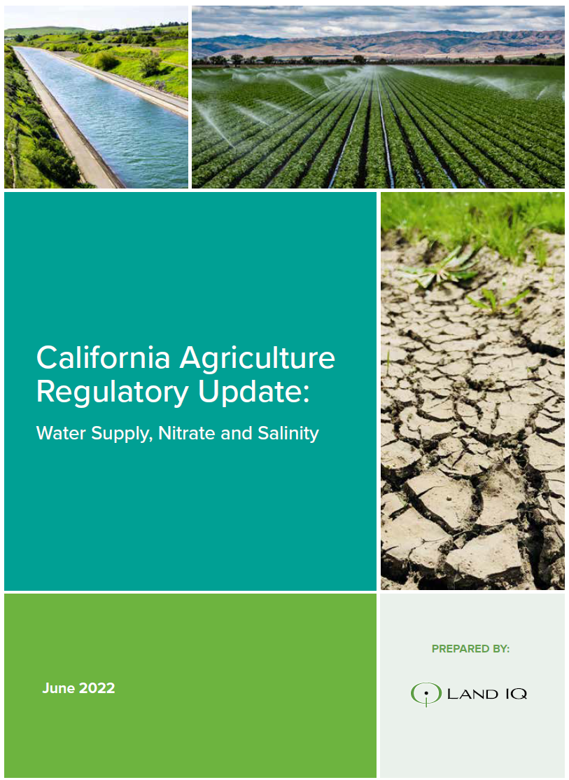
Outline
Land IQ background
  Expertise
  Projects
Regulatory Update
  SGMA
  ILRP
  CV-SALTS
  Bay-Delta Plan

Slide 3
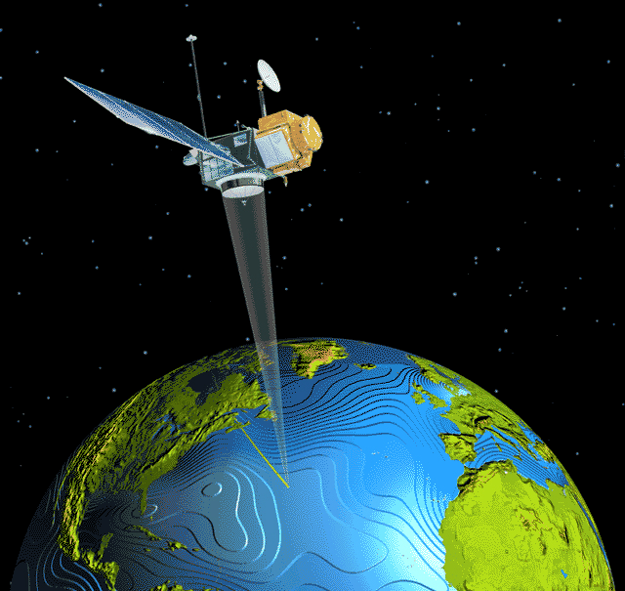
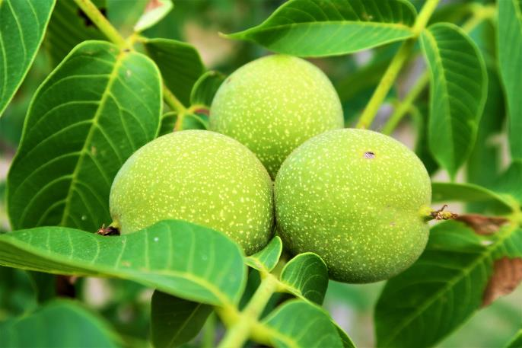
Land IQ
Land-Based Sciences: Land and Water Resources
  Agronomic assessments/soil science
  Water quality and supply evaluations
  Salinity and nutrient management
  Agricultural reuse
  Land stabilization and erosion control
  Soil reclamation and irrigation/drainage
Spatial Sciences: Remote Sensing and GIS
  Consumptive use estimation and crop identification
  Large landscape evaluations
  Irrigation and drainage
  Production agriculture
Development
  Data management tools

Slide 4
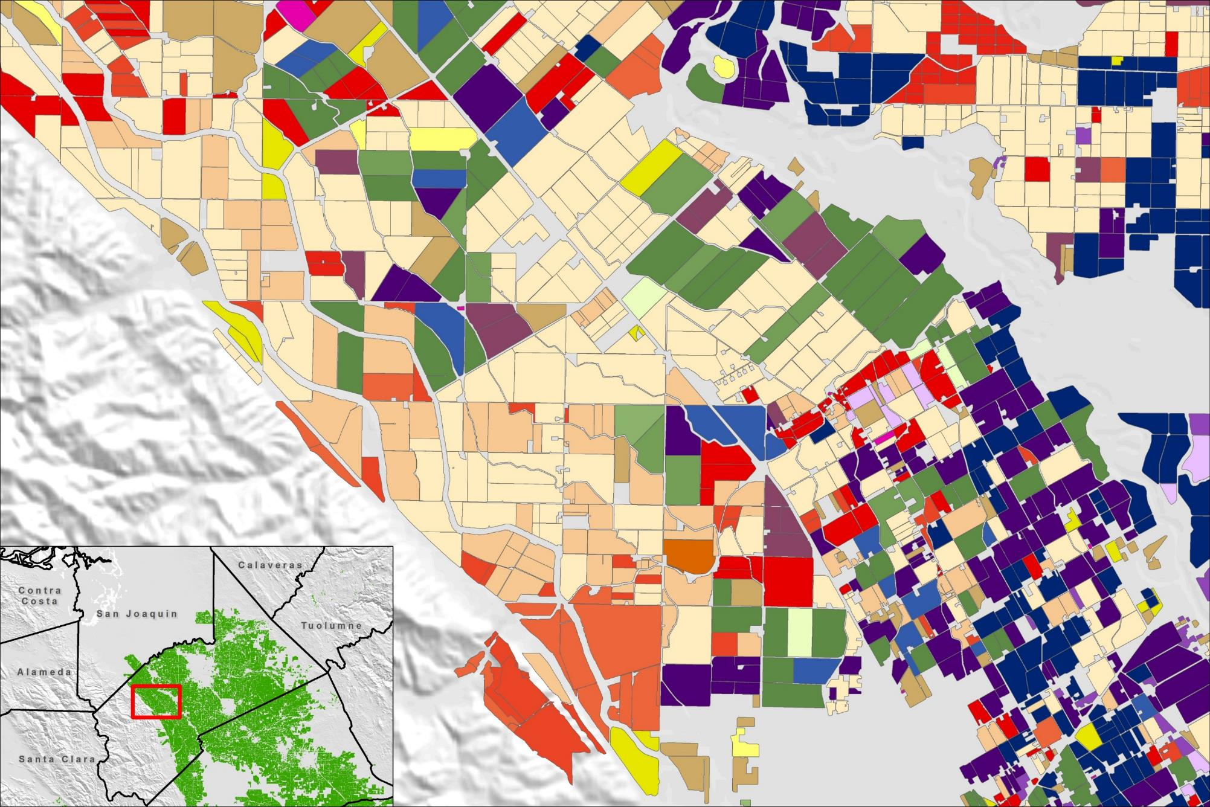
Related Projects
SGMA
  Land use mapping for DWR
  ET estimation
  Regulatory/ag support
  Land retirement/repurposing for adjudicated areas and GSAs
ILRP
  Coalition data collection, management and reporting
CV-SALTS
  Regulatory support
  Ag support for Prioritization and Optimization Study
Bay-Delta Plan
  Regulatory support
  Water supply reliability evaluations

Slide 5
SGMA

Slide 6
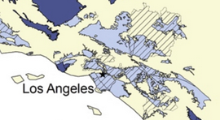
SGMA Background
Last state to formally regulate groundwater
515 groundwater basins
  40 M acres
  Over 40% of CA land area
  82% of population
  97% of ag land

Slide 7
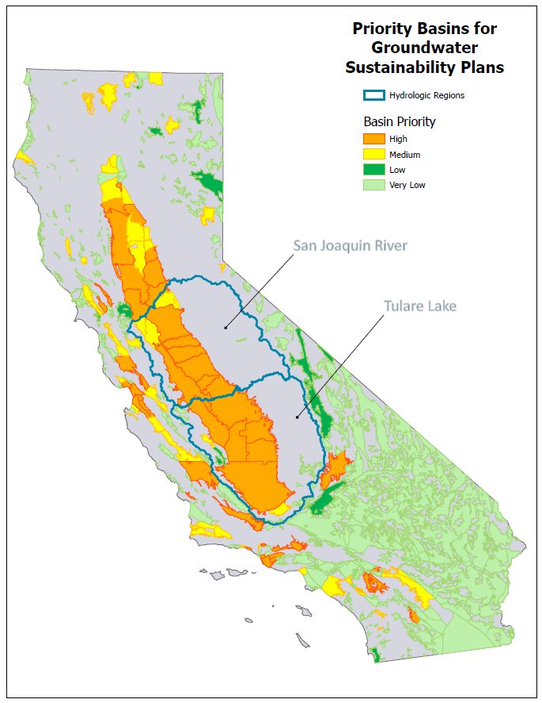
SGMA Background – Prioritization outcome
High/medium priority (2019)
  94 basins (46 high; 48 medium)
  21 are critically overdrafted
Together with adjudicated areas:
  98% of pumping (20M ac-ft)
  83% of population (25M people)
  88% of irrigated acres (6.7M ac)
421 basins not required to form GSAs and submit GSPs
  11 low priority
  410 very low priority

Slide 8
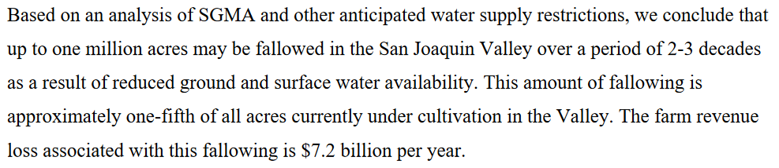
Impact of SGMA on Agriculture
More accurate accounting of water usage
  “Can’t manage what you don’t measure.”
  Sustainable yield need to halt overdraft
Changes in agricultural land use
  Crop type changes – perennial, annual, water use
  Land repurposing for retired farmland
  Estimated 500K-1M ac taken out of production (Sunding and Roland-Holst 2020)

Slide 9
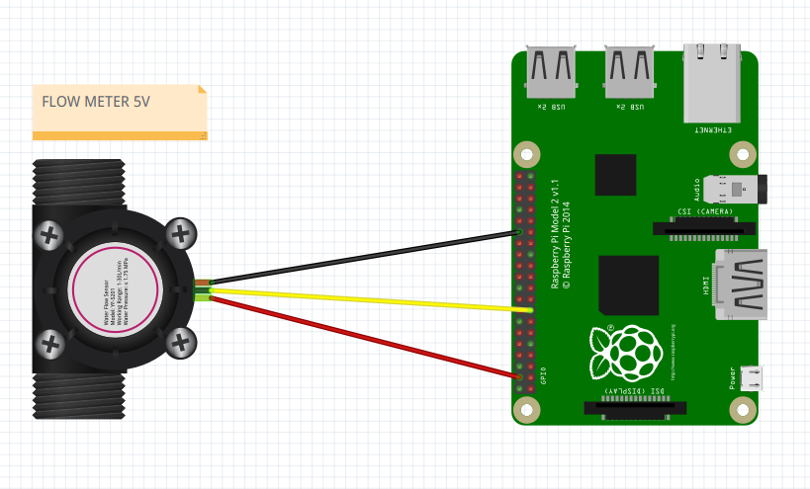
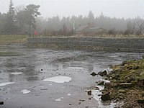
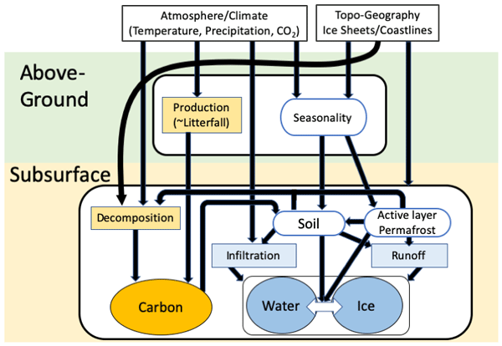
Benefit of SGMA to Agriculture
New data and resources related to water accounting
New technologies for measuring and conserving water
Additional modeling to understand factors such as urban growth
More funding for research and extension
Perceptions replaced with actual information
Realization of important role that ag plays in groundwater recharge

Slide 10
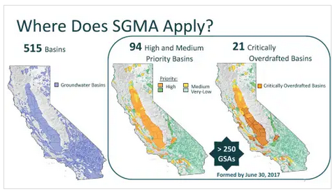
SGMA - implementation
January 2020 – 46 GSPs submitted
January 2022 – 64 GSPs submitted
DWR review (2 years)
  Public comment
  Conditional approval
  Incomplete
Reviews to date
  8 approved
  35 determined incomplete
  74 GSPs in review

Slide 11
ILRP

Slide 12
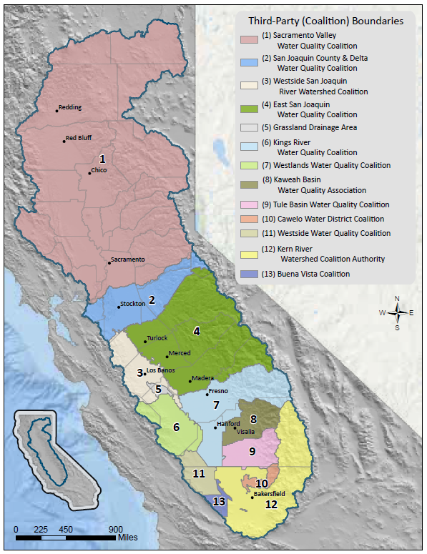
ILRP Background
ILRP initiated in 2003
All ag land in CA must comply with ILRP by February 2023
Nitrogen (N) discharge regulation
Fee based
Comply as individual or group
Coalitions
  Data collection and reporting
  Communicate with regulators
  Educate growers

Slide 13

Impact of ILRP on Agriculture
Fees
  Order of $X/ac as a coalition member
  Order of $XX/ac as an individual
Fines
  $XX,XXX-$XXX,XXX/ac
Reporting
  Farm evaluation (every 5 years)
  Irrigation and N management planning
  Continuing education related to N management

Slide 14

Benefit of ILRP to Agriculture
Substantial funding and research effort dedicated to N dynamics/ use efficiency in crops – improves understanding of N fertilizer requirements
Crop genetics and breeding programs to maximize N use efficiency
Education on management practices
Overall benefits of improving productivity and bottom line

Slide 15
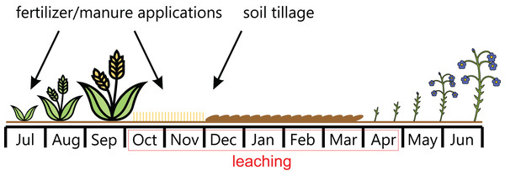
ILRP implementation
Management Practices Evaluation Program
  Multi-year data collection and modeling effort throughout Central Valley
  Will provide information on most effective management practices specific to crop, irrigation type, soil type and climate
Groundwater Protection Values, Formula and Targets
  Modeling effort to figure out, on a township basis
    Current groundwater nitrate status
    How much nitrate is being leached
    How much nitrate can be leached while still avoiding contamination above drinking water limits

Slide 16
CV-SALTS

Slide 17
CV-SALTS Background
Old regulatory system for salts was outdated
Coalition of representative stakeholders was convened to come up with new regulations (ag, food processing, oil and gas, municipal) – applies to all dischargers, not just ag
“Harter Report” 2012 – highlighted nitrate contamination in drinking water
Salt and nitrate control programs
Similar to ILRP, dischargers/permittees can comply as individual entities or as part of a group

Slide 18
CV-SALTS Background
Salt Control Program
  Conservative pathway – individual
  Alternative pathway – participate in group that funds long-term study
Three phases (each ~10 years)
  Valley-wide approach
  Prioritization and Optimization Study
  Environmental permitting and design of physical projects; funding acquisition; begin implementation of management programs
  Construction of physical projects; completion of management programs

Slide 19
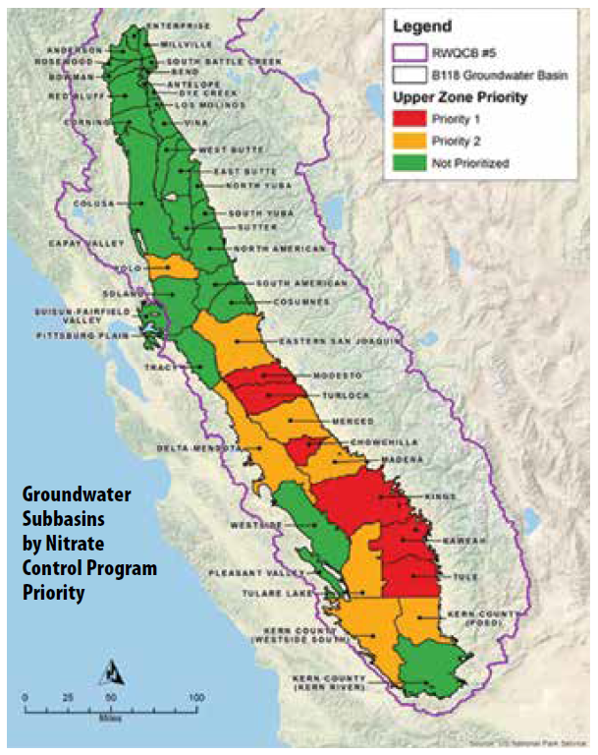
CV-SALTS Background
Nitrate Control Program
  Join a management zone
  Comply as individual
Management Zones
  Prioritized approach
  Represent dischargers from all industries
  Manage groundwater quality collectively
  Required to provide clean drinking water, provide implementation plans
  Similar to SGMA, prioritized for compliance
  Growers can join management zones through their ILRP coalitions

Slide 20

IMPact of CV-SALTS to Agriculture
Considered dischargers of salt and nitrate, growers must comply
Water quality coalition dues increase because CV-SALTS is implemented in the ag community via ILRP
Provide funding for Prioritization and Optimization Study
  No new regulations for 10 years

Slide 21
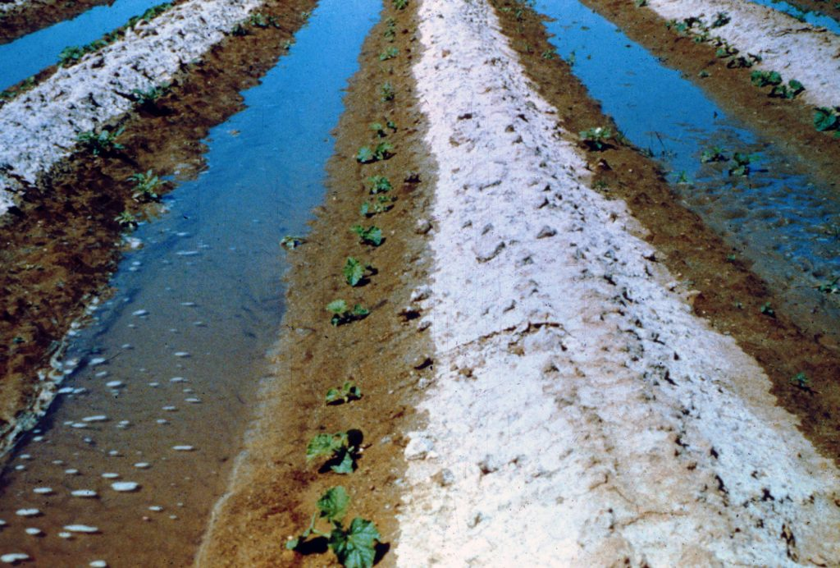
Benefit of CV-SALTS to Agriculture
Arrest salt-build up on ag land
  250,000 ac have been taken out of production
  1.5M ac salinity impaired
  Estimated economic impact of continued salt and nitrate accumulation = $3B/year
New and flexible regulatory tools for all industries
Management zones can decide where to focus activities
Includes important relationship between drought, water quality and salt and nutrient concentrations

Slide 22
Current and Future implementation
Salt Control Program Prioritization and Optimization Study began in November, 2021
Priority 1 management zones
  Providing drinking water and doing MAJOR outreach
  Conducting data collection and cost assessments
  Applying for funding
Priority 2 management zones
  Expecting notice to comply in 2023
  Getting their ducks in a row to be prepared

Slide 23
Bay-Delta Plan

Slide 24
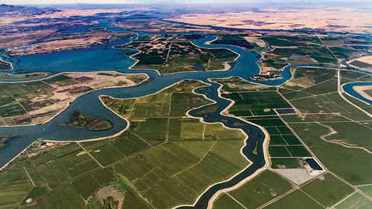
Bay-Delta Plan Background
San Francisco Bay/Sacramento-San Joaquin Delta Estuary Water Quality Control Plan = Bay-Delta Plan!
Sets water quality objectives
Designed to protect
  Drinking water
  Irrigation supply
  Fish and wildlife habitat
  Other uses
Main purpose – address decline of native aquatic species

Slide 25
Bay-Delta Plan Background
Phase 1 – Lower San Joaquin River flow objectives
  San Joaquin, Stanislaus, Tuolumne and Merced Rivers
  “Unimpaired flow”
Phase 2 – Sacramento River Delta
  Sacramento, American, Yuba and Feather Rivers
  Mokelumne, Calaveras, Cosumnes Rivers
  Voluntary agreements

Slide 26
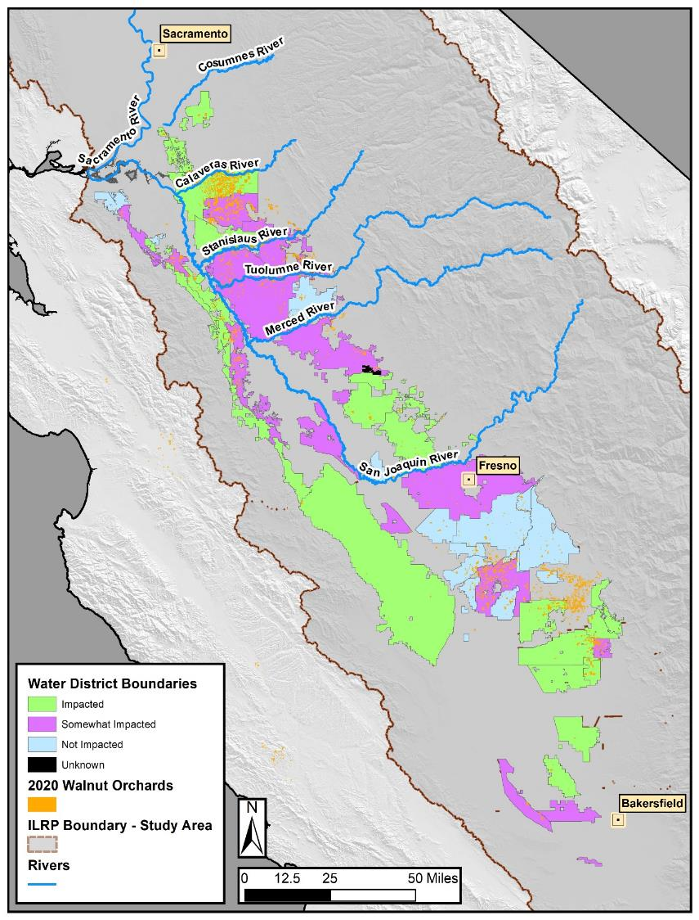
Impact of Bay-Delta Plan on Agriculture
“The 40% unimpaired flow requirement is projected to result in an average annual decrease in economic output of $69 million. This represents a 2.5% reduction from baseline annual average agricultural economic sector output of $2.6 billion.” – State Water Board

Slide 27
Benefit of Bay-Delta Plan to Agriculture
Economic impacts do not consider the mitigation actions water users would likely use to lessen economic effects
  Water efficiency measures
  Conservation measures
  Changes in crop type
  Groundwater recharge projects
Anticipated to curb salinization of irrigation water via water quality objectives

Slide 28
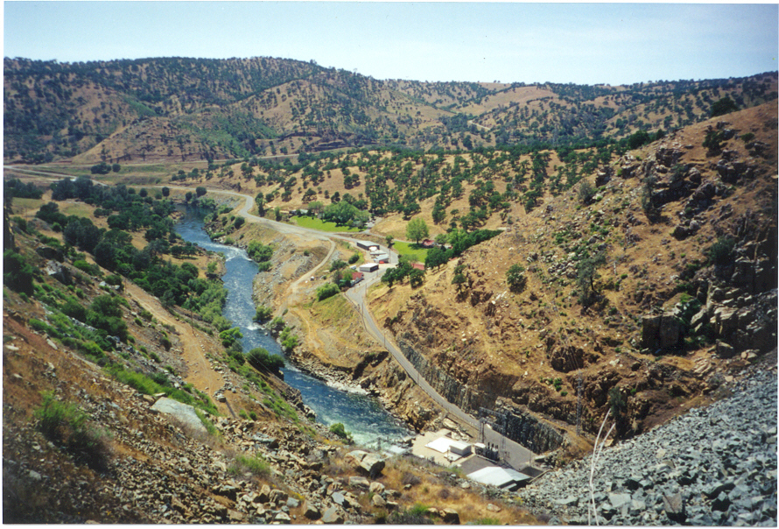
Bay-Delta Plan implementation
Phase 1 activities already implemented
  Initial compliance methods for LSJR flow objectives
  Final water quality certification for hydro projects
    Merced River
    Merced Falls
    Don Pedro (Tuolumne River)
    La Grange (Tuolumne River)

Slide 29

Bay-Delta Plan implementation
Phase 2 activities already implemented
  Objectives
    Inflow for Sacramento River and Delta tributaries
    Cold water habitat for tributaries
    Delta outflow
    Interior Delta flow
  Addition of voluntary agreements to program implementation – March 2022 MOU

Slide 30
Questions?

Slide 31
SGMA Background - Basin Prioritization
DWR used 8 factors
  Population
  Population growth rate
  Wells – number of public supply
  Wells – number of total
  Irrigated acreage
  Dependence on groundwater
  Existing impacts (overdraft, subsidence, water quality degradation, etc.)
  Other relevant information (impacts to habitat, etc.)

Slide 32
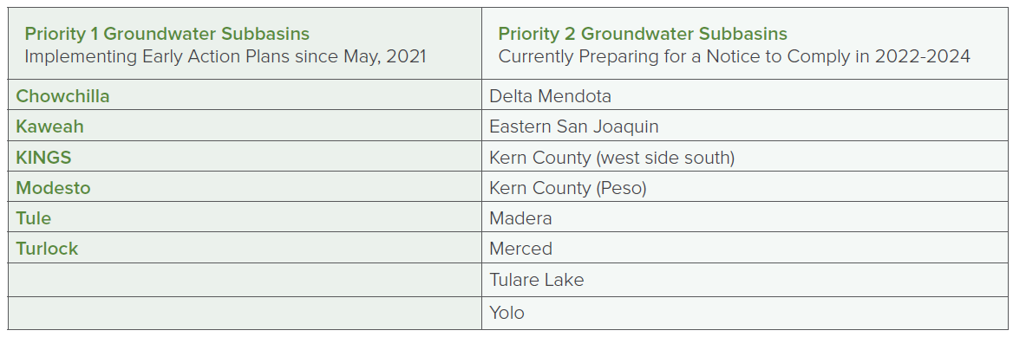
CV-SALTS Background

