Slide 1

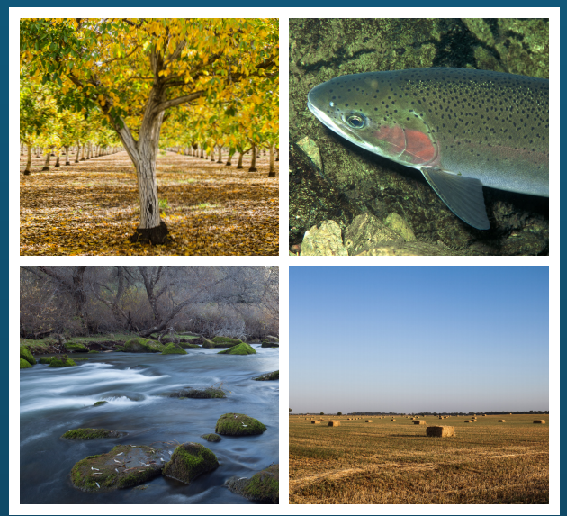

Bay-Delta Water Quality Control Plan Update:
San Joaquin River Flow and Salinity Objectives
State Water Resources Control Board

Slide 2

Lower San Joaquin River (LSJR) Basin
Stockton
Stanislaus River
Vernalis
Modesto
Tuolumne River
Turlock
Merced River
Merced
San Joaquin River
Friant Dam
Notes:
4

Slide 3
Four Key Points
Current Plan is out of date
Why focus on flow?
This is hard, requires balancing
Settlements are encouraged

Slide 4
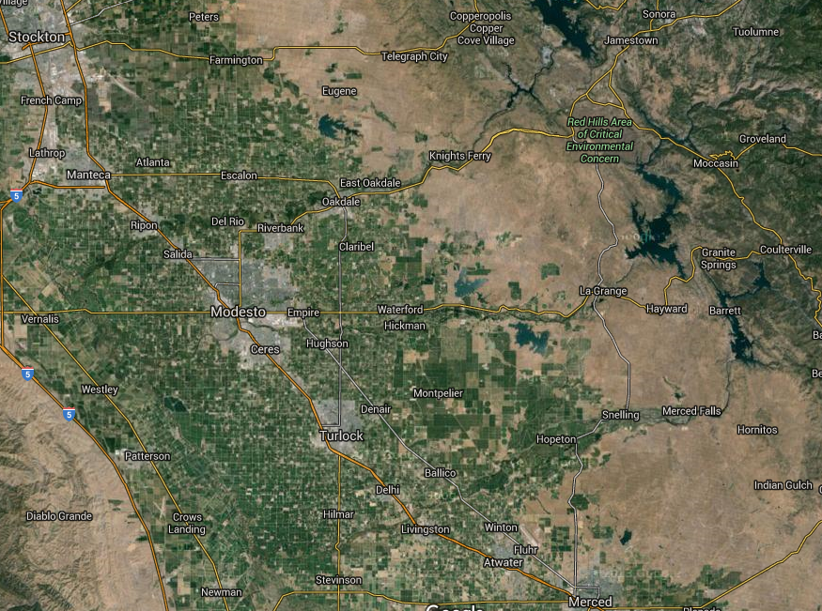
Proposed Flow Requirements
(Percent of Unimpaired Flow Feb-Jun)
UF
UF
= reservoir
= existing requirement
= proposed requirement
UF

Slide 6
Modeling Flow Chart
  CEQA Impacts Analysis (20%/40%/60%)
  Surface Water Deficit
  Applied Water Needs
  Groundwater Use Estimates
  SWAP (StateWide Ag Production)
  IMPLAN Regional Economics
    (IMpact analysis for PLANning)
Water Supply Effects (WSE)
Core Model
HEC-5Q
Temperature
Model
Iterate
Outputs for Fish Benefits
Improved Temperature
Floodplain Habitat Inundation

Slide 7
Programmatic Analysis
Quantitative information from models informs physical changes that could result from the plan amendments and have the potential for quantifiable impacts on environmental resources:
  River flows
  Reservoir operations
  Surface water diversions
  Groundwater pumping
Potential environmental impacts of these physical changes are evaluated in Chapters 5–17 of the SED

Slide 8
If you would like to make a comment on the WQCP Update and SED you must send your comments by no later than 12:00 noon on
January 17, 2017 to: commentlettters@waterboards.ca.gov with “Comment Letter – 2016 Bay-Delta Plan Amendment & SED” in the subject line.
You can also make oral comments during the hearing held on:
For more information visit: http://waterboards.ca.gov/DeltaWQCP-Phase1
SACRAMENTO Nov. 29, 2016 and Jan. 3, 2017 – 9 AM CalEPA Headquarters Building 2nd Floor 1001 “I” Street | STOCKTON Dec. 16, 2016 – 9 AM Stockton Memorial Civic Auditorium Main Hall 525 “N” Center St,
MERCED Dec. 19, 2016 – 9 AM Multicultural Arts Center 645 W. Main Street | MODESTO Dec. 20, 2016 – 9 AM Modesto Centre Plaza Tuolumne River Room 1000 “K” Street

Slide 10
Groundwater and Drinking Water
Technical State Water Board Staff/Community Water Interests meeting
November 18, 2016
State Water Board Panel:
Les Grober, Tim Nelson, Mark Roberson, Anne Huber, Yongxuan Gao, Will Anderson

Slide 11
Topics Covered
Purpose
Overview Geographic Area
Agricultural Groundwater Assessment
  Method
  Assumptions and Data Sources
  Results
Analysis of Potential Impact to Drinking Water
  Context
  Potential impacts
  Sources of Funding

Slide 12
Purpose of the Groundwater Analysis
Purpose
  To estimate the relative effects of the LSJR alternatives on the groundwater subbasins.
  To support other quantitative and qualitative analyses throughout the Substitute Environmental Document (SED).

Slide 13
Groundwater-Related Assessments
Groundwater modeling (Appendix G)
Existing groundwater conditions and groundwater as a resource (storage, quality, subsidence – Ch 9)
Agriculture (Ch 11)
Service providers (groundwater quantity and quality – Ch 13)
Greenhouse gases (energy consumptions and GHG emissions from increased Groundwater pumping – Ch 14)
Economics (Ch 20)
Possible management options for municipal and domestic water supply (Ch 22)

Slide 14
Analytical Framework of the Modeling
Surface water diversions could be reduced in implementing the proposed unimpaired flow requirements
If possible affected water users would increase groundwater pumping to compensate for lost surface water
Groundwater tables could fall, which could affect wells used to supply drinking water
Groundwater pumping would currently be limited by infrastructure capacity, in the future it may be limited by the Sustainable Groundwater Management Act (SGMA)

Slide 15
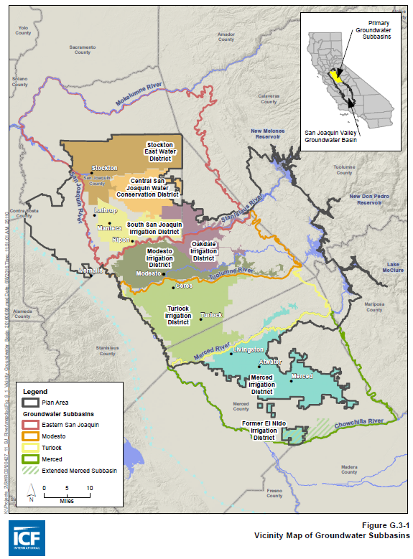
Groundwater Subbasin
  Merced
  Turlock
  Modesto
  Eastern San Joaquin
Irrigation Districts:
  Merced (MeID)
  Turlock (TID)
  Modesto (MoID)
  Oakdale (OID)
  South San Joaquin (SSJID)
  Central San Joaquin Water Conservation District (CSJWCD)
  Stockton East Water District (SEWD)

Slide 16

In District Groundwater Balance
Municipal Use
Crop Consumptive Use of Applied Water
Surface Water Diversion
Evaporation
Irrigation District
Tributary
Distribution System
Irrigated Crops
Applied Surface Water
System Seepage
Deep Percolation
Applied Groundwater
(District + Private Pumping)
Surface Water Returns
Groundwater Subbasin

Slide 17
Groundwater Subbasin Balance
Surface Water Diversion
Crop Consumptive Use of Applied Water
Wastewater
Crop Consumptive Use of Applied Water
Irrigation Districts
Municipal Use
Non-ID Agriculture
Irrigated Crops
Residential and Industrial Use
Irrigated Crops
Distribution System
System Seepage
(Private Pumping)
Applied Groundwater
Applied Groundwater
Deep Percolation
Deep Percolation
Municipal Wells
Groundwater Subbasin

Slide 18
Agricultural Groundwater Use Analysis
Key Assumptions
Within the Irrigation Districts:
  Groundwater pumping occurs at the farm gate and is only used to satisfy crop applied water demand
  Assume districts can pump as much groundwater as needed, up to their maximum pumping capacity
  For SEWD and CSJWCD only the portion of water that they contract for on the Stanislaus (totals 155 TAF) is modeled, assuming both districts can fully replace any shortage with groundwater.
Areas outside of the Districts, but within the groundwater subbasins:
  Includes estimates of municipal pumping based on the 2003 Bulletin 118
  Assume agricultural areas are supplied by groundwater, with a few exceptions

Slide 19
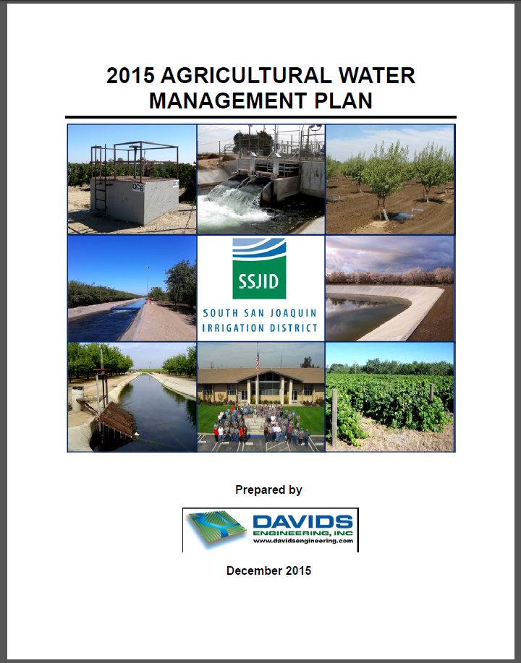
Agricultural Groundwater Use Analysis
Data Sources
Parameters based on district AWMPs and September 2015 information request responses
  District M&I deliveries
  Seepage from regulating reservoirs
  Minimum annual groundwater pumping
  Maximum Groundwater Pumping Capacity
  Distributions loss factors
  Deep percolation factors

Slide 20
Agricultural Groundwater Use Analysis
Surface Water Replacement
See page G-24 Appendix G figure G.2-2A

Slide 21
Agricultural Groundwater Use Analysis
Surface Water Replacement
See page G-26 Appendix G figure G.2-2C

Slide 22
Average Annual Groundwater Pumping
Estimated 2009 Maximum Groundwater Pumping Capacity = 626 TAF/y

Slide 23
Average Annual Groundwater Recharge

Slide 24
GW Net Input within the Districts

Slide 25
Potential Impacts to Drinking Water

Slide 26
Drinking Water Supply in the Four Subbasins
Population: 1.25 million (U.S. Census Bureau 2010)
1.12 million are connected to public water systems
133,000 rely on domestic (private) wells

Slide 27
Drinking Water Supply in the Four Subbasins (cont.)
93 public water suppliers delivered 323 TAF water in 2014
  Groundwater: 169 TAF
  Surface water: 154 TAF
Domestic wells: 38 TAF
Total water production in : 323 + 38 = 361 TAF

Slide 28
Potential Impacts on Drinking Water
May need to deepen existing wells or build more wells
May increase pumping cost
Could degrade groundwater quality
Could make groundwater unavailable in some areas

Slide 29
Potential Effect on Groundwater Overdraft
LSJR Alt 3 (40% UF): 186 TAF/y
Current rate of overdraft: 155 TAF/y
Total groundwater storage: 125 MAF (estimate made in 1960s; Williamson et al. 1989)
Actions are needed to address groundwater overdraft with or without the proposal

Slide 30
Current Estimated Rates of Groundwater Overdraft
Subbasin | From Ch 9 (TAF/y) ¹ | From ExeSum (TAF/y) ²
Eastern San Joaquin | 88 | 50
Turlock | 9 | 21.5
Modesto | 11 | Assumed to have same combined rate as the above two
Merced | 44
Total | 155 | 144
1 Calculated using average annual groundwater level decline between 1970 and 2000 × subbasin area × estimated average specific yield as reported California’s Groundwater Bulletin 118, Update 2003 2 Calculated assuming Modesto and Merced has the same combined rate of overdraft as Eastern San Joaquin (ESJ) and Turlock. Number for ESJ was reported in California’s Groundwater Bulletin 118, Update 2003 and that for Turlock was reported in TGBA 2008

Slide 31
Potential Groundwater Quality Impacts
Reduction in groundwater level could:
  Accelerate migration of surface contaminants to the well
  Cause saline water intrusion to the aquifer
  Mobilize naturally-occurring trace elements and elevate their concentrations in the aquifer
It is speculative to determine the impact from increased groundwater pumping
  Depends on many variables
  Not possible to predict how the affected parties would respond

Slide 32
Public Water Suppliers
A substantial increase in groundwater pumping would not necessarily result in violation of drinking water quality standards because recent data do not indicate increased water quality standard violations in public water systems despite greatly increased groundwater pumping
Service providers are required to take actions to ensure that the water is in compliance with relevant drinking water standards before it is served to the public

Slide 33
Domestic Wells
Increased pumping could affect groundwater flow and quality, depending on many unknown factors
  This could affect domestic wells
No systematic monitoring of domestic wells
  Testing well water and other best practices set forth in SED are important
Important for local groundwater sustainability agencies to implement SGMA both for overpumping and water quality degradation

Slide 34
Example Financial Assistance from the State Water Board
Public Water System Drought Emergency Response
  e.g. 2015, Plainsburg Elementary School in Merced County, $180,882
Drinking Water State Revolving Fund (DWSRF)
  e.g. 2015, City of Hughson in Stanislaus County, $6,607,210
Proposition 1- administered as a part of DWSRF

Slide 35
Further Information
More information on these topics can be found in the following chapters and appendices of the SED:
  Chapter 9, Groundwater Resources
  Chapter 13, Service Providers
  Chapter 22, Integrated Discussion of Potential Municipal and Domestic Water Supply Management Options
  Appendix G, Agricultural Economic Effects of the Lower San Joaquin River Flow Alternatives: Methodology and Modeling Results
These chapters, as well as the Groundwater and Surface Water Use Analysis spreadsheet, can be found at:
http://www.waterboards.ca.gov/waterrights/water_issues/programs/bay_delta/bay_delta_plan/water_quality_control_planning/2016_sed/index.shtml.

Slide 37
Economic Impacts
Technical State Water Board Staff/Community Water Interests meeting
November 18, 2016
State Water Board Panel:
Les Grober, Tim Nelson, Tom Wegge, Dan Worth, Mark Roberson, Nicole Williams

Slide 38
Economic Analyses:
Topics Covered
Regulatory Requirements
Analytical Framework & Resources Evaluated
Study Area(s)
Types of Evaluations
Agricultural Economic Evaluation
  SWAP: Sources of Data, Model Description, Assumptions, and Study Area
  IMPLAN Multipliers: Sources of Data, Assumptions, and Study Area

Slide 39
Economic Analyses:
Regulatory Analytical Requirements
CEQA
  Requires economic effects linked to a physical change
  Allows lead agency to include more information
Porter Cologne Act (CA Water Code)
  Section 13141: estimate of “total cost of a program” and “potential sources of financing”
  Section 13241: consider “economic considerations” – in practice, costs to affected parties and potential impacts on local and regional economies

Slide 40
Economic Analyses:
Analytical Framework
Purpose
To compare potential economic effects of predicted changes in surface water diversions across the LSJR alternatives
Analysis Goal
To help inform the State Water Board’s consideration of potential changes to the 2006 Bay‑Delta Plan related to LSJR flow objectives

Slide 41
Economic Analyses:
Resources Evaluated
Lower San Joaquin River and Tributaries
Changes in Hydrologic Conditions
Agricultural Production and Related Effects on the Regional Economy and Local Fiscal Conditions
Municipal and Industrial Water Supplies and Affected Regional Economies
Hydropower Generation, Revenues and the Regional Economy
Fisheries and Associated Regional Economies
Recreational Opportunities, Activity, and the Regional Economy
In addition, costs of non-flow measures are considered

Slide 42
Economic Analyses:
Study Area(s)
Vary by resource topic
temporal and geographic characteristics of affected resources
geographic extent of effects on local and regional economies
Includes Areas beyond the Plan Area
e.g., commercial and recreational fisheries, water supply

Slide 43
Economic Analyses:
Types of Evaluations
Direct and indirect effects at the local and/or regional level
Qualitative and quantitative assessments
For quantitative analyses, different analytical tools used
EXAMPLE: Agricultural Production and Related Economic Effects
Resource | Type of Evaluation | Analytical Tool
Hydrologic & Water Supply | Quantitative | Water Supply Effects Model
Agricultural production | Quantitative | SWAP
Regional agricultural effects | Quantitative | IMPLAN multipliers
Fiscal effects related to agriculture | Quantitative and Qualitative | IMPLAN multipliers and data from three county region

Slide 44
Agricultural Economic Analysis
Given the proposed unimpaired flow objectives there will likely be more frequent agricultural water shortages
As a result, crop production could be lower in certain years, particularly during drier periods.
Fallowing of crops will reduce their gross revenues. Some changes in prices and adjusting of cropping patterns may dampen this effect.
Reduced revenue could cause some jobs related to the crop production to disappear.
Other economic sectors may also see revenue and employment impacts related to impacts in the agricultural industry.

Slide 45
Suite of Models for Studying Economic Impacts in Agriculture
Potential UF Requirements
Change in Applied Surface Water
Change in Crop Applied Water
Change in Agricultural Revenues
INPUTS
MODEL
Water Supply Effect (WSE)
Agricultural Groundwater Use Analysis
SWAP (Agricultural Production)
IMPLAN Multipliers
(Region -Wide Effects)
Changes in
Surface Water Availability
Changes in
Groundwater Pumping
Changes in
Agricultural Revenues
Cropping Patterns
Changes in
Employment
Total Sector Output
Value-Added
OUTPUT

Slide 46
Agricultural-Economic Analysis
SWAP Model
  Agricultural –Economic optimization model that assumes farmers operate to maximize net economic returns
  Developed in the 1990s and constantly updated
  Covers most agriculture in the state
Inputs: base cropping patterns, water use intensity, total land and water use
  Outputs: agricultural production acreage, crop revenue, optimized cropping patterns
Has been used to study agricultural response to:
  Water scarcity
  Salinity

Slide 47
Agricultural-Economic Analysis
Model Setup
Agricultural Impact Analysis (using SWAP):
  Analysis covers six areas representing each of the 7 irrigation districts that receive surface water from the east side tributaries (with SEWD and CSJWCD combined)
  19 crop categories following DWR classification for land and water use
  Base land and applied water are calibrated to 2010 levels using DWR DAU Crop Surveys for 2010

Slide 48
Total Applied Water
Applied Water (AW) refers to water used to irrigate crops from either groundwater pumping, surface water diversions, or both.
 | Average Annual Applied Water Demand (TAF/y)
 | All Year types | Wet | Above Normal | Below Normal | Dry | Critically Dry
Crop Applied Water Demand | 1604 | 1483 | 1565 | 1643 | 1696 | 1720
 | Average Annual Applied Water Deficit (TAF/y)
Baseline Conditions | 45 | 0 | 0 | 0 | 9 | 224
30% UF Objective | 111 | 0 | 0 | 23 | 90 | 477
40% UF Objective | 182 | 4 | 37 | 104 | 230 | 618
50% UF Objective | 276 | 13 | 83 | 241 | 412 | 780
TAF = Thousand Acre Feet per year UF = Unimpaired Flow Average Annual applied water demand and deficits for the 7 irrigation districts combined

Slide 49
Total change in Acreage

Slide 50
Agricultural-Economic Analysis
Crop Revenue Impacts within Districts

Slide 51
Regional Economic Analysis
IMPLAN is an Input-Output model that provides a snapshot of a region’s economy
Regional Economic Analysis
  Uses marginal multipliers derived from IMPLAN model that relate the direct change in crop revenue output from SWAP to the change in revenue and employment for other industries.
  IMPLAN data from 2010
  Analysis covers the three county area of Merced, Stanislaus, and San Joaquin Counties
  8 IMPLAN crop categories

Slide 52
IMPLAN Multipliers
Changes in SWAP revenue output represent direct revenue impacts associated with reduced crop production
IMPLAN contains multipliers to estimate indirect and induced impacts
  Indirect impacts could result in industries that provide inputs to the agricultural industry
  induced impacts could result because of the changes in spending throughout the economy as labor income has changed

Slide 53
Regional Economic Impacts
Table G.5‑4. Average Annual Total Economic Output Related to Agricultural Production in the Irrigation Districts under Baseline Conditions and the Change for Each of the LSJR Alternatives (page G-67)
Economic Effects | Baseline Total Economic Output | Change from Baseline ($ Millions, 2008)
 | ($ Millions, 2008) | 30% Unimpaired Flow Objective | 40% Unimpaired Flow Objective | 50% Unimpaired Flow Objective
Direct Effects | $1,477 | -$19 | -$36 | -$70
Indirect and Induced Effects | $1,109 | -$14 | -$27 | -$53
Total Sector Output | $2,586 | -$33 | -$64 | -$124
% of Baseline Total Economic Output | 100% | -1.3% | -2.5% | -4.8%
Modified from Table G.5-4, Page G-67 of Appendix G

Slide 54
Regional Employment Impacts
Table G.5‑6. Average Annual Total Employment Related to Agricultural Production in the Irrigation Districts under Baseline Conditions and the Change for Each of the LSJR Alternatives (page G-70)
Employment Effects | Baseline Total Economic Output | Change from Baseline (# of Jobs)
 | (# of Jobs) | 30% Unimpaired Flow Objective | 40% Unimpaired Flow Objective | 50% Unimpaired Flow Objective
Direct Employment | 8,097 | -99 | -190 | -406
Indirect and Induced Employment | 10,514 | -124 | -242 | -471
Total Employment | 18,601 | -224 | -433 | -877
% of Baseline Total Employment | 100% | -1.2% | -2.3% | -4.7%
Modified from Table G.5-6, Page G-70 of Appendix G

Slide 55
Further Information
More information on these topics can be found in the following chapters and appendices of the SED:
  Chapter 11, Agricultural Resources
  Chapter 20, Economic Analysis
  Appendix G, Agricultural Economic Effects of the Lower San Joaquin River Flow Alternatives: Methodology and Modeling Results
These chapters, as well as the Agricultural Economic Analysis spreadsheet, can be found at:
http://www.waterboards.ca.gov/waterrights/water_issues/programs/bay_delta/bay_delta_plan/water_quality_control_planning/2016_sed/index.shtml.

Slide 56
Extra slides…

Slide 57
Current Plan Out of Date
Plan last updated 21 years ago in 1995
Species have been declining – the need for update was identified 10 years ago (in 2006 Plan update)
Endangered Species Act increasing water restrictions
Administration’s California Water Action Plan directs the State Water Board to complete the update of the Plan to further achievement of the co-equal goals in the Delta

Slide 58
Why Focus on Flow?
Scientific studies show that flow is a major factor in the survival of fish like salmon
Many benefits of flow, including improved growth and survival of native fish by improving water temperatures and increasing floodplain habitat
Flow affects risk of disease, risk of predation, reproductive success, growth, smoltification, migration, feeding behavior, and other ecological factors
Non-flow measures can also be important but State Water Board has limited authority to require non-flow measures

Slide 59
This is Hard, Requires Balancing
State Water Board’s 2010 flow criteria report – a purely technical assessment and no balancing – concluded that 60 percent of flow should be left in the LSJR for the benefit of fish
Current uses (agriculture, drinking water) rely on up to 80 percent or more of the unimpaired flow
Unlike the 2010 report, this staff proposal considers other uses and aims to strike a balance among competing uses of water
The staff proposal recommends a range of between 30 and 50 percent of unimpaired flow, with a starting point of 40 percent – this is a big increase

Slide 60
This is Hard, Requires Balancing
This is less than what environmental and commercial fishing interests favor, and more than agricultural and affected urban users want
Balancing is hard, but is what we are called upon to do
Because it is hard, State Water Board has a long history of encouraging settlements.

Slide 61
Settlements are Encouraged
The flow proposal includes “adaptive implementation,” which allows adjustments so water is used wisely and more effectively – implementation of non-flow measures could also reduce the flows needed
Board is looking for durable local solutions that will improve flows and other conditions that can reduce the need for flow
Local water agencies and local people working with agency experts and other organizations can provide the foundation for such durable solutions
The California Natural Resources Agency is leading settlement discussions to explore the potential for a comprehensive agreement on environmental flows in both the San Joaquin and Sacramento River basins

Slide 62
Current SJR Spring Flow Objective
One compliance location: Lower San Joaquin River at Vernalis (inflow to Delta)
Minimum monthly average flow rates
Includes "pulse" flow during a 31-day period in April and May of each year
USBR only responsible water right holder

Slide 63
Proposed LSJR Flow Objective
Applies to the Stanislaus, Tuolumne, and Merced Rivers
Narrative Objective:
  Maintain inflow conditions from the SJR watershed to the Delta at Vernalis sufficient to support and maintain the natural production of viable native SJR fish populations migrating through the Delta
Numeric Objective:
  Feb - June: 30% - 50% unimpaired flow
  Starting point of 40%
  Unimpaired flow: the natural water production of a river basin, unaltered by upstream diversions, storage, or by export or import of water to or from other watersheds

Slide 64
Proposed LSJR Flow Objective
Adaptive Implementation
  Adjustments within the 30% - 50% range
  Adjustments within Feb - June period
  Flow shifting to avoid temperature impacts in fall
Stanislaus, Tuolumne, and Merced (STM) Working Group – implementing entity
  Biological goals
  Planning, monitoring, and reporting
  Voluntary agreements

Slide 65
Current Southern Delta Salinity Objective
April through August: 0.7 millimhos per centimeter (mmhos/cm) EC
  based on the salt sensitivity and growing season of beans
September through March: 1.0 mmhos/cm EC
  based on the growing season and salt sensitivity of alfalfa during the seedling stage
4 Salinity compliance stations within the south Delta:
  San Joaquin River at Vernalis
  San Joaquin River at Brandt Bridge
  Old River at Middle River
  Old River at Tracy Road Bridge.
Hoffman Report, Figure 1.1.

Slide 66
Proposed Southern Delta Salinity Objective
Year round objective of 1.0 deciSemens per meter (dS/m) EC
Three compliance locations changed to channel segments
  SJR from Vernalis to Brandt Bridge
  Middle River from Old River to Victoria Canal
  Old River/Grant Line Canal from Head of Old River to West Canal
Continued conditions in USBR and DWR’s water rights
  USBR - 0.7 EC at Vernalis April - Aug; 1.0 EC Sep - March
  DWR & USBR - 1.0 EC year round in the interior Delta locations
  DWR & USBR - Continued operations of agricultural barriers or other reasonable measures to address impacts of SWP/CVP operations on water levels and flow conditions
Other Requirements
  Comprehensive Operations Plan - Information, actions, performance goals to address SWP/CVP export operations on water levels and flow conditions affecting salinity
  Monitoring and reporting
  Study to characterize dynamics of water level, flow, and salinity conditions
LSJR flow objectives would improve salinity conditions

Slide 67
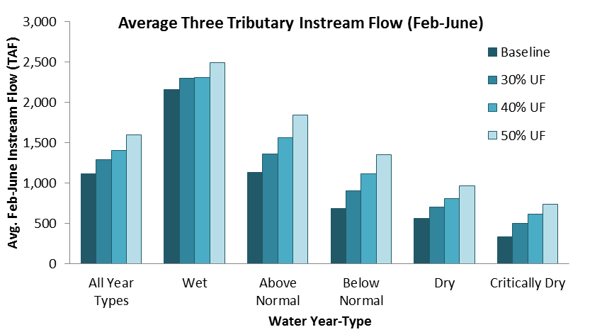
Instream Flows Under the Flow Proposal
Under the 40% unimpaired flow (UF) proposal, average annual instream flow Feb - June would increase by 288 thousand acre feet (TAF), or 26 percent.

Slide 68
Ecosystem Benefits of the Flow Proposal
Restores the pattern and some limited magnitude of flow that are more closely aligned to the flow conditions to which native species are adapted
Improves attainment of temperature criteria and increases floodplain inundation, resulting in greater survival and resiliency of native fish

Slide 69
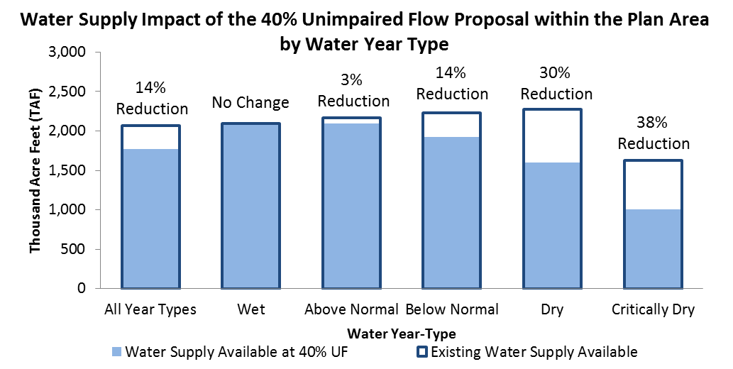
What are the Impacts of the Flow Proposal?
The greatest impact on diversions for human use would be in driest years; there would be almost no impact on diversions for human use in wet years.

Slide 70
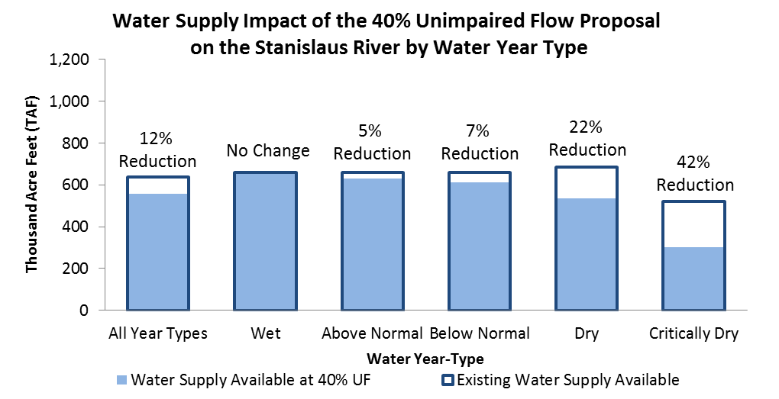
What are the Impacts of the Flow Proposal?

Slide 71
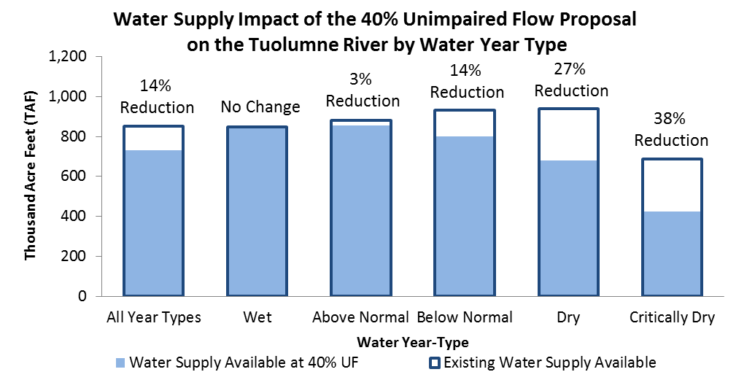
What are the Impacts of the Flow Proposal?

Slide 72
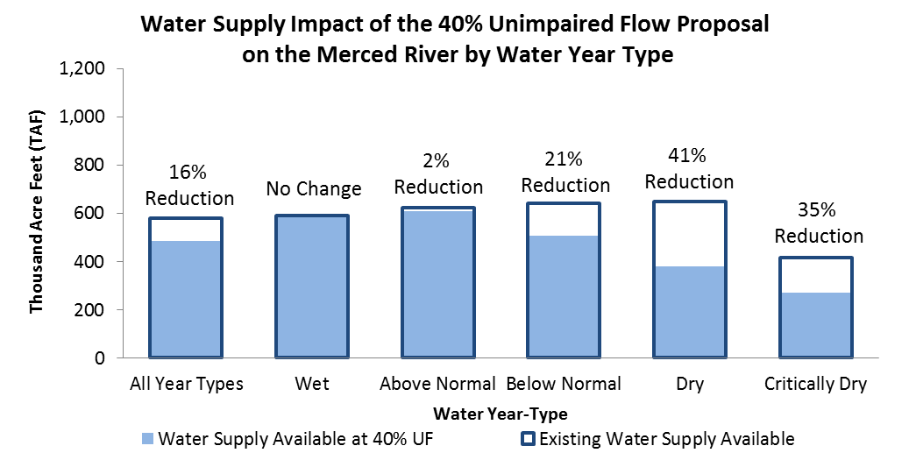
What are the Impacts of the Flow Proposal?

Slide 73
What are the Impacts of the Flow Proposal?
Implementing the 40% flow proposal could result in:
14% reduction (293 TAF) in water available for surface water diversion (7% to 23% reduction for 30% to 50% range of unimpaired flow)
Increase groundwater pumping by an average of 105 thousand acre-feet per year (TAF/yr)
Increase unmet agricultural water demand by 69 TAF/yr (2014 baseline GW pumping) to 137 TAF/yr (2009 baseline GW pumping) in the plan area
An average annual decrease in economic output of $64 million (2.5% reduction from baseline annual average agricultural economic sector output of $2.6 billion)

Slide 74
Phase 1 Next Steps
Public Hearing Dates:
  Nov 29: Sacramento
  Dec 16: Stockton
  Dec 19: Merced
  Dec 20: Modesto
  Jan 3: Sacramento
Technical Workshops: December 5th and 12th, Sacramento
Draft SED & Plan Comments due: Jan 17, 2017
Release Final SED & Plan: May 2017
Board meeting to adopt: July 2017

Slide 75
If you would like to make a comment on the WQCP Update and SED you must send your comments by no later than 12:00 noon on
January 17, 2017 to: commentlettters@waterboards.ca.gov with “Comment Letter – 2016 Bay-Delta Plan Amendment & SED” in the subject line.
You can also make oral comments during the hearing held on:
For more information visit: http://waterboards.ca.gov/DeltaWQCP-Phase1
SACRAMENTO Nov. 29, 2016 and Jan. 3, 2017 – 9 AM CalEPA Headquarters Building 2nd Floor 1001 “I” Street | STOCKTON Dec. 16, 2016 – 9 AM Stockton Memorial Civic Auditorium Main Hall 525 “N” Center St,
MERCED Dec. 19, 2016 – 9 AM Multicultural Arts Center 645 W. Main Street | MODESTO Dec. 20, 2016 – 9 AM Modesto Centre Plaza Tuolumne River Room 1000 “K” Street

