Slide 1

ETSGSA Benefit Assessment and Extraction Fees
Stanislaus County Water Advisory Committee
October 25, 2023
Notes:
Opening remarks and introductions.

Slide 2

Topics
Introduction and Background
Supporting Policies, Rules & Regulations
Proposed Benefit Assessments and Fees
Example Application to a Theoretical Site
Notes:
Recognize people on line. Review the agenda. This presentation includes recommendations. Nothing has been adopted at this time. We want feedback and questions, so feel free to interrupt. If we get a lot of questions or comments or run short on time, we’ll ask people to hold them until the end of each section. People on line can post questions or raise their hand. We will monitor.

Slide 3
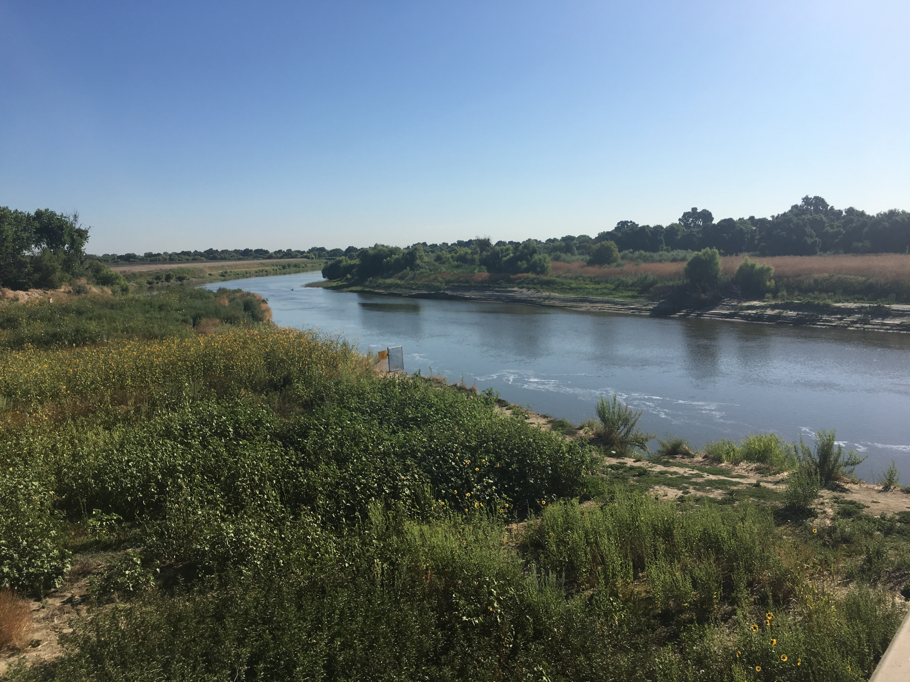
Introduction and Background

Slide 4
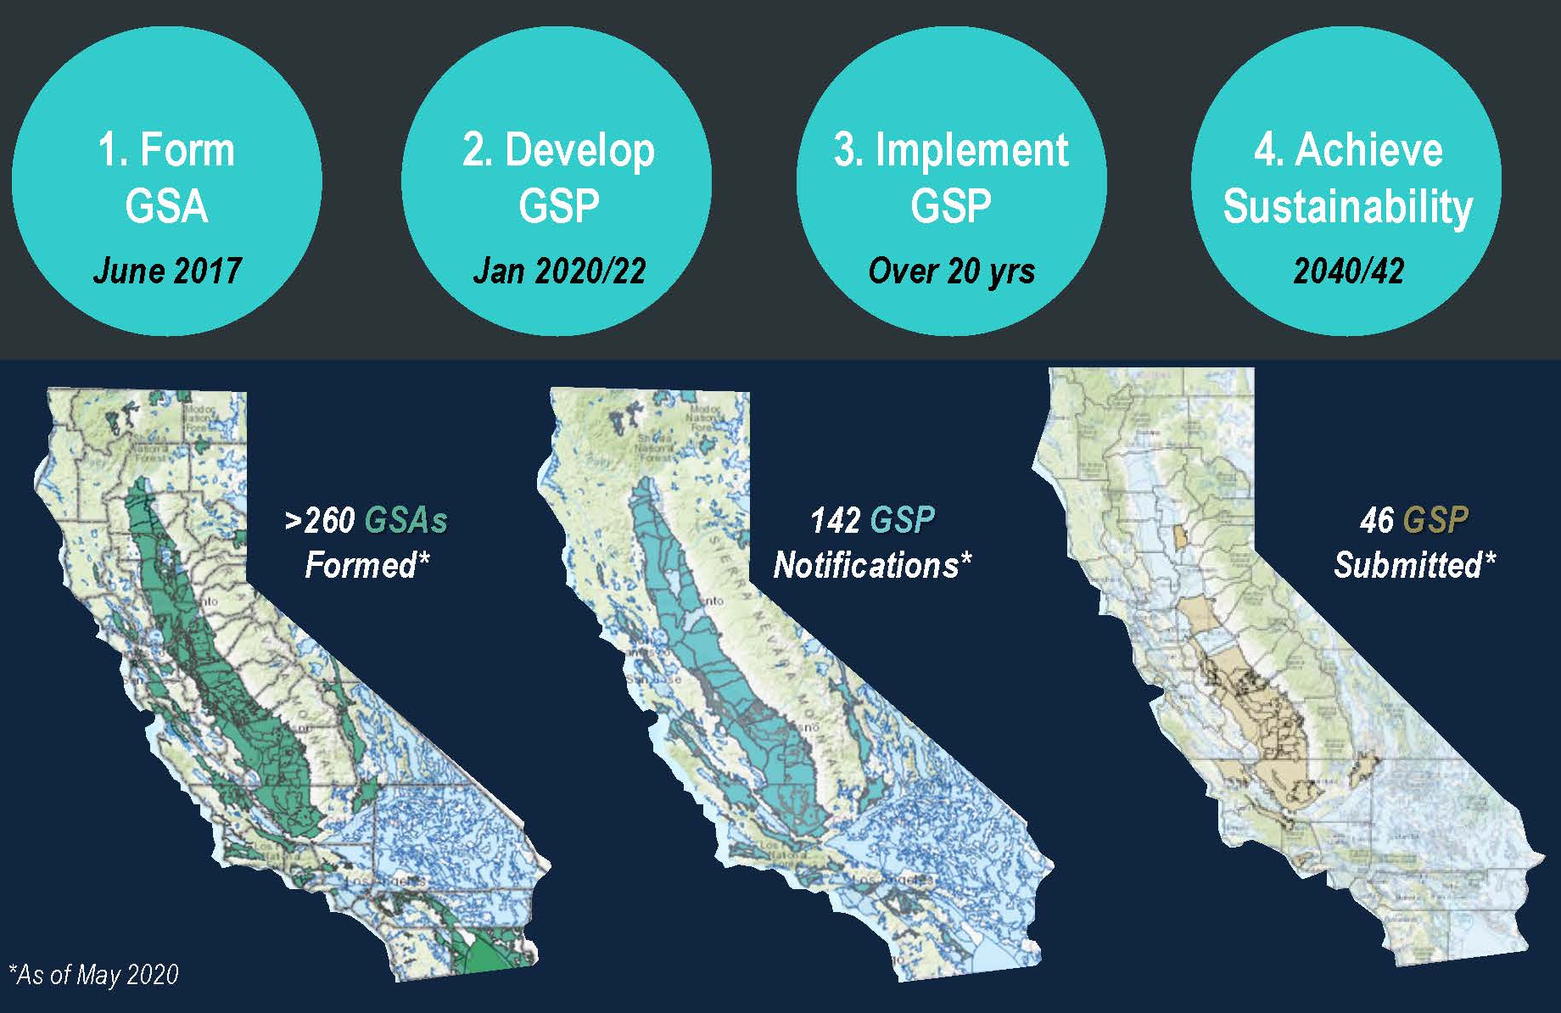
Sustainable Groundwater Management Act (SGMA)
Achieve groundwater sustainability in medium and high priority GW basins.
Implement monitoring, projects and management actions to achieve sustainability in 20 years.
Local control, if successful, backstopped by State intervention.
111 GSPs Submitted
Notes:
Overview of SGMA. Dates represent deadlines. Signed into law late in 2014. Four main requirements with time deadlines. Critically overdrafted basins two years ahead of than us. Local control with state intervention is possible if GSPs or their implementation are deemed insufficient.

Slide 5
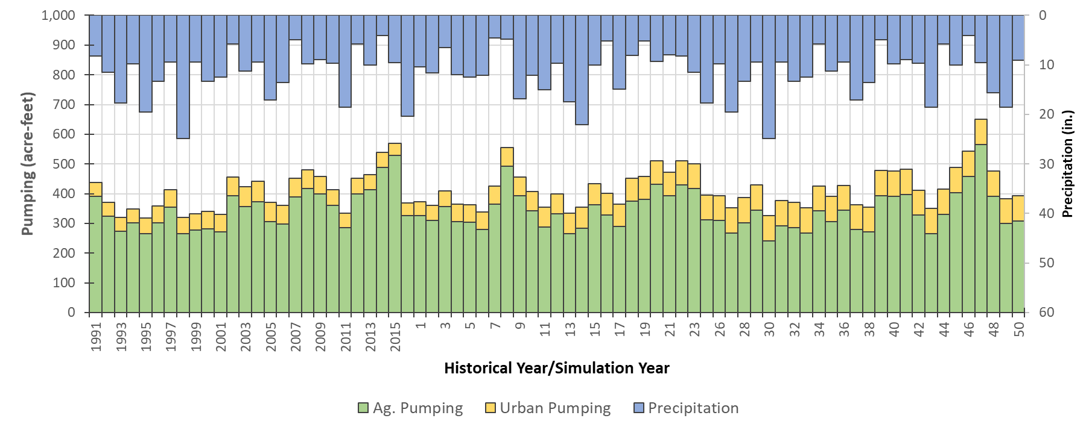
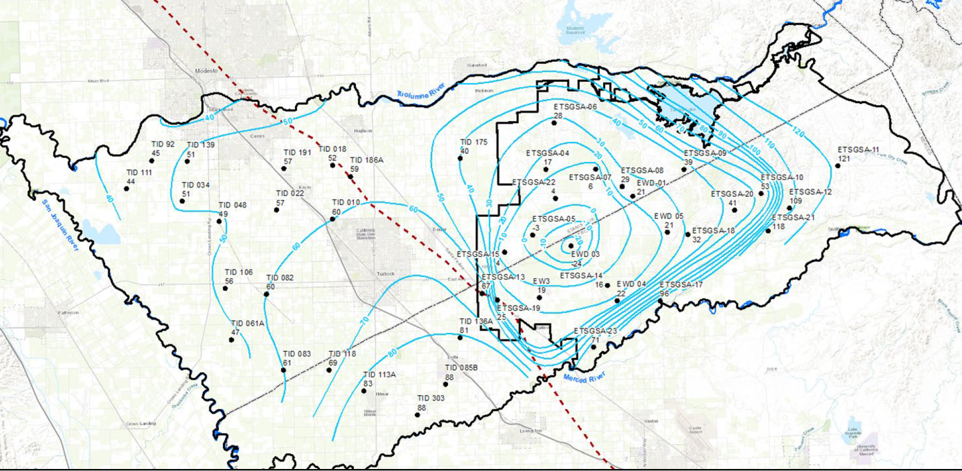
Groundwater Pumping and Sustainable Yield
Historical
Conditions
Projected Conditions
Current and projected subbasin groundwater demand exceeds long-term sustainable yield
Estimated Long-Term Average Sustainable Yield
Long-term groundwater extraction has created a cone of depression in the eastern subbasin
Notes:
This is a graphic view of the problem we are trying to solve, which is a long term imbalance between groundwater extraction and recharge, leading to drawdown on the east side of the subbasin. The graph shows model groundwater pumping for the entire subbasin, with historical conditions left of the vertical line, and forecast conditions on the right. Precipitation is on the top in blue, and groundwater pumping is on the bottom in green and yellow. The estimated sustainable yield is the red line, and the bars show it has been exceeded historically and is expected to be exceeded during dry periods in the future. Sustainable yield is estimated at ~314,000 AFY. The map shows groundwater level contours around a cone of depression that has formed on the east side of the subbasin.
The map shows a “cone of depression” that has formed as a result of groundwater pumping in ETSGSA. Deeper groundwtaer levels can cause groundwater pumping to be more expensive, can dry up wells, and result in other undesirable results. Water flows from the rivers toward this depressed area.

Slide 6
How will we Meet Subbasin Sustainability Goals?
Projects:
Physically constructed water delivery and recharge projects
Projects
Management
Actions
Management Actions:
Programs or policies that reduce groundwater demand
Notes:
We will address overdraft through a combination of projects and management actions. Projects are capital improvements constructed to increase recharge. Management actions are programs and requirements that decrease groundwater demand or help prevent undesirable results. They will work together – the more we accomplish through projects, the less we will have to do through management actions. There is an optimal balance.

Slide 7

GSA Administration and
GSP Implementation
Projects and
Management Actions
Data Collection & Analysis
In Lieu Recharge Projects
Planning & Management
Direct Recharge Projects
Monitoring
Sustainable
Groundwater
Management
Dispersed Recharge
Response Actions
Land Repurposing
Compliance Reporting
Other Demand Reduction
GSA/GSP Administration
Pumping Management

Slide 8
Sustainable Groundwater Management Strategy
Recharge Projects
MLRP Program
Policies, Rules & Regulations
Replenishment Water Program
Land-based Benefit Assessment
Direct recharge
Recharge Master Planning
MLRP Plan
Dispersed storm-water recharge
Optimization (GRAT)
Allocations and accounting
Assessment/ Fees
Programmatic and site permitting
Land repurposing
Prioritization and optimization (GRAT)
Incentive Payments
Trading & credits
Measurement and monitoring
Alternatives and appeals
Grower Decision Support Portal
Volume-based Extraction Fee
Engineer’s Report and Fee Study
Public Outreach
Vote/Protest
Management Zones

Slide 9
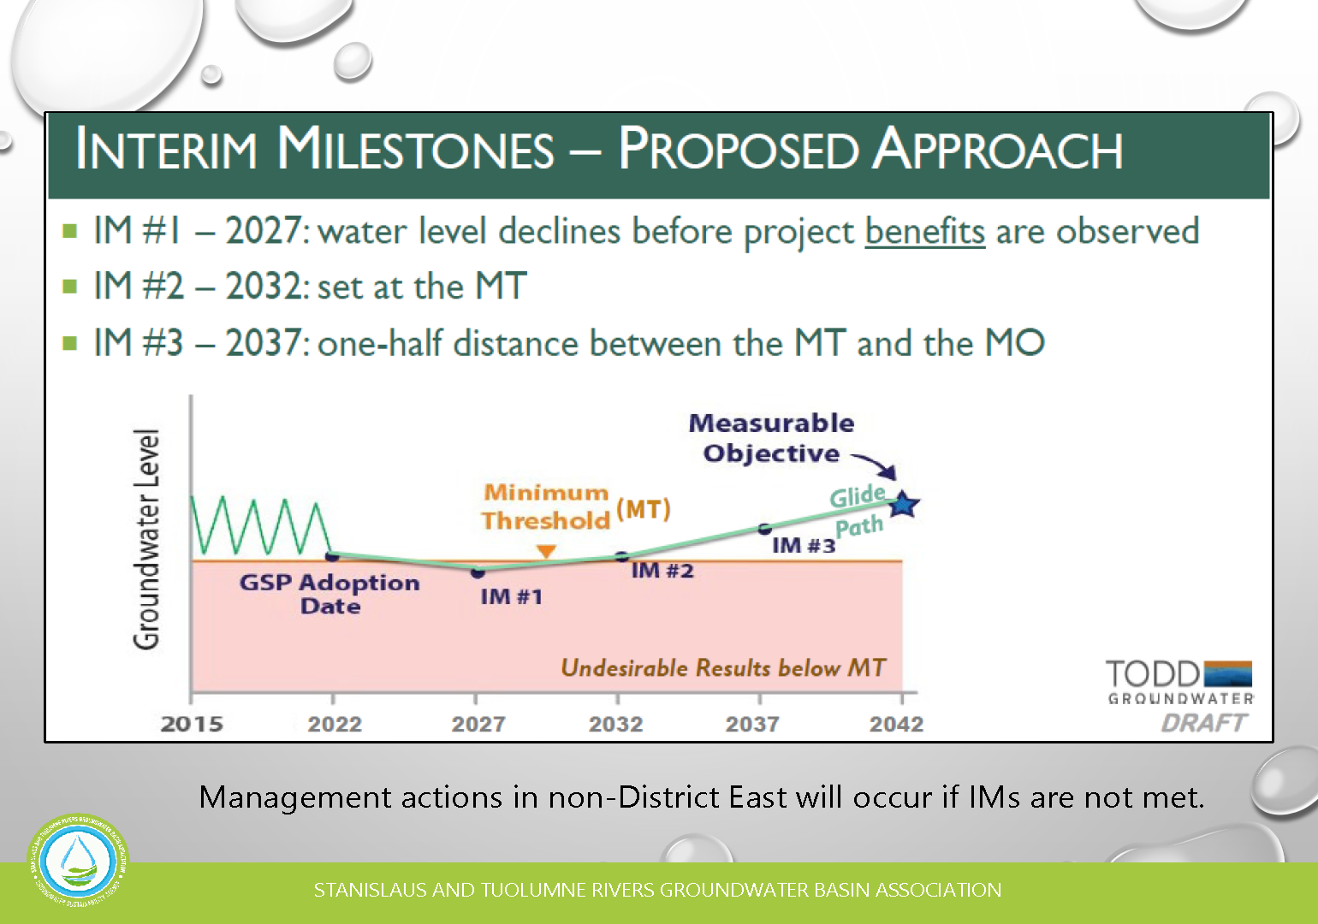
Pumping Management Framework Implementation approach
Notes:
Intro slide shows the “glide path” to reach sustainability over 20 years. We are near the beginning of the process

Slide 10
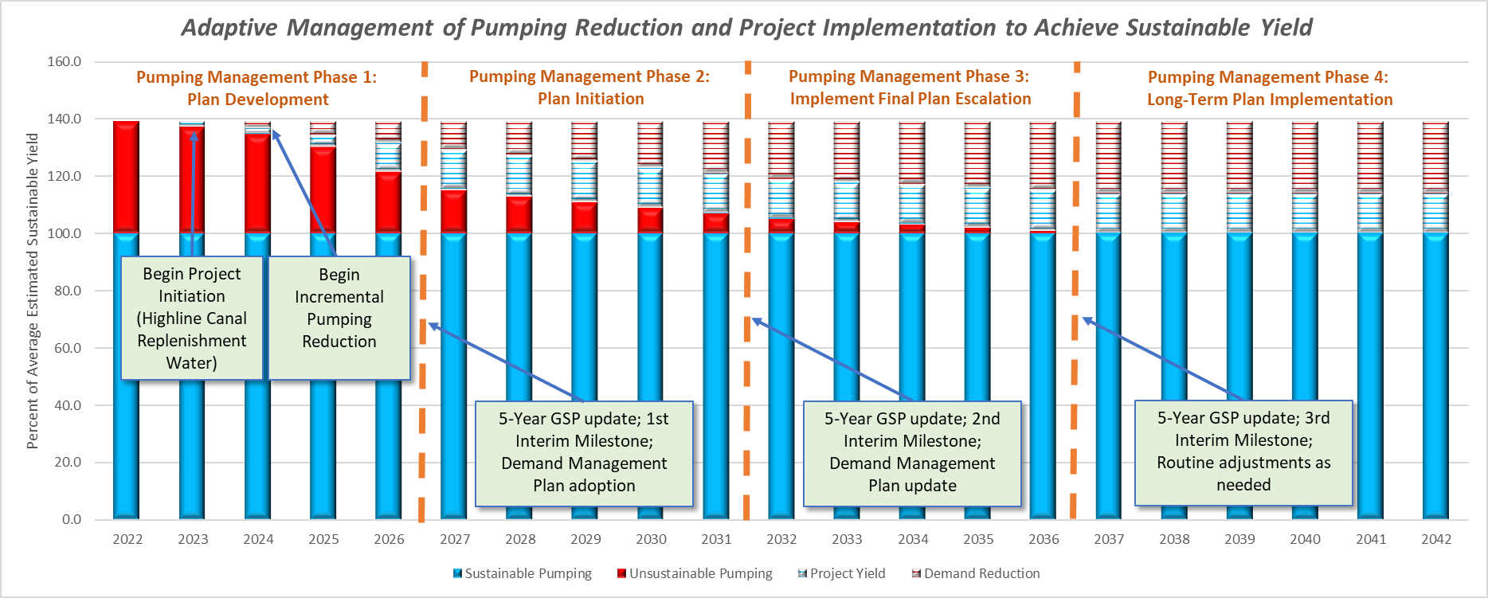
Adaptive Management Implementation Strategy
Notes:
Add caveat that this is simplified and doesn’t reflect year to year variability. Does not account for the possibility that adjustments that may be needed depending on the observed outcomes, variability and whether we achieve our measurable objectives

Slide 11
Yield from Projects & Management Actions

Slide 12
Yield from Projects & Management Actions

Slide 14
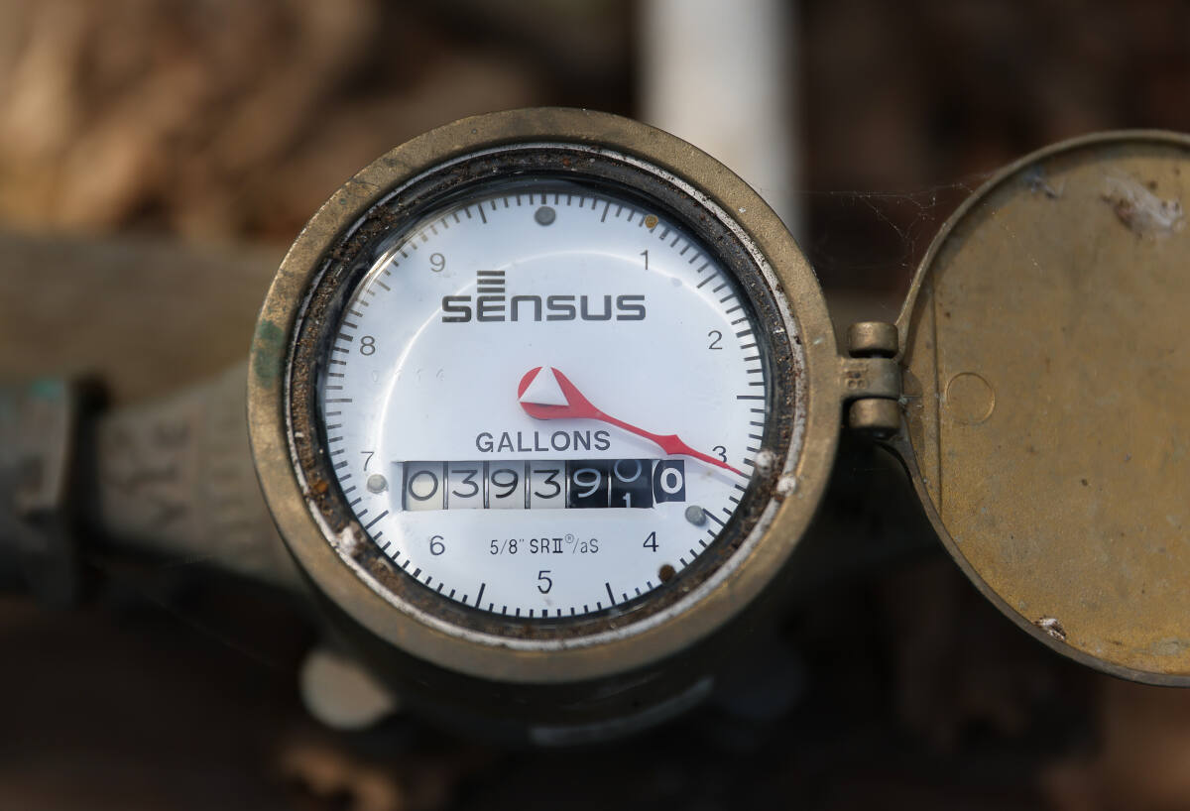
Rules
&
Regulations

Slide 15
Schedule for Development of Policies, Rules & Regulations
NOW
(Support Prop 218)
NEXT
(Before 2024 Irrigation Season)
LATER
(Before 2025 Irrigation Season)
Groundwater Allocations
Assessment/Fee Calculation
Groundwater Use Monitoring Methods
Surface water Accounting
Groundwater Account Creation
Key Definitions
Accounting for Non-Irrigated Land Uses, Fallowing, Repurposing
Consolidating Accounts
Other Credits
Appeals Process
Grower-Supplied Modifications
Metering Manual
Measurement of Surface Water Deliveries
Penalties & Enforcement
Trading Between Accounts
GSA Management Zones

Slide 16
Guiding Objectives for Fee and Allocation Rules
Maintain/adopt incentives that decrease groundwater use
Provide incentives to use surface water when available
Maintain equity
Recognize when parcels receive less benefit from P&MAs
Use a proportional approach when warranted
Avoid creating surface water use disincentives such as multiple charges
Keep it simple
Avoid creating special classes or benefits when possible
Avoid creating complex or special rules
Minimize creation of special benefit zones
Provide incentives to decrease groundwater use

Slide 17
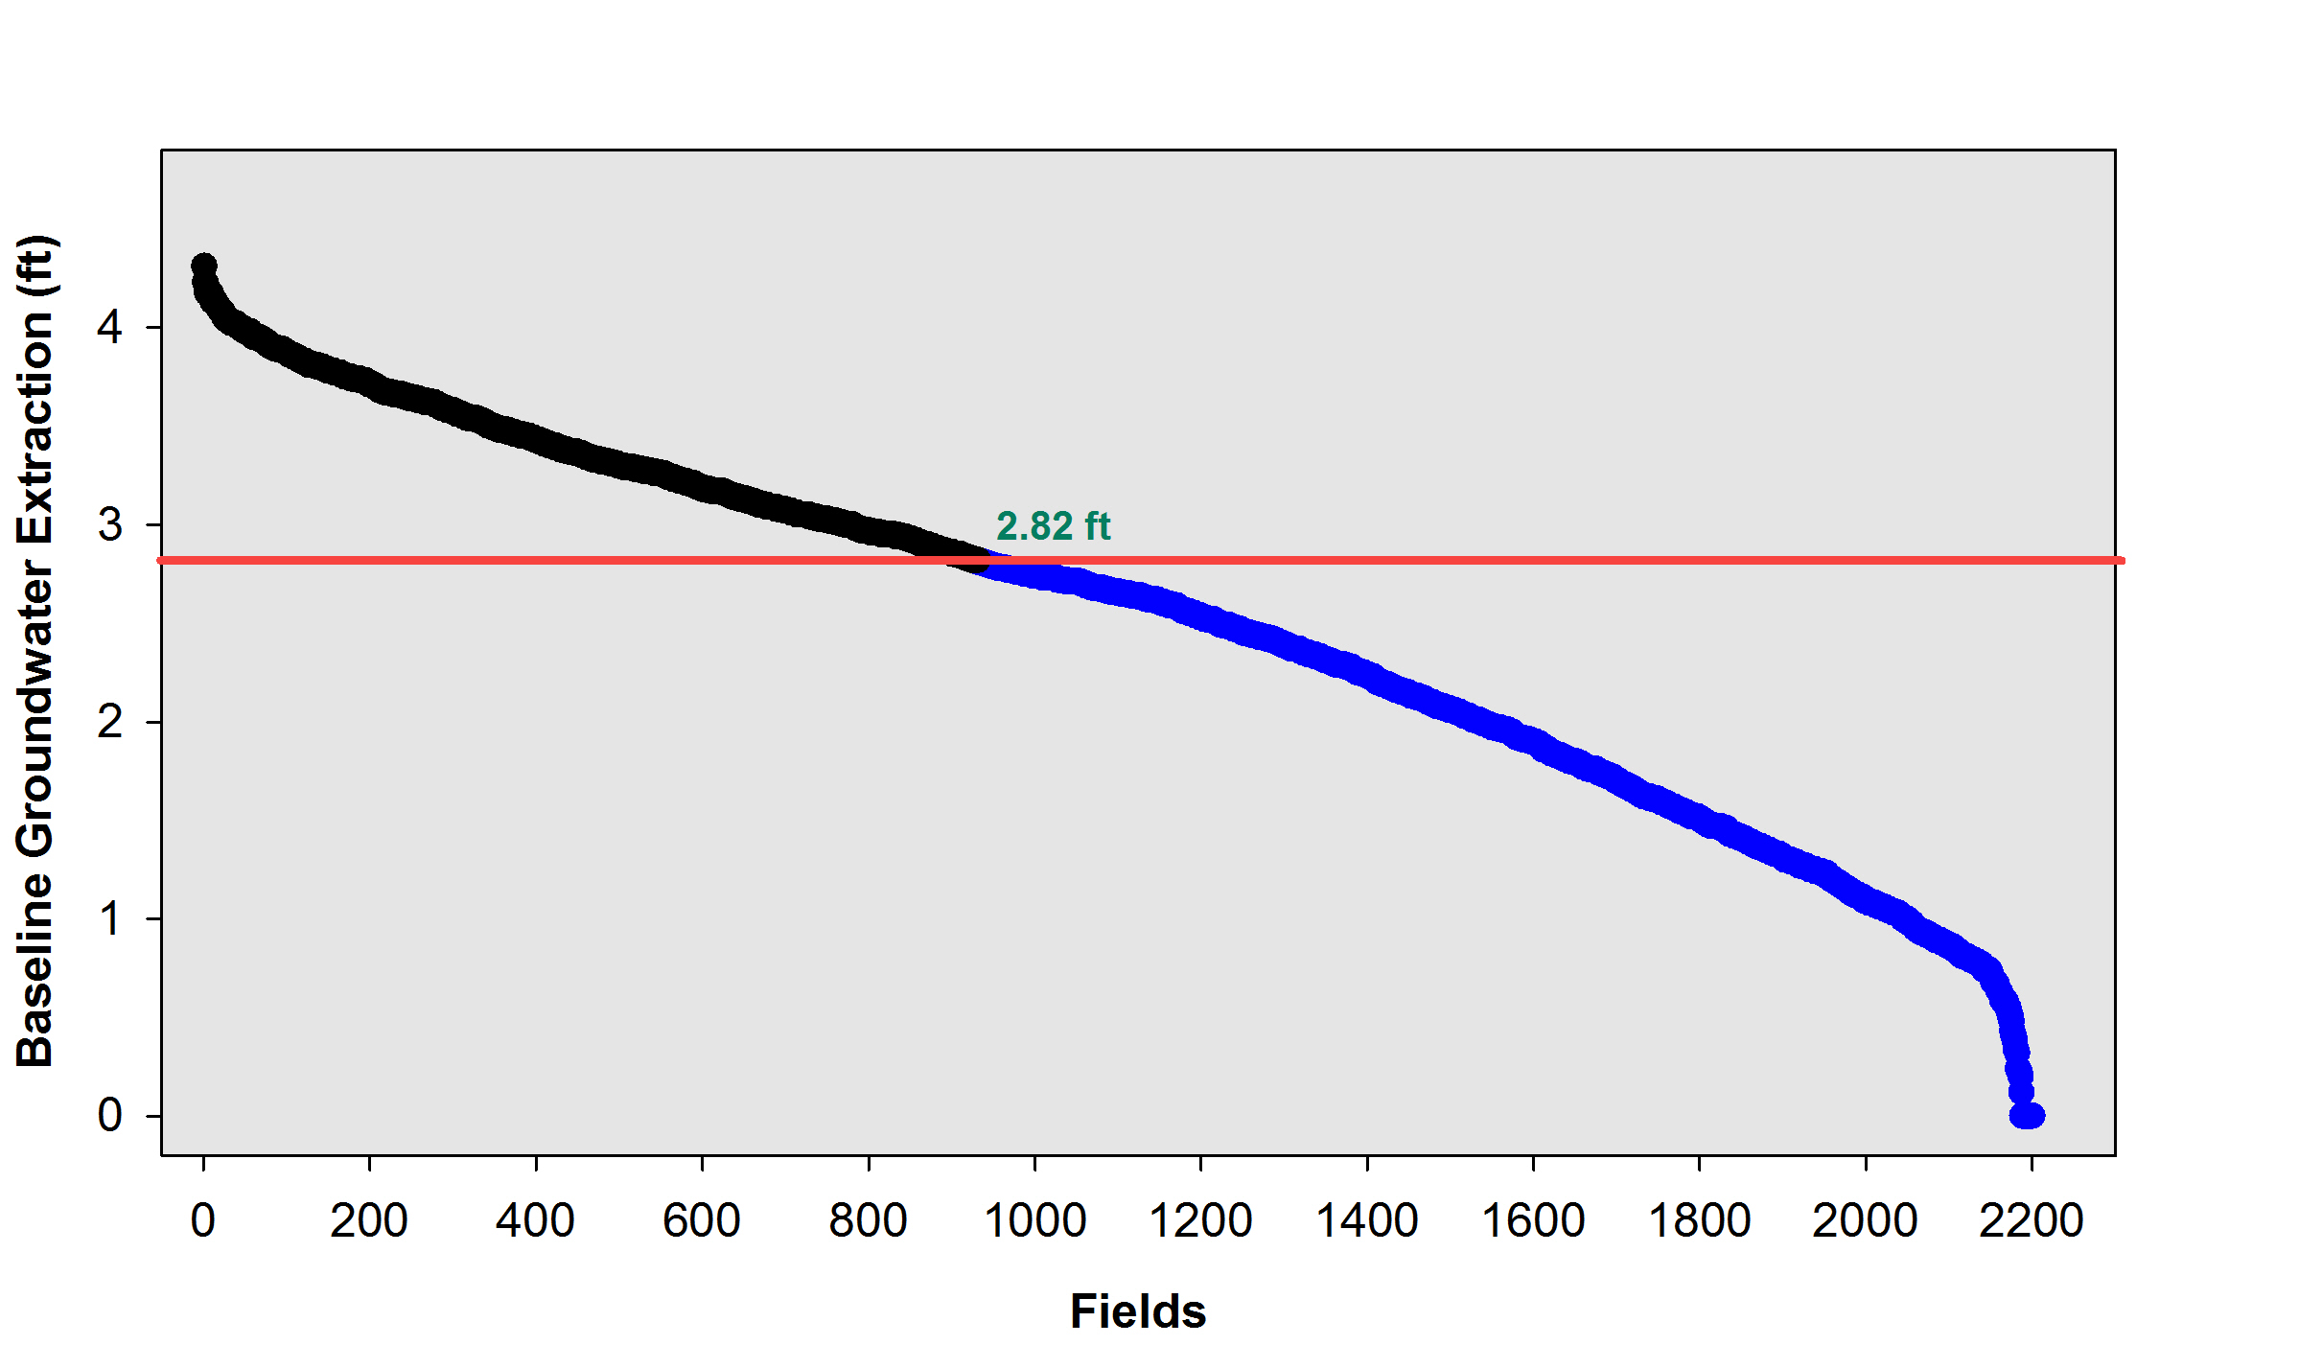
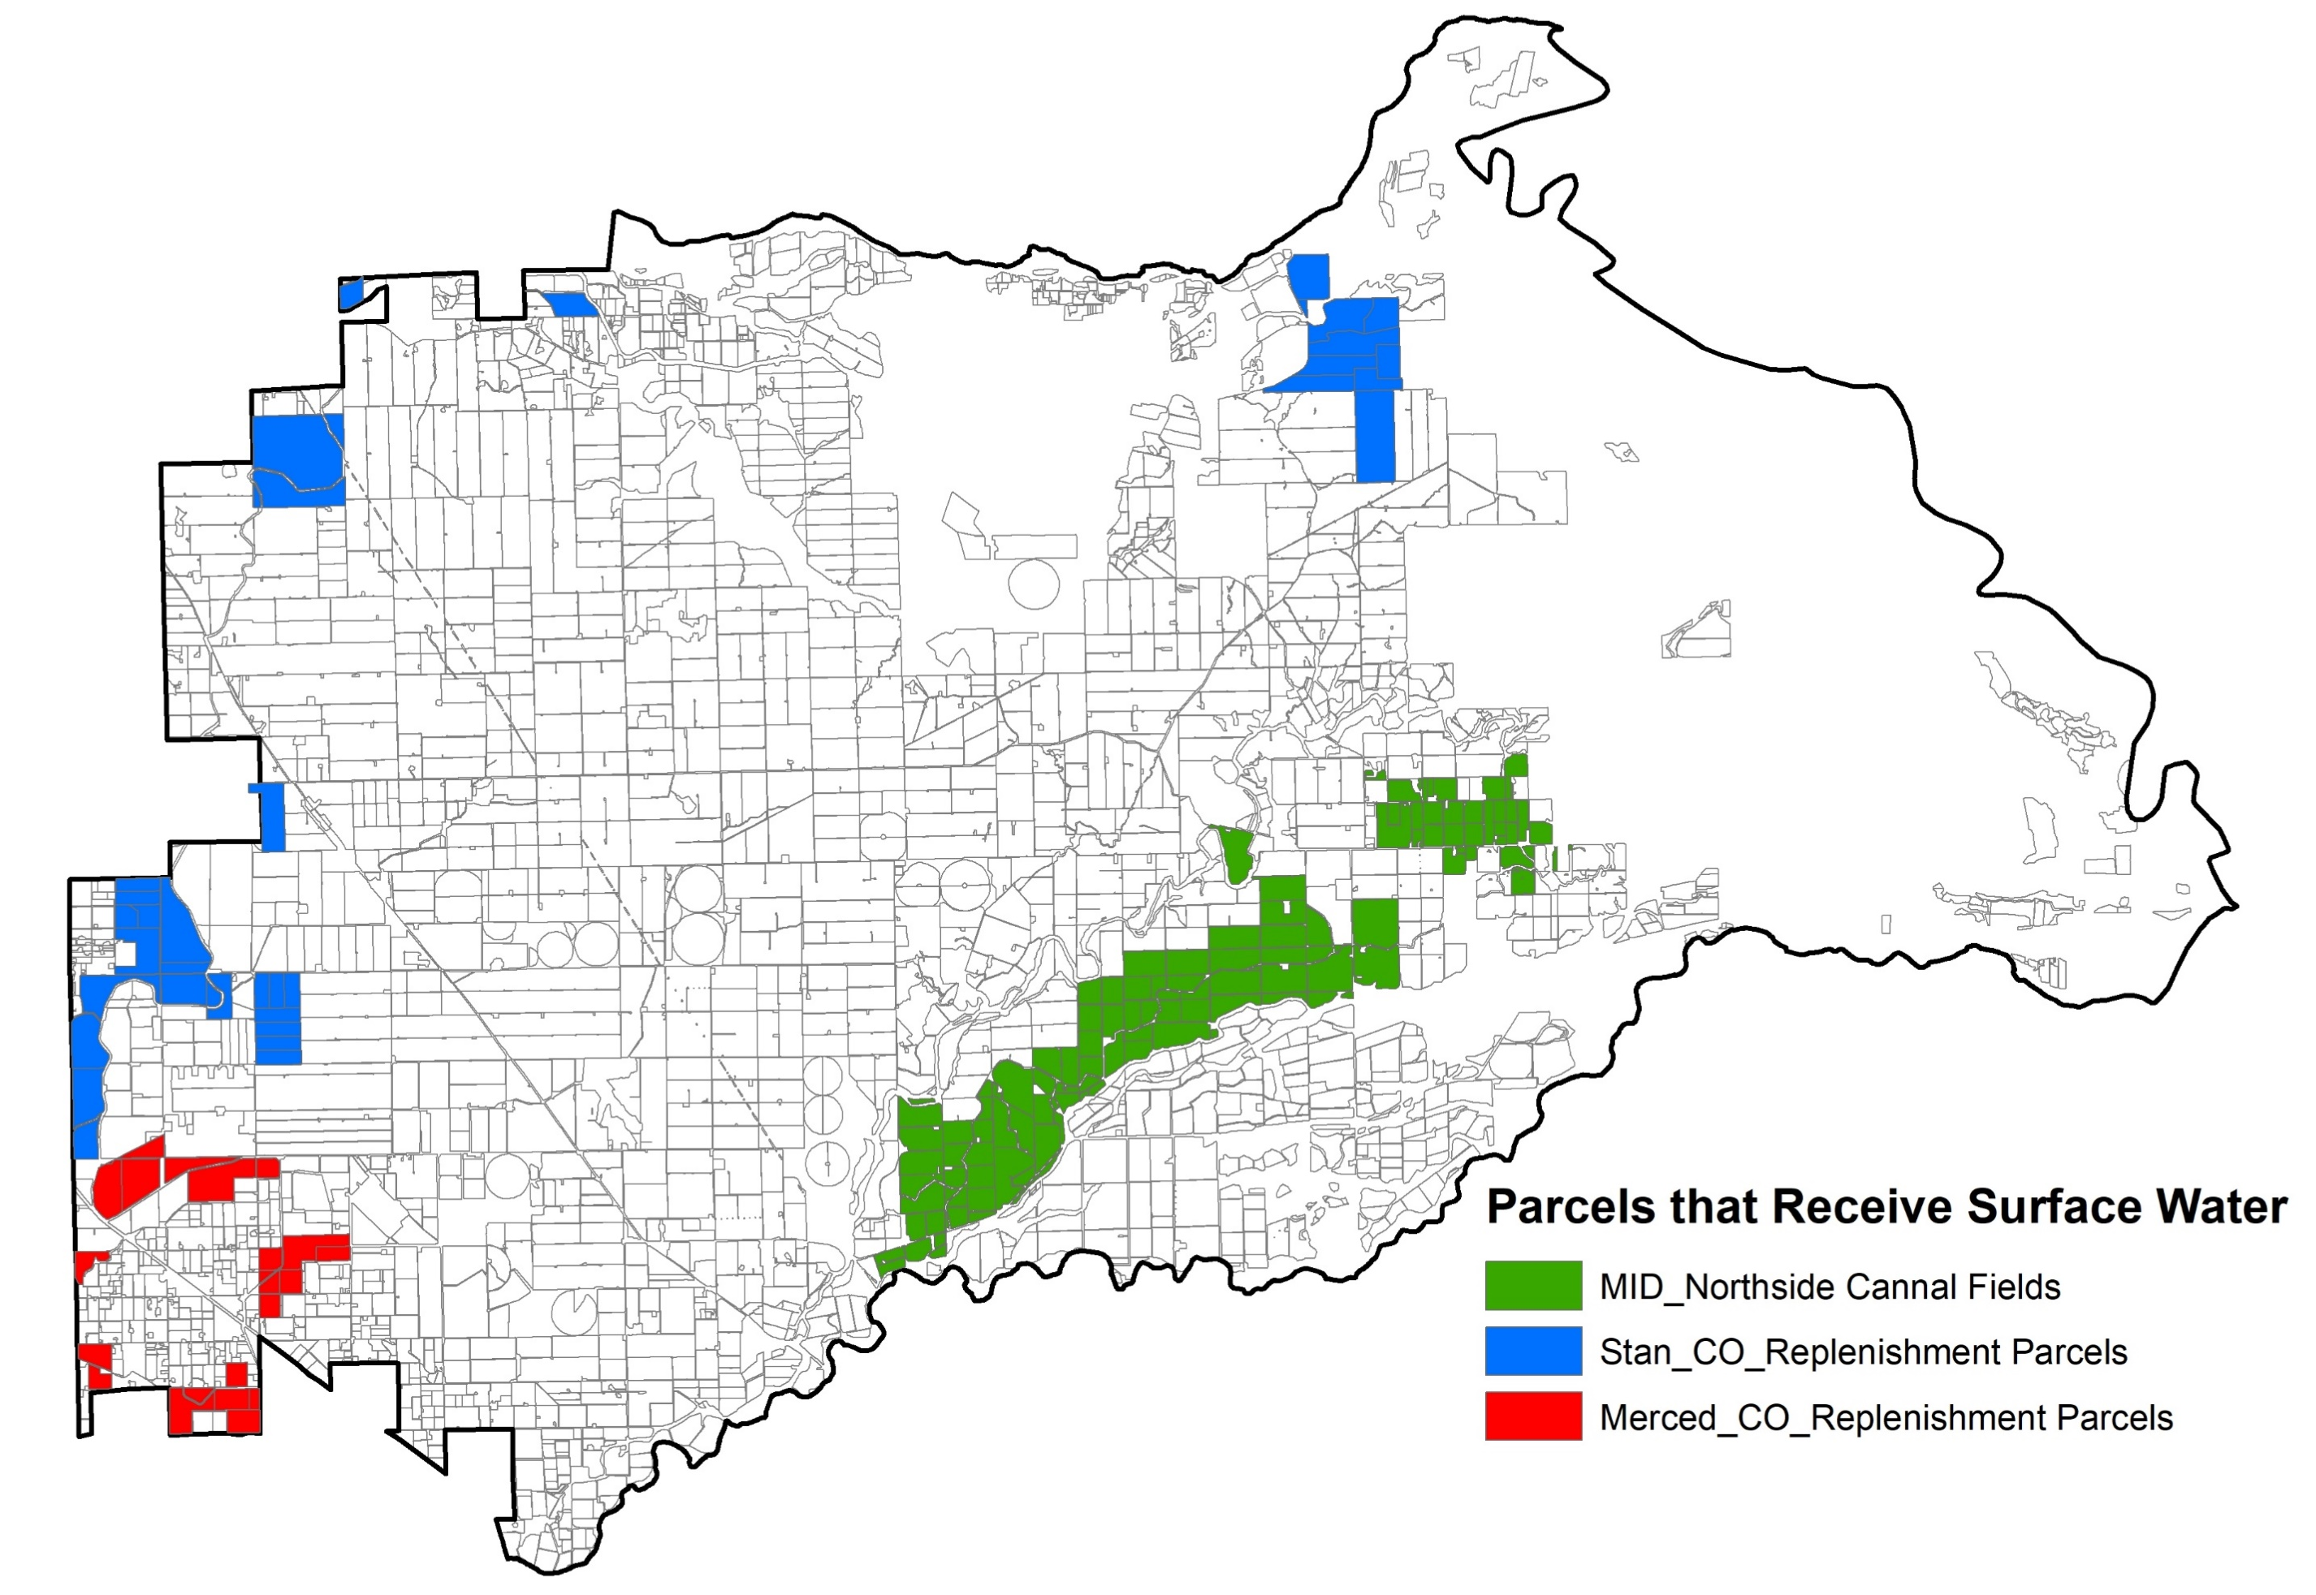
Baseline Consumptive GW Use
Average Baseline ET for all parcels designated as irrigated (Mar – Oct)
= 241,425 AF/year
Equivalent Consumptive GW Use
= 2.82 ft/year (33.8 in/year)
Approximate Surface Water Deliveries
= 12,000 AF/year
931 fields
Baseline Groundwater Use (ft)
1269 fields

Slide 18
Consumptive Groundwater Use Allocations
Eligibility
Parcels classified as irrigated by County Assessor
Determined for each parcel in March 1 of each year
Basis
Acre-foot/acre of assessed irrigated parcel
Annual allocations
Amount
Escalating Reduction Target below average GSA-wide Baseline
Years 1-5 = 10% reduction
Years 6-10 = 20% reduction

Slide 19
Groundwater Use Calculation Considerations
Parcel Boundary
Irrigated Field
Dairy, Poultry, Packing or Other Operation
Fallowed or Repurposed Land
Non-Irrigated Land Use e.g., building, farmstead, roads, open water, natural land, etc.
Groundwater Use Allocation (AF) =
(Baseline – Reduction Target) x (Assessed Parcel Acres)
Reduction Target = 10% in Years 1 – 5; 20% in Years 6 - 10
Groundwater Use Calculation (AF) =
([ET of Irrigated Field 1] x [Field 1 Acres]) + ([ET of Irrigated Field 2] x [Field 2 Acres]) + (Calculated or Measured GW Use of Dairy or Poultry Operation)

Slide 20
Consumptive Groundwater Use Calculation
Consumptive Groundwater Use
=
Surface Water Deliveries
ET Consumptive Use
Precipitation
minus
minus
PROPOSED RULES & REGULATIONS
Analysis for irrigation season (March – October) to minimize precipitation effects
Precipitation subtracted at full value
Surface water deliveries subtracted (MID, TID and diversions)
Calculated using Land IQ ET data with options for metering
Compared to allocation calculated from historical ET baseline minus reduction target
Notes:
We will rely on ET to establish a baseline because it is the most robust way to analyze historical trends. Metering is the preferred approach for long term measurement, but will need to be implemented over time. So for the initial period, allocations and usage will be tracked in ET units. There will be an option to use metering during this time for those that have data that meets minimum standards. After the first five years, metering will be used with ET as a fallback

Slide 21
Surface Water Rules & Regulations
Replenishment Water
Up to 5,000 af in 79/127 years to parcels near Highline and Upper Main Canal
Potential future delivery of up to 20,000 afy in cone of depression in 79/127 years
Northside Canal Service Area
4,830 acres with water service from MID, supplemented by groundwater
Average of 9,831 afy from 2008 to 2022
Riparian Diversions
44 active non-MID points of diversion with 21 over 1 cfs, primarily along Merced River
Exclusive water source to a few parcels, supplemental to groundwater on most

Slide 22
Assessment Proportional to Groundwater Use
Concept
P&MA Benefit Assessment = (Assessment) x (Proportionality Factor)
Implementation: Calculate a proportional assessment share
Requires adoption of policies for establishment of allocations and for measurement of consumptive use
Proportionality Factor considers the relative stake in/benefit from achievement of the Sustainability Goal
Proportionality Factor = (Volume of Groundwater Pumped) / (Total Consumptive Use)
Calculate based on available ET and surface water delivery for the already evaluated baseline period
Use historical ET, surface water delivery and precipitation for the baseline period to calculate historical groundwater consumptive use and total consumptive use of applied water
Advantages and Limitations
Multiply GSA-wide benefit assessment for P&MAs by proportionality factor calculated for each parcel
Understandable, justifiable, and Uses available data
Riparian diversions may require specific attention

Slide 23
Replenishment Water
Background
Delivery of replenishment water for in lieu recharge and direct recharge is a Group 2 GSP project that benefits subbasin sustainability when and where surface water can be made available by TID and MID.
Proposed Policies
The GSA policy would pay for infrastructure improvements to implement and expand the replenishment water program to as many parcels as possible. This use benefits the subbasin as a whole.
EWD and BCWD have adopted policies that recognizes replenishment water programs as benefits to all their constituents, and pay for infrastructure improvements and purchase of replenishment water to promote its use.
GSA benefit assessment of all irrigated parcels for infrastructure and direct recharge water costs is defensible. Replenishment water parcels would therefore be charged at the full land-based benefit assessment rate.
The GSA would not pay for replenishment water used for in lieu recharge because irrigation provides a direct benefit to the parcels irrigation season replenishment water and not to other parcels.
The policy of the GSA is to promote and maximize the use of surface water for direct and in lieu recharge.
The GSA would pay for water used for direct recharge. This use benefits the subbasin as a whole.
EWD and BCWD replenishment water purchase may continue as projects implemented by those agencies.

Slide 24

Proposed
Assessment & Fees

Slide 25
Potential Funding Mechanism Structure and Timeline
Funding Mechanism Organization
All land-based charges fulfilled by a Prop 218 benefit assessment
All extraction-based charges fulfilled by a Prop 218 property related fee
Funding Mechanism Implementation Timeline
Prop 218 benefit assessment adopted first (Dec-Mar 2023/24)
Covers 100% of project and operational budget
Prop 218 property related fee adopted second (Spring 2024)
Covers additional costs based on pumping beyond allocation (Tiered Overdraft Pumping Rates )

Slide 26
Potential Assessment Implementation Timeline
December 2023
Draft Engineer’s Report Reviewed
January 2024
March 2024
April 2024
Final Engineer’s Report adopted
Assessment ballots mailed to property owners (60-day balloting period)
January 2024
Board reconvenes to tabulate ballots
If majority support is achieved, assessment imposed by Board

Slide 27
Operational Budget
NOTE – DEBT SERVICE CHARGES INCLUDE A 2.5% INTEREST RATE COMPOUNDED ANNUALLY

Slide 28
Project & Management Action Budget

Slide 29
Land-Based Benefit Assessment

Slide 30
Limitations of this Rate Model
Acreage
We are working to refine the total number of irrigated land acres.
Debt Service
It is anticipated that parcels within Eastside Water District will not be required to pay into the debt service related to loans received from EWD.
Assessment rates may change slightly based on this refinement (likely decrease).
For the existing loan from EWD and any potential future loans from EWD, these parcels would see a slightly reduced rate during debt repayment.
Conversely, parcels within the GSA but outside of EWD would see a slight rate increase during debt repayment.

Slide 31
Tiered Overdraft Fees
NOTE – OVERDRAFT FEES WOULD ONLY GENERATE REVENUE REQUIRED TO MAKE UP FOR A FAILURE TO MEET PUMPING ALLOCATION

Slide 32
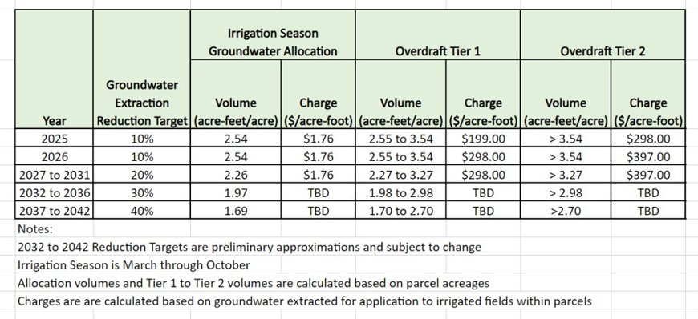
Groundwater Allocations & Overdraft Fees

Slide 33
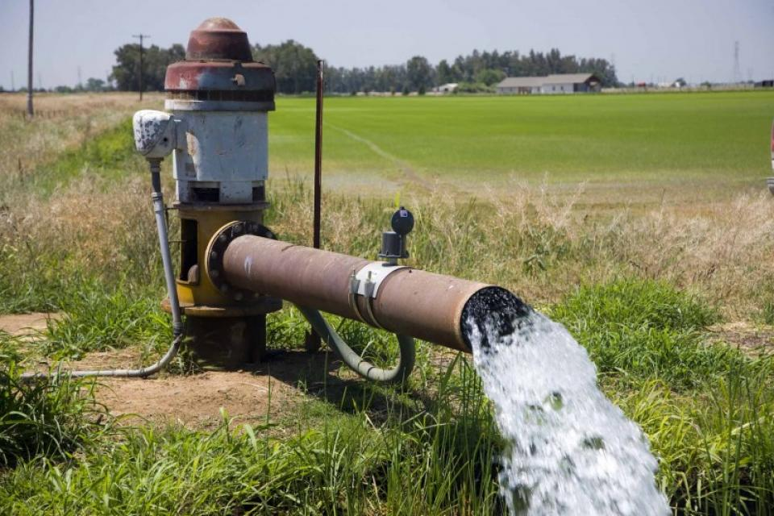
Example Application to a Theoretical Site

Slide 34
Example Fee/Assessment Calculation – Theoretical Parcel
Parcel Boundary
Irrigated Field
Fallowed or Repurposed Land
Non-Irrigated Land Use e.g., building, farmstead, roads, open water, natural land, etc.
Assumptions
100 acre parcel with 95 acres of almond orchard irrigated by groundwater
Consumptive groundwater demand of 3.4 acre-feet/acre
No land fallowing, repurposing or demand reduction

Slide 35
Example Fee/Assessment Calculation – Allocation and Volume Used
Parcel Boundary
Irrigated Field
Fallowed or Repurposed Land
Non-Irrigated Land Use e.g., building, farmstead, roads, open water, natural land, etc.
Groundwater Consumptive Use Allocation
Through 2027: (2.82 feet – 0.282 foot) x (100 acres) = 254 acre-feet (rounded)
2028 to 2032: (2.82 feet – 0.564 foot) x (100 acres) = 226 acre-feet (rounded)
Groundwater Consumptive Use Volume
Total Volume: (3.4 feet) x (95 acres) = 323 acre-feet
Volume over allocation through 2027: (323 acre-feet) – (254 acre-feet) = 69 acre-feet
Volume over allocation in 2028 to 2032: (323 acre-feet) – (226 acre-feet) = 97 acre-feet

Slide 36
Example Fee/Assessment Calculation – Benefit Assessment and Extraction Fee (2025)
Parcel Boundary
Irrigated Field
Fallowed or Repurposed Land
Non-Irrigated Land Use e.g., building, farmstead, roads, open water, natural land, etc.
Total Payments Due
Irrigated Parcel Benefit Assessment through 2032: ($57.76/acre) x (100 acres) = $5,776
Tier 1 Overdraft Fee in 2025:
($199/af) x {(323 acre-feet) – (254 acre-feet)} = $13,731.00
Tier 2 Overdraft Fee in 2025:
($298/af) x {(volume > 354 acre-feet)} = $0

Slide 37
Example Fee/Assessment Calculation – Benefit Assessment and Extraction Fee (2028)
Parcel Boundary
Irrigated Field
Fallowed or Repurposed Land
Non-Irrigated Land Use e.g., building, farmstead, roads, open water, natural land, etc.
Total Payment Due
Irrigated Parcel Benefit Assessment through 2032: ($57.66/acre) x (100 acres) = $5,776
Groundwater Allocation Extraction Fee through 2032:
($1.76/af) x (100 acres) x (2.26 feet) = $397.76
Tier 1 Overdraft Fee in 2028 to 2032:
($298/af) x {(323 acre-feet) – (226 acre-feet)} = $28,906.00
Tier 2 Overdraft Fee in 2028 to 2032:
($397/af) x (volume > 326 acre-feet) = $0

Slide 38
Example Fee/Assessment Calculation – Effect of Land Repurposing or Demand Reduction
Parcel Boundary
Irrigated Field
Fallowed or Repurposed Land
Non-Irrigated Land Use e.g., building, farmstead, roads, open water, natural land, etc.
Scenarios
Extraction Fees due with 0%, 10%, 20%, 30% and 40% land repurposing to non-irrigated use or fallowing
Incentive payments of $500/acre for repurposing or fallowing
Demand reduction of 8 inches (by means other than non-irrigated use or fallowing)
Evaluated for 2027, and for 2028 through 2032

Slide 42
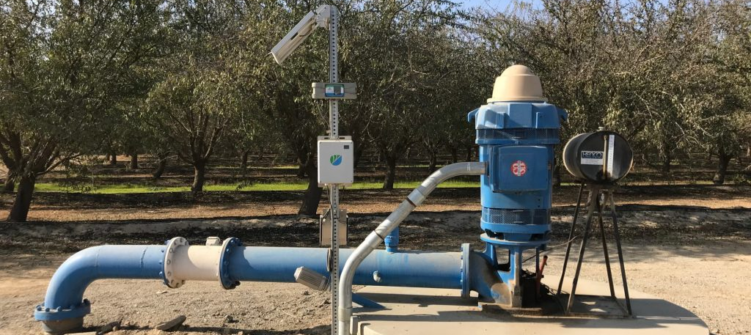
Schedules
Notes:
Introduce George

Slide 43
Parallel Schedules: Prop 218, Pumping Management, and MLRP
Land-Based Assessment
Workshop
(Dec 2023)
Adopt Report, Send Ballots (Jan 2023)
Volume-Based Fee
Workshop
(April 2024)
Adopt Report, Send Ballots (June 2024)
Policies, Rules & Regulations
Allocation & Measurement (Dec 2023)
Workshops (Dec 2023 and Nov 2024)
Grower Decision Support Portal
Pilot Study, Data Discovery (Jan 2025)
RFP
(Q1 2024)
GSA-Wide Trial
(Q2/Q3 2024)
Implementation
(April 2024)
Implementation
(2025)
Final Adoption
(Dec 2024)
MLRP Implementation
Plan Development
(Q4 2023 – Q4 2024)
MLRP Adoption
(Q1 2025)
Implementation
(Q2 2025 – Q2 2027)

Slide 44
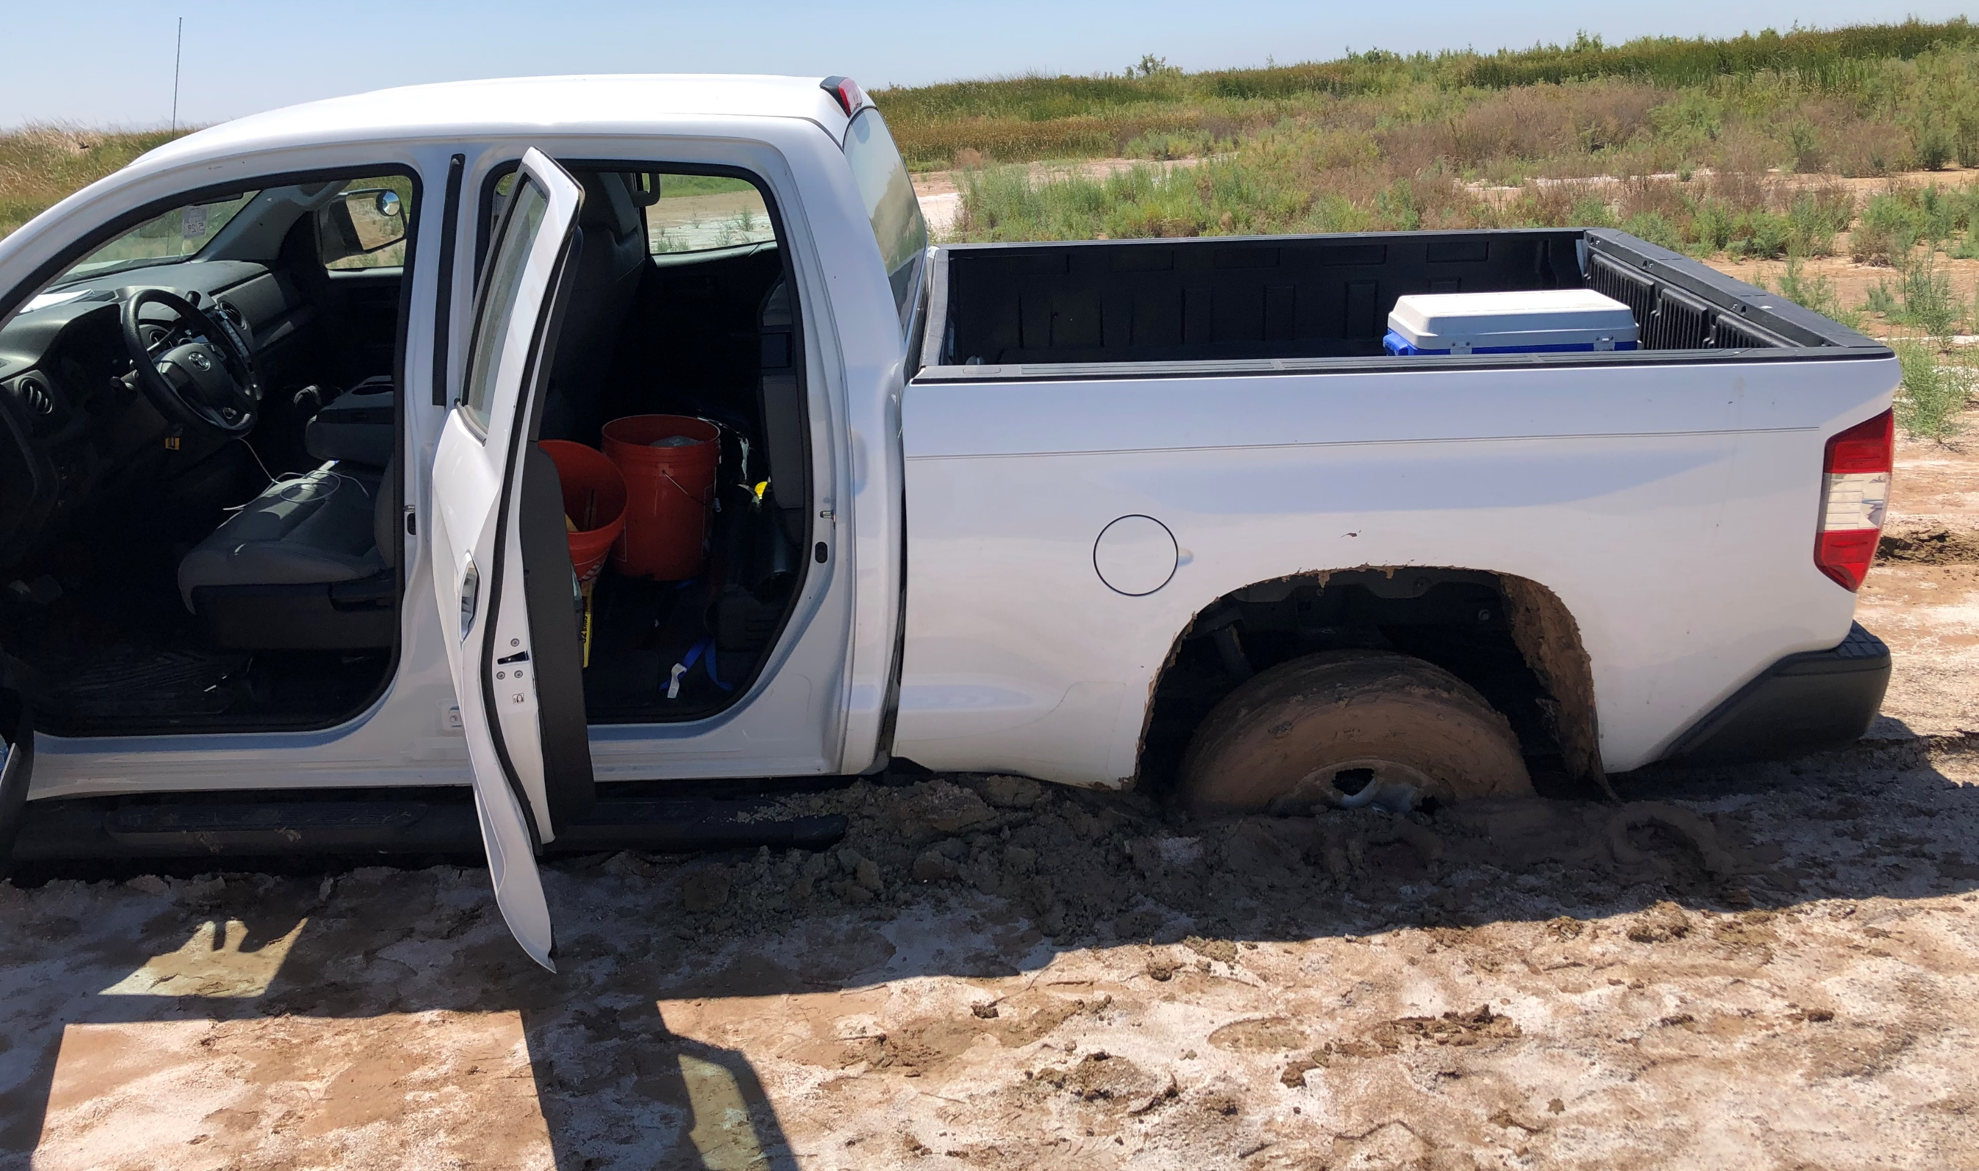
Questions?

