Slide 1

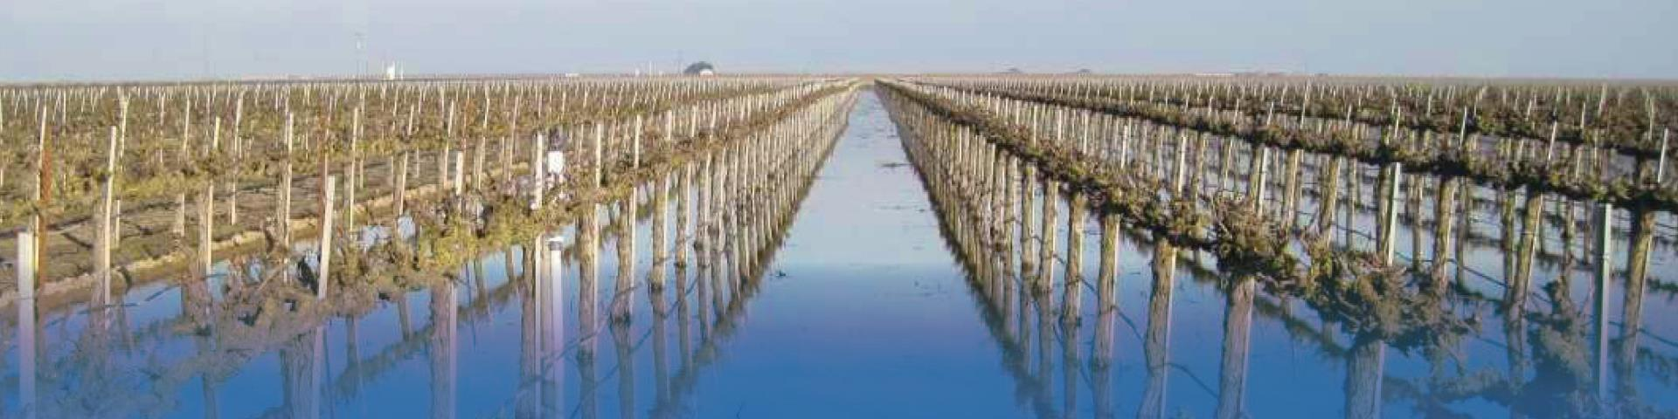
Flood-Managed Aquifer Recharge
Mariposa & Owens Creek
May 31, 2023

Slide 2
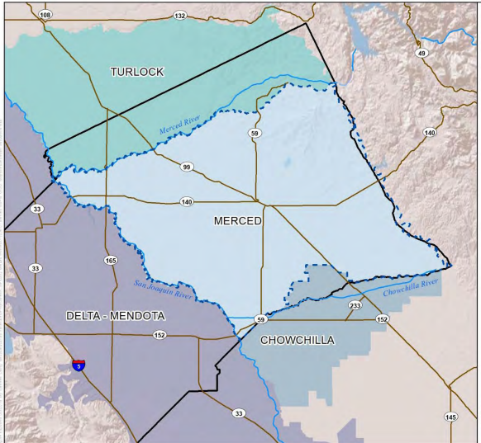
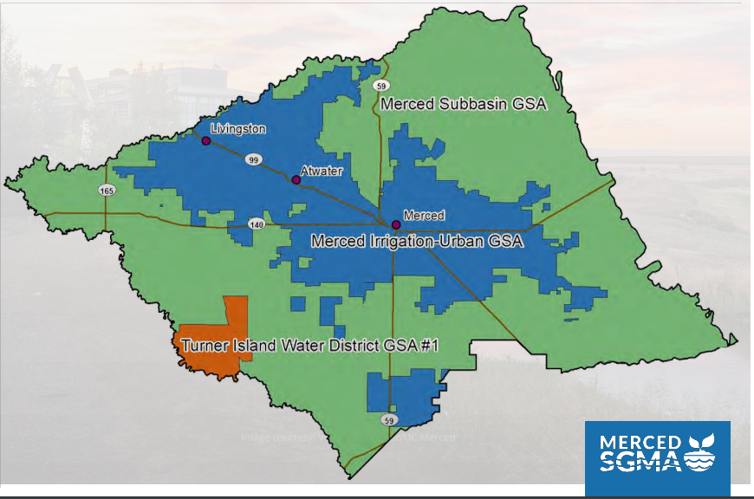
Merced Groundwater Basin – Local Management
337,000 Gross Acres
170,000 Irrigated Acres
160,000 Gross Acres
130,000 Irrigated Acres
Merced Subbasin is Critically Overdrafted (262 TAF in WY 2022, Avg. 192 TAF between 2006-2015)
Three (3) GSAs, collaborated on the development of one (1) Groundwater Sustainability Plan
Merced Irrigation District one of the seven member agencies within the Merced Irrigation-Urban Groundwater Sustainability Agency (MIUGSA)
  Almost all the urban/municipal water providers and users are within MIUGSA
Notes:
Hicham to explain in a couple slides the purpose of the SGC meeting and how they’ve gotten here. GSP has been written, but it’s MIUGSA’s responsibility to be sustainable. Have certain criteria MIUGSA must manage to avoid undesirable results such as water level declines and subsidence.

Slide 3
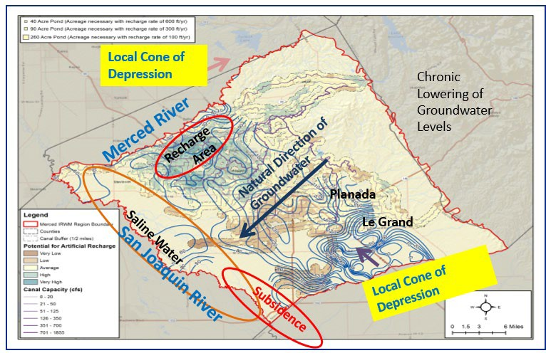
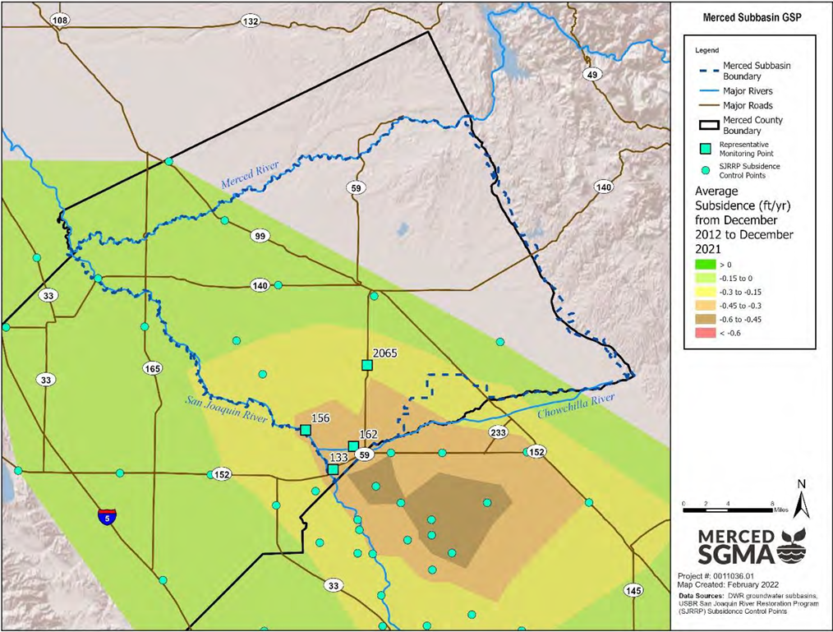
Major Challenges in the Merced Subbasin
Average Annual Subsidence Rate 2012-
2021 (ft/yr)

Slide 4
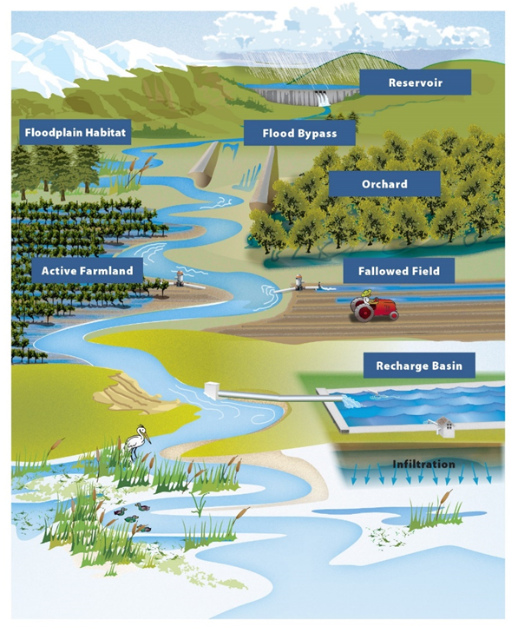


Flood-MAR
An integrated strategy to manage
water resources for sustainability & climate resiliency …
…using high flows from (or in anticipation of) rainfall or snowmelt
for managed aquifer recharge…
… on agricultural lands, working landscapes, and natural managed lands

Slide 5
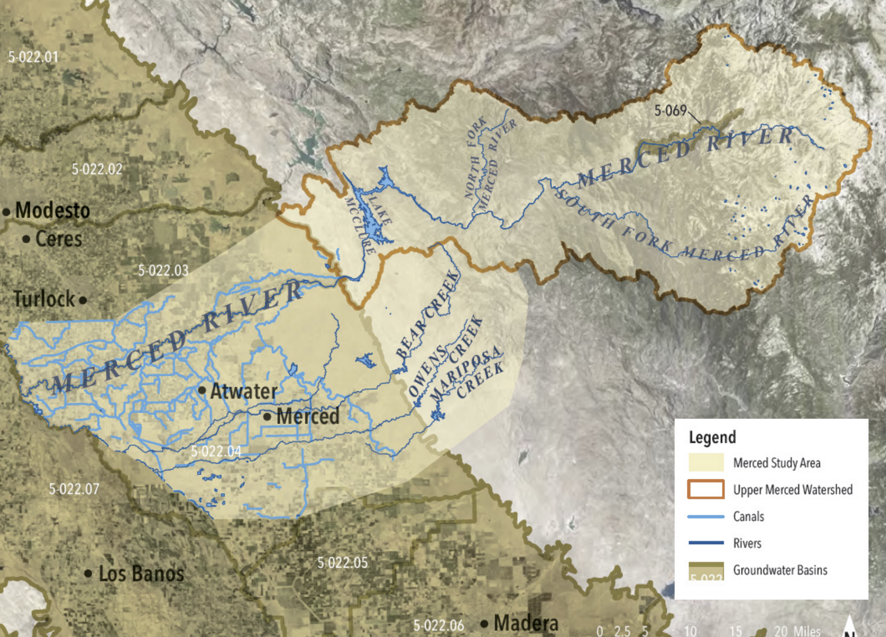
DWR – Study – Merced Watershed
Level 1 – Existing Infrastructure & Existing Operations
Level 2 – Existing Infrastructure & Reservoir Reoperations
Level 3 – New/Expanded Infrastructure & Reservoir Reoperations

Slide 6
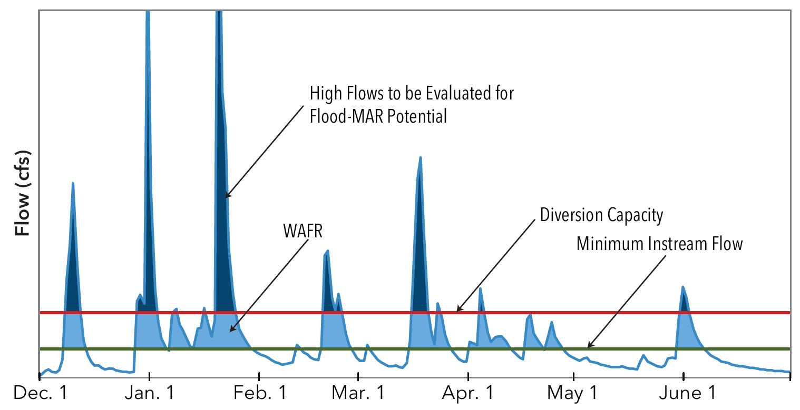
Floodwater to be Evaluated for Flood-MAR

Slide 7
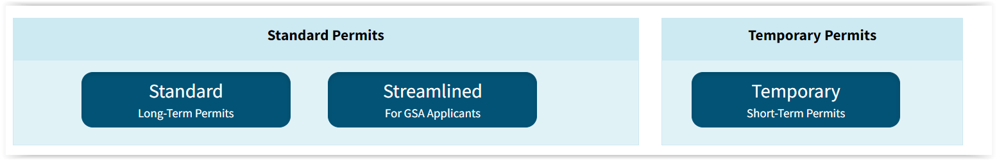
Paths to Flood-MAR
Diversions during a flood event – Water is not applied to beneficial use and no GW credit is awarded by SWRCB. However, could Still be recognized by GSA.
  Diversions did occur almost to the end of January under this rule
SWRCB Processes for diversions and claiming GW credit

Slide 8
Pilot Project – Temporary Short-Term Permit on Mariposa & Owens Creek Flood-MAR
Process begun in August 2022
DWR and MID were Co-applicants for the permit
Funded by DWR
1/12/23 – CDFW Permit

Slide 9
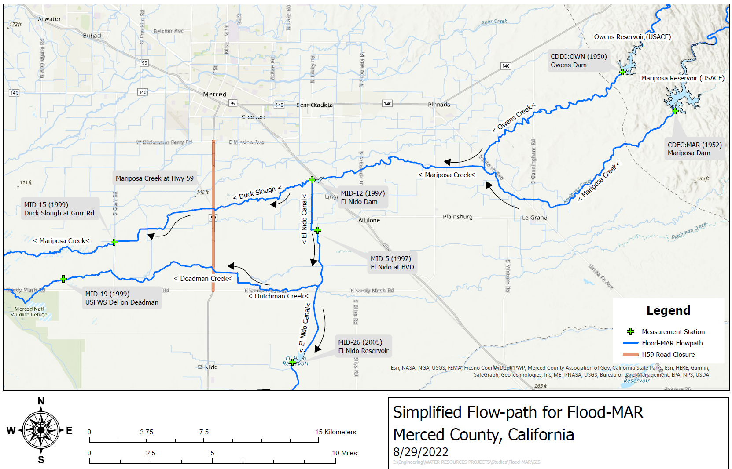
Flow-path
Subsidence Area

Slide 10
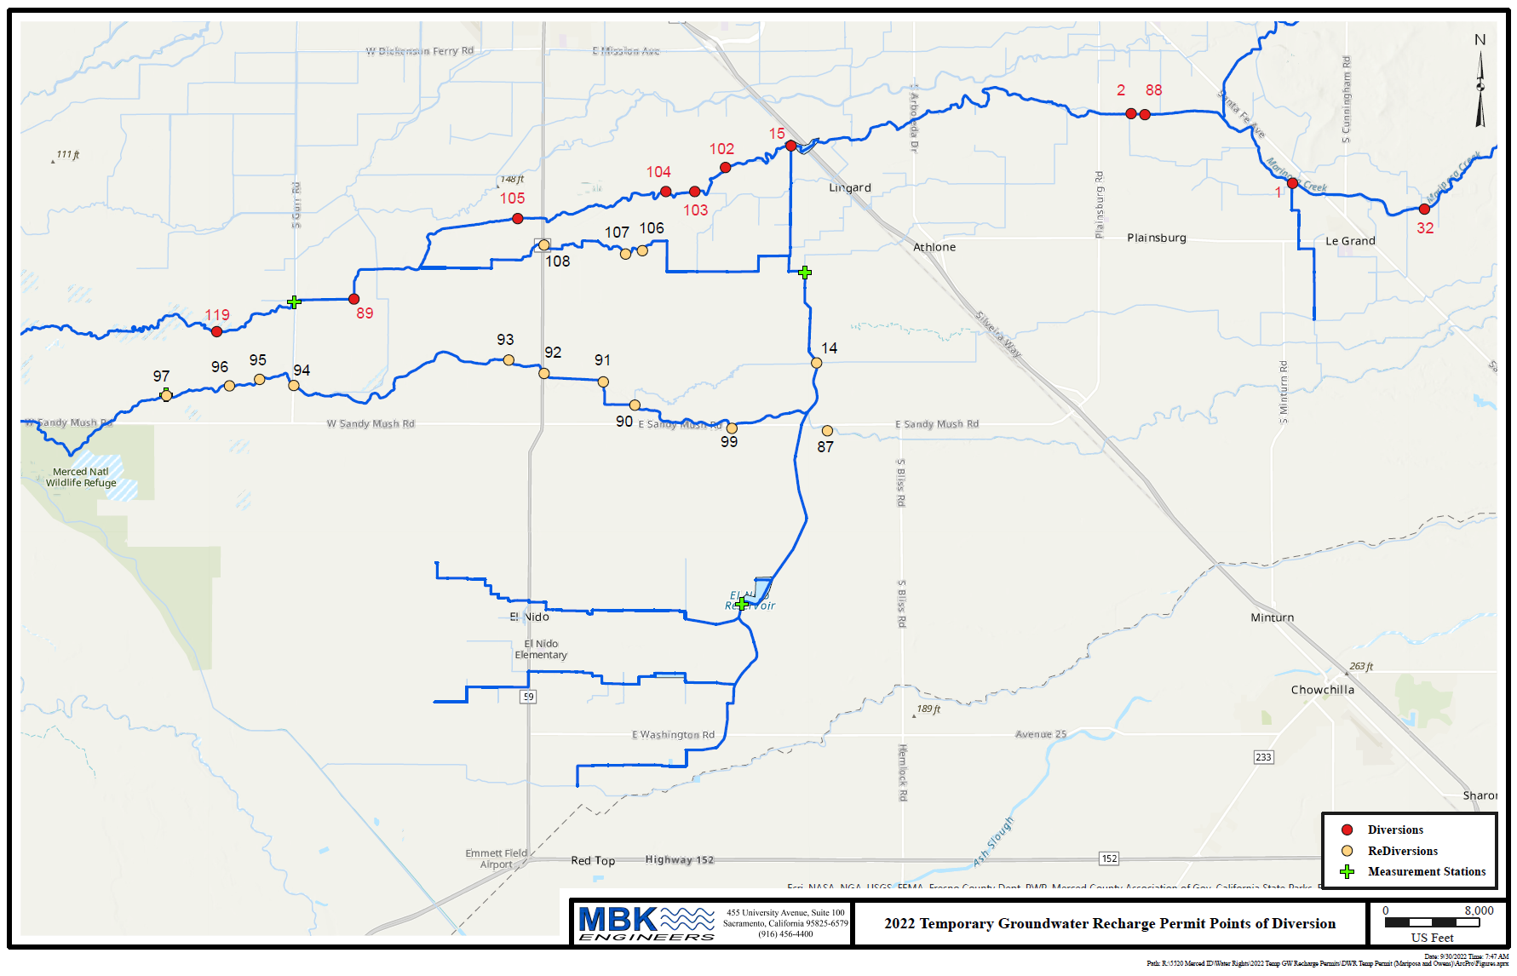
Overall Look

Slide 11
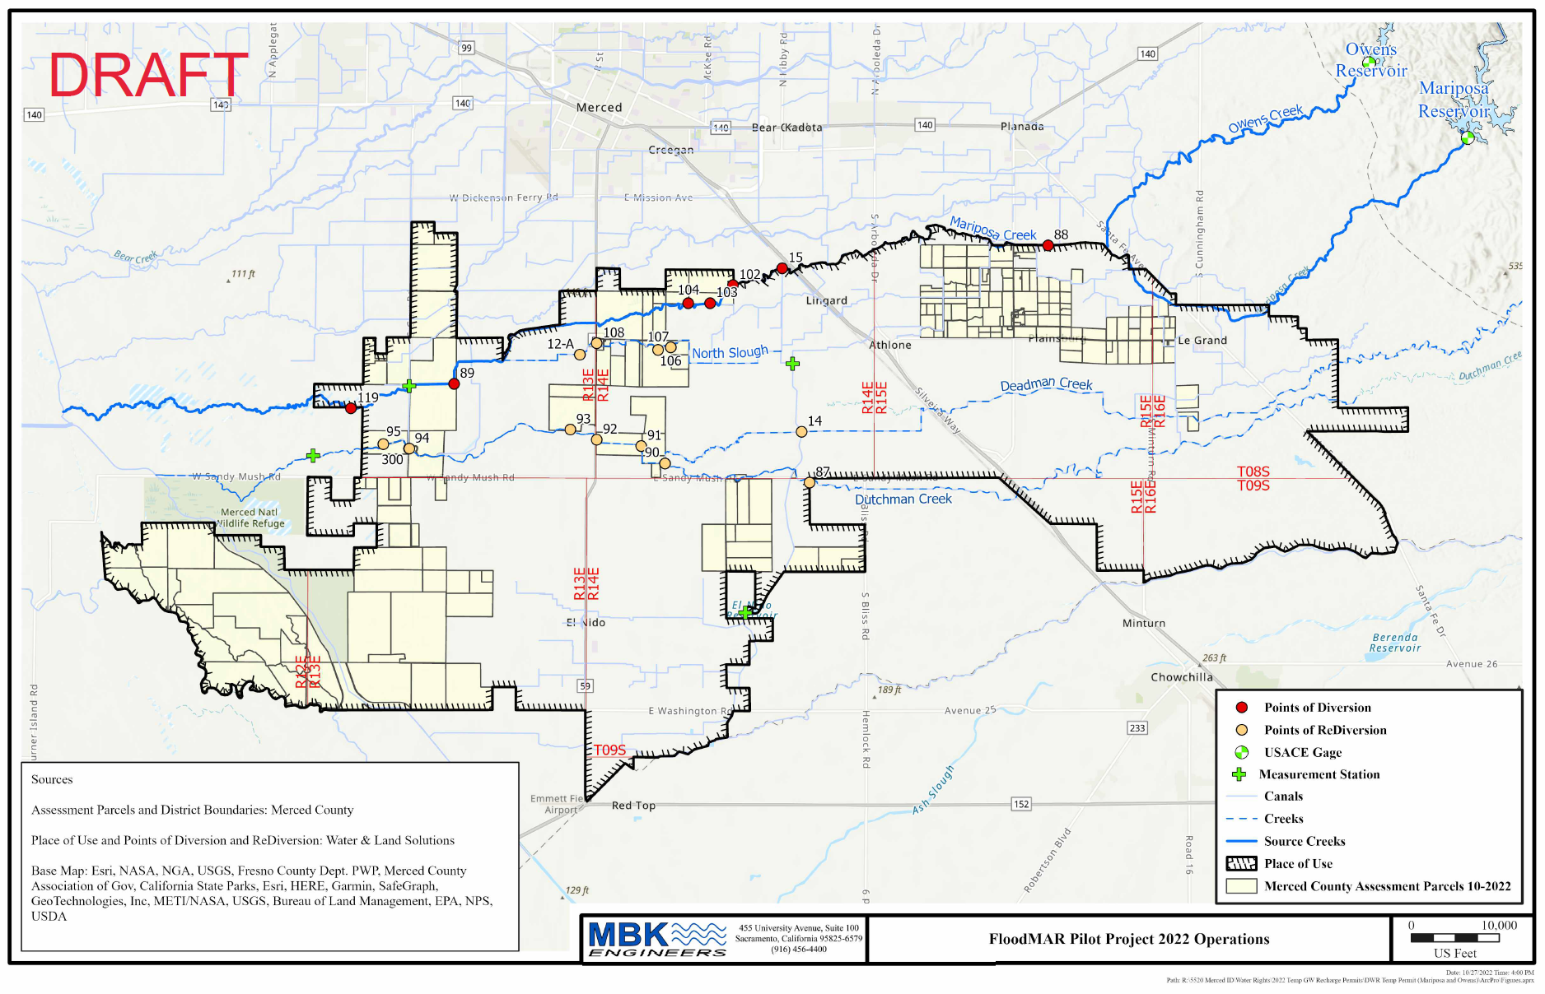
Where the Water Goes

Slide 12
Components of MID/DWR Flood-MAR Permit
Diversions under 90-20 Rule Expires March 31, 2023
Diversions to prevent flooding at Hwy 59 until May 31, 2023

Slide 13
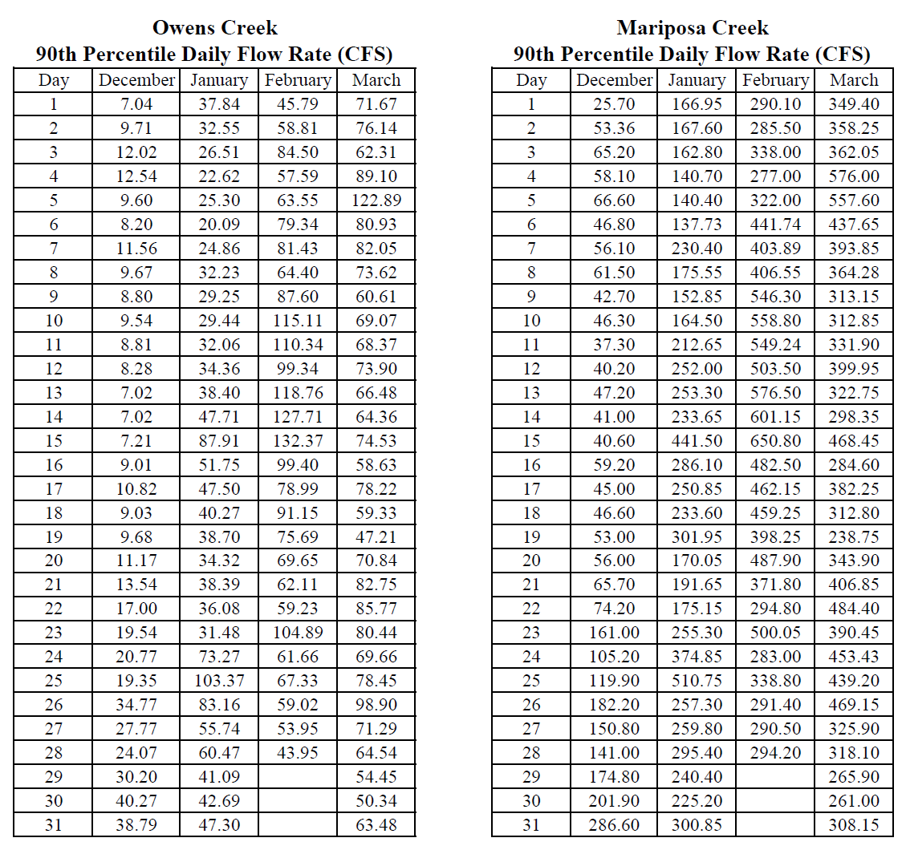
90/20 – Method
Flows above 90th Percentile
Or 20% of Total Flow from each Creeks… Whichever is Less
Sample:

Slide 14
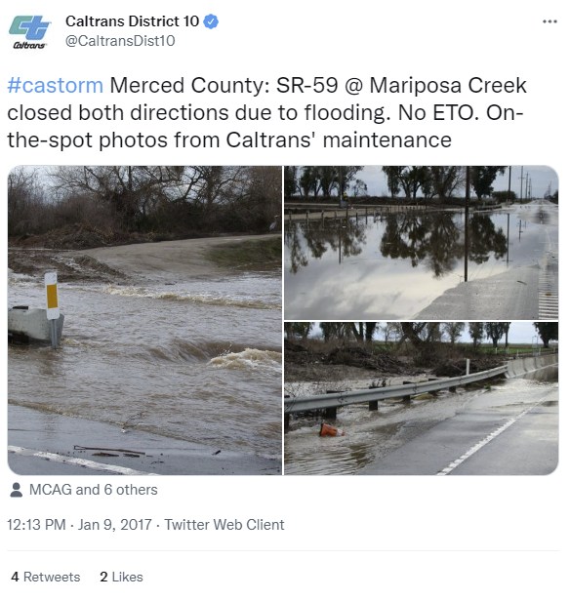
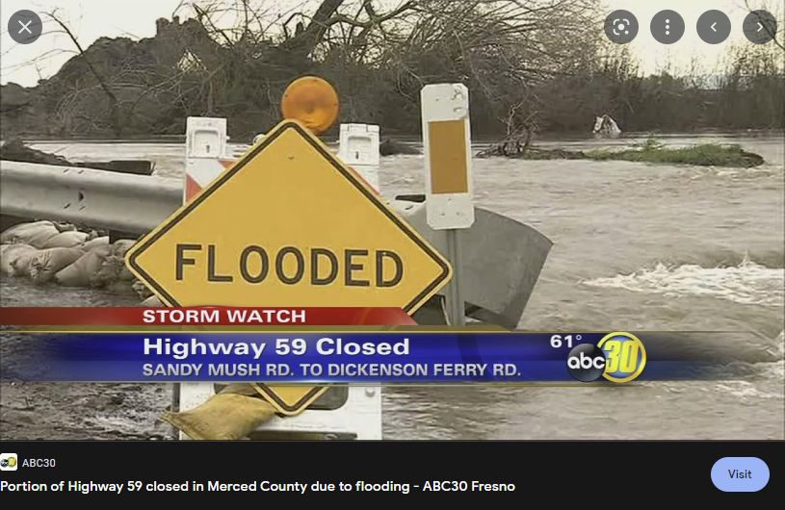
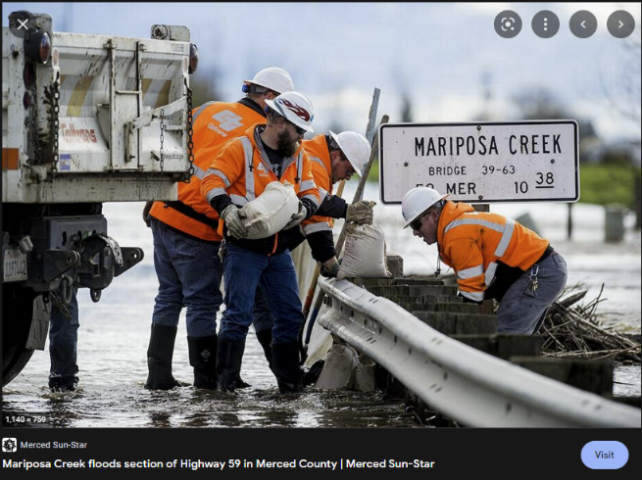
Alternative Trigger Point
CA H-59 Flooding
Closed for 29 days in Jan 2023

Slide 15
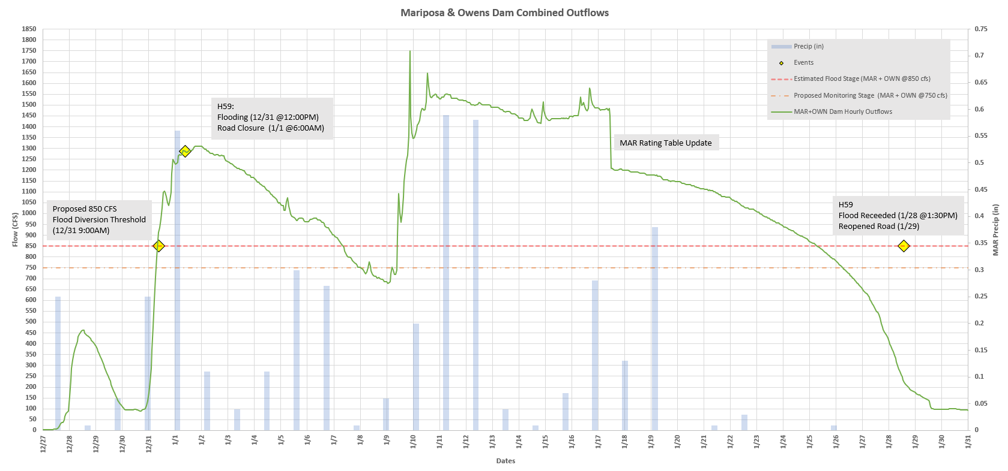
Mariposa Creek – January Flooding

Slide 16
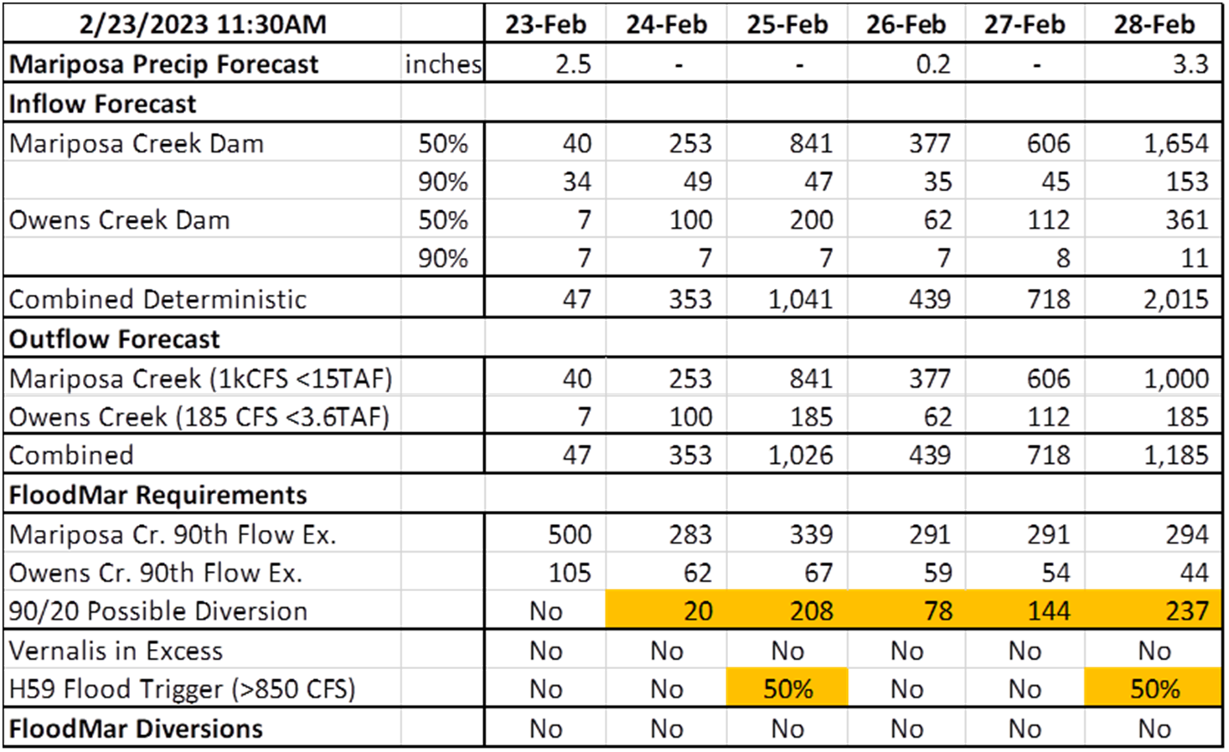
Draft Operation Plan
Forecaster (MID)
  Keeps group informed on potential FloodMar eligible flows.

Slide 17
Draft Operation Plan
Coordinator
  Reaches out & coordinate with Growers for diversion staging.
  Collects diversion data and Submit reports to SWCRB
Growers
  Maintains contact with Coordinator
  Stages diversion points and Divert Flood-MAR water following all rules & regs.

Slide 18
Take Away
Flood-MAR would have been robust this year if major state reservoirs had a higher carry over similar to 1997, 2010, and 2016. Diversions would have lasted between one and two months, with the maximum available diversion capacity.
The winners are entities that are prepared to divert and recharge during wet events.

Slide 19
Conclusion
The permit was meant as a proof of concept
Many requirements and limitations set by SWRCB and CDFW were reduced, still more work is needed.
The existing permit could be used as a template
Many challenges still exist:
  SWD letter of concern to SWRCB
  Concurrence from Merced County Corroborating MID’s observed flooding at Hwy 59 at 850 cfs
Thresholds for diversion are high and most likely will only happen in wet years

Slide 20
Other Ongoing Flood-MAR Activities/What’s Next
Diversions under Executive Order N-3-23 – Extended to Flood Declaration - Allows for recharge
Diversions During Flooding events – Currently doesn’t allow for recharge. However, GSA can take into consideration in their implementation plan.
Improve Streamlining of Permits (AB 830)
Water supply and flood risk reduction projects: expedited permitting (SB 23)

